Slide 1

Long Range Facility Planning
April 1, 2024

Slide 2
Agenda
Welcome
Vision, Mission and Guiding Principles of the LRFPC
District Priorities
Facility Master Plan
FMP: Process
FMP: Lifespan of a Facility
FMP: Deferred Maintenance
FMP: Deferred Maintenance by system
Facility Condition Index [FCI]
District Overview – Landowners
District Overview - Developments
Demographics – El Paso County School District Comparison
District 49 Planning Data
LFFPC DRAFT: Review and potential details: Feedback / Suggestions / Needs

Slide 3






Vision, Mission and Guiding Principles
Role Model Organization
Notes:
Guiding Principles: Accountability, Transparency, Trust, Continuous Improvement
Mission: Responsible stewards of taxpayer monies through building for long term stainability, adaptability and efficiency.
During this process we expect to have open, honest, difficult conversations, if there are items you would like to see, speak up
Get down to business, limit side conversations,

Slide 4
District Priorities
Safety, Security and Compliance
Existing Facilities Conditions
Educational Programs & Offerings
Operational Efficiency
Growth in the District
Notes:
Introduction to the LRFPC is taken from the 50,000 foot approach, very, very high level, during the next year, we will focusing on individual components, strategies (short term and long) and much more!
No specific order to the priorities: Address – Root causes
Safety, Security and Compliance: Secure vestibules, compliance items, lighting, door hardware, etc.
Existing Facilities Conditions: Age of “systems”, Life safety impacts to building inhabitants, environmental conditions, deferred maintenance
Educational Programs & Offerings: Career and Technical Education, collaboration and concurrency
Operational Efficiency: optimizing resource allocation, maximizing productivity and overall performance
Growth in the District: projected steady growth for the District as a whole, with the current economic environment

Slide 5
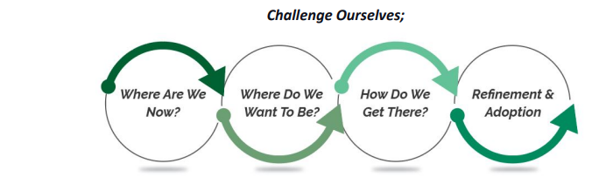
Facility Master Plan [FMP]
“The Circle of Life”
Notes:
Completed in November 2023 the LRFPC is created to challenge ourselves
FMP defined the Districts baseline
Up to this team moving forward to help strategically shape the District [Keep the End in Mind - Covey]
3-5 years / 5-10 years / 10 plus years / 50 plus years
Facility Master Plan is intended to be:
A Living Document
To review and adjust as changes occur, no less than annually
Intended to provide a baseline, while maintaining flexibility for emerging requirements, CDE driven requirements, changing or new educational programs, state / federal mandates, etc.

Slide 6
FMP: Process / Timeline
Assessment
Data Analysis
Tools for Planning
Understanding Impact Differently
Current Condition
Zone
District
Priority Matrix
Based on Function, age and life safety impacts
Snap Shot in time
Facility Condition Index [FCI] is 2024 Operations KPI
Condition Assessment
Capital Improvement
Funding Sources
System(s)
School
Objective: Holistic approach to Data Driven Decisions
Understand: Equality vs. Equity
2023
2028
2033
2038
2043
5 year Timeline :
Notes:
Assessment:
Holistic approach to Data Driven Decisions; looking at things by school, by zone, by District, by system etc.
Analysis:
Objectively ranked based on function, age, and life safety impact to the building inhabitants;
What is the impact to education if this fails?
Can this shut down a school?
Tools
LRFPC will utilize baseline data
Capital Improvement Processes, timeline, and funding sources
With a new CFO, strategies may change
Facility Condition
Keep in mind, the data presented is from the day RTA assessed the building in 2023 – A Snapshot in Time
Information changes daily
Working on Dashboards to reflect progress, current impacts

Slide 7
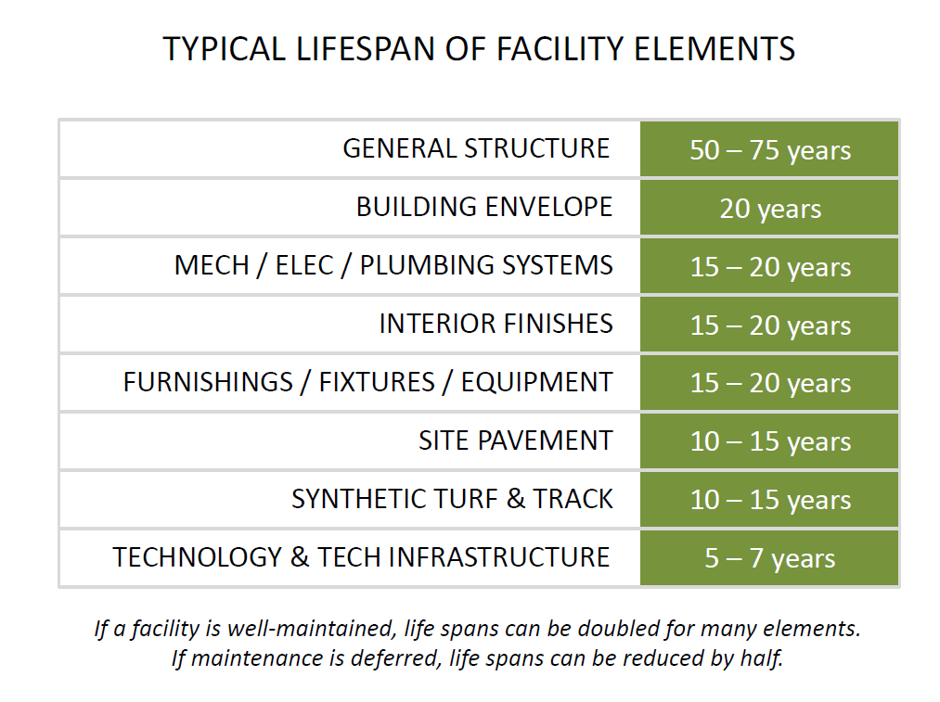
FMP: Lifespan of a facility
AVERAGE AGE OF D49 FACILITIES:
25 YEARS
6 Facilities
+/- 40 Years Old
Notes:
Within most Districts, there is typically a gap in understanding of “how” the Infrastructure (operations) supports the educational needs of the District; the individual components are not highly visible; I mean, how often to you have company and show them your HVAC system, my domestic water heater, what about my fire suppression system.

Slide 8
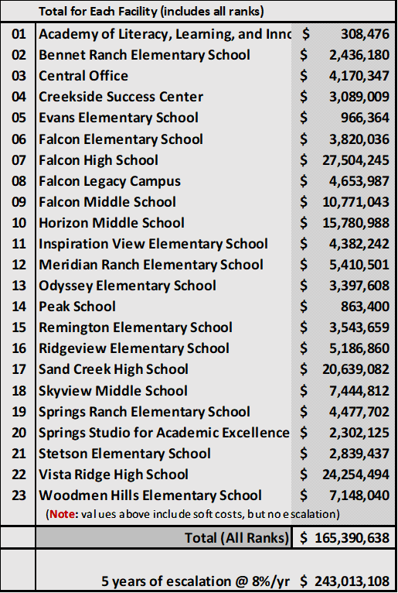
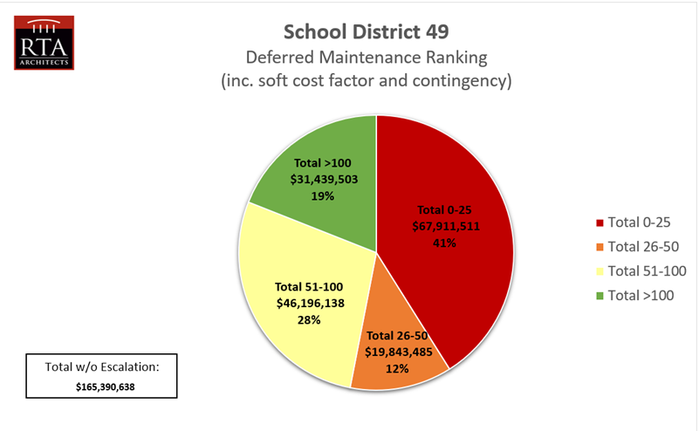
FMP: Deferred Maintenance
Red: Immediate Action
Orange: Replace within 5 years
Yellow: Replace within 6-10 years
Green: Improvement Cycle

Slide 9
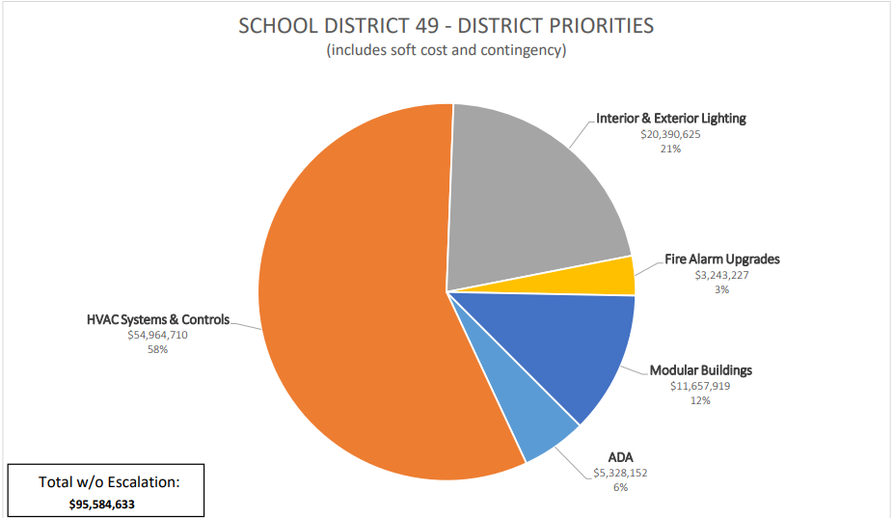
FMP: Deferred Maintenance by Systems
**NOTE**
ADA: is often misinterpreted
~ Yes, there may be items that
need immediate attention
~ Most “ADA Flags” represent
a “change in code”
~ District is “grand-fathered” in
~ Avoid unintended consequences
Notes:
Roofs rise to the level of end of life requiring replacement…Thanks to Bruce and teams.
District is negating approximately $ 4 million by replacing the worst of the roofs this summer; still more to do, but a great start!
ADA gets a bit confusing, most of the items “captured” are code related, acting as a flag, in the event we plan renovation or disturbance to existing area; than typically it becomes mandated we bring the “system” up to the “newest” codes, risk and/or trade-off

Slide 10
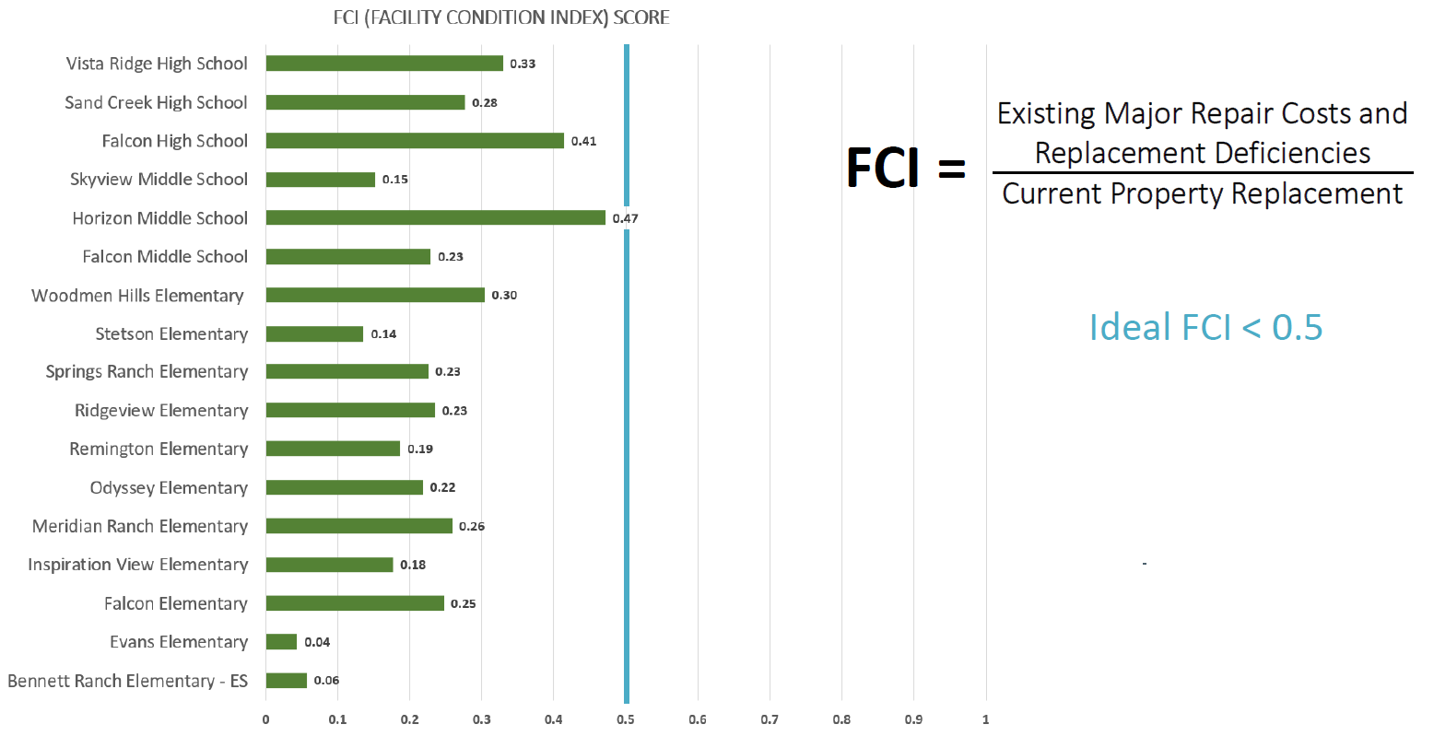
Facility Condition Index [FCI]
Notes:
OES: .33 to .27
WHES: .30 to .20
HMS: .47 to .26
FHS: .41 to .35
VRHS: .33 to .27
NOTE: Shout out to Bruce, CJ & Daniel (and teams) for work completed reducing FCI score on multiple buildings – Still a LOT to do!

Slide 11
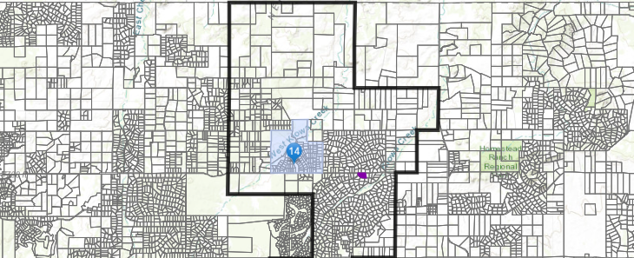
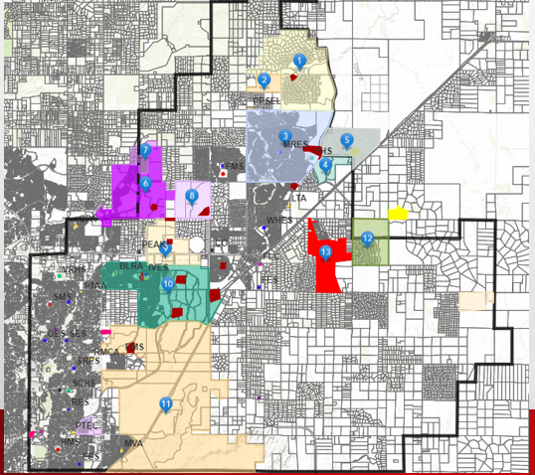
Landowners
Latigo
Antlers Ridge
Meridian Ranch Investments / GTL Investments
  Meridian Ranch: 1,081.37 AC / 5,000 DU
Westside Development
  Waterbury: 322 AC / 1,100 DU
DR Horton [PEYTON]
  Grandview Reserve 768.2 AC / 3,261 DU
Classic Companies
  Sterling Ranch: 1,444 AC / 4,800 DU
Classic Companies – Timber Ridge
Classic Companies
  The Ranch: 610 AC / 2,100 DU
Norwood [BLH No. 1 LLC]
  Percheron: 788.64 AC / 4,200 DU
Oakwood
  Banning Lewis Ranch: 1,629.8 AC / 6,159 DU
Norwood
Gorilla Capital / ROI Investments
  Saddlehorn Ranch: 750 AC / 2.5 ac lots
Meadowlake Airport [757 AC]
Winsome
Federal / State / County / City (not pictured)

Slide 12
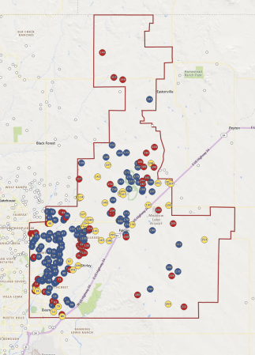
Developments
Red: Active
Yellow: Future
Blue: Built-Out

Slide 13
Demographics: District Comparison Statistics
 | Colorado Springs 11 | Academy SD 20 | District 49 | Lewis Palmer 38 | Harrison SD 2 | Widefield SD 3 | Cheyenne Mountain SD 12 | Ftn Ft Carson SD 8 | Manitou Springs SD 14 | Peyton 23 | Ellicott SD 22 | Calhan SD RJ1 | Hanover SD 28 | Big Sandy SD 100 | Edison SD 54 | Miami-Yoder SD 60
Geographical [Size in Square Miles] | 71.9 | 128.0 | 132.7 | 128.5 | 18.9 | 58.8 | 52.1 | 147.2 | 90.2 | 124.7 | 235.9 | 223.7 | 265.5 | 535.1 | 338.2 | 416.4
Population | 299,696 | 147,898 | 126,457 | 45,195 | 108,579 | 82,208 | 38,813 | 72,506 | 12,208 | 25,982 | 27,640 | 6,608 | 14,207 | 4,462 | 2,851 | 5,649
No. of Properties | 82,632 | 43,624 | 44,968 | 17,349 | 20,573 | 23,297 | 8,930 | 8,715 | 5,289 | 2,057 | 2,417 | 1,776 | 1,506 | 508 | 423 | 1,642
Appraised Value | 46,250,000,000 | 33,370,000,000 | 22,680,000,000 | 12,070,000,000 | 10,400,000,000 | 9,920,000,000 | 7,270,000,000 | 3,410,000,000 | 2,460,000,000 | 949,120,000 | 904,610,000 | 478,970,000 | 303,070,000 | 69,220,000 | 47,720,000 | 296,560,000
Agriculture | 1,470,000 | 8,600,000 | 30,380,000 | 37,640,000 | 2,476 | 664,566 | 4,137 | 8,870,000 | 303,185 | 57,290,000 | 72,860,000 | 84,160,000 | 20,880,000 | 17,020,000 | 19,220,000 | 52,600,000
Commercial | 5,260,000,000 | 2,850,000,000 | 925,940,000 | 340,800,000 | 1,390,000,000 | 536,900,000 | 283,300,000 | 91,070,000 | 68,650,000 | 1,720,000 | 8,200,000 | 11,960,000 | 9,750,000 | 31,312 | - | 545,781
Exempt | 2,760,000,000 | 2,060,000,000 | 724,560,000 | 250,070,000 | 605,270,000 | 381,280,000 | 184,640,000 | 166,090,000 | 108,080,000 | 24,120,000 | 192,830,000 | 22,020,000 | 56,240,000 | 1,650,000 | 20,290,000 | 13,240,000
Mixed Use | 378,590,000 | 88,310,000 | 89,670,000 | 47,030,000 | 64,310,000 | 29,090,000 | 12,810,000 | 28,610,000 | 78,180,000 | 31,800,000 | 27,620,000 | 15,240,000 | 4,370,000 | 2,810,000 | 950,873 | 11,220,000
Partial Exempt | 235,530,000 | 186,810,000 | 5,070,000 | 17,960,000 | 61,380,000 | 6,060,000 | 10,470,000 | 1,230,000 | 3,320,000 | - | 558,273 | - | - | 108,784 | - | -
Residential | 37,300,000,000 | 27,840,000,000 | 20,610,000,000 | 11,160,000,000 | 8,170,000,000 | 8,840,000,000 | 6,730,000,000 | 3,080,000,000 | 2,160,000,000 | 800,610,000 | 574,640,000 | 336,760,000 | 199,670,000 | 45,650,000 | 5,620,000 | 207,100,000
SA Placeholder | - | 52,164 | - | - | - | - | - | - | - | - | - | - | - | - | - | -
Vacant Land | 319,980,000 | 343,180,000 | 298,750,000 | 210,010,000 | 101,760,000 | 125,510,000 | 45,660,000 | 28,220,000 | 38,020,000 | 33,580,000 | 27,890,000 | 8,820,000 | 12,160,000 | 1,950,000 | 1,630,000 | 11,850,000
HOA | - | - | - | - | - |  |  | - | 417,000 | - | - | - | - | - | - | -
Mining Claim | - | - | - | - | - |  |  | - | 108,848 | - | - | - | - | - | - | -
Percent by Group | Colorado Springs 11 | Academy SD 20 | District 49 | Lewis Palmer 38 | Harrison SD 2 | Widefield SD 3 | Cheyenne Mountain SD 12 | Ftn Ft Carson SD 8 | Manitou Springs SD 14 | Peyton 23 | Ellicott SD 22 | Calhan SD RJ1 | Hanover SD 28 | Big Sandy SD 100 | Edison SD 54 | Miami-Yoder SD 60
Commercial | 11.373% | 8.541% | 4.083% | 2.824% | 13.365% | 5.412% | 3.897% | 2.671% | 2.791% | 0.181% | 0.906% | 2.497% | 3.217% | 0.045% | 0.00% | 0.18%
Residential | 80.649% | 83.428% | 90.873% | 92.461% | 78.558% | 89.113% | 92.572% | 90.323% | 87.805% | 84.353% | 63.524% | 70.309% | 65.882% | 65.949% | 11.78% | 69.83%
Notes:
The intention is to take a deeper dive into D49 demographic trends and projections regarding population, birth, enrollments, financial and long term potential, again for schools, sites, zones and district, inclusive of potential impacts from neighboring Districts.
El Paso School District Comparison as a whole provides a quick impact analysis;
Example:
Geographical – SD11 is 71.9 square miles / D49 is 132.7 square miles – What’s the District going to look like 50 years down the road, long after we are gone?
Financial – Commercial to Residential Funding; SD11 is 11% Commercial, while D49 is 4%
Trends may be year over year, but we will also be looking at 5 year, 10 year 15 and 20, even 50+ years – Norwood has a 70 year plan for developing
GOAL: Building for sustainability – learning from various SDs mothballing sites, D49 needs to remain deliberate in our approach
5-year Count Change: SY2019 to 2024: 3,402 or (15.19%) / whereas the 1 year change is 183 student increase or a .71%

Slide 14

Planning Data
DISTRICT 49 - AT A GLANCE
BUILDING STATISTICS |  | Falcon | Sand Creek | Power | iConnect | Educational | Central
Statistics | Total | Zone | Zone | Zone | Zone | Services | Services
Average Age of Bldgs | 25.49 | 26.33 | 33.33 | 16.80 | 49.00 | 19.50 | 29.50
Building Square Feet | 1,609,827 | 596,185 | 484,723 | 528,919 | 76,750 | 42,866 | 53,978
Modular Square Feet | 119,189 | 23,813 | 76,296 | 19,080 | 17,707 | 0 | 2,532
Other Building | 23,558 | 0 | 18,998 | 4,560 | 0 | 0 | 0
Total Square Feet | 1,752,574 | 619,998 | 580,017 | 552,559 | 94,457 | 42,866 | 17,232
Total Acreage | 401.22 | 204.31 | 96.36 | 100.55 | 14.55 | 9.13 | 10.2
Deducted SQFT | 1,395,878 | 412,396 | 502,885 | 480,597 | 58,697 | 0 | 56,510
Acreage Maintained | 367.50 | 193.90 | 85.10 | 88.50 | 12.40 | 9.13 | 9.19
Functional Capacity (Bldg) | 13,397 | 4,867 | 4,246 | 4,284 | 808 | 0 | 426
Functional Capacity (w/Modulars) | 15,491 | 5,382 | 5,438 | 4,671 | 808 | 0 | 426
Enrollment [2023] | 12,287 | 4,086 | 4,294 | 3,907 | 635 | 0 | 0
PROJECTED DWELLING UNITS
Projected Dwelling Units | Total | *FALCON Zone | SAND CREEK | POWER Zone | iConnect Zone | Educational Services | Central Services
Q423 Starts [Excluded from calculations] | 728 | 356 | 181 | 191
Q423 Annual Closings | 777 | 407 | 146 | 224
FinVacant [Pre-Sold/Spec/Const. Complete] | 177 | 62 | 66 | 49
VDL Inventory [Lots ready to build] | 1,972 | 1,544 | 243 | 185
Future [Lot Development Pipeline] | 17,949 | 12,852 | 1,825 | 3,272
Total | 21,603 | 14,865 | 2,280 | 3,730
*POTENTIAL IMPACTS: Grandview Reserve: Builder - DR Horton [Peyton District - Boarders D49] - water / sewer by Summer of 2025
PROJECTED STUDENT IMPACT - Immediate
Level | Total | FALCON Zone | SAND CREEK | POWER Zone
Elementary School | 878 | 604 | 137 | 137
Middle School | 351 | 242 | 55 | 55
High School | 439 | 302 | 68 | 69
Projected Student Impact | 1,668 | 1,147 | 259 | 261
PROJECTED STUDENT IMPACT - Overall
Level | Total | FALCON Zone | SAND CREEK | POWER Zone
Elementary School | 6,263 | 4,460 | 684 | 1,119
Middle School | 2,505 | 1,784 | 274 | 448
High School | 3,131 | 2,230 | 342 | 560
Projected Student Impact | 11,899 | 8,473 | 1,300 | 2,126
Building Data: District, Zone, School
Projected Housing Units per Zone
  Starts – Validate Trend
  Closing – Trend
Neighboring district “potential” impacts NOT included
“Potential” Student Impact
Notes:
**DRAFT**
I personally think the student impact maybe high – working on verifying with Shannon (demographer)
Starts / Closings: Developers indicate approximately 100 houses per year
FinVacant: Finished Vacant is pre-sold homes, Specs, or Complete
VDL Inventory: Lots that are ready to build on
Future: Is anticipated pipeline of housing units
This is a tremendous amount of data, it takes a team, if there is something that does not look right, bring it to our attention, please.
Only one thing is guaranteed in this process – THINGS WILL CHANGE
It could be densities, types of homes, land changing hands

Slide 15
LRFP Draft Charter
Feedback – suggestions – priorities
Notes:
What is helpful to you as collaborators to see?
LRPC Discussion Topics – Add information or email Evelyn
Evelyn to do: Dates / Times of meetings: Is an hour a month sufficient to start?
Do we have the right audience? Did we overlook anyone?
Questions?

