Slide 1

Presented by
Melissa Fordham, MSW
School Social Worker/Attendance Court Liaison
2024-2025 MTSS ATTENDANCE TRAINING for MTSS chairs
Notes:
Our best investments in instruction and curriculum won’t matter much if students aren’t in class to benefit from them. If we’re serious about improving our schools, we need to take attendance seriously. We need to ensure that all students are in class regularly, so they have an equal opportunity to learn.

Slide 2

Absenteeism is a leading indicator of educational inequity
Notes:
As educators we know from experience what research confirms: Showing up for class matters. Students cannot benefit from investments in high quality instruction and more engaging, rigorous curriculum unless they are in their classroom. Every day a student is absent is a lost opportunity for learning. Too many absences not only can affect achievement for the absent student but also can disrupt learning for the entire class.

Slide 3

Chronic Absenteeism
Focus is on reducing chronic absenteeism, which is defined as missing 10 percent of school days for any reason, whether excused or unexcused absences, including out-of-school suspensions.
Research shows that chronic absenteeism is a primary cause of low academic achievement and a powerful predictor that students will eventually drop out of school.

Slide 4
Chronic Absenteeism Rate Five Year Comparison
(Students are considered chronically absent if they accumulate 10% or more absences in a school year)
LEVEL | 2019-2020 | 2020-2021 | 2021-2022 | 2022-2023 | 2023-2024
Elementary Schools | 13.9% | 29.6% | 28.6% | 28.3% | 30.9%
Middle Schools | 15.1% | 33.1% | 29.2% | 30.2% | 33.7%
High Schools | 19.6% | 33.2% | 34.2% | 32.6% | 35.8%
Alternative Education | 59.0% | 79.7% | 82.7% | 84.8% | 79.2%
Charter Schools | 20.4% | 24.1% | 29.4% | 43.6% | 50.9%
Online Learning* | --- | --- | 6.1% | 5.5% | 3.9%
TOTALS | 16.2% | 31.3% | 30.2% | 30.9% | 34.2%

Slide 5
What can schools do to encourage good attendance?
Make Attendance a priority even during a pandemic
01
Begin intervention strategies early
02
Develop targeted intervention strategies for students with chronic attendance problems
03
Develop strategies to increase student engagement
04
Use data to identify areas of concern and concentrate resources in those areas
05
Recognize that students in transition may be at risk
06
Publicize attendance policies and communicate expectations to students and parents
07
Compassion, sensitivity, and flexibility are key in addressing attendance
Notes:
High chronic absence levels signal the need for extra support to particular students or investments that are needed to address systemic problems. It’s even more critical that approaches are adapted to what works when students and families face even greater challenges to education and may need a higher level of support from us. The best results occur when there is an intentional effort to avoid blaming students and families for the lack of attendance or participation. We must work on building relationships with our students and parents to ensure engagement and connectivity.

Slide 6
Habitual Truancy Rate Five Year Comparison
(Students are considered habitually truant if they accumulate a minimum of 15 unexcused absences from school during a 90 calendar day period.)
LEVEL | 2019-2020 | 2020-2021 | 2021-2022 | 2022-2023 | 2023-2024
Elementary Schools | 3.9% | 6.0% | 6.2% | 4.9% | 2.6%
Middle Schools | 4.9% | 7.6% | 7.8% | 7.6% | 5.2%
High Schools | 6.3% | 7.2% | 9.1% | 7.7% | 5.1%
Alternative Education | 19.5% | 28.1% | 31.1% | 35.0% | 22.9%
Charter Schools | 4.7% | 5.6% | 8.2% | 17.3% | 14.7%
Online Learning* | --- | --- | 1.1% | 0.3% | 0.9%
TOTALS | 4.9% | 6.8% | 7.5% | 7.1% | 4.7%

Slide 7
Compulsory School Attendance Law
All children who have attained the age of 6 years or who will have attained the age of 6 years on or before February 1 of the school year up to the age of 16 years (only if a formal declaration of intent to terminate school enrollment has been completed and filed with the school district) are required to attend school regularly during the entire school term (Florida Statute 1003.21)
According to Florida Statute 1003.24, each parent of a child within the compulsory attendance age is responsible for the child’s school attendance.
Habitual Truancy is defined as 15 unexcused absences within 90 calendar days
Notes:
1. All 16 and 17-year olds are required to attend school under the compulsory attendance law. However, in Florida at age 16 and older, children can be withdrawn from school by a parent, only if they sign a declaration of intent to terminate school enrollment. An exit interview and student survey must be completed with the school counselor. Without the declaration of intent, all children are required to attend school until age 18. At age 18, students can withdraw from school without parent’s permission. However, we recommend that the school obtain a declaration of intent and that the school counselor conducts an exit interview and student survey with the student to explore other educational options.
2. Parents have the right to enroll their child in a public school, a parochial, religious or denominational school, a private school, a home education program, or a private tutoring program.
3. Our teams will need to work together to identify the barriers to attendance and provide interventions to students/parents to remedy the issue. While your attendance clerks are reviewing lists daily from the FOCUS Letter Queue–discussions should be occurring about the possible reasons for the absences.

Slide 8

Changes to Compulsory Law
Effect of Changes - July 2017
  School boards are to adopt student polices regarding student appointments to receive autism spectrum disorder therapy.
  Allows parents to request and be granted permission for a student’s absence resulting from an appointment to receive therapy.
  Allows a student who is continually sick and repeatedly absent to satisfy nonattendance requirement by being under the supervision of a licensed health care practitioner or certified behavior analyst for the treatment of autism spectrum disorder.
Notes:
Autism Spectrum Disorder Therapy: Absences including early checkouts for student appointments for therapy will be excused upon parent request. The parent must notify the school on each day of the absence(s). Therapy includes, but is not limited to, applied behavioral analysis, speech therapy, and occupational therapy. Therapy must be provided by a licensed health care practitioner or behavior analyst who is certified for the treatment of ASD. If the student who is diagnosed ASD is continually sick and repeatedly absent, they must be under the supervision of a licensed health care practitioner or a certified behavior analyst for the absences to be excused.

Slide 9
Enforcement of School Attendance
Florida Statute 1003.26
School districts must take an active role in promoting and enforcing attendance as a means of improving student performance.
Daily Notification-Schools must notify parents of each unexcused absence (i.e. personal contact, phone calls, Volusia Connect, letters, etc.) to determine the reason for the absence.
Students who are exhibiting a pattern of nonattendance must be referred to the Multi-Tiered Systems of Support (MTSS) Individual Problem Solving Team (IPST) to provide solutions to attendance barriers. A meeting with the parent must be scheduled to identify potential remedies.
Notes:
1. Schools should take every opportunity to build a positive school culture by engaging students and parents, thus promoting good school attendance.
2. Your attendance clerks should be sending out the 5 unexcused absences within 30 days letter, 10 unexcused absences within 90 days letter, and 15 days excused/unexcused letters requesting a doctor’s note for subsequent absences to be excused. MTSS Chairs, you are able to access the Attendance Warning Log Report for your school. This report can be found in FOCUS under Reports and shows you the number of students with 5, 10, and 15 day letters and the date that they met the criteria for each. For individual students, you can go into the student’s Letter Logging to see when the letters were sent and download if needed.
3. The PST process always addresses the whole child, including their academic and emotional/behavioral functioning.

Slide 10

Enforcement of School Attendance:
MTSS-IPST
Encourage teachers to take every opportunity to notify parents of developing patterns of nonattendance and determine the cause. Contacts should be documented on IPST 2.
Parent contact must be made or attempted prior to referral to the IPST. (At minimum, this should occur when a student has 5 unexcused absences within 30 calendar days.)
If a nonattendance pattern continues (reaches 10 unexcused absences within 90 calendar days)
  Ask teachers to submit IPST 5
  During the meeting, Teachers bring documentation of all contacts/attempts at contacts with the parent/student and interventions tried. If the teacher is not able to attend the meeting, MTSS Chair should elicit their feedback prior to the meeting.
  Complete IPST 6A/H during meeting
  Complete Attendance Contract AND Notice of Right to Appeal WITH the parent and/or student
  ESE-ONLY contact DPS/IEP Facilitator if it is determined that the student’s attendance issues are directly linked or related to their exceptionality. Otherwise, follow the MTSS process.
Notes:
You are able to run 10 unexcused abs within 90 days on FOCUS by using the Compulsory Attendance Report. Ask your SSW for assistance when needed.
For secondary, if teacher doesn’t complete IPST 5, please fill it out!
IPST 5 and IPST 6A/H- can be found in the MTSS tab on Focus
Attendance Contract AND Notice of Right to Appeal- can be found in the MTSS tab on Focus
complete WITH the parent and/or student

Slide 11
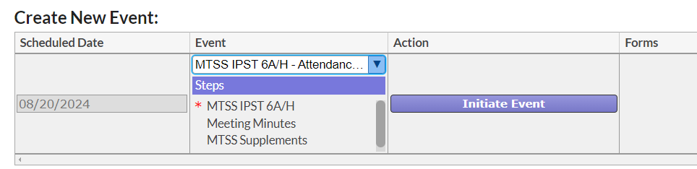

Slide 12
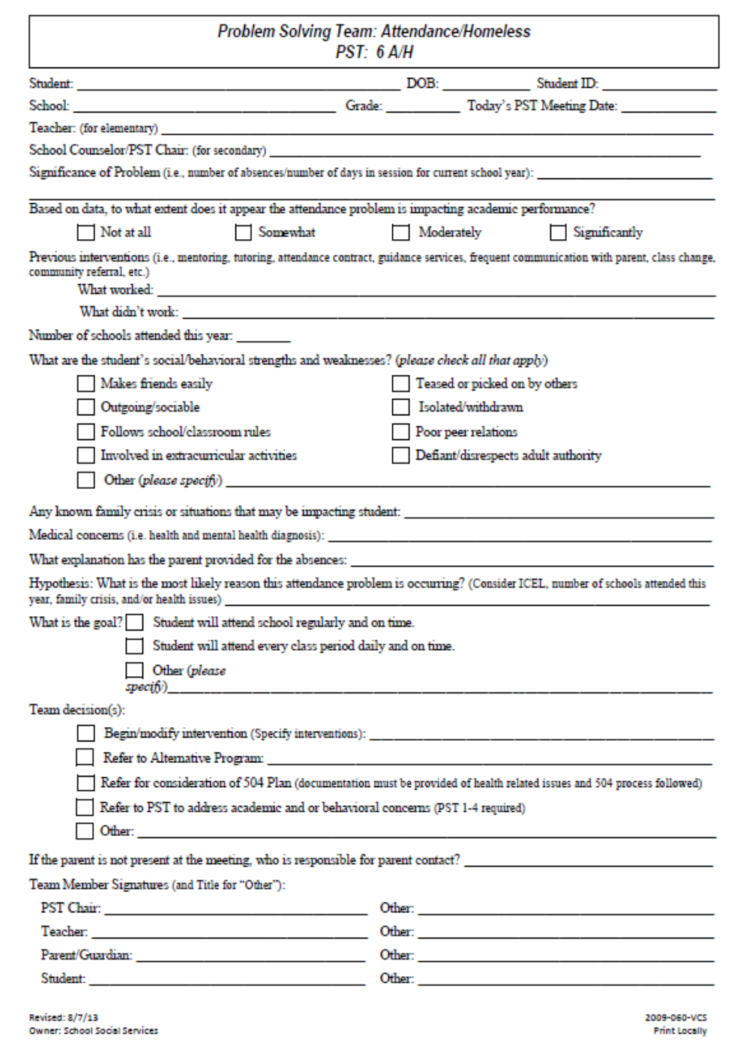
IPST 6A/H
Notes:
Forms are accessible in Focus under the MTSS tab. Completely fill out the form and click on Initiate. Again, the IPST process is to address the whole child. This is to be used as a guided discussion to gather information about the child and then problem solve barriers. If the parent doesn’t show, call them to for their availability to participate. If they aren’t able to participate then, reschedule. It is vitally important to have parents participate in this meeting to provide us with necessary information to support their child in school.
If the team including parent participates by phone/virtually, add their names to the Team Member portion of the form.

Slide 13
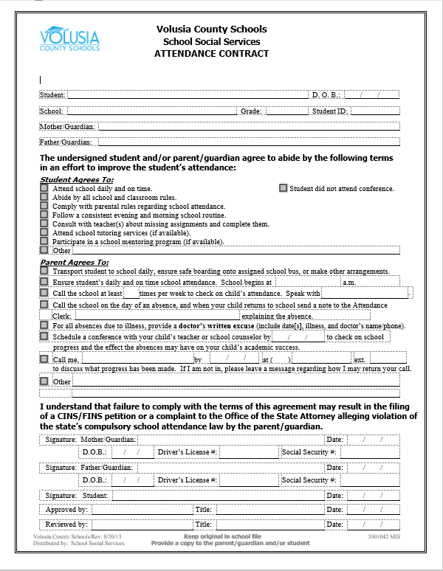
Attendance Contract
Notes:
Talk to students about morning routines. If they are disengaged, talk to the student about their feelings about school and ask what would make school better for them. Perhaps assigning them to a duty/task in the classroom would help to build relationships.
You want to offer an attendance contract to parents at each meeting, even if it’s virtual. Email/Send home two copies of the completed contract you discussed with the parent for their signature and ask them to send one back. Always keep a copy for your file. If a parent refuses to sign the attendance contract, write that on the bottom.

Slide 14
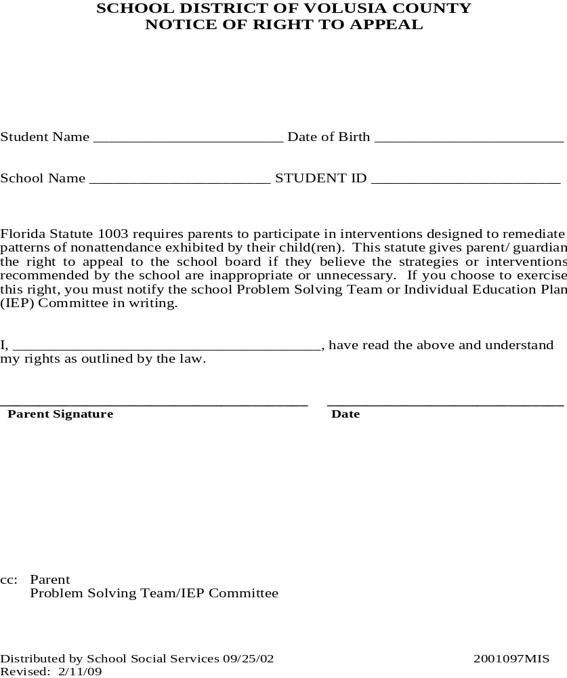
Notice of Right to Appeal
Notes:
This form should be presented to parents at each meeting. It is important to explain these rights to parents and ask them to sign. If the meeting is virtual, email or send home 2 copies for parent signature and ask them to return one. Keep a copy for your file. If a parent refuses to sign the attendance contract, write that on the bottom.

Slide 15
Enforcement of School Attendance: Monitoring Intervention Results
If nonattendance pattern continues,
Make additional contact with the family to review the plan and barriers to implementation OR
Schedule a follow-up meeting OR
Complete an Attendance Referral for School Social Worker to provide follow-up

Slide 16
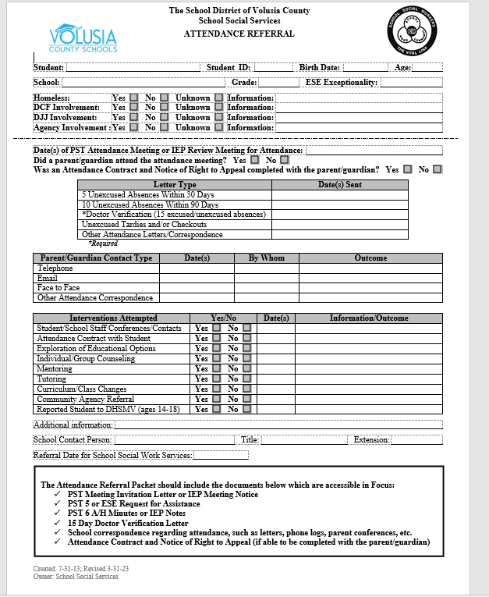
Attendance Referral
Notes:
Attendance Referral- can be found in Forms on VCS Intranet
be sure to email me and your SSW the completed attendance referral packet with all forms which are listed in the black bordered box at the bottom of the referral form

Slide 17

Enforcement of School Attendance: School Social Worker Interventions
Consultation with school/district staff regarding attendance cases and compulsory reports
Parent and/or student contacts, including home visits when necessary
Create and/or review attendance contracts with parent and/or student
Connect families to community resources
Attendance monitoring and follow-up with the parent/student and school staff

Slide 18

Enforcement of School Attendance: Legal Action and Consequences
If the parent/student continues to be noncompliant with the Compulsory Attendance Law, the School Social Worker may make the following referrals:
  CINS/FINS (ages 6-17)
  Teen Court (ages 10-17)
  ASAP -Achieving School Attendance Program
  Adult Court-misdemeanor of the 2nd degree
Other Consequences:
  Learnfare families may lose benefits
  Students may lose driving privileges/license
  Students more likely to engage in delinquent behavior
  Lifetime earning potential is limited
Notes:
With Learnfare, families receive cash assistance from the state and could lose as much as $500 from the household income.
To reinstate DL – student must have 30 consecutive days of attendance (no unexcused absences or tardies) to be back in good standing. Schools must keep accurate data, run daily reports, and report to the DHMSV those students’ names (ages 14-17) who are habitually truant. For more information contact me or refer to the 2022-2023 Driver’s License and Learnfare Attendance Manuals located on the School Social Services website.
The % of street crime, burglaries, criminal damage, car theft is carried out by kids 10-16 years old. Students’ earning potential as adults is significantly reduced when they drop out of school.

Slide 19


Notes:
September is Attendance Awareness Month. This year’s Attendance Works theme – Show Up Together!– emphasizes the role everyone can play in ensuring students attend school daily. We are encouraging the review of attendance data on an ongoing basis, to help identify, early on, students in need of additional support as well as practices and policies in need of revision. This information can be used to activate supports to prevent students from missing so much school they fall academically behind. Improvement strategies informed by attendance and chronic absence data are invaluable for rebounding from the adverse impact of Covid-19 and reducing educational inequity. Attendance Works is a great resource for schools and has many tools to help teams build upon your attendance plans.
THANK YOU for all you do to assist our students and parents!

Slide 20

September
Attendance Awareness Month
Weekly attendance-related marquee messages posted at schools and business locations
Articles in school newsletters
Blogs on schools’ webpages
Daily/weekly social media messages
Daily/weekly PA announcements at schools
Videos for students and parents regarding importance of school attendance
Daily/weekly incentives/rewards for good attendance
Attendance Flyer distribution to parents
Notes:
We begin making schools, parents, students, and our community partners aware of school attendance in September every year. All schools will receive a packet full of information to distribute to our parents, students, and community partners in recognizing school attendance and the benefits of attending school regularly. Schools are also provided Attendance and Engagement Strategies (school wide, elementary, middle, high), Attendance Tiers of Intervention to assist with planning school wide interventions, and Attendance Statistics booklets which shows district and individual schools’ chronic absenteeism rates and habitual truancy rates to assist in identifying barriers to attendance and implementing strategies to decrease chronic absenteeism and increase school attendance.
Your SSW has access to all the documents in the packets and can share with you upon request.

Slide 21

Notes:
Advent Health and School Social Services Department is once again sponsoring our Everybody Every Day Poem, Poster, and Video Contest this school year! We need your schools to participate! Please pass this information along to your administration and teachers this week.

Slide 22

For additional Questions, contact:
Melissa Fordham, School Social Worker/Attendance Court Liaison
mhfordha@volusia.k12.fl.us
386-255-6475, ext. 50720 or Microsoft Teams, ext. 70896

