Slide 1


Slide 2

The Meetings
Meeting 1
Meeting 2
Meeting 3
Meeting 4
Presentation
to the Board
LAUNCH
May 9
Kick-off
& Student Panel
LISTEN
May 18
Committee
Meeting
LEARN
June 12
Business & Higher Ed Panel & Committee
LIFT UP
July 17
Final Committee
Meeting
Monday,
August 21

Slide 3
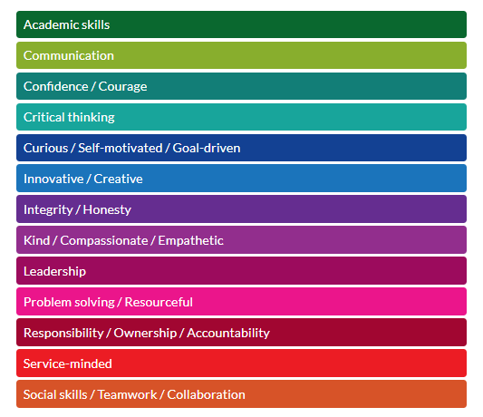
Meeting Themes

Slide 4
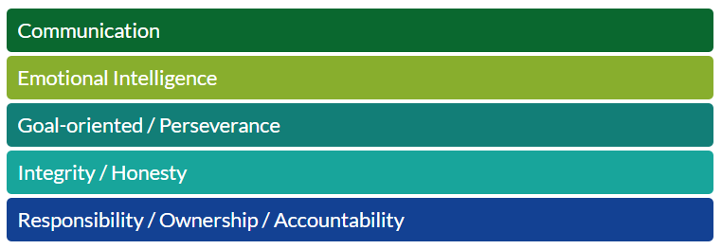
Top 5 Big Ideas

Slide 5
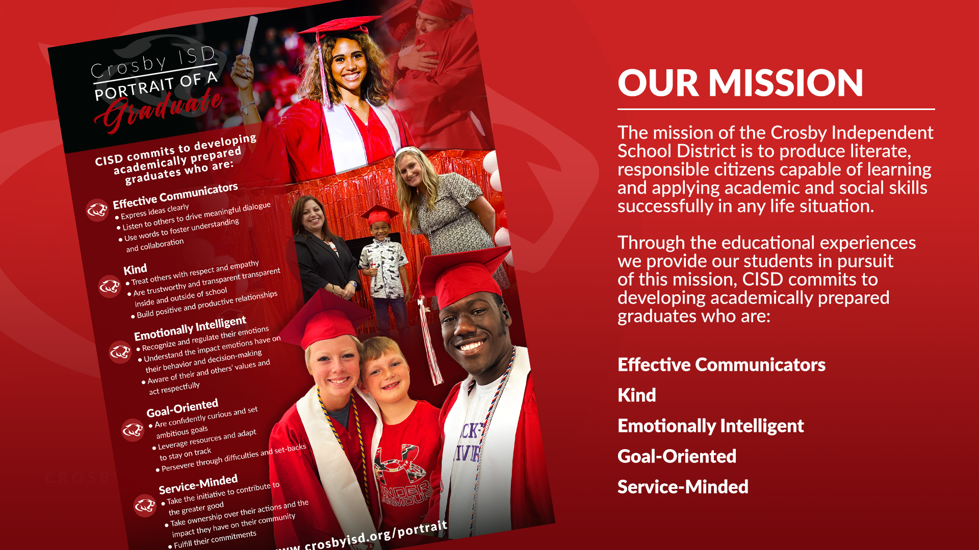

Slide 6
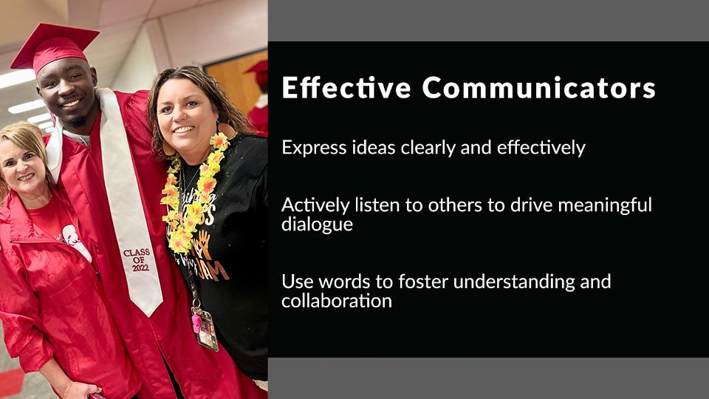
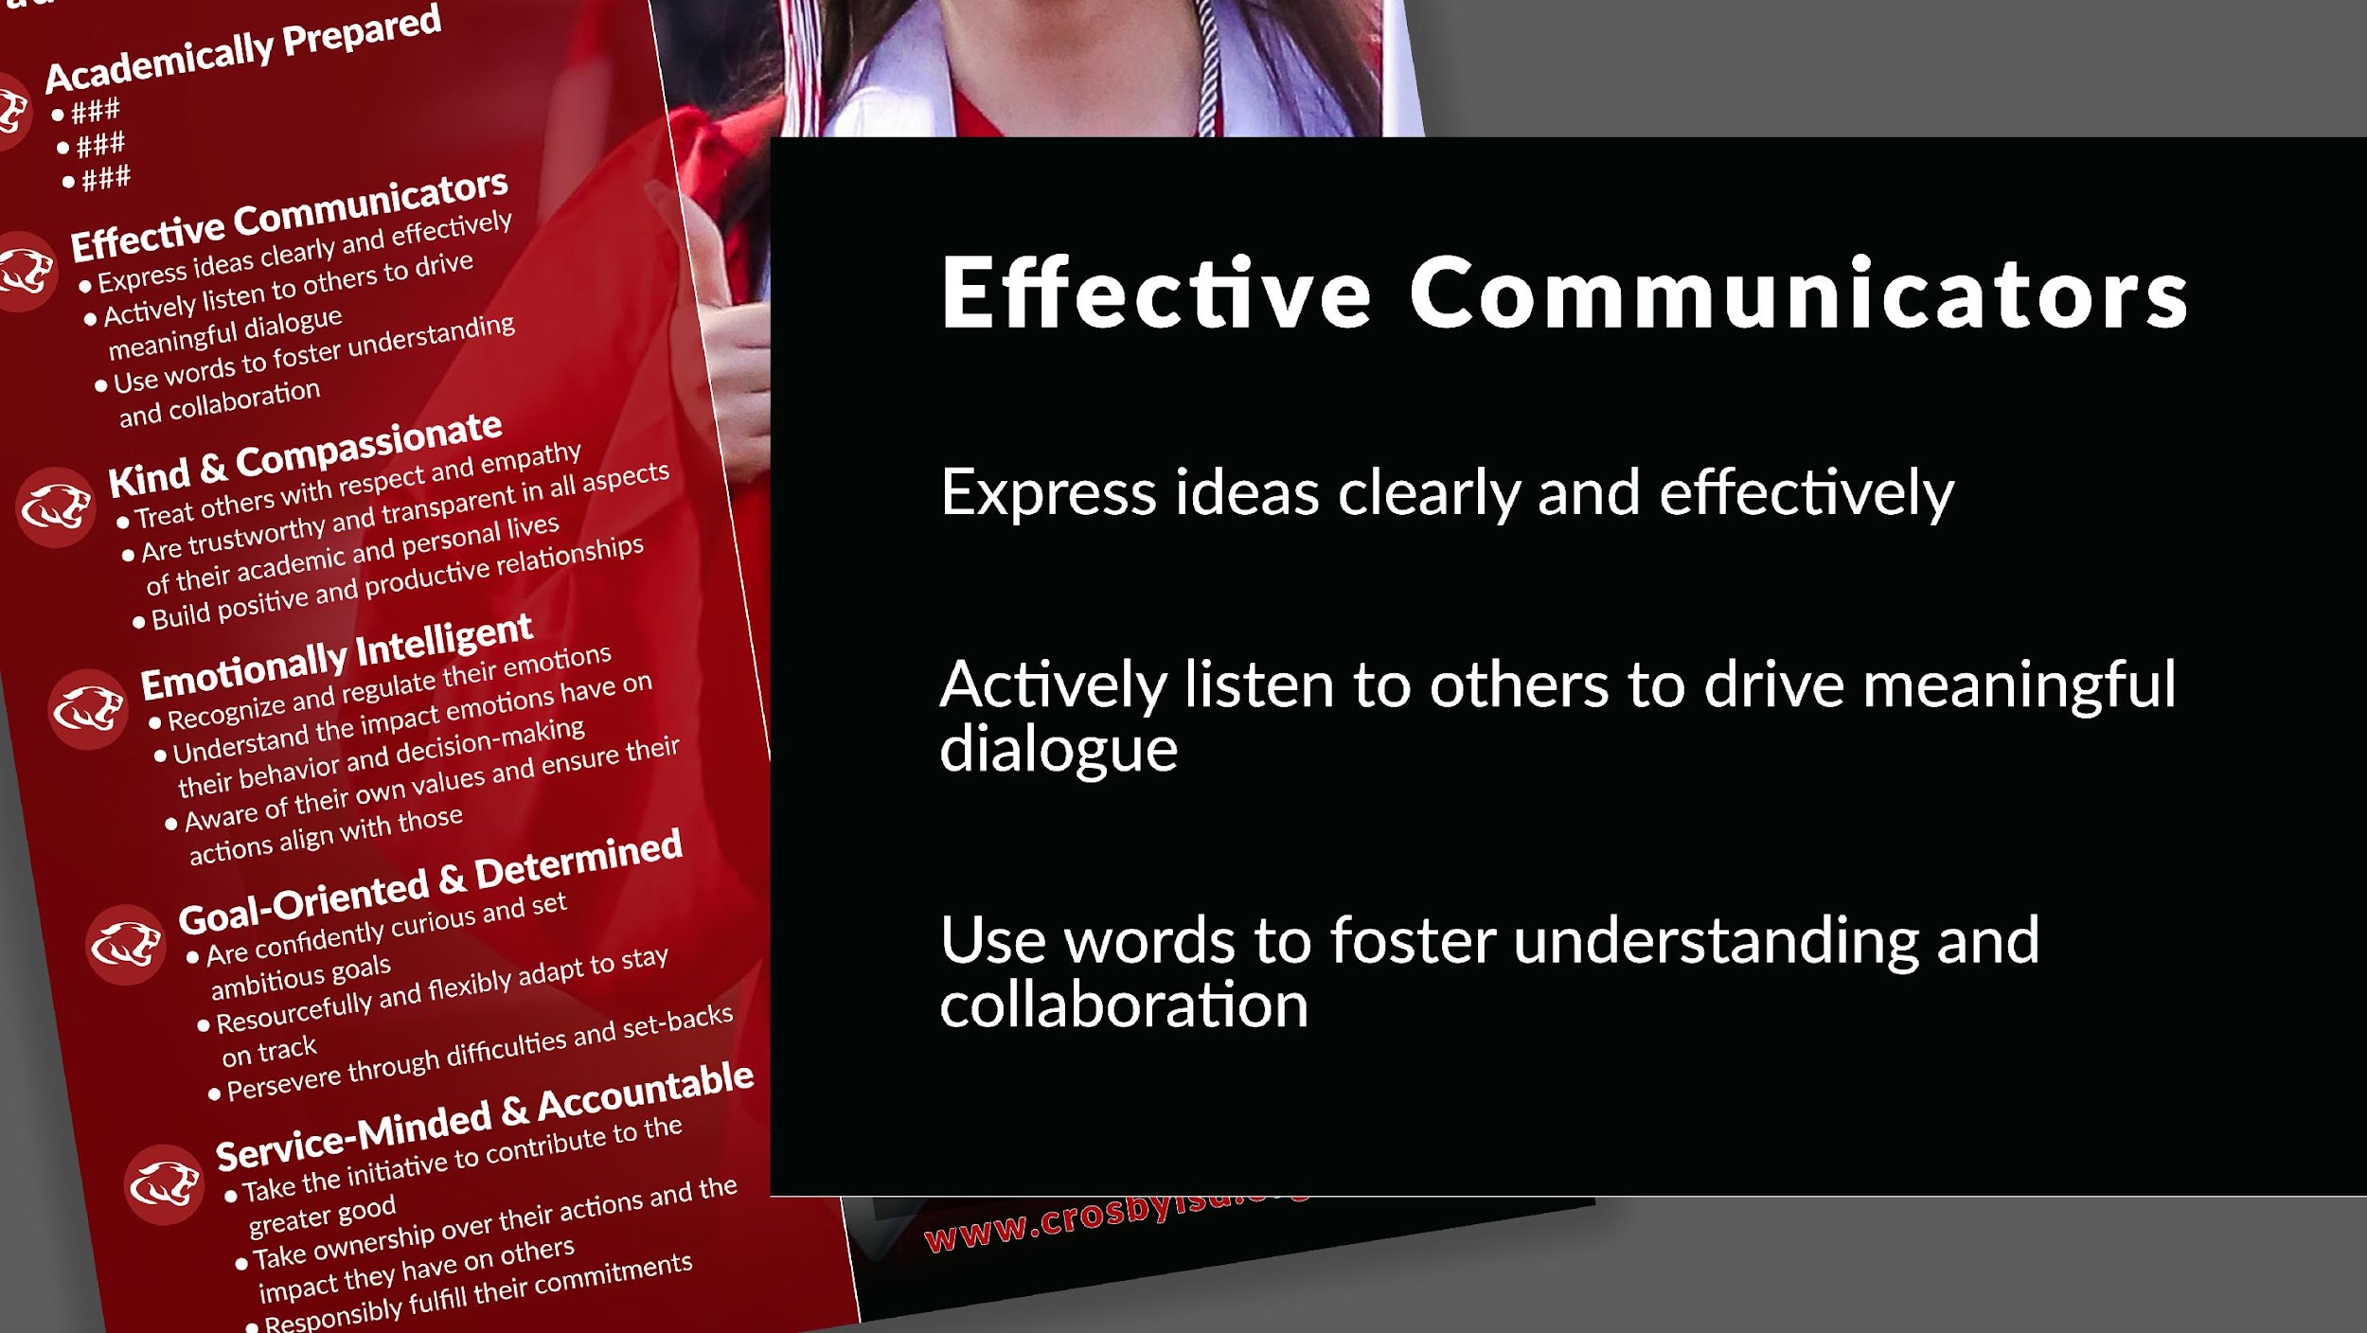

Slide 7
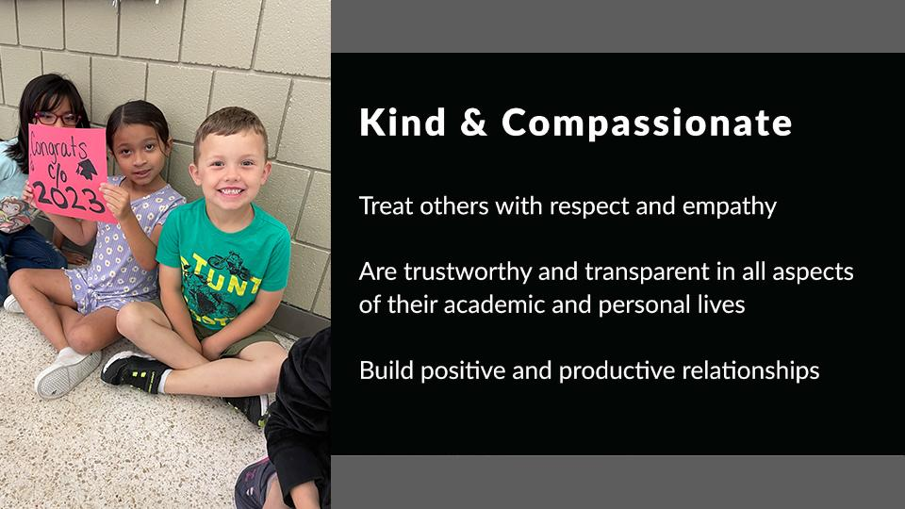
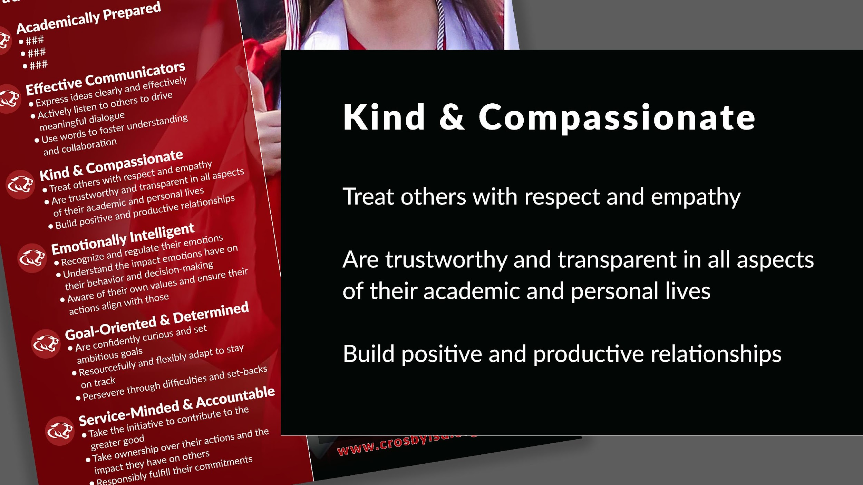

Slide 8
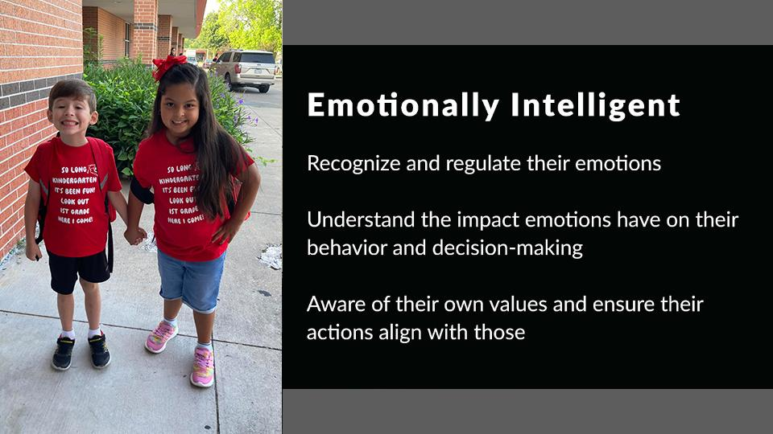
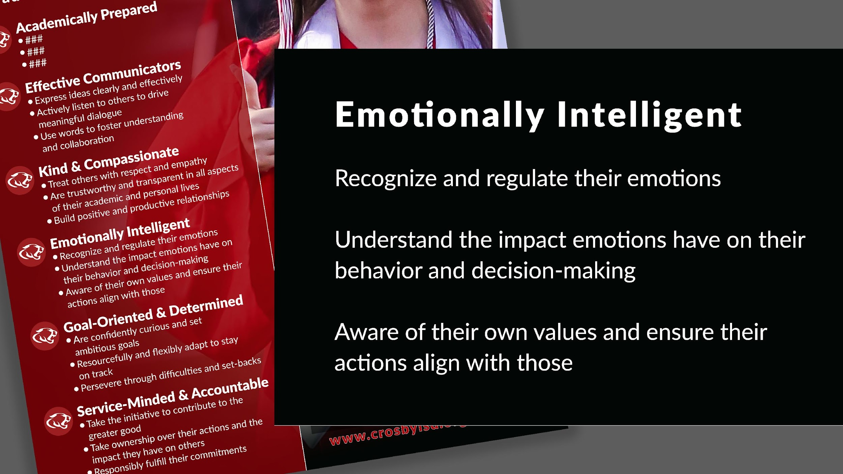

Slide 9
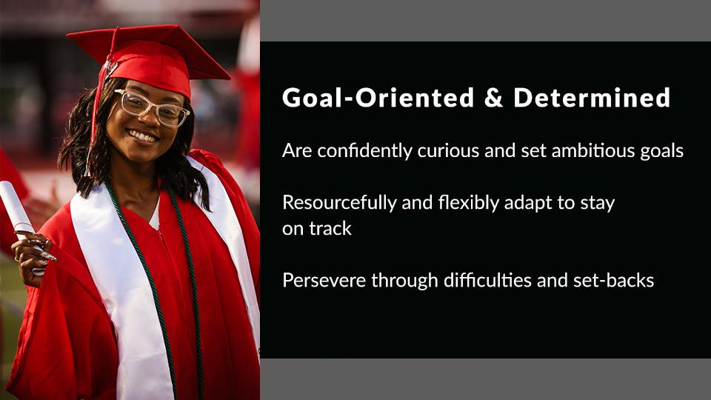
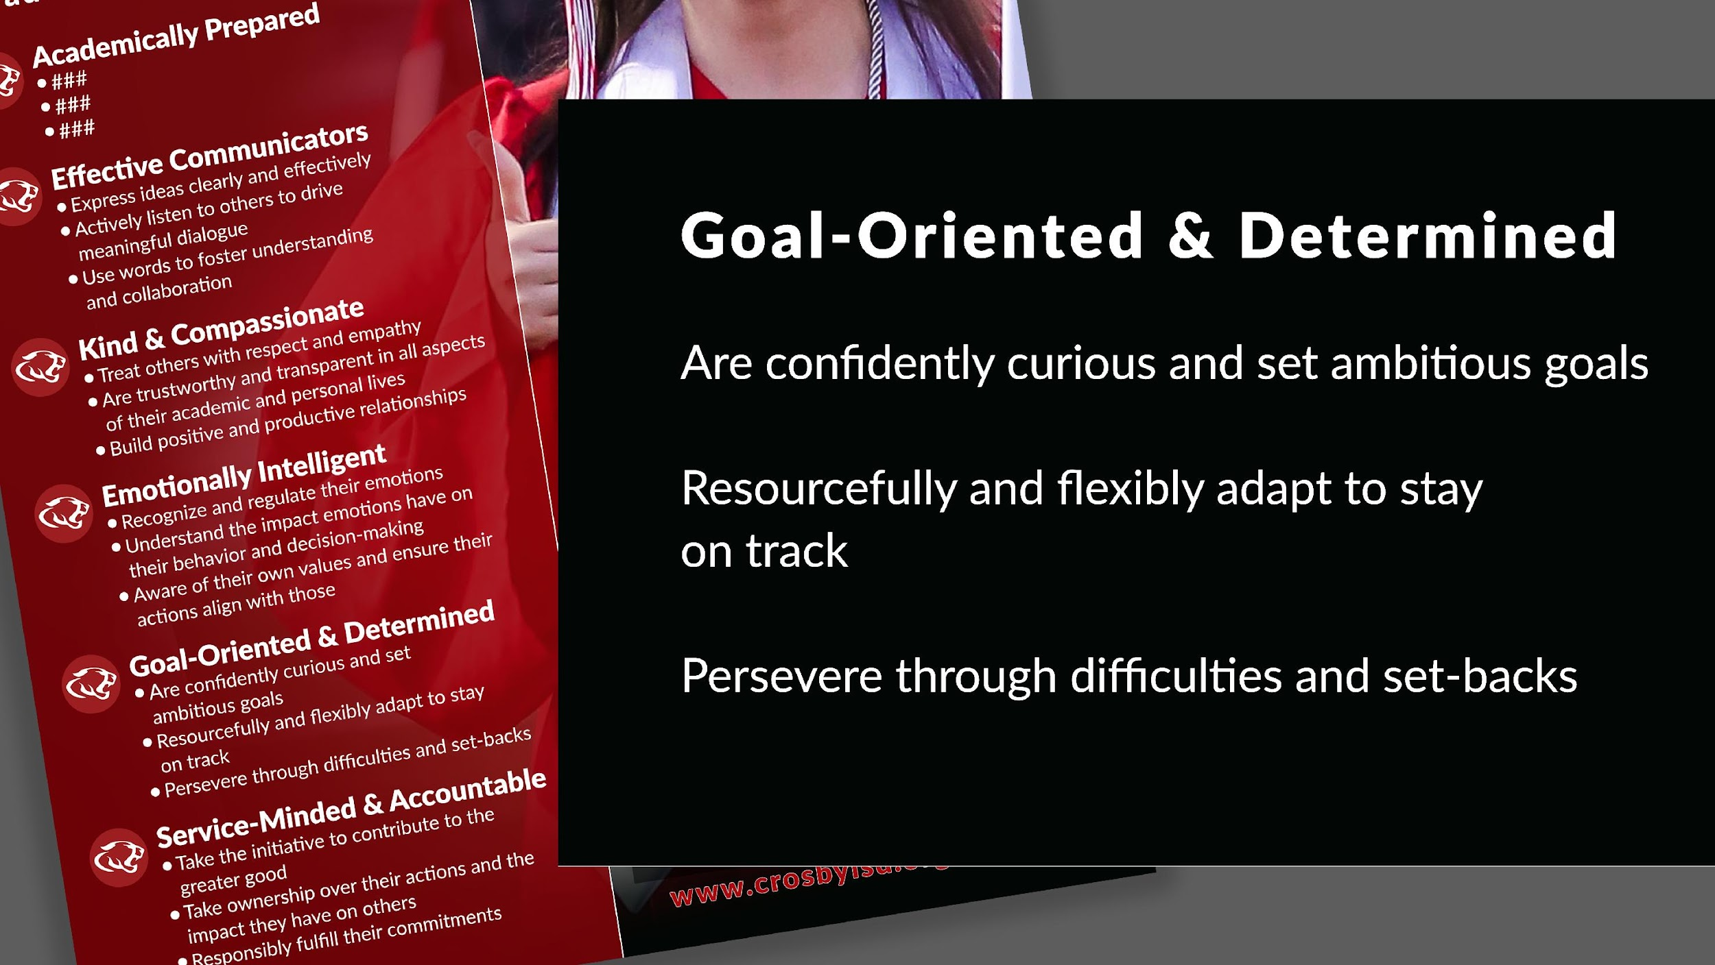

Slide 10
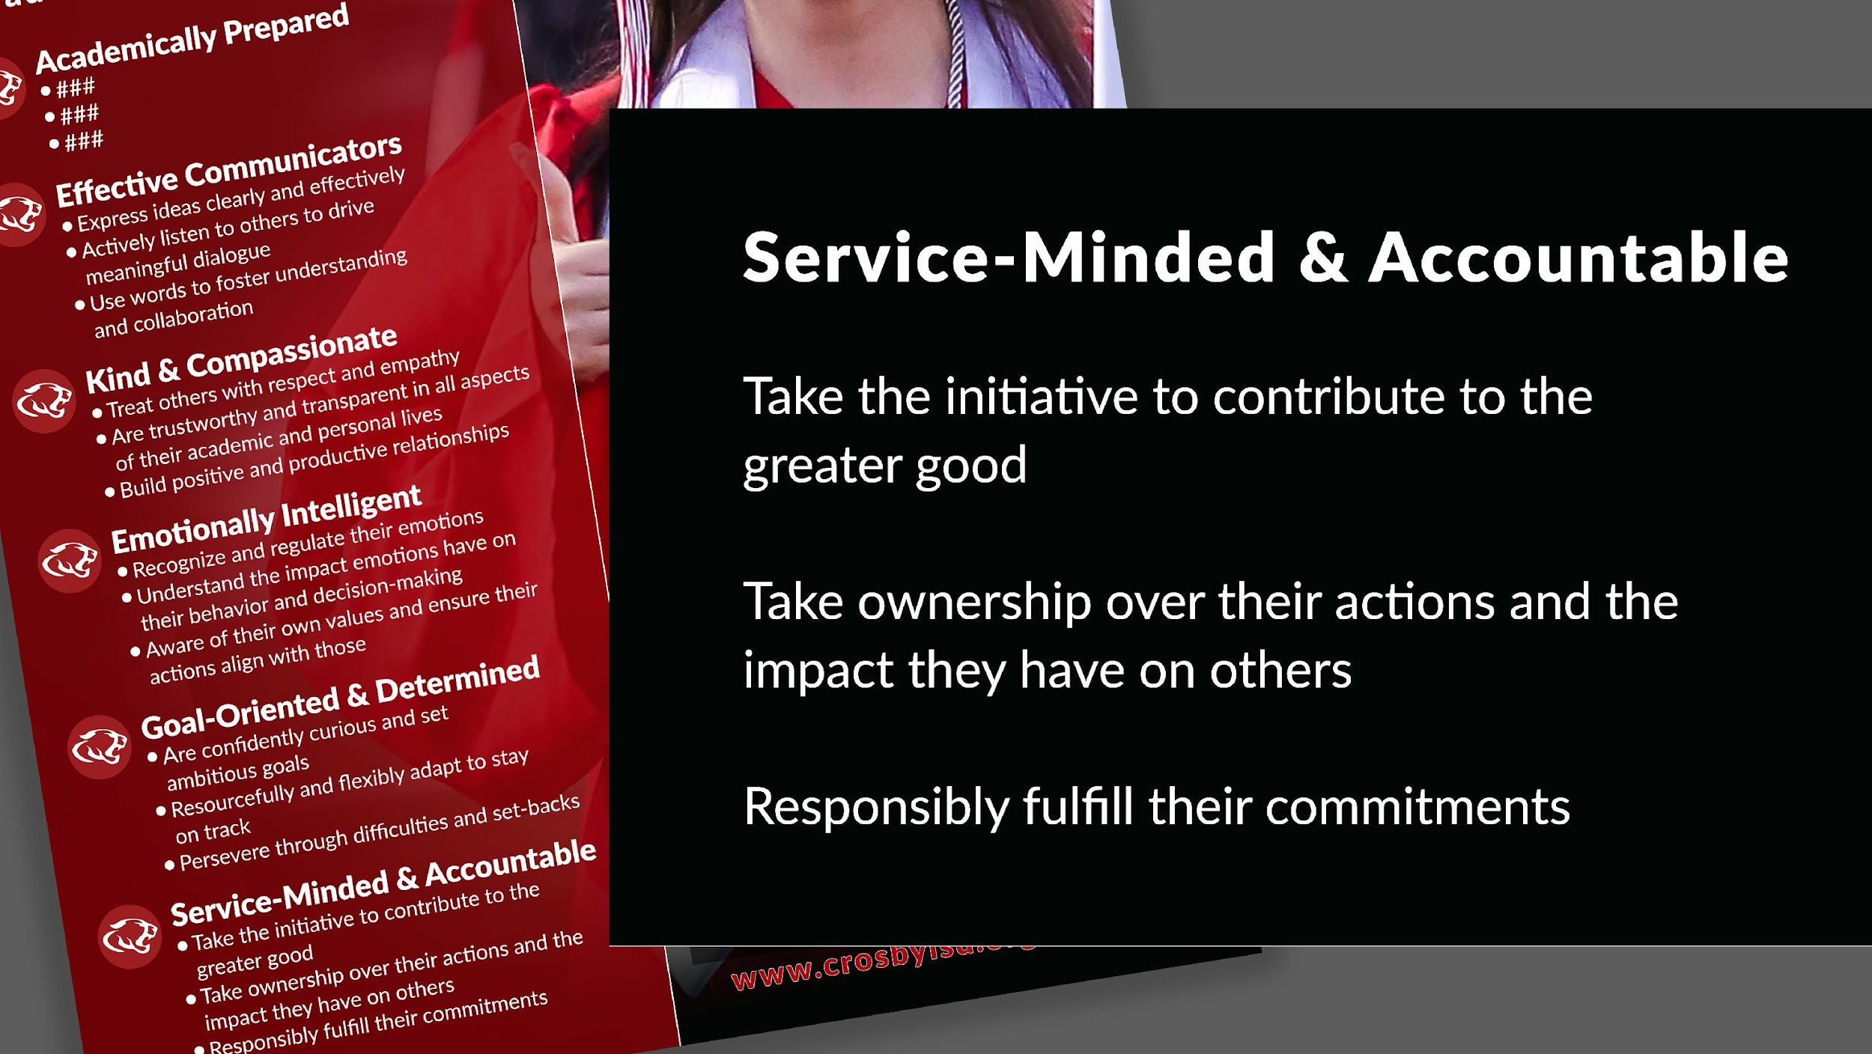
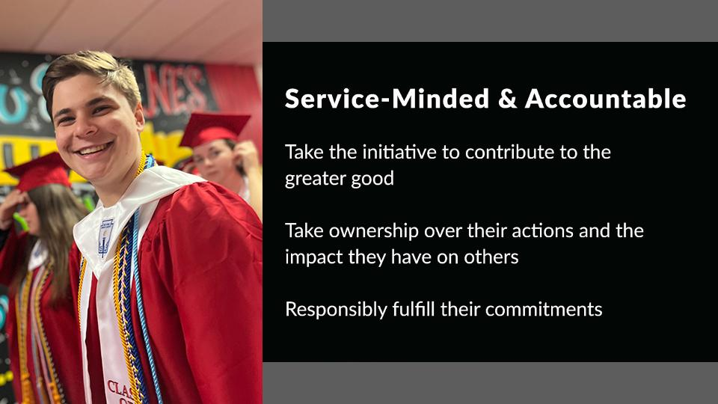

Slide 11
NEXT STEPS
Meet with the Portrait of a Graduate Implementation Committee (September 12)
Determine Universal Iconography
Identify Mastery at Grade Level Spans

Slide 13
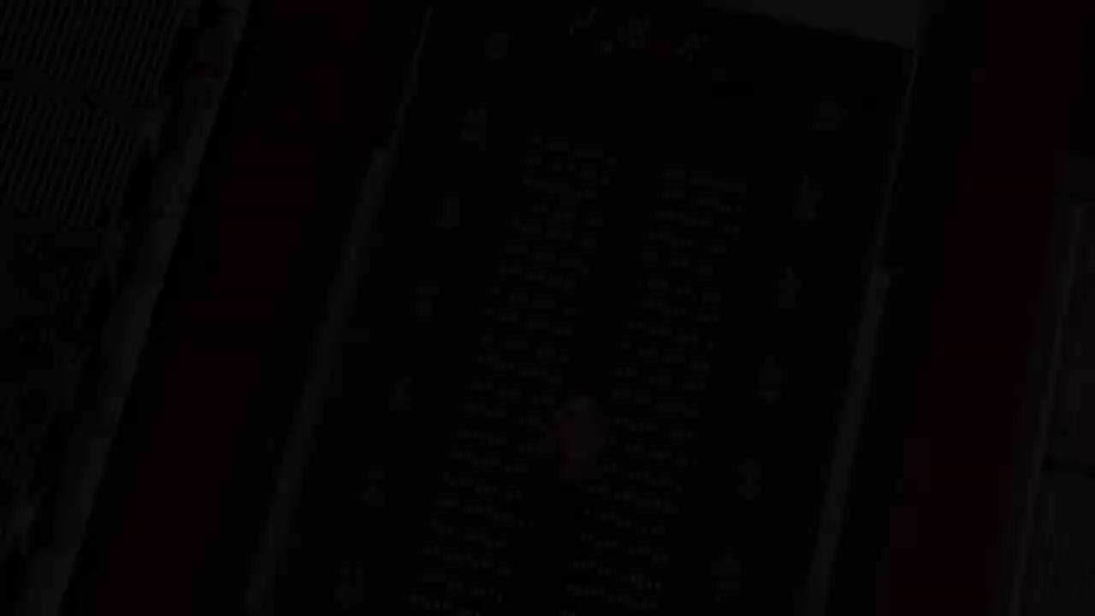

Slide 14

STUDENT VOICE
Zion Parker, Crosby High School Graduate
Landon Darjean, Crosby High School Senior
Miah Chase, Crosby High School Junior

Slide 15

Thank You

