Slide 1
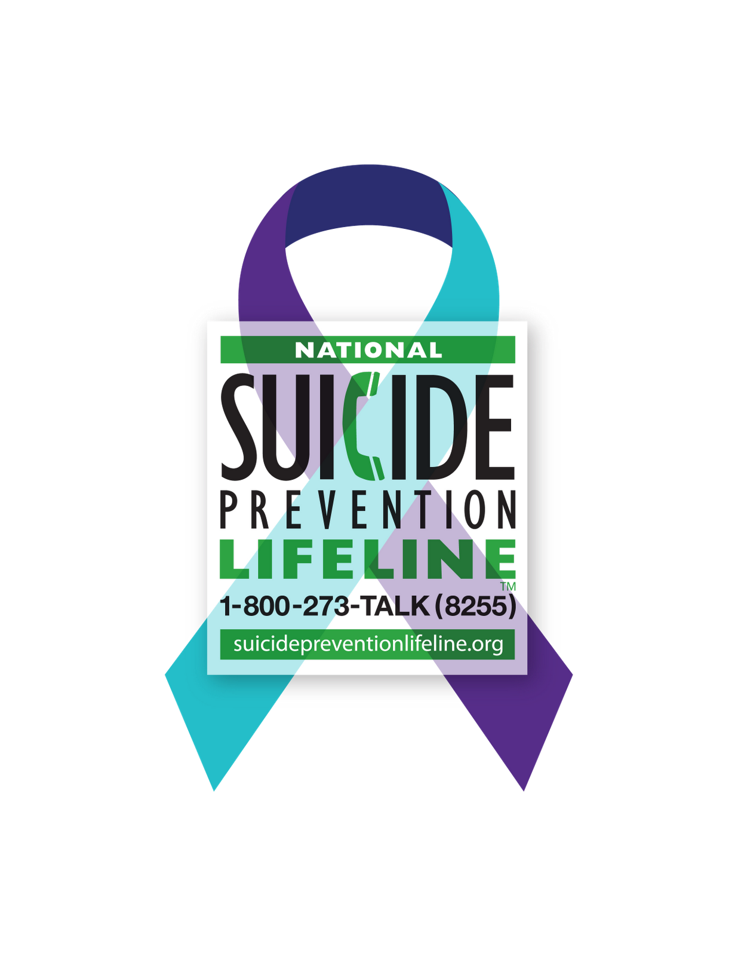
Suicide Prevention and Intervention

Slide 2
Prevention & Intervention: The Need
Suicide is the 2nd leading cause of death for 10-14 year olds
Suicide is the 3rd leading case of death for 15-24 year olds
15.8% of students surveyed in a national study, reported seriously considering suicide within the past 12 months
2016 Henry County Student Health Survey indicated that:
  ~10% of our high school students seriously considered suicide in the past year.
  ~8% of our middle school students seriously considered suicide in the past year

Slide 3
Objective
To learn risk factors and warning signs for suicide
To learn protective factors to prevent suicide
To understand what to do and how to access help if you identify a student that may need intervention
Learn some local and national resources dedicated to preventing suicide

Slide 4
Risk Factors vs. Warning Signs vs. Protective Factors
Risk Factors
Warning Signs
Risk factors are characteristics that make it more likely that individuals will consider, attempt, or die by suicide
Warning signs indicate an immediate risk of suicide
Protective Factors
Protective factors are characteristics that make it less likely that individuals will consider, attempt, or die by suicide

Slide 5
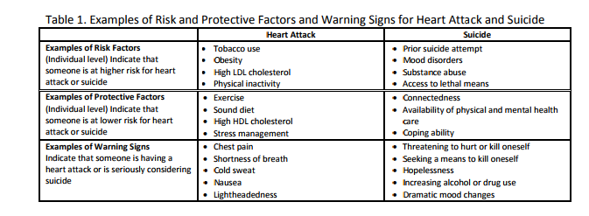
Examples of Risk, Warning, and Protective Factors for Heart Attack and Suicide

Slide 6

Risk Factors for Suicide
Previous suicide attempts
Alcohol and drug abuse
Mental illness, including mood disorders, such as depression, anxiety disorders, and certain personality disorders
Impulsive/Aggressive Tendencies
Hopelessness
History of Trauma or Abuse
Family history of suicide
LGBTQ+ Identification
  Adapted from Suicide Prevention Resource Center http://www.suicidepreventionlifeline.org/learn/riskfactors.aspx

Slide 7
If you notice risk factors for suicide…
Get help by contacting your school counselor, school social worker, or administrator.
Continue to build a meaningful relationship with the student
Increase protective factors that may save a child’s life

Slide 8
Warning Signs for Suicidal Thoughts
4 out of 5 teens who attempt suicide give clear warning signs.
Warning Signs of suicidal ideation include, but are not limited, to the following:
Talking about suicide
Talking about being a burden to others
Making or writing statements about feeling hopeless, helpless, or worthless
  This may be contained in a writing prompt, assignment, or other form of written expression
A deepening depression
Preoccupation with death
Taking unnecessary risks or exhibiting self-destructive behavior
Out of character behavior
A loss of interest in the things one cares about
Visiting or calling people one cares about
Making arrangements; setting one’s affairs in order
Giving prized possessions away

Slide 9
If you notice warning signs of suicidal thoughts…
Get help immediately by contacting your school counselor, school social worker, or administrator.

Slide 10

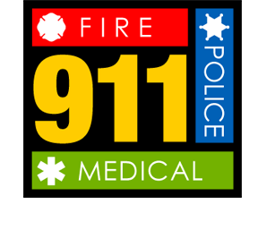
How Do Students Ask for Help?
In dialogue with other students:
  Often, students will disclose their thoughts/plans with peers first
  Take all concerns from peers seriously
Within written exercises, such as a writing prompt, literature assignment or other.
In dialogue with teachers or other staff
Non-verbal expressions during, before, or after the school day:
  Self-injury – in itself is not always indicative of suicidal ideation, but there is a correlation between these two behaviors.
  Sudden change in behavior - withdrawn, angry, sad, giving things away
  Sense of or expression of hopelessness
Suicide attempt – student may disclose that they took a handful of pills before coming to school, or at school. Student may be actively attempting to cut or harm self at school with intention to die (Extreme Risk - Notify Administrator immediately for help/authorized to CALL 911 if needed)

Slide 11
Making a Referral for Suicide Assessment
Designated student services personnel should be notified immediately to begin assessment process
Students should be treated with compassion from start to end of referral/assessment process
Students should be actively supervised at all times once identified:
  do not send students alone to counseling office
  do not allow them to sit alone in the media center while you are busy in a nearby office
Share all information regarding the referral with the counselor, school social worker, or administrator. Do not assume the student will share with another adult.

Slide 12
Protective Factors
Effective mental health care
Connectedness to individuals, family, community, and social institutions
Problem-solving skills
Conflict resolution skills
Social skills
Impulse control
Coping skills
Hope for the future
Reasons for living
Supportive peers
Contacts with caregivers – research has shown that even postcards from providers to patients have demonstrated reductions in suicide

Slide 13

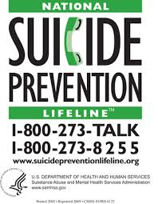
Creating Safe Spaces
BE AVAILABLE FOR KIDS
Encourage supportive communication and actions in the classroom
Eliminate bullying behaviors and promote positive behaviors
Have resources readily available (Suicide Prevention Line cards; SAMHSA SAFE T Cards) for students without them having to ask
Place SAFE SPACE stickers in your office area, somewhere visible for students
No Place for Hate activities – creating an inclusive, supportive classroom environment
Know which students struggle with depression, other mental illness
Always be aware and actively identify students that need help
All kids need to know that they matter to someone

Slide 14

Where to Get Help?
Local Mobile Crisis Assessment
National Suicide Prevention Lifeline

Slide 15
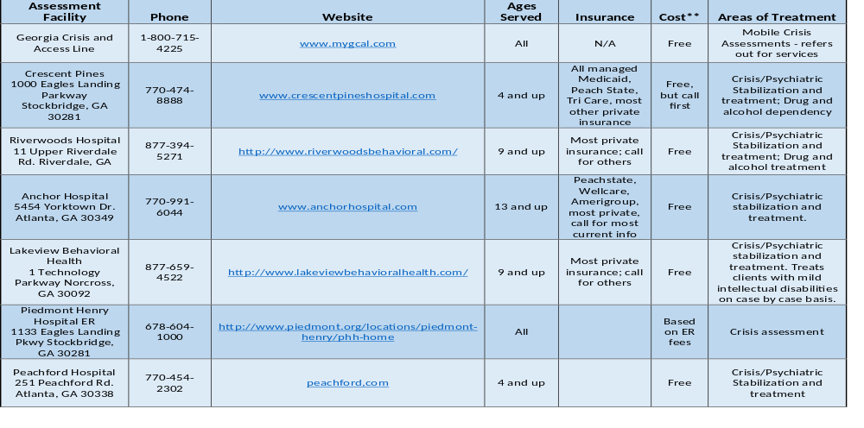
Where Can Students and Adults Get Help?
Local Crisis Assessment Resources:
***Crescent Pines is no longer a resource***

