Slide 1


Review of SEL/MH Learning Objectives
What does that acronym mean?
What am I supposed to be doing?

Slide 2
Common Acronyms
SEL- Social Emotional Learning
MH- Mental Health
CRSE- Culturally Responsive and Sustaining Education
PBIS- Positive Behavior Interventions and Supports
MTSS- Multi Tiered System of Support
DEI – Diversity Equity and Inclusion
RTI – Response to Intervention
RP- Restorative Practices

Slide 3
Important Documents to Read or Reference
Mental Health Education Literacy In Schools: Linking to a continuum of well-being
Mental Health Education Literacy in Schools- quick guide
New York State Social Emotional Learning Benchmarks
Social Emotional Learning: Essential for Learning, Essential for Life NYSED
CASEL 5 – Newer SEL Competencies- interactive wheel
Culturally Responsive and Sustaining Education- NYSED Framework

Slide 4
Important Documents to Read or Reference
DEI Policy Statement and Draft Framework and call to action – overview
Nassau County Mental Health & Wellness Strategic Plan
Protecting Youth Mental Health, The US Surgeon General’s Advisory
Draft Suicide Prevention Guide for Schools
Research for Recovery Brief- the importance of teacher well-being on education

Slide 5
What is my district mandated to do?
Implement Mental Health Literacy - May 21, 2018 memo from SED
“Please consider this memorandum as a point of clarification regarding the recently adopted amendments to Commissioner’s Regulations by the New York State Board of Regents. Education Law §804 was amended by Chapter 390 of the Laws of 2016 and Chapter 1 of the Laws of 2017 to clarify that required health education in schools must include instruction in mental health. The statutory amendments further provide that such instruction shall be designed to enhance student understanding, attitudes and behaviors that promote health, well-being and human dignity. “
SED summary memo 4.26.18
SED summary memo 1.11.18

Slide 6
What is my district mandated to do?
Implement Erin’s Law K-8
In August 2019, New York State became the 37th state to sign Erin’s Law into legislation. New York State’s law, (Chapter 187 of the Laws of 2019(link is external)) - known as Erin's Law - requires public schools to teach child sexual abuse and exploitation prevention classes to students in kindergarten through eighth grade.
Erin’s Law is intended to help children, teachers, and parents in New York State schools identify sexual abuse, and to provide awareness, assistance, referral, or resource information for children and families who are victims of child sexual abuse.
Erin’s Law FAQ
Resources Memo
Grade band objectives

Slide 7
SEL implementation
& creating a positive school Climate
Create a team made up of stakeholders to work on your initiatives, goals and projects
  Read the School Mental Health Teaming Playbook
  Collect data and identify gaps in student support services. This is a wonderful interactive, confidential, free tool. SHAPE – School Health Assessment and Performance Evaluation (theshapesystem.com)
  Administer a school climate survey

Slide 8
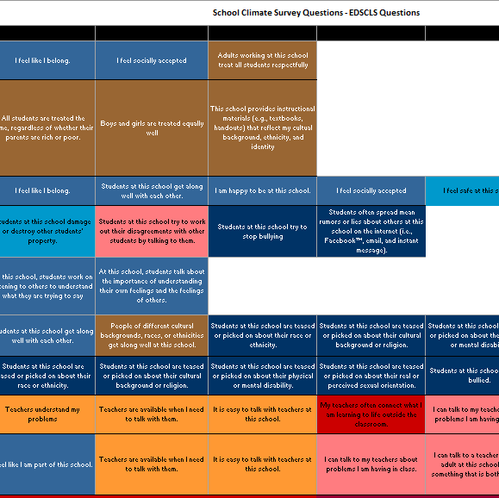
Crosswalk of major initiatives
How to link
  Mental Health Education Requirements
  SEL Benchmarks (CASEL 5)
  Culturally Responsive and Sustaining Education Objectives
  School Climate Survey results

Slide 9
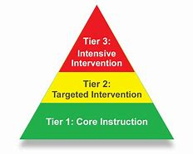
SEL implementation & creating a positive school Climate
MTSS
Team resources
School Mental Health Team Alignment Tool – to prevent duplication
Multi-Disciplinary School Mental Health Team Roles and Functions
School or District “wish list” for community, mental health provider services

Slide 10
Tier 1 supports – For everyone
How does my school handle suspensions?
Does my district have a program in place to help teachers with their own personal wellness?
Does my district have a space dedicated to wellness? Stress reduction? Cool off time? Zen Den, Chill out chamber, Relax Room, etc.?
Are my teachers using welcoming circles? Optimistic Closures?
Have my teachers/admins been trained in the use of Restorative Practices?
Is the staff knowledgeable about “whole child” - CDC whole school, whole community, whole child (WSCC)
Are district leaders using scheduled staff meeting time to model SEL/MH techniques- circles, mindfulness, positive affirmations, etc.

Slide 11
Tier 2 Supports
Do students know where to go to talk to an adult?
Do we have each student in our building connected to one adult in the building?
How are we communicating student/staff supports? Posters, social media?
Do families know how to access mental health and wellness resources?
Does our district provide mental health and wellness supports for staff?
Are nurses and other student support staff trained in Mental Health First Aid for Youth? Recess monitors, school resource officers, aides, lunchroom monitors, school bus drivers?

Slide 12
Tier 3 supports
Has our district updated our crisis response plan to include
  new suicide and mitigation strategies manual- December 2021
  student monitoring software after hours supports
  mandated reporter training updates
Do we have crisis response contacts updated and readily available?
Do we have a team that regularly reviews students who need support?
Does out district have a community resource to provide emergency interventions?
  Documents to help form partnerships

Slide 13
At minimum
Health teachers are covering mental health education
Elementary students are taught Erin’s Law objectives – covering all the objectives within each grade band.
Crisis plan in place

Slide 14
Along the continuum
Districtwide MH & wellness team – all stakeholders meets regularly.
Building wide MH & wellness team- meets regularly.
Administered a climate survey and shared results with community and committees.
Identified areas of school climate that need to be addressed and identified priorities. See additional questions available Spring 2023
Adopted an “evidence based” SEL framework to implement with fidelity K-12 – Set up PD for all school staff to address MH and SEL initiatives
Identified members of team who will work on becoming “experts” in a variety of programs/initiatives who turn-key at faculty/staff/parent meetings

Slide 15
Along the continuum
Formed community partnerships
Have established areas for staff and students to use for “time-out”
Adopted restorative practices and revised student hand-books and codes of conduct
Students have been linked to at least one adult in the school as their “go to” person/ advocate
Staff prioritize positive healthy relationships with students.

Slide 16
Along the continuum
Reviewed ALL programs, policies, practices and cultural influencers for cultural competence.
ALL members of the school community prioritize mental wellness.
Staff continue to improve their own SEL skills and prioritize wellness.

Slide 17
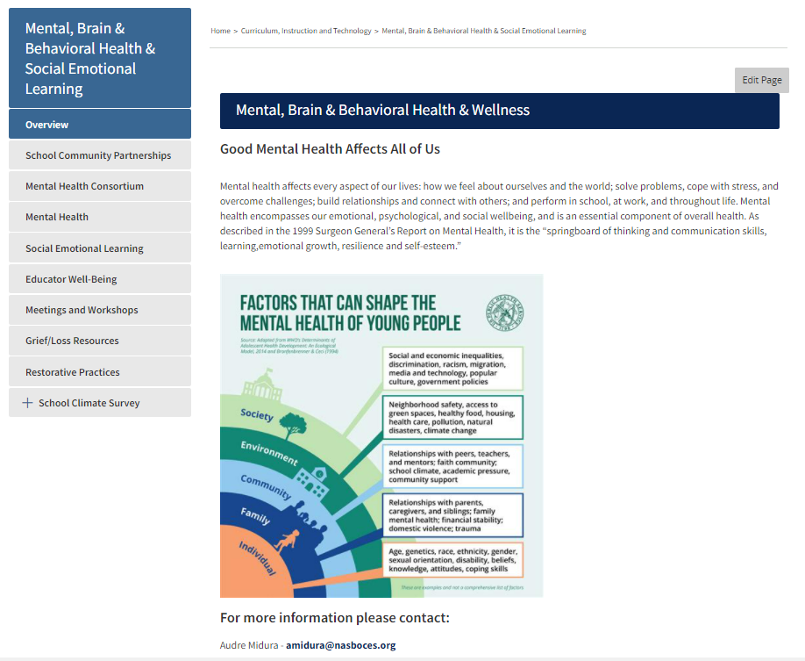
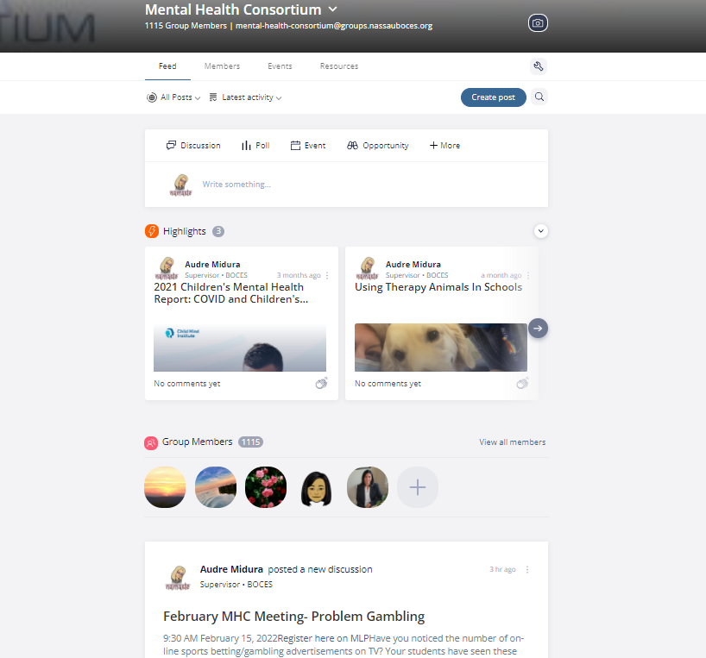
Help for you
Nassau BOCES MHC Listserv
Email us email addresses of staff to join listserv – closed list
Nassau BOCES MH Web

Slide 18
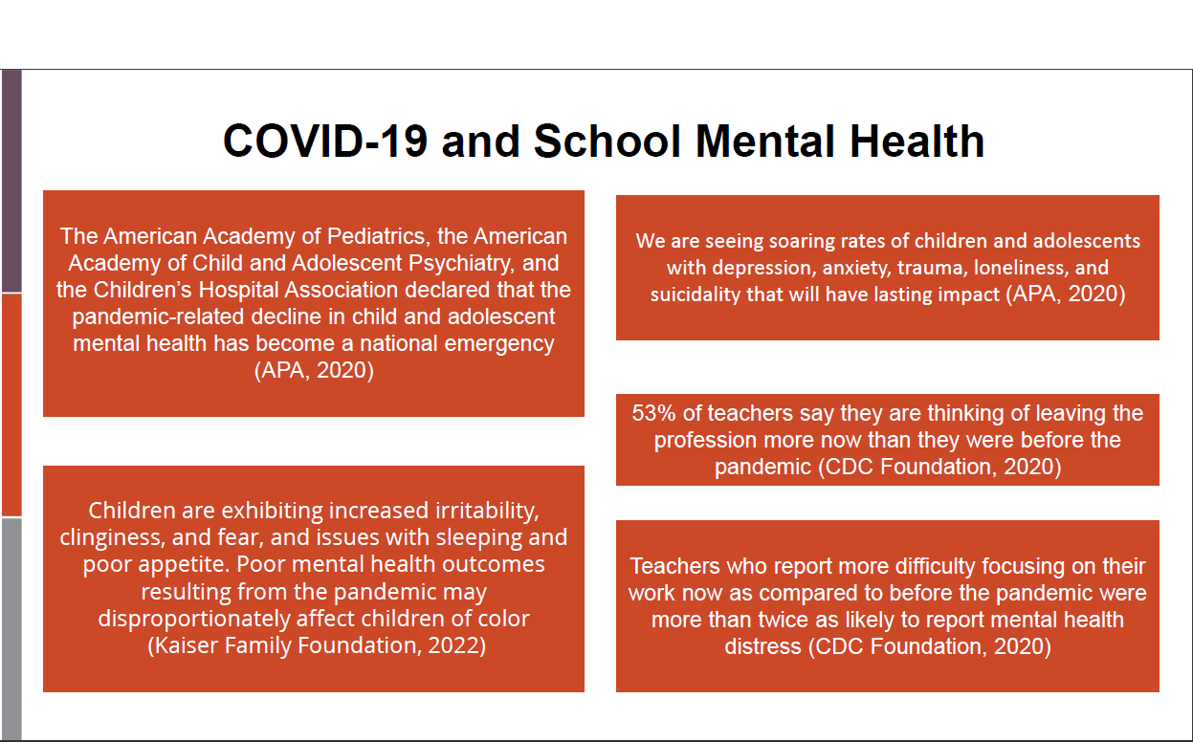

Slide 19

Ways we can support you
Help with your MH/SEL team development and implementation
Administer Climate Survey
Provide PD for climate survey result interpretation
Implementation of “evidence based” program
Assistance with community school partnerships
Professional Development for entire school community
Elementary Counselor assistance
Please contact
Audre Midura amidura@nasboces.org
or
Beverly Forgash bforgash@nasboces.org

