Slide 1
Threat Assessment and Management in K-12 Settings
August 23rd and 24th 2023
Kostas A. Katsavdakis, Ph.D., ABPP
Diplomate in Forensic Psychology
Center for Forensic and Clinical Psychology
New York City
kostas@drforensic.com
Notes:
Understanding a book contract is not difficult -- but it does require reading a lot of fine print.
To illustrate the typical book contract, we have a handout today of the standard 4-page agreement issued by American Psychiatric Press, Inc.
Book publishers like to use a “boilerplate” contract because it is basically a form that specifies the publisher’s usual terms.
Blanks in the form are then filled in with specific details for each new author and work.

Slide 2
Outline of Presentation
Prevalence Rates/Legal
Affective and Predatory Modes of Violence
Biopsychosocial Factors Associated with Violence in Juveniles
Differences between Risk and Threat Assessment
Warning Behaviors for Targeted Violence
Implementation of Threat Assessment Management Team
Limitations of Threat Assessment and Management
Risk Assessment – Structured Professional Judgment
Case Practice/Samples

Slide 3
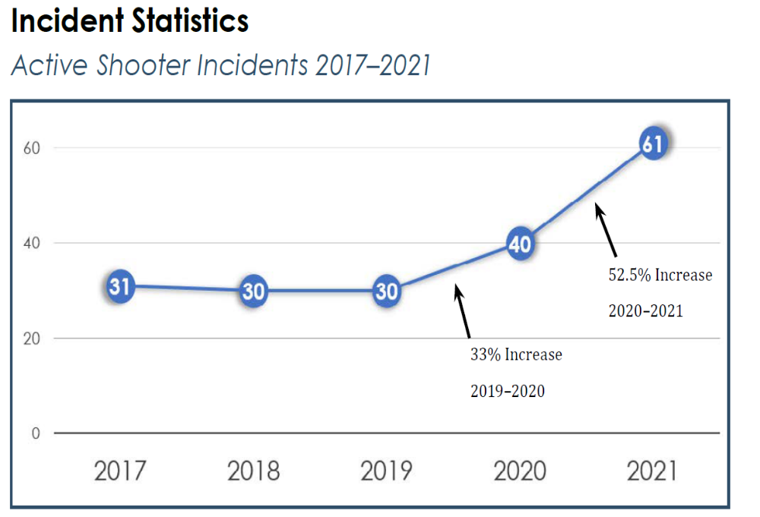
FBI Active Shooter Criteria
Shootings occurring at more than one location
Shootings where the shooter’s actions were not the result of another criminal act
Shootings resulting in a mass illing4
Shootings indicating apparent spontaneity by the shooter
Shootings where the shooter appeared to methodically search for potential victims
Shootings that appeared focused on injury to people, not buildings or objects
Active Shooter Incidents in the United States, 2021, United States Department of Justice, FBI

Slide 4
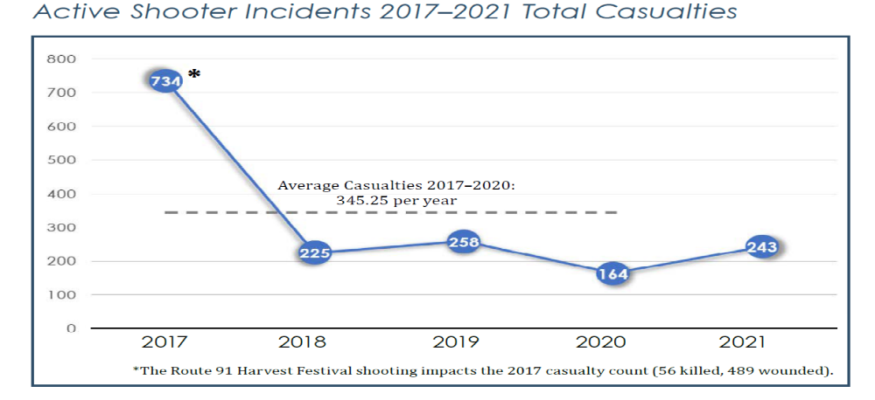
Active Shooter Incidents in the United States, 2021, United States Department of Justice, FBI

Slide 5
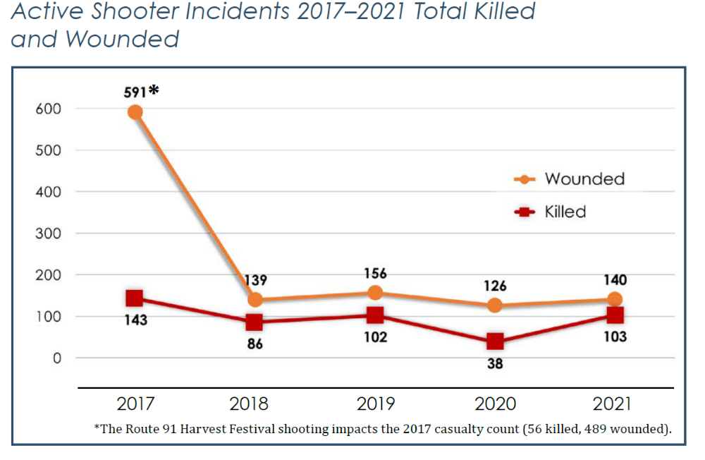

Slide 6
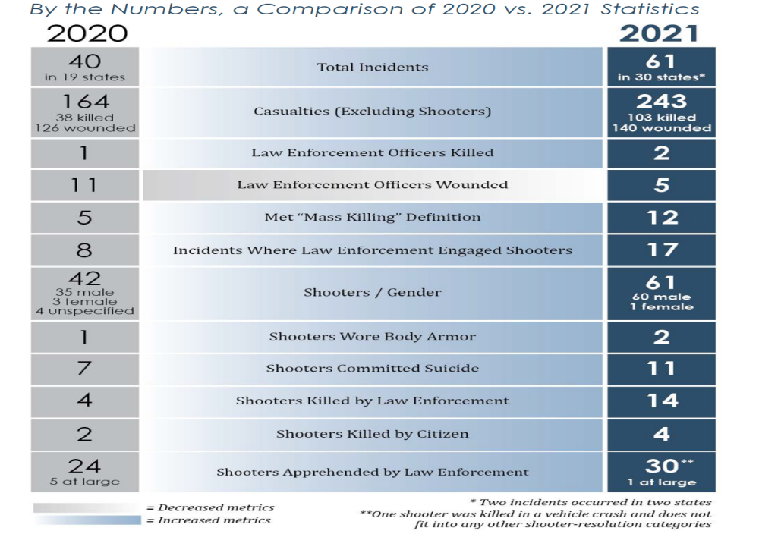

Slide 7
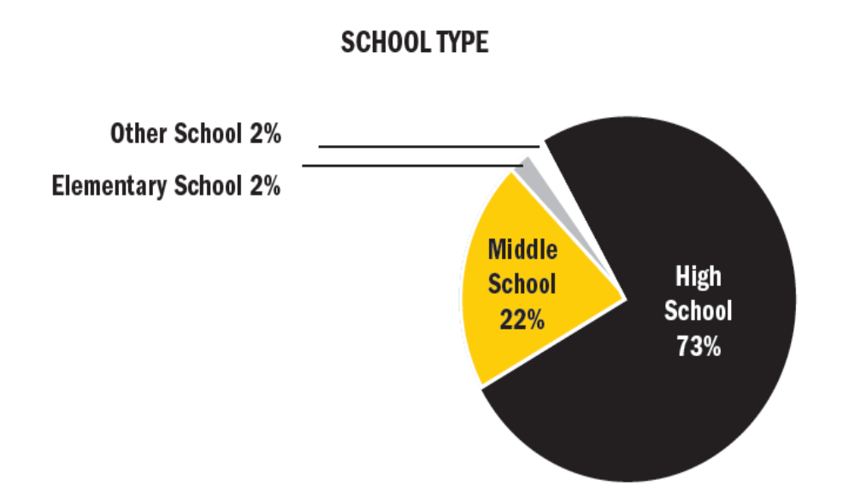
PROTECTING AMERICA’S SCHOOLS: A U.S. SECRET SERVICE ANALYSIS
OF TARGETED SCHOOL VIOLENCE (2019)
U.S. Department of Homeland Security UNITED STATES SECRET SERVICE
National Threat Assessment Center

Slide 8
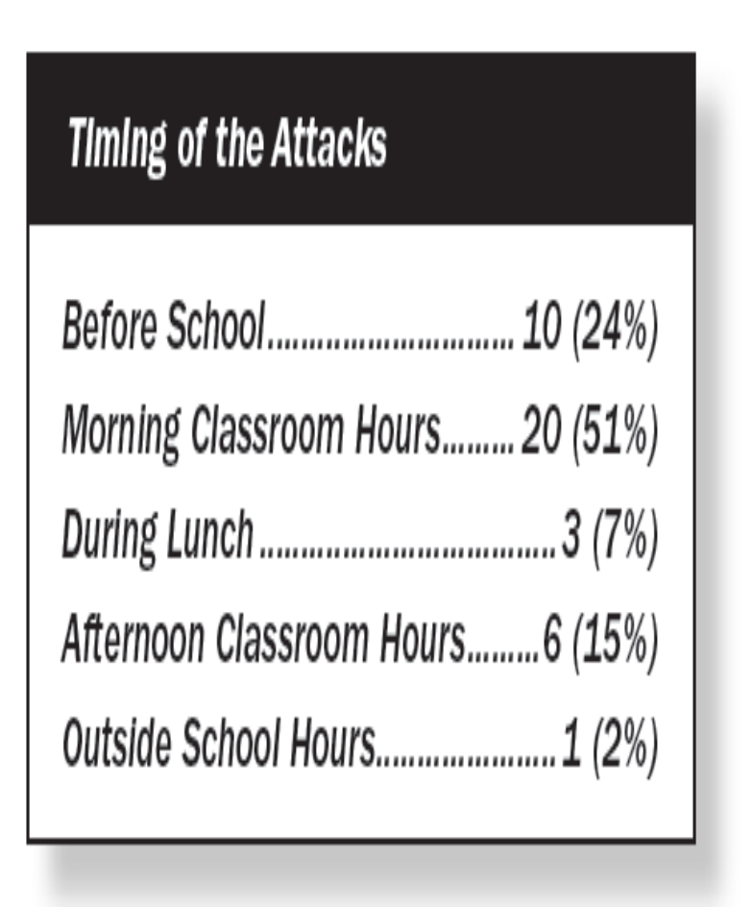
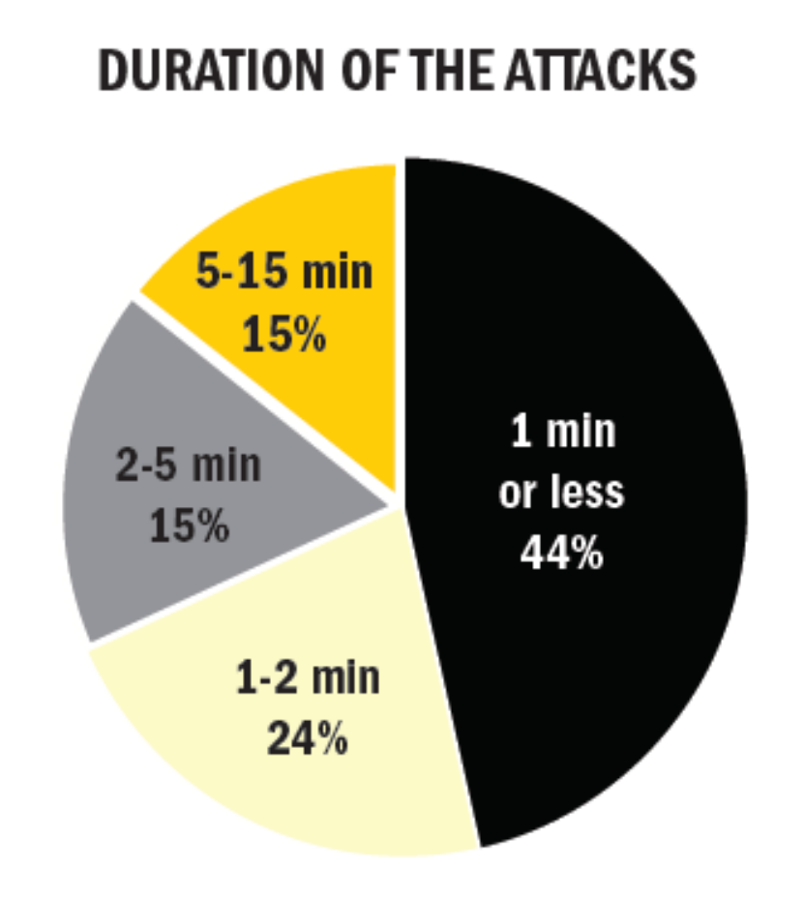
PROTECTING AMERICA’S SCHOOLS: A U.S. SECRET SERVICE ANALYSIS
OF TARGETED SCHOOL VIOLENCE (2019)
U.S. Department of Homeland Security UNITED STATES SECRET SERVICE
National Threat Assessment Center

Slide 9
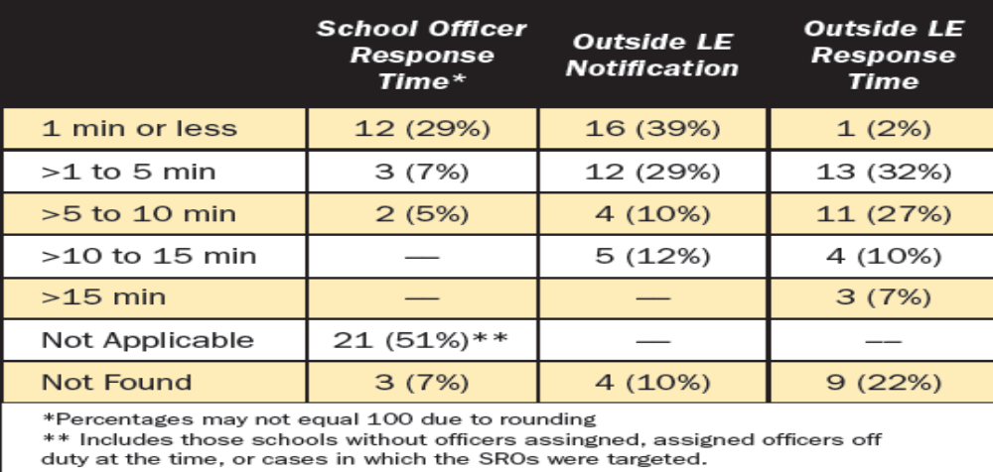
PROTECTING AMERICA’S SCHOOLS: A U.S. SECRET SERVICE ANALYSIS
OF TARGETED SCHOOL VIOLENCE (2019)
U.S. Department of Homeland Security UNITED STATES SECRET SERVICE
National Threat Assessment Center
41 incidents of targeted school violence 1/08 – 12/17

Slide 10
Forensic Mental Health Assessment
Heilbrun, Matteo, Marczyk, Goldstein, 2008
 | Standards of Care | Standards of Practice
1 | Judicially determined | Best practices in field
2 | External est. by Court | Internally est. by field
3 | Adherence mandatory | Adherence aspirational
4 | Breach = liability and monetary damages | May result in sanctions but not civil liability

Slide 11
There ARE STANDARDS OF PRACTICE for the Development and Implementation of a Behavioral Threat Assessment and Management

Slide 12
New Jersey
Bill A4075/3229 AcsAaAca (ACS/2R)
Session 2022 – 2023 (signed into law 8/1/22 – unanimous passage in legislature)
Requires all public school districts to create school-based threat assessment teams to help identify and assess students at risk of committing violent acts or other harmful activity.
  Need to be in place by the start of the 2023-24 school year.
TAT required to multidisciplinary and include to the extent possible a school psychologist, counselor or social worker, a teacher, an administrator, and a school resource officer or school employee who serves as a liaison to law enforcement.
Training must ensure that threat assessments don’t have a disparate impact on students based on their race, ethnicity, homelessness status, religious belief, gender, gender identity, sexual orientation and socioeconomic status.

Slide 13
Which states require in-school threat assessment teams?
  According to the National Association of State Boards of Education (NASBE)'s State Policy Database, threat assessment is required by law in:
  18 states
  encouraged in five states
  non-codified policy in 16 states

Slide 14
New York, 2022
Executive Order 18 (signed on or about 8/18/22)
10 million dollars to Requiring Each County and the City of New York to Develop Plans to Confront Domestic Terrorism, Including Racially and Ethnically-Motivated Violence
  Does not include K-12 settings

Slide 15
COUNTERMAN v. COLORADO
CERTIORARI TO THE COURT OF APPEALS OF COLORADO, 6/27/23
Billy Raymond Counterman repeatedly contacted a female over FB in 2014
Sends “creepy” messages from numerous different accounts.
Messages continues despite her blocking him.
Messages implied that Counterman was watching her and saying that he wanted her to die or be killed.
Counterman reported to law enforcement, arrested in 2016.

Slide 16
COUNTERMAN v. COLORADO
CERTIORARI TO THE COURT OF APPEALS OF COLORADO, 6/27/23
Charged:
  1 count of stalking (credible threat)
  1 count of stalking (serious emotional distress)
  1 count of harassment.
Prosecution dismissed the count of stalking (credible threat).
Counterman claimed that the remaining charges, from FB messages, would violate his right to free speech under the First Amendment because they were not “true threats.”
The trial court denies motion to dismiss.
Jury verdict, guilty of stalking (serious emotional distress).
Colorado Court of Appeals affirmed his conviction.

Slide 17
COUNTERMAN v. COLORADO
CERTIORARI TO THE COURT OF APPEALS OF COLORADO, 6/27/23
Question…
To establish that a statement is a "true threat" unprotected by the First Amendment, must the government show that the speaker subjectively knew or intended the threatening nature of the statement?
Primary Holding (6-3 Decision)…
Supreme Court holds that in "true threat" First Amendment cases, the prosecution must prove that the defendant had some subjective understanding of his statements’ threatening nature; the correct standard is recklessness.
In other words….
To establish that a statement is a “true threat” unprotected by the First Amendment, the State must prove that the defendant had some subjective understanding of the statements’ threatening nature, based on a showing no more demanding than recklessness.

Slide 18
Extreme Risk Protective Orders
(Pomeranz & Ochoa, 2021)
As of July 2020, 19 states and DC enacted a total of 43 ERPO laws for both temporary and final orders.
7 states had standard ERPO laws; LE or a state attorney files petitions.
12 states and DC expanded their ERPO laws to allow additional categories (e.g., family).
Imminent risk present; 18 states allowed initial proceedings to be without respondent present.
All ERPO states required a final hearing where the respondent is present within 3−30 days from the initial order.
All states and DC also provided a procedural mechanism for the respondent to challenge the order and recover their firearm.

Slide 19
Extreme Risk Protective Orders
(Pomeranz & Ochoa, 2021)
Pre-emption laws:
  ERPO laws violated the First Amendment/ right to free speech
  Second Amendment/right to self-defense
  Fourth Amendment/right to be protected from unlawful searches and seizures
  Fifth Amendment/right to due process
  Right to a fair trial
  Gun owners’ right to face their accuser who may make a false accusation

Slide 20
Extreme Risk Protection Orders
“Red Flag Laws,” NYS, 8/24/2019
Goal to keep guns away from persons deemed “high risk” of using against self/others
Not have (possess) a firearm, rifle or shotgun
Not buy a firearm, rifle or shotgun
Not attempt to have or buy a firearm, rifle or shotgun
Give up any firearms, rifles or shotguns
Petitioners include:
  Police officers
  District Attorneys
  Family or household members
  School administrators; including persons chosen by the school – teachers; guidance counselors, school psychologist, school nurse and coaches

Slide 21
Extreme Risk Protection Orders
“Red Flag Laws,” NYS, 8/24/2019
Filed to NYS Supreme Court Judge
Turn-around time rapid; hearing held within 3 - 10 days after the application is filed
  https://ww2.nycourts.gov/erpo
  Outside normal business hours, contact 1-800-430-8457 or emergency@nycourts.gov
Both sides get a chance to tell their side of the story to the judge
ERPO will say the expiration date (up to 1 year)
ERPO must be followed in every state
If the judge decides that a final ERPO is not needed, the case is over

Slide 22
Extreme Risk Protection Orders
“Red Flag Laws,” NYS, 8/24/2019
ERPO DOES NOT ORDER PERSON AT RISK TO STAY AWAY FROM TARGET
ERPO can’t order a person to:
  Stop threatening or committing abuse
  Stay away from your home, job, or school
  Have no contact with you or others
  Follow custody orders
  Pay child or spousal support
An ERPO has no criminal charges or penalties.

Slide 23
NY Secure Ammunition and Firearms Enforcement (SAFE) Act; Mental Hygiene Law, 9.49 (1/15/13)
NYS SAFE Act stops criminals and the dangerously mentally ill from buying a gun by requiring universal background checks on gun purchases
Increases penalties for people who use illegal guns
Mandates life in prison without parole for anyone who murders a first responder
Office of National Instant Criminal Background System (NICS) and SAFE Act provides the guidance to mental health professionals on reporting requirements.
Resource for clinicians on the NY SAFE Act and Section 9.46 of the Mental Health Law.

Slide 24
NY Secure Ammunition and Firearms Enforcement (SAFE) Act; Mental Hygiene Law, 9.49 (1/15/13)
MHL, 9.46 (A) - Reporting Requirements for Mental Health Professionals:
“requires four groups of mental health professionals (i.e., physicians, psychologists, registered nurses, and licensed clinical social workers), in the exercise of their reasonable professional judgment, to make a report as soon as practical to county mental health officials if an individual for whom they are providing mental health treatment is “likely to engage in conduct that will cause serious harm to self or others.”

Slide 25
NY Secure Ammunition and Firearms Enforcement (SAFE) Act; Mental Hygiene Law, 9.49 (1/15/13)
MHL, 9.49 (B) Reporting Standard:
“the reporting standard is “likely to engage in conduct that will cause serious harm to self or others.” This standard is consistent with the “likely to result in serious harm to self or others”
“As such, decision making with respect to a Section 9.46 report requires a clinical
determination that a person’s clinical state creates either: “(a) a substantial risk of
physical harm to the person, as manifested by threats of or attempts at suicide or serious
bodily harm or other conduct demonstrating that the person is dangerous to himself or
herself, or (b) a substantial risk of physical harm to other persons as manifested by
homicidal or other violent behavior which places others in reasonable fear of serious
physical harm1.”

Slide 26
NY Secure Ammunition and Firearms Enforcement (SAFE) Act; Mental Hygiene Law, 9.49 (1/15/13)
MHL, 9.49 (C) Confidentiality and Liability Concerns:
“With any mandatory reporting requirement, concerns regarding confidentiality and liability (for making a report or, conversely, failing to make a report) may be raised.”
“These concerns are addressed as follows: The law specifically provides that mental health professionals will not be subject to any civil or criminal liability if the professional’s decision with respect to whether or not to report was made “reasonably and in good faith.”

Slide 27
Family Educational Rights and Privacy Act (FERPA)
[20 U.S.C. § 1232g – 34 C.F.R. Part 99]
Applies to all educational agencies (i.e., school districts) and institutions (i.e., schools) that receive funds under any program administered by the U.S. Secretary of Education. In K–12, FERPA applies to most public schools.
In postsecondary, FERPA applies to nearly all postsecondary institutions.

Slide 28
Family Educational Rights and Privacy Act (FERPA)
[20 U.S.C. § 1232g – 34 C.F.R. Part 99]
Gives parents the right to access the student’s education records (and to seek to amend any information in the student’s education record that is inaccurate, misleading, or in violation of the student’s right of privacy).

Slide 29
Family Educational Rights and Privacy Act (FERPA)
[20 U.S.C. § 1232g – 34 C.F.R. Part 99]
Requires written parental consent before personally identifiable information (PII) from the student’s education record may be disclosed, subject to certain exceptions.
When a student turns 18 years of age, or enrolls in a postsecondary institution (at any age), the student becomes an “eligible student” and all parental rights transfer to the student.

Slide 30
FERPA – Protect?
Education records are generally defined as those records that are directly related to the student and maintained by (or on behalf of) an educational agency or institution.

Slide 31
FERPA – Protect?
FERPA excludes certain types of records from this definition, including, but not limited to: Records created and maintained by the educational agency’s or institution’s law enforcement unit for law enforcement purposes;

Slide 32
FERPA – Protect?
Records made or maintained by a professional or paraprofessional (e.g., physician, psychologist, etc.) that are made, maintained, or used only in connection with treatment of an eligible student, if certain conditions are met.

Slide 33
FERPA –Key Exceptions
Health and Safety Emergencies. Educational agencies and institutions may disclose PII from education records without consent to appropriate parties (e.g., law enforcement, emergency responders) in connection with an articulable and significant health or safety emergency, if knowledge of the information is necessary to protect the health or safety of the student or other individuals. 34 C.F.R. §§ 99.31(a)(10) and 99.36;

Slide 34
FERPA –Key Exceptions
School Officials. Educational agencies and institutions may disclose PII from education records without consent to school officials (including School Resource Officers), provided they meet the school’s criteria for “school officials” with “legitimate educational interests.” 34 C.F.R. § 99.31(a)(1);

Slide 35
FERPA –Key Exceptions
Judicial Orders/Subpoenas. Educational agencies and institutions may disclose PII from education records without consent in order to comply with judicial orders and lawfully issued subpoenas if the conditions set forth at 34 C.F.R. § 99.31(a)(9) are met;

Slide 36
FERPA –Key Exceptions
Parents of Dependent Students. Educational agencies and institutions may disclose PII from the education records of an “eligible student” without consent to the parents of that student if the parents claim the student as a dependent for federal tax purposes. 34 C.F.R. § 99.31(a)(8).

Slide 37
FERPA –Key Exceptions
Juvenile Justice System. Educational agencies and institutions may disclose PII from education records to state and local officials or other authorities if the disclosure is allowed by a state law adopted after November 19, 1974, and if the disclosure concerns the juvenile justice system and its ability to serve, prior to adjudication, the student whose records are disclosed. The officials and authorities to whom such information is disclosed must certify in writing to the school that the information will not be provided to any other party without written consent, except as provided for under state law. 34 C.F.R. §§ 99.31(a)(5) and 99.38.

Slide 38
Affective and Predatory
Modes of Violence

Slide 39
What is violence?
An intentional act of aggression toward another human being that physically injures, or is likely to physically injure, that human being.

Slide 40
Affective & Predatory
Modes of Violence
Intense ANS arousal
Subjective experience of emotion
Reactive and immediate violence
Internal or External threat
Goal is threat reduction
Minimal or no ANS
No conscious emotion
Planned and purposeful
No or minimal threat
Many goals

Slide 41
Affective and Predatory (continued)
Rapid displacement of target
Time-limited behavior
Preceded by public posturing
Primarily emotional
Heightened and diffuse awareness
No target displacement
No time limit to behavior
Preceded by private ritual
Primarily cognitive-conative
Focused awareness

Slide 42
Biopsychosocial Factors Associated with Violence among Juveniles

Slide 43
Key #1
Violence/Aggression and Development
  Very common
  Rates of criminal activity during adolescence are so high that it is statistically normative.
  A small portion of juveniles are responsible for a majority of violent offenses

Slide 44
Key #2
Early Onset >>>> Chronic Course
  Fifty percent of youth continued violent behavior into adulthood when the onset was prior to 11 years of age.
  Serious persistent delinquency begins early in childhood.
  Thirty percent of youth continued violent behavior into adulthood when the onset was between 11 – 13 years of age.
  An estimated 10% of youth continued violent behavior into adulthood when the onset was during adolescence.

Slide 45
Key #3
Psychological maturity ≠ age, physical maturity, seriousness of crime.

Slide 46
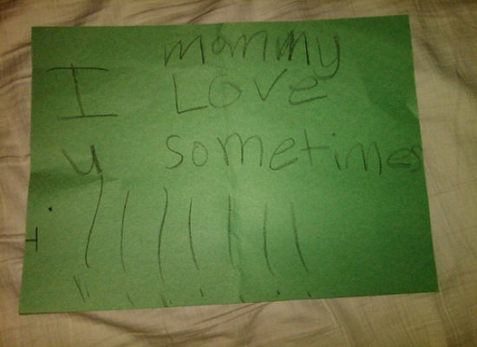
Key #4
Less stable personality patterns and traits.
  Remorse and empathy limitations

Slide 47
Key #5
Current offense ≠ prediction of recidivism

Slide 48
Dynamic
Acute
Alcohol Intoxication
Recent Loss of Job
Stable
Cognitive Distortions
Sexual Deviancy
risk factors that can change
change rapidly
remain unchanged
for years
can’t change with any intervention
Static Factors
Gender
Age
Head Injury
Hx of violence
Victim Type

Slide 49
Relevant Diagnoses
Conduct Disorder
  Psychiatry base rate 2% – 16%
  Convicted adolescents base rate 75% - 90%
Attention Deficit Hyperactivity Disorder
  Combination of ADHD and serious delinquent behavior are at a high risk for developing serious criminal careers into adulthood.
  When conduct problems are controlled, hyperactivity not a good predictor of delinquent behavior.

Slide 50
Psychological
Individual Correlates of Violence
Male
Childhood fighting
Hyperactivity, withdrawn, aggressive
Risk Taking/Impulsivity
Substance Use Difficulties
Anger Management problems
Diverse criminal acts
Lack of guilt or low capacity for empathy, Frick, et al., 2003
Callous – unemotional traits, Frick, et al., 2003

Slide 51
Sociological Correlates of Violence
Childhood history of maltreatment in home
Early caregiver disruption
Poor school achievement
Harsh parenting
Exposure to violence in home
Poverty and social class/community disorganization
Peer group endorsement of violence
Peer rejection
Media – small moderate effect
Early antisocial influences
  Drug availability
  Criminogenic attitudes

Slide 52
Biological Correlates of Violence
Left hemisphere damage
  Verbal functioning
Frontal lobe trauma
  Self-control functions of the brain – frontal and prefrontal

Slide 53
Executive Functioning Deficits
Self-control functions of the brain – frontal and prefrontal in particular is responsible for executive functioning
Deficits in executive functioning and aggression have been found

Slide 54
Pathways of Juvenile Offending
Life Course Persistent
Adolescent Limited

Slide 55
Differences and Similarities between Threat and Risk Assessment

Slide 56
Threat Assessment,
Goodrum et al., 2018
“The threat assessment process seeks to evaluate
the likelihood a person will perpetrate “targeted
violence” (i.e., toward a specific person or group), such as an assassination or a school shooting. In schools, threat assessment procedures seek to evaluate a student’s risk of targeted violence and build a safety plan to support the student.” (pp. 123).

Slide 57
Risk Assessment,
Goodrum et al., 2018
“A risk assessment evaluates the risk and protective
factors present in a person and evaluates the risk for general and specific forms of violence (e.g., intimate partner violence, stalking).” (pp. 123).

Slide 58
Risk v. Threat Assessment (Meloy, et al., 2011)
Violence risk assessment has older provenance
Risk assessment focuses on probability of violence and estimated for an individual based upon his/her comparison to a known group
Typically a history of violence
Classification of low, medium or high risk

Slide 59
Risk v. Threat Assessment (Meloy, et al., 2011)
Threat assessment focuses on targeted violence by a subject of concern and encompasses a behavioral and profiling focus.
Person of focus may have no history of violence.

Slide 60
Differences between TA and RA
Operational context
Dynamic emphasis
Idiographic (case-driven) approach
Very low base rates
Risk management rather than prediction
Subject and potential victim
Predatory (instrumental, intended) violence
Likely urgency

Slide 61
Threat Assessment Model
We don’t focus on predicting what the subject will do in the future. We focus on managing risk for what subject is doing now.
We are not able to anticipate threats with certainty (Meloy, et al., 2014).
We attempt to implement sound practices to identify and intervene with subjects as early as possible on the path toward violence (Cornell, 2010).

Slide 62
Threat Assessment Model
Generally posits that targeted violence is deliberate, planned and well thought out versus expressive/reactive violence
The progress occurs from ideation >> planning >> acquisition>> implementation (Deisinger et al., 2008).

Slide 63
Threat Assessment Model
Pathway to violence is not linear
Iterative such that the person can cycle between the pathway, contingent upon information gathered, increased desperation and monitoring.

Slide 64
Threat Assessment Model
De-emphasizes:
  Psychiatric Diagnoses
  Static variables
  Communicated threats

Slide 65
Implication for Threat Assessment,
(Vossekuil, Fein and Berglund, 2015)
Targeted violence is the end result of an understandable, and often time discernible, process of thinking and behavior.
Targeted violence stems from an interaction among the individual, the situation, the setting, and the target.
An investigative, skeptical, inquisitive mind-set is critical to successful threat assessment.

Slide 66
Implication for Threat Assessment,
(Vossekuil, Fein and Berglund, 2015)
Effective threat assessment is based on facts rather than on characteristics or “traits.”
An integrated systems approach should guide threat assessment inquires and investigations
The central question in a threat assessment investigation or inquiry is whether her person of interest poses a threat, not whether the person of interest made a threat.

Slide 67
Dynamic Factors for
Targeted Violence

Slide 68
Warning Behaviors (Meloy, et al., 2012)
Pathway
Fixation
Identification
Novel aggression
Energy burst
Leakage
Directly communicated threat
Last resort behavior

Slide 69
Warning Behaviors
They are accelerants—focus on accelerating change
Patterns of behavior, not individual risk factors

Slide 70
Pathway warning behavior
Any behavior that is part of research, planning, preparation, or implementation of an attack (Fein & Vossekuil, 1998, 1999; Calhoun & Weston, 2003)

Slide 71
Pathway to Targeted or Intended Violence
Adapted with permission from F.S. Calhoun and S.W. Weston (2003). Contemporary threat management: A practical guide for identifying, assessing and managing individuals of violent intent. © 2003 F.S. Calhoun and S.W. Weston. All rights reserved.
Attack
final acts
Probing & Breaches
Pre-attack Preparation
Escalation
Research & Planning the Attack
De-Escalation
decision
Violent Ideation
The “Grievance”
Notes:
71

Slide 72
Grievance
Loss
Humiliation
Anger
Blame

Slide 73
Fixation warning behavior
    Any behavior that indicates an increasingly pathological preoccupation with a person or a cause (Mullen et al., 2009). It is measured by: a) increasing perseveration on the person or cause; b) increasingly strident opinion; c) increasingly negative characterization of the object of fixation; d) impact on the family of the object of fixation, if present and aware; e) angry emotional undertone. It typically causes deterioration of social and occupational functioning.

Slide 74
Identification warning behavior
    Any behavior that indicates a psychological desire to be a “pseudocommando” (Dietz, 1986; Knoll, 2010), have a “warrior mentality” (Hempel et al., 1999), closely associate with weapons or other military or law enforcement paraphernalia, identify with previous attackers or assassins, or to identify oneself as an agent to advance a particular cause or belief system.
    “A fanatic is never discouraged by the impossibility of his righteous mission.”

Slide 75
Characteristics of Identification
Meloy, Mohandie, Knoll & Hoffman, 2015
Pseudo-commando
Warrior mentality
Close association with weaponry, law enforcement, military paraphernalia
Identify with other attackers or assassins
Become an agent to advance a particular cause or belief system

Slide 76
Weapon Access and Background
What is the subject’s familiarity with weapons?
Do they possess weapons?
Do they seek out weapons?
Frequency of attending gun shows
Do they collect/stockpile ammunition
Do they carry/conceal weapons?
Have they made recent purchases?

Slide 77
Weapon Access and Background
Internet searches for weapons?
Does the subject of interest purchase parts from internet sites “swap meet” sites; etc., craigslist
Is the person purchasing attire/clothing related to identification or “pseudo-commando” goals
Does the subject of interest have relatives who possess guns?

Slide 78
Novel aggression warning behavior
    An act of violence which appears unrelated to any targeted violence pathway warning behavior which is committed for the first time. Such behaviors may be utilized to test the ability (de Becker, JACA) of the subject to actually do a violent act, may be a measure of response tendency, the motivation to act on the environment (Hull, 1952), a behavioral tryout (MacCulloch, Snowden, Wood & Mills, 1983), or proof of kill (G. Deisinger, personal communication, 2011).

Slide 79
Energy burst warning behavior
    An increase in the frequency or variety of any noted activities related to the target, even if the activities themselves are relatively innocuous, usually in the days or weeks before the attack (Odgers et al., 2009).

Slide 80
Leakage warning behavior
    The communication to a third party of an intent to do harm to a target through an attack (Meloy & O’Toole, Behavioral Sciences and the Law, 29:513-527, 2011).

Slide 81
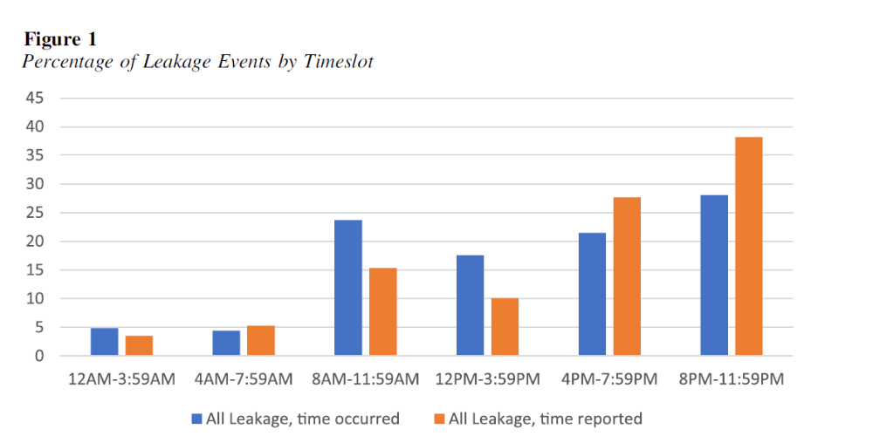
Leakage Warning Behaviors
(Hendrix, et al., 2022)

Slide 82
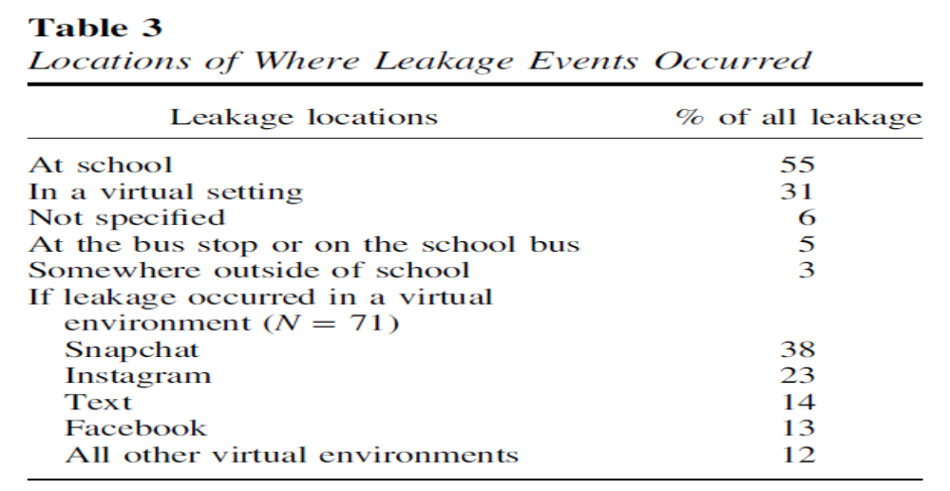




Leakage Warning Behaviors
(Hendrix, et al., 2022)

Slide 83
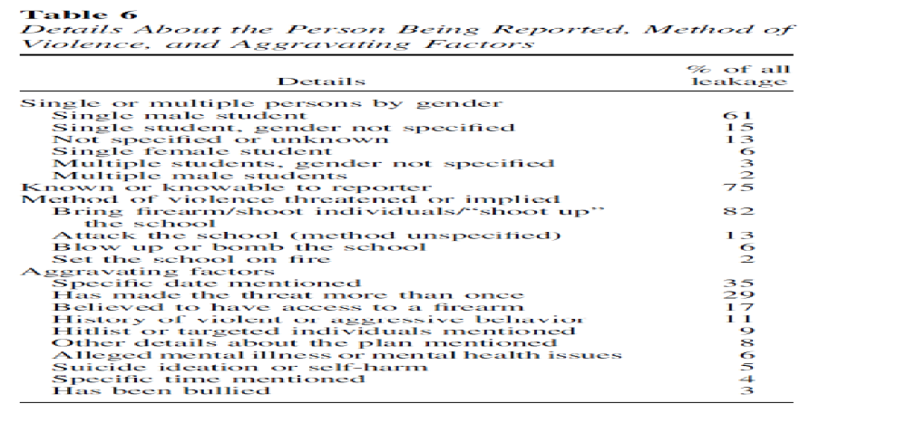
Leakage Warning Behaviors
(Hendrix, et al., 2022)

Slide 84
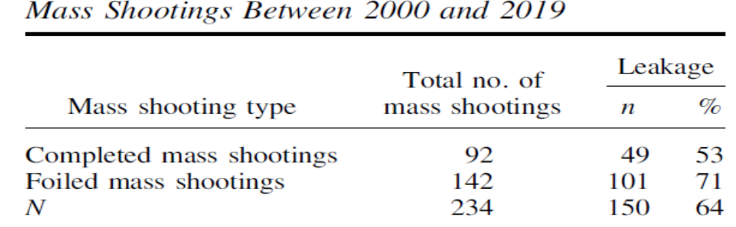
Leakage Warning – Foiled v. Completed
(Silva & Green-Colozzi, 2023)
Foiled were leakage was present, 101 (71%) Completed were leakage was present, 49 (53%)

Slide 85
Leakage Warning – Foiled v. Completed
(Silva & Green-Colozzi, 2023)
Young offenders, those less than 8 years old, co-offenders, and those targeting education locations were significantly more likely to be foiled
Middle-aged offenders (35–44 years old) and those targeting commerce locations and their workplace were significantly more likely to be completed
  in-person leakage was the most common for all mass shooters
  no mode of leakage significantly impacted the likelihood of a mass shooting being foiled
  in-person leakage and written leakage were significantly more likely to contribute to a mass shooting being completed.

Slide 86
Leakage Warning – Foiled v. Completed
(Silva & Green-Colozzi, 2023)
Offenders leaking to their family member, wife/girlfriend, acquaintance/neighbor, and a coworker were significantly more likely to complete their attack
Higher proportion of mass shootings were foiled after leaking to friends and classmates (not significant at p < .05 level)

Slide 87
Leakage Warning Behaviors
1990 to 2014, 58% engaged in some form of leakage (Silver, Horgan, & Gill, 2018)
2000 to 2013 FBI study of active shooters, 56% openly expressed their violent thoughts or intent prior to attacking (Silver, Simons, & Craun, 2018)

Slide 88
Lankford, 2019
Leakage of violent thoughts/intent (87%)
Leakage of specific interest in mass killing (80%)
Concerning behavior reported to LE (80%)
Concerning interest in homicide reported LE (47%)
Firearms in mass shooting acquired legally (80%)

Slide 89
Leakage and Reports to LE
Lankford, 2019
Prevention appears possible in the vast majority of cases
Public should be educated, encouraged, and pressured to report leakage and warning signs to LE
LE needs to be educated and trained on how to more effectively investigate potential threats
Individuals who have admitted homicidal or suicidal thoughts or interest in committing mass shootings should be prohibited from purchasing or possessing firearms

Slide 90
Last resort warning behavior
    Evidence of a violent “time/action imperative” (Mohandie & Duffy, 1999). Increasing desperation or distress through declaration in word or deed, forcing the individual into a position of last resort. There is no alternative other than violence, and the consequences are justified (de Becker, 1997). The subject feels trapped (S. White, personal communication).

Slide 91

“If you have the knowledge and inspiration, all that’s left is to take action.”
      Posted one week before April 15, 2013 Boston Marathon bombing by Dzhokhar Tsarnaev

Slide 92
Directly communicated threat warning behavior
    The communication of a direct threat to the target or law enforcement beforehand. A threat is a written or oral communication that implicitly or explicitly states a wish or intent to damage, injure, or kill the target, or individuals symbolically or actually associated with the target.

Slide 93
Implementation of Threat Assessment and Management

Slide 94
Threat Management Team Make-Up
Case Manager/Team Leader/Lead
Administrative Staff /HR/ER
Teacher/Counselor/Mental Health Professional
Law Enforcement – Security – Campus Police
Attorney
Vetted External referral sources for Threat Assessment
Ad-hoc members, as needed

Slide 95
Threat Assessment Team
(Van der Meer and & Diekhuis, 2014)
Each person/member has identified task/role
Documentation guidelines
Legal issues
Developing timelines
  Constantly monitored and logged/altered with specific dates/times
Managing information
  Ensure validity, reliability
  Maintain position of healthy skepticism
Referral source educated about providing all information
  silo effect

Slide 96
Threat Assessment Logistics
Call from potential referral source.
Determine urgency of matter-can you respond.
Contractual services with retaining party (if necessary).
Identify parameters of assessment.
Conduct assessment.
Provide feedback, orally or in writing.

Slide 97
BTAM Goals
  Piece together information
  Redirect subject of interest’s motion away from the path toward violence.
  Engage in a non-adversarial manner.
  Involves engaging subject of interest.
  Casts a wide net.
  Behavior of team does not exacerbate the situation.

Slide 98
BTAM Role and Responsibilities
Identify prohibited and concerning behaviors
Create central reporting mechanism
Determine level threshold for LE intervention
Establish clear assessment procedures
Develop risk management options
Create and promote safe school climates
Conduct training for all stakeholders

Slide 99
Ongoing Training
Technical vs. Adaptive Solutions
Goodrum, et al., 2018
Technical solutions are addressed with few small adjustments by one authority and within organizational boundaries (e.g., metal detector, video surveillance system).

Slide 100
Ongoing Training
Technical vs. Adaptive Solutions
Goodrum, et al., 2018
Adaptive solutions include number ongoing TA trainings, assessing more students for threats, and increasing the number of indicators on the TAT screener.

Slide 101
Benefit of Adaptive Solutions
(Goodrum, et al., 2018)
Adaptive solutions require multiple authorities, crossover organizational boundaries (e.g., schools, mental health, and criminal justice) but elicit emotional responses, and face resistance.
Adaptive solutions require that school officials share information to promote a “culture of safety,” adopt continuous improvements to threat assessment, monitor quality of threat assessment and engage in safety planning implementation process.

Slide 102
Relevant for K-12 Settings
Behavioral Threat Assessment and Management

Slide 103
PROTECTING AMERICA’S SCHOOLS: A U.S. SECRET SERVICE ANALYSIS
OF TARGETED SCHOOL VIOLENCE (2019)
U.S. Department of Homeland Security UNITED STATES SECRET SERVICE
National Threat Assessment Center
There is no profile of a student attacker, nor is there a profile for the type of school that has been targeted.
Attackers usually had multiple motives, the most common involving a grievance with classmates.
  83% male; 17% female

Slide 104
PROTECTING AMERICA’S SCHOOLS: A U.S. SECRET SERVICE ANALYSIS
OF TARGETED SCHOOL VIOLENCE (2019)
U.S. Department of Homeland Security UNITED STATES SECRET SERVICE
National Threat Assessment Center
Most attackers used firearms, and firearms were most often acquired from the home.
Most attackers had experienced psychological, behavioral, or developmental symptoms.

Slide 105
PROTECTING AMERICA’S SCHOOLS: A U.S. SECRET SERVICE ANALYSIS
OF TARGETED SCHOOL VIOLENCE (2019)
U.S. Department of Homeland Security UNITED STATES SECRET SERVICE
National Threat Assessment Center
Half of the attackers had interests in violent topics.
All attackers experienced social stressors involving their relationships with peers and/or romantic partners.

Slide 106
PROTECTING AMERICA’S SCHOOLS: A U.S. SECRET SERVICE ANALYSIS
OF TARGETED SCHOOL VIOLENCE (2019)
U.S. Department of Homeland Security UNITED STATES SECRET SERVICE
National Threat Assessment Center
Nearly every attacker experienced negative home life factors.
Most attackers had a history of school disciplinary actions, and many had prior contact with law enforcement.

Slide 107
PROTECTING AMERICA’S SCHOOLS: A U.S. SECRET SERVICE ANALYSIS
OF TARGETED SCHOOL VIOLENCE (2019)
U.S. Department of Homeland Security UNITED STATES SECRET SERVICE
National Threat Assessment Center
All attackers exhibited concerning behaviors.
  Most elicited concern from others, and most communicated their intent to attack.

Slide 108
Comprehensive Student Threat Assessment Guidelines (CSTAG)
Step 1:
TAT evaluates the threat by interviewing subject of interest
Document/note exact content of the threat
What have others observed regarding nature of threat and behavior
Gather information on the circumstances in which the threat was made
What are the circumstances in which threat was made – situational context
Is there communication of intent to harm or behavior suggesting intent to harm
In most cases, the threatening student is interviewed and given an opportunity to explain what he or she meant by the threatening statement or behavior.

Slide 109
Comprehensive Student Threat Assessment Guidelines (CSTAG)
Step 2:
All available information is used by the school teams to consider the credibility and seriousness of the threat.
Humor, rhetoric, frustration, reactive situation that can be easily resolved
Does person retract and then apologize for behavior with consistent de-escalation.

Slide 110
Comprehensive Student Threat Assessment Guidelines (CSTAG)
Step 3: TAT respond to a substantive threat
  Take precaution to protect individual
  Warn intended victim and family
  Explore manners to resolve conflict
  Disciplinary procedures, when necessary

Slide 111
Comprehensive Student Threat Assessment Guidelines (CSTAG
Step 4: Serious substantive threats.
  Student screened for mental health services or counseling.
  Potential law enforcement investigation of the case
  Closer examination of probing/planning behavior
  Develop safety plan
  Potential target hardening

Slide 112
Comprehensive Student Threat Assessment Guidelines (CSTAG)
Step 5: Implementation/monitoring safety plan formulated
  Documentation
  Monitoring/surveillance of students
  Assess effectiveness of plan/tactics

Slide 113
SCHOOL THREAT ASSESSMENT IN FLORIDA:
TECHNICAL REPORT OF 2021-2022 CASE DATA,
Jennifer L. Maeng, Dewey G. Cornell, Jordan Kerere, Francis Huang, Timothy Konold, and Kelvin Afolabi 6/1/23
Threat Severity and Safety
No threat (17.8%)
Case readily resolved as a transient (no serious intent) threat (64%)
Substantive cases classified as serious (13.4%; a threat to fight)
Very serious (4.7%; a threat to kill, rape, or use a lethal weapon)
Findings demonstrate the value of using threat assessment to resolve less serious cases efficiently and concentrate more time and effort on serious cases.
Schools relying on a zero tolerance approach would be removing far more students from school.

Slide 114
SCHOOL THREAT ASSESSMENT IN FLORIDA:
TECHNICAL REPORT OF 2021-2022 CASE DATA,
Jennifer L. Maeng, Dewey G. Cornell, Jordan Kerere, Francis Huang, Timothy Konold, and Kelvin Afolabi 6/1/23
Students referred for threat assessment:
  White (37%)
  Black (37%)
  Hispanic (23%)
  Other racial/ethnic groups (4%)
  Approximately 72% were male students
  33% received special education services through an IEP
  9% received services through a 504 Plan

Slide 115
SCHOOL THREAT ASSESSMENT IN FLORIDA:
TECHNICAL REPORT OF 2021-2022 CASE DATA,
Jennifer L. Maeng, Dewey G. Cornell, Jordan Kerere, Francis Huang, Timothy Konold, and Kelvin Afolabi 6/1/23
Comparison of Results of Threat Assessments by Gender and Race/Ethnicity
  Male students were more likely to receive out-of-school suspension than female students, and female students were more likely to receive a legal action than male students
  Small differences in disciplinary outcomes for Black, Hispanic, and White students who received a threat assessment
  OSS were slightly higher for Black students (27.0%), lower for Hispanic students (24.8%) than for White students (25.9%)
  Expulsions were very low overall, but slightly higher for Black (1.9%) and Hispanic (2.0%) students than White (1.2%) students
  Placement changes were 11.1% for Black students, 13.9% for Hispanic students, and 7.2% for White students

Slide 116
SCHOOL THREAT ASSESSMENT IN FLORIDA:
TECHNICAL REPORT OF 2021-2022 CASE DATA,
Jennifer L. Maeng, Dewey G. Cornell, Jordan Kerere, Francis Huang, Timothy Konold, and Kelvin Afolabi 6/1/23
Comparison of Results of Threat Assessments by Gender and Race/Ethnicity
  Some of these comparisons led to significant differences, samples were large, but magnitude was low
  There were no statistically significant differences in law enforcement actions (i.e., arrest, charges, incarceration) for Black, Hispanic, or White students

Slide 117
Threat Management

Slide 118
Identify risk and threat factors
How they manifest in person
How each is relevant
Assessment
Communication
Management
& Treatment
Low, moderate, high
Intensity of Management
Tailored interventions based on risk and threat factors
Application of risk and threat management strategies
Reassessment on regular intervals

Slide 119
Strategy Planning
Monitoring
Surveillance or repeated assessment
Treatment
Rehabilitation, further assessment
Victim Safety Planning
Enhanced security measures, resources for identified targets
Supervision
Imposition of controls, restriction of movement

Slide 120
Developing Scenarios
Douglas, et al., 2013
Consider all past violence, not just recent
Escalation, including worst case scenario
Assess change in motivation, victim selection and behavioral topography
Improvement, including desistance or best case scenario

Slide 121
Hierarchy of Threat Management
(Palarea & Van Horn, 2010)
Incarceration/Jail
Arrest
Hospitalization
Restraining Order/Protection Order
Refer for outpatient mental health counseling
Administrative actions
Ecological/physical measures
Leverage subject of interest’s social network
Notify subject of interest boundaries/consequence
Notify subject of interest about safety measures
Notify target

Slide 122
Target Hardening
Ecological and situational controls
  Reduce opportunity for strangers or subject of interest to access location.
  Availability to access/exits.
  Communication device accessibility.
  Law enforcement presence.
  CCTV systems/monitoring.

Slide 123
Armed Personnel at School
(Peterson, 2021)
N=133 (1980 – 2019)
Identified case where more than one person was intentionally shot in a school building during a school day or a person arrived at school with the intent of firing indiscriminately reported by the public K-12 School Shooting.
Identified offender motive, an armed guard on scene during the shooting, number and type of firearms the perpetrator used.
70% (94) current students
15% (21) former students
76% were Caucasian (83)
98% were male (148)
In n=121 cases with full information (57), 47.11% were targeted shootings

Slide 124
Armed Personnel at School
(Peterson, 2021)
Armed guards were not associated with significant reduction in rates of injuries; in fact, controlling for a number of factors (private v. public, grade level, location type, use of lock down drill, number of weapons brough to scene), the rate of deaths was 2.83 times greater in schools with an armed guard present

Slide 125
School Security Measures
Post-Columbine
King & Bracy, 2019
  School Security Personnel – staff, teachers, aides, administrators – remained relatively stable from 1999 (85.4%) to 2015 (89.5%)
  School Based Law Enforcement – including SRO – 1996/1997 (22%) to 2015/2016 (57%)
  CCTV – in 1999 (19.4%) to 2015/2016 (80.6%)
    Unless cameras monitored-less utility
  Emergency Preparedness – 2015/2016 (94.6%) have drills on lock-down procedures
  Active Shooter Drills - 2015/2016 (92%)

Slide 126
School Security Measures
Post-Columbine
Addington, 2018
  Empirical support is lacking that any of these tactics alone or in combination is effective to prevent school shootings

Slide 127
School Security Measures
Post-Columbine
Addington, 2018
  Empirical support is lacking that any of these tactics alone or in combination is effective to prevent school shootings

Slide 128
Limitations in
Threat Assessment and Management

Slide 129
Threat Assessment
School Violence Prevention (Cornell, 2020)
Limitations in Predicting Violence in School
Low base rate of ordinary acts of violence - extraordinarily lower base rate of mass violence makes the target even smaller “If the bullseye for homicide is miniscule, the bullseye for mass violence is microscopic.” (pp. 239)

Slide 130
Threat Assessment
School Violence Prevention (Cornell, 2020)
Limitations in Predicting Violence in School
Perpetrators of mass violence are heterogeneous

Slide 131
Threat Assessment
School Violence Prevention (Cornell, 2020)
Limitations in Predicting Violence in School
Identification of reliable risk factors unlikely unless one subdivides the small group into even smaller groups. The microscopic bullseye must be fragmented into pieces that are placed on different targets

Slide 132
Threat Assessment
School Violence Prevention (Cornell, 2020)
Limitations in Predicting Violence in School
Barrier to research is that efforts to validate the accuracy of violence predictions are ethically constrained. It is not permissible to conduct a prospective study to test the accuracy

Slide 133
Bias - 101
Term “bias” has its roots in the French biais
Greek, epikarsios, which refers to “oblique”
Currently refers to deviations from the norm

Slide 134
Bias - 101
The Heuristics & Biases (HB) focused on limitations of and systematic errors in human cognition (Tversky & Kahneman, 1974; Kahneman, 2011; Kahneman, Slovic, & Tversky, 1982)

Slide 135
Bias - 101
Naturalistic Decision Making (NDM) developed as reaction to HB’s narrow focus on problems in cognition
NDM focused on the strengths and evolutionary adaptiveness of human cognitive capacities (see, e.g., Gigerenzer & Goldstein, 1996; Lipshitz, Klein, Orasanu, & Salas, 2001)
Posit that our brains have adapted to process information in a fast and frugal way—quickly making sense of the vast amount of information

Slide 136
Disagreement & Bias
(Guarnera et al., 2017)
Potentially linked to five sources
Inherent task difficulty
Limited training and certification
Unstandardized methods
Individual evaluator differences
Adversarial allegiance

Slide 137
Confirmatory Bias—how we seek to protect our beliefs
We notice facts to support our beliefs
We overlook facts that don’t
We seek information to support our beliefs
We give greater weight to such information
We accept at face value such information
We are better able to remember such information

Slide 138
Additional Biases
Google Bias
  Tendency to not remember information is easily found online – (cell phones)
Ikea Effect
  Tendency to overvalue something that we put together

Slide 139
Anchoring Bias
Our propensity to rely too heavily on initial information or salient numbers present in a decision context when making judgments (Tversky and Kahneman, 1974)
Overlaps with the priming effect
Can be linked to availability heuristic

Slide 140
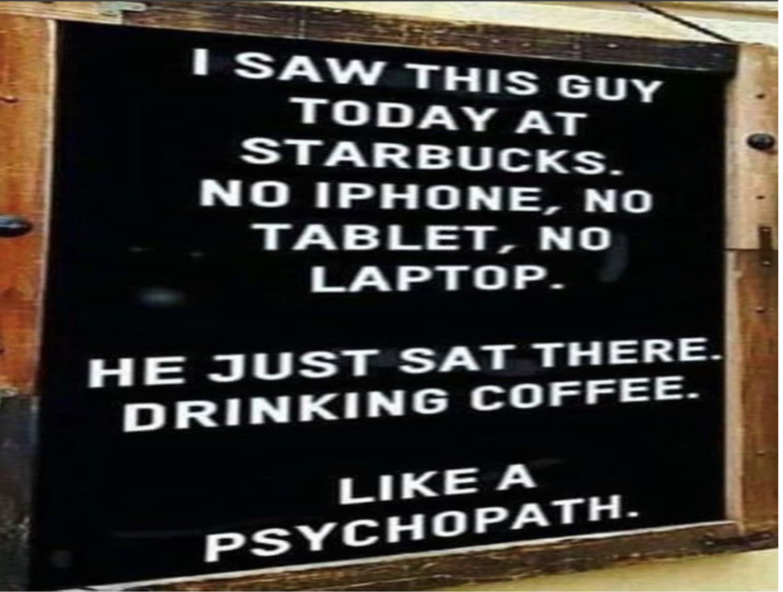

Slide 141
Halo Effect
Propensity for the initial impression of a person to influence what we think of them overall
"physical attractiveness stereotype"
"what is beautiful is 'good' principle“
Impact of physical attractiveness/appearance

Slide 142
Hindsight Bias
Tendency to overestimate the probability that an event could have been predicted once its outcome is known (Fischhoff, 1974)

Slide 143
Inductive (Abductive) Reasoning
  Transition from one particular facts about a case to a general principal

Slide 144
Bias Blind Spot
The bias blind spot a meta-cognitive bias, describes peoples’ tendency to recognize the impact of cognitive biases on others more than themselves. (Pronin et al., 2002)

Slide 145
Allegiance Effect
Unconsciously draw conclusions that support the view of their referral source – when/if criminal or civil matters are pending

Slide 146
Base Rate Bias/Fallacy
Propensity to ignore the base rate or what is considered general prevalence in favor of the individuating information or information pertaining only to a specific case
Predictive attempts will result in too many false positives due to low base rate for targeted violence
We will never know the targeted acts we prevented

Slide 147
Debiasing – Motivational Cognitive Technological
(Croskerry et al., 2013; Soll et al., 2015, Larrick et al., 2004; Lerner & Tetlock, 1999;
Dawes, et al., 1989)
Motivational strategies aim at reducing errors in decision making by raising the stakes—for instance, by holding people accountable for their decisions
  Accountability, such as the expectation of having to justify a decision later on, can help people to recognize flaws in their argumentation and thus reduce the effect of various biases

Slide 148
Debiasing – Motivational Cognitive Technological
(Croskerry et al., 2013; Soll et al., 2015, Larrick et al., 2004; Lerner & Tetlock, 1999;
Dawes, et al., 1989)
Cognitive strategies such as “consider-the-opposite” can also counteract biases
  Data shows that asking oneself why an initial judgment might be wrong and considering possible alternatives is a promising method to minimize the effects of cognitive biases

Slide 149
Cognitive Biases – Human Judgement
(Neal et al., 2022)
Study focused on systematic rev. of empirical research on
  impact of cognitive biases on forensic mental health experts
  debiasing techniques

Slide 150
Cognitive Biases – Human Judgement
(Neal et al., 2022)
k=22 studies (23% before 2010)
k=16 biases examination only (allegiance effect most often examined)
k=6, biases and debiasing
17 studies that tested for a significant effect of biases, most (k = 10, 58.8%) found an effect
Term “bias” not defined similarly or uniformly across studies
Based on meta – analysis; no general definition for bias was provided in 64% of the records

Slide 151
Debiasing – Blinding
(Neal et al., 2022; Robertson & Kesselheim, 2016)
Blinding, or not exposing people to task-irrelevant information in the first place (rather than correcting for such after the fact), is likely the most promising strategy for eliminating exposure-induced biases
Professionals are reticent about adopting blinding procedures for various reasons, such as conceptual, practical, and logistical barriers to blinding in real-world forensic settings and loss of relevant records/documents or review

Slide 152
Debiasing – Linear Sequential Unmasking
(Neal et al., 2022; Dror & Kukucka, 2021; Dror et al., 2015; Krane et al., 2008 )
Graded blinding procedure
Professionals make initial judgments based on the most probative and least biasing information first, followed later by “unmasking” information with more biasing potential that is nevertheless probative or practically difficult to blind entirely

Slide 153
Debiasing – Linear Sequential Unmasking
(Neal et al., 2022; Dror & Kukucka, 2021; Dror et al., 2015; Krane et al., 2008 )
Professionals may conduct an initial interview with an individual before reading others’ opinions in previous records (reducing potential anchoring effects) or conduct the evaluation while blind to an another professional retained by possible adversarial source

Slide 154
Relevant Cultural Considerations
(Shepherd & Lewis-Fernandez, 2016)
Ewert v. Canada (Correctional Service) 2018 SCC 30 Judgment on 6/13/18; On Appeal from the Federal Court of Appeal
9/18/15; Canadian court strongly cautioned the continued use of five risk instruments (Hare Psychopathy Checklist Revised [PCL-R], Violence Risk Appraisal Guide [V-RAG], Sex Offender Risk Appraisal Guide [SORAG], Static 99, Violence Risk Scale—Sex Offender [VRSSO]) by the Correctional Service Canada (CSC)1 with Aboriginal inmates
The court argued that the research base supporting the psychometric properties of the five above instruments with Canadian Aboriginal prisoners was currently inadequate
Additionally, actuarial tests were accepted by the court as susceptible to cultural biases and were therefore viewed as unreliable predictors of re-offense for Aboriginal inmates

Slide 155
Ewert v. Canada (Correctional Service) 2018 SCC 30 Judgment on 6/13/18;
On Appeal from the Federal Court of Appeal
Writing for the majority, Justice Richard Wagner granted Mr. Ewert a declaration that CSC was not obeying the law
CSC hadn’t taken reasonable steps to make sure its tools gave accurate and complete results for Indigenous offenders
Concerned about the growing gap between how Indigenous and non-Indigenous offenders are treated in the criminal justice system
CSC knew there were concerns about the tools, but it continued using them anyway
Justice Wagner, along with six Justices concurred

Slide 156
Relevant Cultural Considerations
(Shepherd & Lewis-Fernandez, 2016)
International meta-analyses have demonstrated that risk instrument validity diminishes as samples approach greater ethnic heterogeneity
Data for equivalent cross-cultural predictive validity of risk assessment instruments is unclear due to restricted and varied nature of the available findings precludes an assertion that instruments commensurately extend to minority groups

Slide 157
Relevant Cultural Considerations
(Shepherd & Lewis-Fernandez, 2016)
Asserting that all instruments extend to minority groups is possibly premature given that minority groups do not receive the levels of representation in validation studies typically afforded to White populations
Data derived from risk instruments often influences client liberties and treatment decisions—if instruments are consistently less accurate for particular cultural groups, then individuals from such groups may be legally and/or medically disadvantaged by their use

Slide 158
Threat Assessment
Cultural Considerations (Hart, 2016)
Identify potential diversity issues that may bias evaluator.
When potential diversity issues exist, evaluator is responsible for education about impact the diversity will have on assessment process (lit. review, colleagues).
Decline case if do not have requisite skills; decline to use instrument/assessment procedures, cautionary statements, identifying limitations.

Slide 159
Threat Assessment-Cultural Considerations (Weiss and Rosenfeld, 2012)
Consider one’s own cultural competence prior to accepting a referral.
Level of acculturation should be considered when administering psychological tests to an individual from another culture.
If interpreters are used, they must be objective, well trained, and provide a verbatim translation of the evaluatee’s responses.

Slide 160
Threat Assessment-Cultural Considerations (Weiss and Rosenfeld, 2012)
Evaluators must consider the reliability and validity of measures used with respect to an evaluatee’s group membership.
The evaluator must acknowledge when the psychometric challenges for use of a measure are insurmountable. If the lack of reliability and validity data prohibit the use of a measure, the evaluator may be forced to rely on other sources (e.g., clinical and collateral interviews, medical and criminal justice records).

Slide 161
Documentation http://www.studentthreatassessment.org/

Slide 162
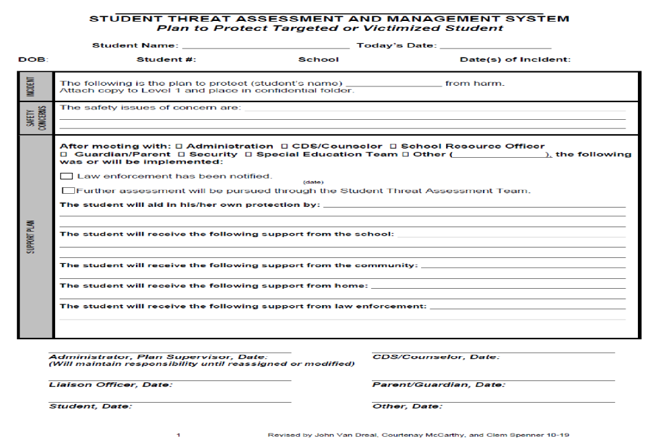

Slide 163
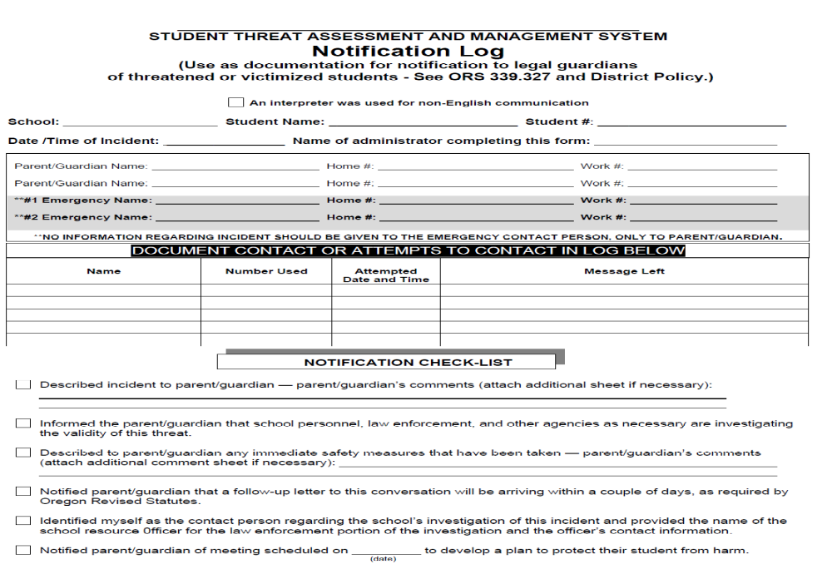

Slide 164
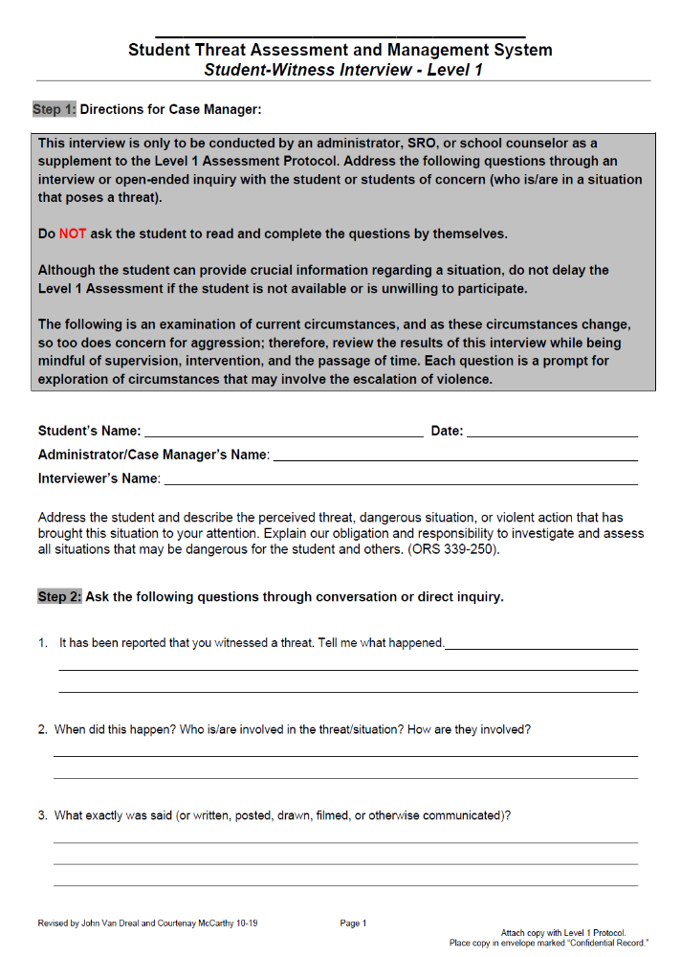


Slide 165
Risk Assessment (not threat☺)
Structured Professional Judgment

Slide 166
Structured Assessment of
Violence Risk in Youth
(SAVRY)

Slide 167
Structured Assessment for Violence Risk in Youth (SAVRY)
Borum, R., Bartel, P., & Forth, A. (2006). Structured Risk Assessment in Youth: Professional Manual. Lutz, FL: Psychological Assessment Resources, Inc.
Focus is on General Risk Assessment
  Structured Professional Judgment
  Systematic
  Empirically Grounded
  Developmentally Informed
  Treatment-Oriented
  Flexible
  Practical
Notes:
Modeled after existing SPJ protocols for adult risk assessment, the SAVRY consists of 24 different risk items and 6 protective items that are derived from existing research and professional literature. Risk items provide a rating choice of either low, moderate, or high, while protective items provide a choice of either present or absent. It is specifically intended to assess the risk of violence in adolescents between the ages of 12 and 18 in order to determine the degree of possible future violence. The purpose of its design is to guide professionals from a variety of disciplines in both risk assessment and intervention planning for the troubled youth. Authors aimed for an assessment guide that was systematic, empirically grounded, developmentally informed, treatment-oriented, flexible, and practical. Systematic in that there are clear cut operational definitions for each primary factor, empirically grounded in that the items of the assessment are based on the best available research in the field, developmentally informed in that both risk and protective factors are the best fit for adolescents, as opposed to small children or adults, treatment-oriented in that the assessment must provide suggestions for treatment, flexible in that it allows for case-specific factors, as well as those grounded in research, and finally practical in that, it should take a certain amount of time to complete the assessment and any additional time after that is really not necessary.

Slide 168
What does the SAVRY measure?
Juvenile risk for violence
Not designed for threat assessment
Notes:
What does the SAVRY measure?
Juvenile risk for violence (used to assist professional evaluators in assessing and making judgments about a juvenile’s risk for violence)
Violence defined (an act of battery or physical violence that is sufficiently severe to cause injury to another person or persons (e.g., cuts, bruises, broken bones, death), regardless of whether injury actually occurs; it is any forcible act of sexual assault; a threat made with a weapon in hand. Should be of sufficient severity that criminal charges either do, or could, result. What is not considered violence: accidental or unintentional injury; or threats in the absence of physical violence; possession of weapon unless used on someone or threatens someone with it.
Reactive Aggression (impulsive; hostile; occurs in response to perceived threat or provocation (real or imagined) Studies show tends to be more girls.
Proactive Aggression (instrumental, controlled, and predatory aggression; violence is goal directed and used as an instrument or tool to achieve a goal other than the physical harm of the victim; do not occur in response to perceived provocation, not impulsive; no high levels of angry arousal). Studies show tends to be more boys.
Dangerousness or “risk” as a construct is now viewed as contextual, or highly dependent on situations and circumstances; it is dynamic, subject to change; continuous.
Used to be many false positives when assessing dangerousness. Now accuracy in prediction is better.

Slide 169
Why was the SAVRY developed?
To assist in structuring risk assessment
Useful in intervention planning/monitoring Resource Management
Considers developmental factors
Notes:
Why was the SAVRY developed?
Adult version not adequate (HCR-20) (contextual/dynamic risk factors equally if not more predictive of future violence than historical risk factors)
Considers developmental factors (time of significant change: physically, intellectually, socially, emotionally. Most youth who are violent during adolescence do not persist in this behavior later in life; nature and degree of violence risk may frequently change or vary; personality traits much less stable than that of adults; makes adolescents “moving targets” and more difficult to characterize based on observations made at any single point in time.)
To assist in structuring assessment
Useful in intervention planning/monitoring (emphasis is on dynamic factors)
An increase in youth violence has led to an emphasis on assessing and reducing violence.
Public attention to mass murders within schools increased the need for proper assessment tools.
Developed by Randy Borum, Patrick Bartel, and Adelle Forth

Slide 170
SAVRY- Population of Use
12-18 years old
Males and females
Juvenile justice system
Psychiatric inpatient/outpatient
Educational settings
Minority youth
Notes:
Who is the SAVRY used with?
Adolescent population
Between the 12-18 years old (can be used in slightly older or slightly younger, it’s not recommended. Suggest to use other SPJs, HCR-20: Assessing Risk for Violence or the Early Assessment Risk List for Boys/Girls: EARL-20B or EARL-21G)
Males and females (research has shown that many risk and protective factors are similar) (exceptions: trauma, particularly sexual abuse, and caregiver disruption has greater impact on girls)
Juvenile justice system (context)
Psychiatric inpatient/outpatient (context)
Educational settings (context) (helpful w/ bullies who can become future adult criminals; will be drawn out due to anti-bullying legislation; intervene here)
Minority youth (not a lot of studies done; however, it was found that items and ratings work with minority youth.)
Not systematically biased against minority youth, esp. African American and Hispanic)

Slide 171
SAVRY-General Principles
Administered by trained probation officers, psychologists, social workers, and psychiatrists.
Structured interviews, family reports, criminal records, probation reports, and other relevant records from the juvenile.
Coded/scored by hand on the SAVRY Rating Form.

Slide 172
Considerations/Limitations
Might not be appropriate for assessing targeted violence
Important to re-assess at regular intervals
Use additional sources to rate items
Most research has been done with males
User qualifications are important
Notes:
Considerations/Limitations
Might not be appropriate for assessing targeted violence (threat of harm to an identified or identifiable person; this requires different approach. Targeted: objective is to appraise whether youth is on path toward violent act against a person or entity, not just whether he may be violent in general.)
Important to re-assess at regular intervals (focus primarily on changes that have occurred in dynamic risk factors, individual or social/contextual, that might lessen or exacerbate risk; important for youth identified as high risk or preceding any transitional stage, transfer to community w/ less supervision)
Most research has been done with males (if a risk factor is known to apply differently to males vs. females, it is noted in the specific item description in the Professional Manual)
User qualification important (must be used by professionals with expertise in conducting individual assessments, in child/adolescent development, and in youth violence)
Use additional sources to rate items (self report, parent/guardian reports, teacher reports, social worker reports, police reports, probation reports, psychological and psychiatric evaluations, school records, juvenile justice records, mental health and/or medical records)

Slide 173
SAVRY Structure - Items
24 Risk Items
  Historical (10)
  Social/contextual (6)
  Individual/clinical (8)
6 Protective Factor Items
Additional Risk Factors
Notes:
SAVRY Structure (cont’d)
24 Risk Items
Historical (looks at prior episodes of violence)
Social/contextual (looks at influence of interpersonal relationships, connection to social institutions, and the environment)
Individual/clinical (looks at youth’s attitudes and key aspects of psychological and behavioral functioning)
6 Protective Factor Items (factors that can reduce the negative impact of (i.e., buffer) a risk factor or otherwise act to diminish the probability of a violent outcome) Examples: strong social support; strong attachment & bonds; resilient personality traits.
Additional Risk Factors (evaluator can list additional factors or situational variables that come up during the assessment that are not listed in any of the risk items or protective factors: example: severe pattern of animal cruelty (not enough research linking animal cruelty to violence to warrant it’s own item)

Slide 174
SAVRY Structure and Scoring
24 risk items that would predict to put the youth at risk for violence
6 protective factors that can influence whether or not the youth will be more at risk for violence.
Rated on a scale of Low, Moderate, and High and are decided by structured judgment from the person giving the test with all the available information.
Six Protective Factors are rated on whether they are absent or present.

Slide 175
SAVRY Structure
Risk Items—3 level rating structure
  Low
  Moderate
  High
Notes:
SAVRY Structure (cont’d)
Risk Items—3 level rating structure (not assigned numerical value; no specified cutoff scores, no data available about degree to which SAVRY rated items correspond to percentile rankings or relative base rate position (at, above, below) for specified reference groups)
Low (when the characteristics or circumstances are not present)
Moderate (risk factor is present to some degree and/or is not severe enough or causes only minor impairment)
High (if the characteristic is prominent and/or is severe or causes significant impairment)

Slide 176
SAVRY Structure
Protective Factor Items—2 level rating structure
  Present
  Absent
Notes:
SAVRY Structure (cont’d)
Protective Factor Items—2 level rating structure (the evaluator must consider whether the factor has been active or present during the preceding year)
Present
Absent

Slide 177
Limitations
Male-centric (can be used on both genders, but most research was on males)
No specific cutoff scores=they cannot equate results to numerical scores as accurately or validly
Dynamic factors are constantly changing- assessment needs to be repeated regularly
Could be viewed as a subjective test from interviewer to interviewer

Slide 178
Historical Risk Factors
History of Violence
History of Nonviolent Offending
Early Initiation of Violence
Past Supervision/Intervention Failures
History of Self-Harm or Suicide Attempts
Exposure to Violence in the Home
Childhood History of Maltreatment
Parental/Caregiver Criminality
Early Caregiver Disruption
Poor School Achievement
Notes:
Historical Risk Factors (is based on past behavior or experiences, they are generally static and not subject to change. History is important because it shares a link to recidivism)
History of Violence (prior violent behavior, looking at frequency and severity not just criminal history)
History of Nonviolent Offending (anti-social behavior and/or prior arrests, linked to violence, however not a good predictor of severity of subsequent violence)
Early Initiation of Violence (earlier onset greater overall frequency of violence)
Past Supervision/Intervention Failures (failed to comply with rules and expectations of correctional and mental health services, or failure to comply with court order)
History of Self-Harm or Suicide Attempts (history of suicide attempts or self harm linked to future violence)
Exposure to Violence in the Home (not directly involved but witnessed, family discord, conflict, violent relationships, aggression. Consider aggression as an acceptable method for dealing with interpersonal conflict, violence is reinforced)
Childhood History of Maltreatment (being a victim of abuse induces predisposing experiences, physical abuse, neglect)
Parental/Caregiver Criminality (parental antisocial behavior and maladjustment within the family system, parental criminality increases risk for violent crime of the child)
Early Caregiver Disruption (early separation from parents or caregivers associated with higher risk for violence, living in a broken or single parent home)
Poor School Achievement (academic failure beginning in the elementary grades is associated with an increased risk for later violence and delinquency)

Slide 179
Social/Contextual
Risk Factors
6 items
  11. Peer Delinquency
  12. Peer Rejection
  13. Stress and Poor Coping
  14. Poor Parental Management
  15. Lack of Personal/Social Support
  16. Community Disorganization
Notes:
These factors look at the adolescent’s relationships and environment around them.

Slide 180
Individual/Clinical
Risk Factors
8 items
  17. Negative Attitudes
  18. Risk Taking/Impulsivity
  19. Substance Use Difficulties
  20. Anger Management Problems
  21. Low Empathy/Remorse
  22. Attention Deficit/Hyperactivity Difficulties
  23. Poor Compliance
  24. Low Interest/Commitment to School
Notes:
These factors analyze the individual’s general attitude, as well as important psychological and behavioral aspects of functioning.

Slide 181
Individual Risk Factors
Negative Attitudes – antisocial attitudes or social cognitive deficiencies.
  Lo – Attitudes do not support the legitimacy of crime or violence and can generate non aggressive solutions to problems.
  Mod – Some attitudes support the legitimacy of crime or violence and has some problems generating non aggressive solutions to problems.
  Hi – clearly endorses attitudes and values that condone violence and has severe difficulty in generating non aggressive solutions to problems.

Slide 182
Protective Factors
6 items
  Prosocial Involvement
  Strong Social Support
  Strong Attachment and Bonds
  Positive Attitude Toward Intervention and Authority
  Strong Commitment to School
  Resilient Personality Traits
Notes:
The protective factors are considered a short of “buffer” and while the risk factors help professionals determine the likelihood of violence, the protective factors work to reduce their negative impact. In some instances, the factors in this section are also integrated into the youth’s treatment and/or intervention plan.

Slide 183
SPJ Risk Assessment
Younger Age Children
Early Assessment Risk List Version 3
(Augimeri, et al., 2021)
    School settings and community

Slide 184
EARL-Version 3
Augimeri, Smaragdi, Walsh, Koegl, Webster, 2021
  Theoretically and empirically grounded items
  Utilized to identify intervention strategies
  Especially helpful in identifying children who are high risk
  Structured professional judgment
  Up to age 12
  No overall score

Slide 185
EARL-V3
Three Sections
Family Factors, F (9 items)
Child Factors, C (9 items)
Barriers to Treatment, B (3 items)

Slide 186
Family Items
Unsafe/Under Resourced Neighborhood
Disadvantaged Household
Insufficient Supports
Stressors
Caregiver Discontinuity
Unhealthy Caregiver-Child Relationships
Maladaptive Parenting Style
Parental Mental Health Problems
Antisocial Values and Conduct

Slide 187
Child Items
Antisocial Attitudes and Thinking
Antisocial Behavior
Impaired Emotional Recognition
Poor Self Control
Trauma
Problems with Sexual Behavior
Negative Peer Relationships
Academic Under-Performance
Perceived as Unlikeable

Slide 188
Barriers to Treatment Items
Barriers to Treatment-Family
Barriers to Treatment-Child
Barriers to Treatment Community

Slide 189
Child Items
Antisocial Behaviour
Severity of behavior, number of behaviors and context/settings
2=one or more serious antisocial act (e.g., assault, bodily harm) or several antisocial acts across settings or diagnoses of CD and ODD
1=engaging in milder forms of antisocial behavior (e.g., theft, vandalism); occur in one or two settings
0=exhibits no conduct problems that are of concern

Slide 190
Child Items
Coping Abilities
are coping abilities adequate for current surroundings, self-confidence, self-discipline, positive outlook and sense of control over events
2=unable to cope with most dimensions in various dimensions
1=able to perform tasks without too much difficulties, some signs of depressive symptoms
0=regardless of life circumstances, able to adapt well
Notes:
Are

Slide 191
Responsivity Items
Family Responsivity
Motivation to participate in treatment
2=reserved for families where there is a clear indication that parents are reluctant to engage in treatment; not likely to follow through, minimize problems faced by child
1=some resistance to treatment, can be difficult to engage, guarded, inconsistent
0=able to work collaboratively, make necessary effort to modify behavior

Slide 192
Responsivity Items
Child Responsivity
Child’s motivation levels
2=clearly opposed to reasonable interventions, difficult to engage, uninterested, uncooperative
1=guarded or resistant, but able, at least minimally, to participate in treatment
0=clearly responsive to treatment and interested in changing behavior

Slide 193
Overall Clinical Judgment
Low, moderate or high
Total score not as important – may be instance when a low scoring child is deemed “high risk”
Generally, speaking a child coded with a higher score is more likely to present a higher risk
Critical items
  Distinctively important to child’s risk – idiographic in nature

Slide 194
THANK YOU!
kostas@drforensic.com

