Slide 1
Threat Assessment and Management in K-12 Settings
Nassau County BOCES
September 23rd and October 13th, 2022
Kostas A. Katsavdakis, Ph.D., ABPP
Diplomate in Forensic Psychology
Center for Forensic and Clinical Psychology
New York City
kostas@drforensic.com
Notes:
Understanding a book contract is not difficult -- but it does require reading a lot of fine print.
To illustrate the typical book contract, we have a handout today of the standard 4-page agreement issued by American Psychiatric Press, Inc.
Book publishers like to use a “boilerplate” contract because it is basically a form that specifies the publisher’s usual terms.
Blanks in the form are then filled in with specific details for each new author and work.

Slide 2
Outline of Presentation
Affective and Predatory Modes of Violence
Biopsychosocial Factors Associated with Violence in Juveniles
Differences between Risk and Threat Assessment
Warning Behaviors for Targeted Violence
Implementation of Threat Assessment Management Team
Risk Assessment – Structured Professional Judgment
Case Practice/Samples

Slide 3
There is no “profile” of a
student attacker

Slide 4
National Institute of Justice • Strengthen Science • Advance Justice
August 2022 NCJ 305045
Most people who commit a mass shooting are in crisis leading up to it and are likely to leak their plans to others, presenting opportunities for intervention.
Everyone can help prevent school mass shootings.
Threat assessment is a promising prevention strategy to assess and respond to mass shooting threats, as well as other threats of violence by students.
Individuals who commit a school shooting are most likely to obtain a weapon by theft from a family member, indicating a need for more secure firearm storage practices.
The overwhelming majority of individuals who commit K-12 mass shootings struggle with various aspects of mental well-being.

Slide 5
New Jersey
Bill A4075/3229 AcsAaAca (ACS/2R)
Session 2022 – 2023 (signed into law 8/1/22 – unanimous passage in legislature)
Requires all public school districts to create school-based threat assessment teams to help identify and assess students at risk of committing violent acts or other harmful activity.
  Need to be in place by the start of the 2023-24 school year.
TAT required to multidisciplinary and include to the extent possible a school psychologist, counselor or social worker, a teacher, an administrator, and a school resource officer or school employee who serves as a liaison to law enforcement.
Training must ensure that threat assessments don’t have a disparate impact on students based on their race, ethnicity, homelessness status, religious belief, gender, gender identity, sexual orientation and socioeconomic status.

Slide 6
Which states require in-school threat assessment teams?
  According to the National Association of State Boards of Education (NASBE)'s State Policy Database, threat assessment is required by law in:
  18 states
  encouraged in five states
  non-codified policy in 16 states

Slide 7
New York, 2022
Executive Order 18 (signed on or about 8/18/22)
10 million dollars to Requiring Each County and the City of New York to Develop Plans to Confront Domestic Terrorism, Including Racially and Ethnically-Motivated Violence
  Does not include K-12 settings

Slide 8
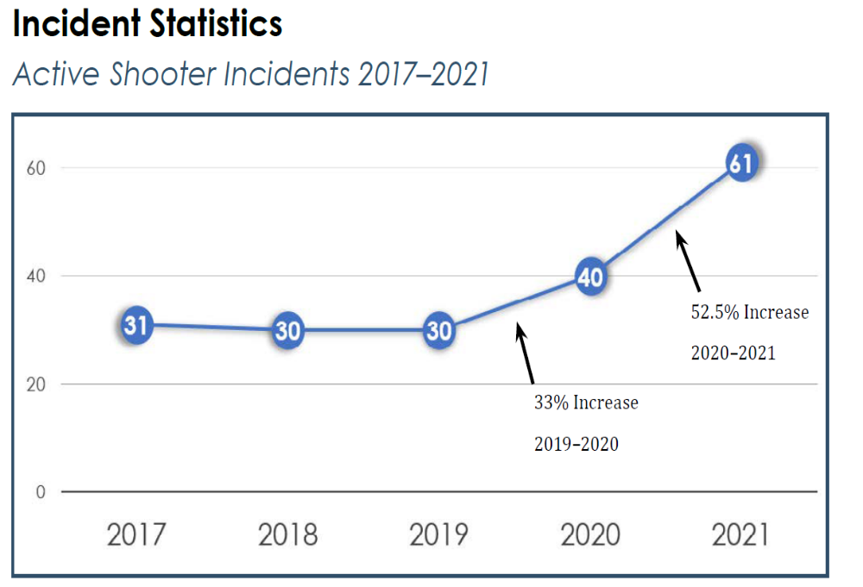
FBI Active Shooter Criteria
Shootings occurring at more than one location
Shootings where the shooter’s actions were not the result of another criminal act
Shootings resulting in a mass illing4
Shootings indicating apparent spontaneity by the shooter
Shootings where the shooter appeared to methodically search for potential victims
Shootings that appeared focused on injury to people, not buildings or objects
Active Shooter Incidents in the United States, 2021, United States Department of Justice, FBI

Slide 9
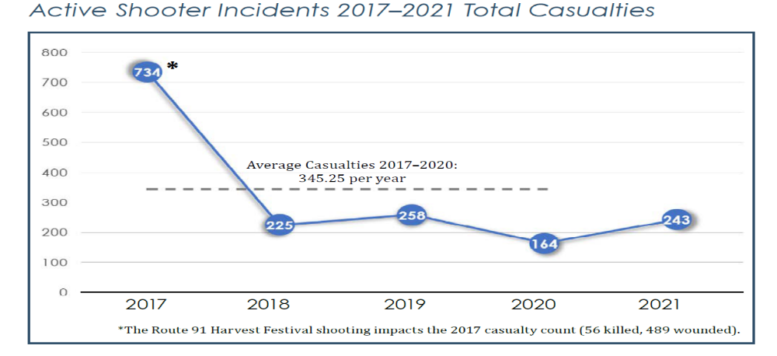
Active Shooter Incidents in the United States, 2021, United States Department of Justice, FBI

Slide 10
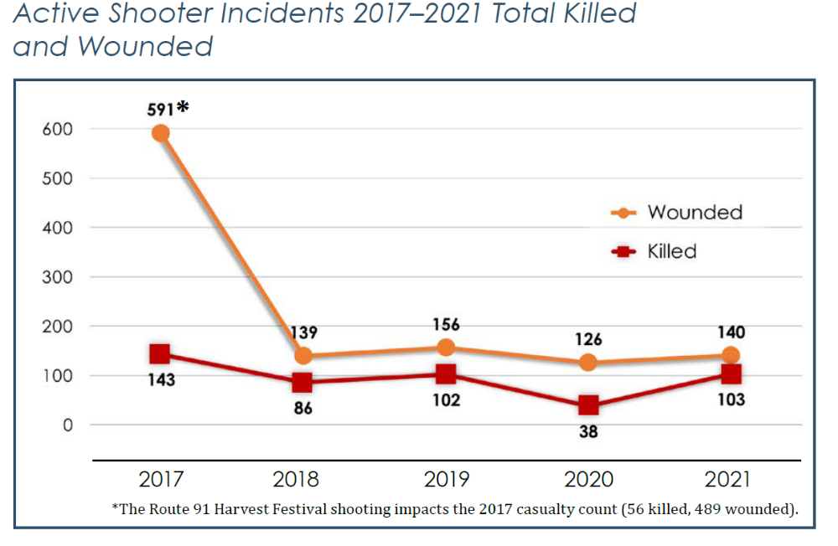

Slide 11
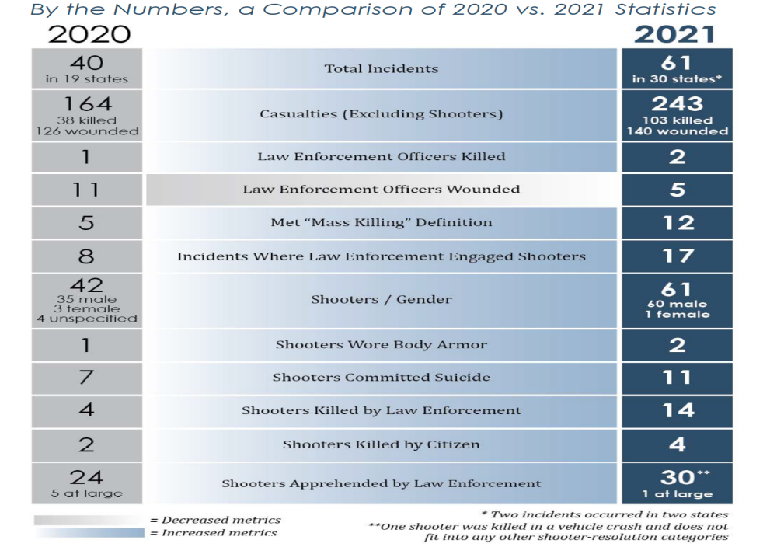

Slide 12
PROTECTING AMERICA’S SCHOOLS: A U.S. SECRET SERVICE ANALYSIS
OF TARGETED SCHOOL VIOLENCE (2019)
U.S. Department of Homeland Security UNITED STATES SECRET SERVICE
National Threat Assessment Center
2008 to 2017 (Targeted school violence) N=41 (January 2008 – December 2017)
(i) a current or recently former K-12 school student
(ii) purposefully used a weapon
(iii) to cause physical injury to, or the death of, at least one other student and/or school employee
(iv) in or on the immediate property of the school (v) while targeting in advance one or more specific and/or random student(s) and/or employee(s).
Excluded: perpetrator could not be identified, incidents related to gang violence, drug violence, or other incidents with a strong suggestion of a separate criminal nexus, violence from the surrounding community that spilled onto school property by happenstance, spontaneous acts, such as those that were the immediate result of an unplanned fight or other sudden confrontation.

Slide 13
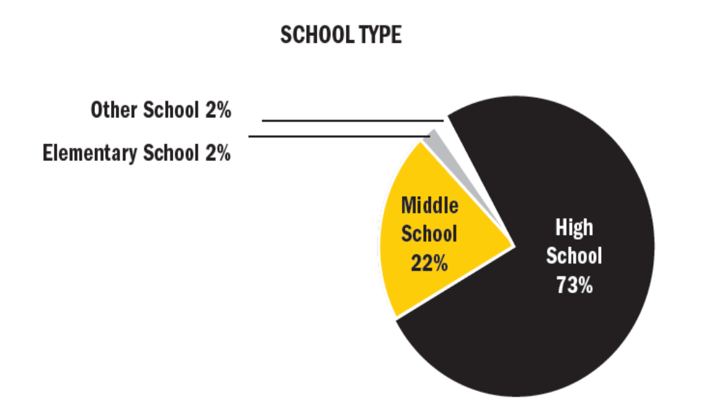
PROTECTING AMERICA’S SCHOOLS: A U.S. SECRET SERVICE ANALYSIS
OF TARGETED SCHOOL VIOLENCE (2019)
U.S. Department of Homeland Security UNITED STATES SECRET SERVICE
National Threat Assessment Center

Slide 14
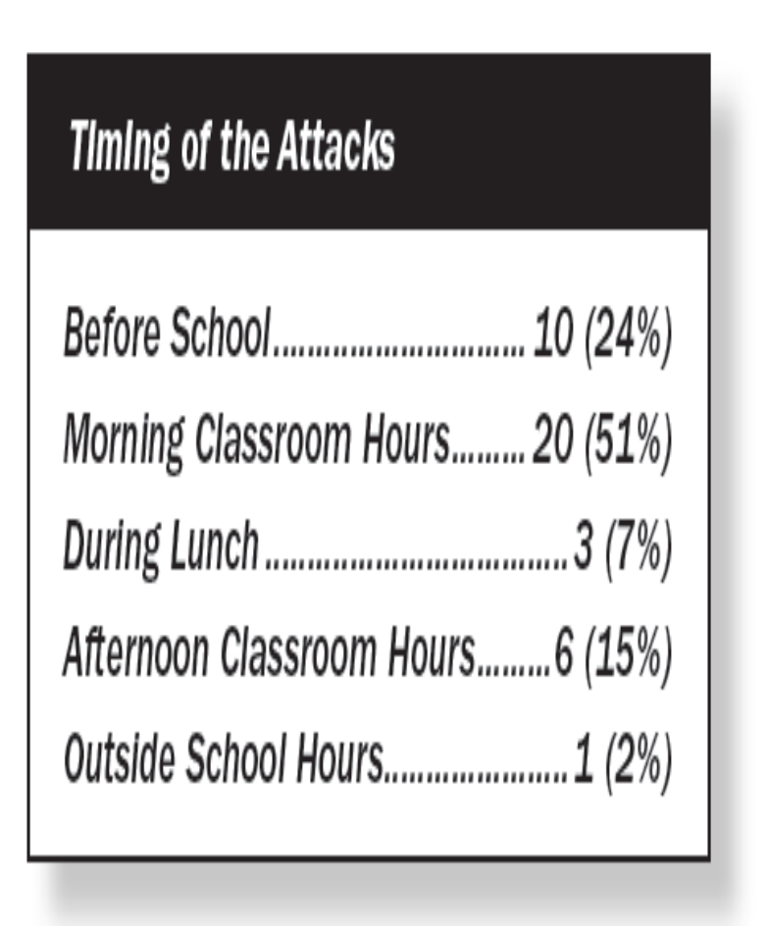
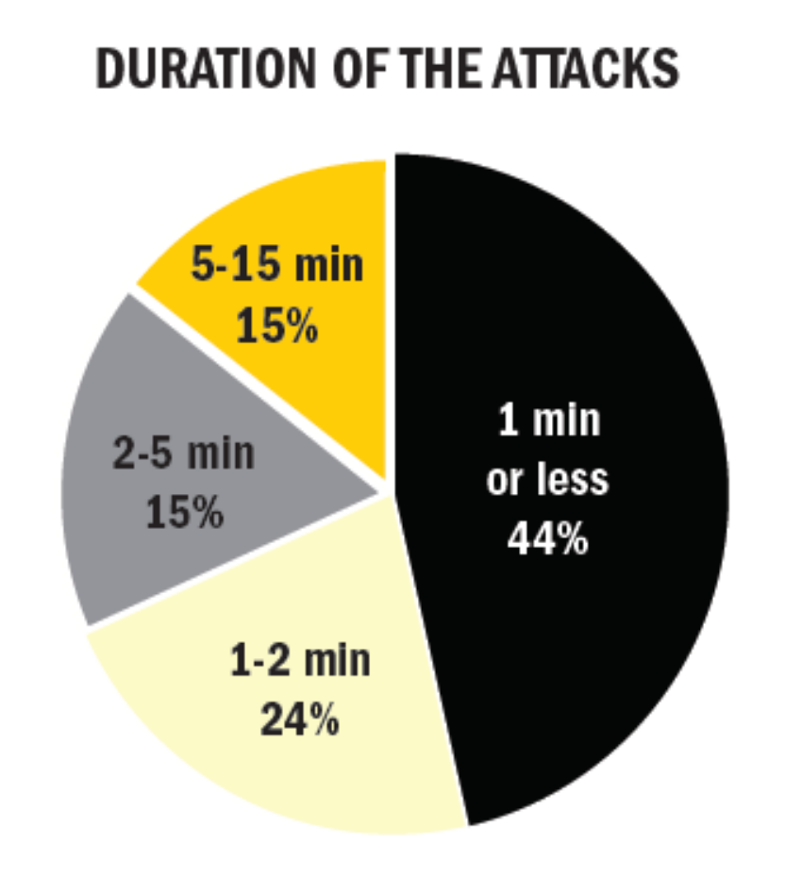
PROTECTING AMERICA’S SCHOOLS: A U.S. SECRET SERVICE ANALYSIS
OF TARGETED SCHOOL VIOLENCE (2019)
U.S. Department of Homeland Security UNITED STATES SECRET SERVICE
National Threat Assessment Center

Slide 15
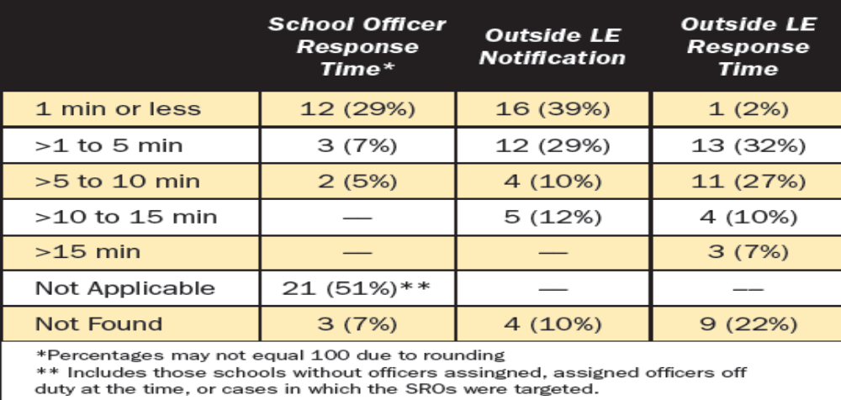
PROTECTING AMERICA’S SCHOOLS: A U.S. SECRET SERVICE ANALYSIS
OF TARGETED SCHOOL VIOLENCE (2019)
U.S. Department of Homeland Security UNITED STATES SECRET SERVICE
National Threat Assessment Center
41 incidents of targeted school violence 1/08 – 12/17

Slide 16
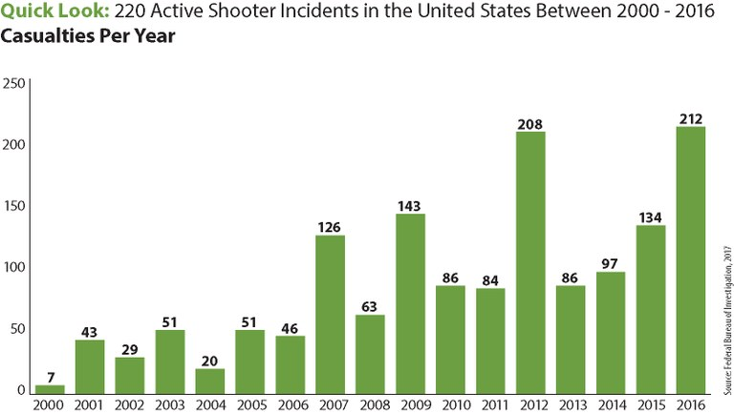

Slide 17
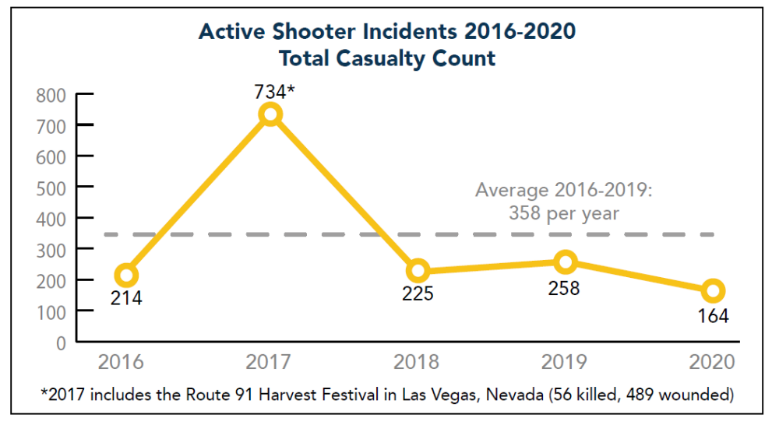

Slide 18
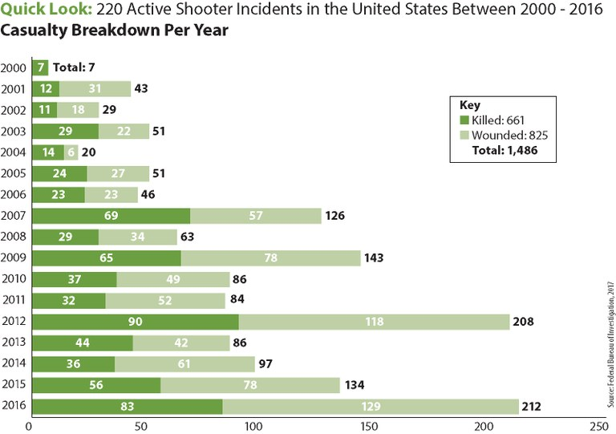

Slide 19
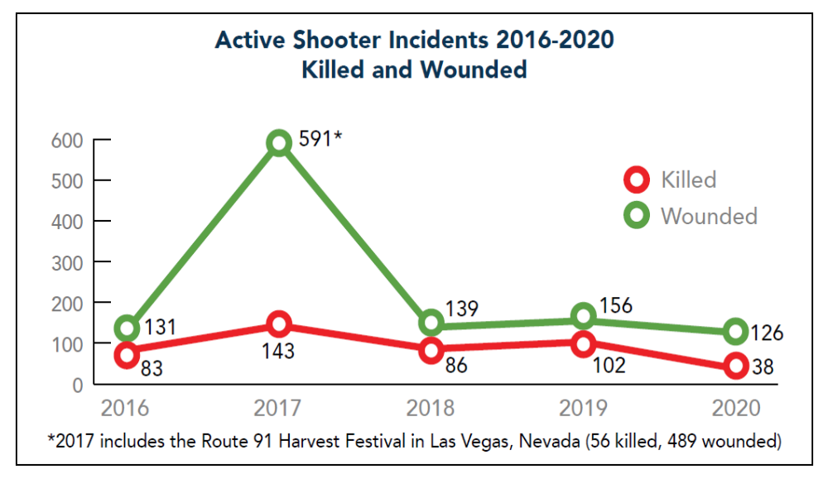

Slide 20
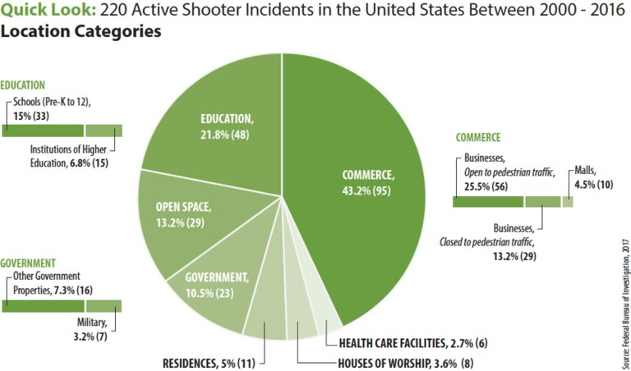

Slide 21
School Settings
School Shooters, O’Toole, 2000
Subjects demonstrate some type of warning behaviors
Threats, innuendoes, journal entries, videotaping
Attempted to persuade family or others to help with preparations
Common themes include:
  Violence
  Hopelessness
  Despair
  Hatred

Slide 22
Affective and Predatory
Modes of Violence

Slide 23
What is violence?
An intentional act of aggression toward another human being that physically injures, or is likely to physically injure, that human being.

Slide 24
Affective & Predatory
Modes of Violence
Intense ANS arousal
Subjective experience of emotion
Reactive and immediate violence
Internal or External threat
Goal is threat reduction
Minimal or no ANS
No conscious emotion
Planned and purposeful
No or minimal threat
Many goals

Slide 25
Affective and Predatory (continued)
Rapid displacement of target
Time-limited behavior
Preceded by public posturing
Primarily emotional
Heightened and diffuse awareness
No target displacement
No time limit to behavior
Preceded by private ritual
Primarily cognitive-conative
Focused awareness

Slide 26
Categorizing Aggressive Acts
Affective: “hot, short fuse”
  Impulsive, unplanned, reactive
  Purpose: to reduce a perceived immediate
  “threat” (of abandonment, rejection, etc.)
Predatory: “cold blooded”
  Premeditated, controlled, instrumental, targeted, intended
  Purpose: power, dominance, gratification, revenge, notoriety, control, etc.

Slide 27
Biopsychosocial Factors Associated with Violence among Juveniles

Slide 28
Key #1
Violence/Aggression and Development
  Very common
  Rates of criminal activity during adolescence are so high that it is statistically normative.
  A small portion of juveniles are responsible for a majority of violent offenses

Slide 29
Key #2
Early Onset >>>> Chronic Course
  Fifty percent of youth continued violent behavior into adulthood when the onset was prior to 11 years of age.
  Serious persistent delinquency begins early in childhood.
  Thirty percent of youth continued violent behavior into adulthood when the onset was between 11 – 13 years of age.
  An estimated 10% of youth continued violent behavior into adulthood when the onset was during adolescence.

Slide 30
Key #3
Psychological maturity ≠ age, physical maturity, seriousness of crime.

Slide 31
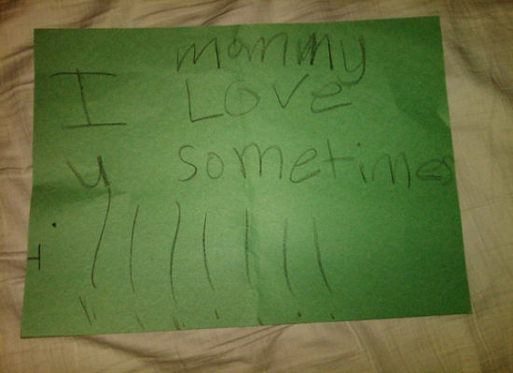
Key #4
Less stable personality patterns and traits.
  Remorse and empathy limitations

Slide 32
Key #5
Current offense ≠ prediction of recidivism

Slide 33
Dynamic
Acute
Alcohol Intoxication
Recent Loss of Job
Stable
Cognitive Distortions
Sexual Deviancy
risk factors that can change
change rapidly
remain unchanged
for years
can’t change with any intervention
Static Factors
Gender
Age
Head Injury
Hx of violence
Victim Type

Slide 34
Relevant Diagnoses
Conduct Disorder
  Psychiatry base rate 2% – 16%
  Convicted adolescents base rate 75% - 90%
Attention Deficit Hyperactivity Disorder
  Combination of ADHD and serious delinquent behavior are at a high risk for developing serious criminal careers into adulthood.
  When conduct problems are controlled, hyperactivity not a good predictor of delinquent behavior.

Slide 35
Psychological
Individual Correlates of Violence
Male
Childhood fighting
Hyperactivity, withdrawn, aggressive
Risk Taking/Impulsivity
Substance Use Difficulties
Anger Management problems
Diverse criminal acts
Lack of guilt or low capacity for empathy, Frick, et al., 2003
Callous – unemotional traits, Frick, et al., 2003

Slide 36
Sociological Correlates of Violence
Childhood history of maltreatment in home
Early caregiver disruption
Poor school achievement
Harsh parenting
Exposure to violence in home
Poverty and social class/community disorganization
Peer group endorsement of violence
Peer rejection
Media – small moderate effect
Early antisocial influences
  Drug availability
  Criminogenic attitudes

Slide 37
Biological Correlates of Violence
Left hemisphere damage
  Verbal functioning
Frontal lobe trauma
  Self-control functions of the brain – frontal and prefrontal

Slide 38
Executive Functioning Deficits
Self-control functions of the brain – frontal and prefrontal in particular is responsible for executive functioning
Deficits in executive functioning and aggression have been found

Slide 39
Pathways of Juvenile Offending
Life Course Persistent
Adolescent Limited

Slide 40
Differences and Similarities between Threat and Risk Assessment

Slide 41
Threat Assessment,
Goodrum et al., 2018
“The threat assessment process seeks to evaluate
the likelihood a person will perpetrate “targeted
violence” (i.e., toward a specific person or group), such as an assassination or a school shooting. In schools, threat assessment procedures seek to evaluate a student’s risk of targeted violence and build a safety plan to support the student.” (pp. 123).

Slide 42
Risk Assessment,
Goodrum et al., 2018
“A risk assessment evaluates the risk and protective
factors present in a person and evaluates the risk for general and specific forms of violence (e.g., intimate partner violence, stalking).” (pp. 123).

Slide 43
Risk v. Threat Assessment (Meloy, et al., 2011)
Violence risk assessment has older provenance
Risk assessment focuses on probability of violence and estimated for an individual based upon his/her comparison to a known group
Typically a history of violence
Classification of low, medium or high risk

Slide 44
Risk v. Threat Assessment (Meloy, et al., 2011)
Threat assessment focuses on targeted violence by a subject of concern and encompasses a behavioral and profiling focus.
Person of focus may have no history of violence.

Slide 45
Differences between TA and RA
Operational context
Dynamic emphasis
Idiographic (case-driven) approach
Very low base rates
Risk management rather than prediction
Subject and potential victim
Predatory (instrumental, intended) violence
Likely urgency

Slide 46
Threat Assessment Model
We don’t focus on predicting what the subject will do in the future. We focus on managing risk for what subject is doing now.
We are not able to anticipate threats with certainty (Meloy, et al., 2014).
We attempt to implement sound practices to identify and intervene with subjects as early as possible on the path toward violence (Cornell, 2010).

Slide 47
Threat Assessment Model
Generally posits that targeted violence is deliberate, planned and well thought out versus expressive/reactive violence
The progress occurs from ideation >> planning >> acquisition>> implementation (Deisinger et al., 2008).

Slide 48
Threat Assessment Model
Pathway to violence is not linear
Iterative such that the person can cycle between the pathway, contingent upon information gathered, increased desperation and monitoring.

Slide 49
Threat Assessment Model
De-emphasizes:
  Psychiatric Diagnoses
  Static variables
  Communicated threats

Slide 50
Implication for Threat Assessment,
(Vossekuil, Fein and Berglund, 2015)
Targeted violence is the end result of an understandable, and often time discernible, process of thinking and behavior.
Targeted violence stems from an interaction among the individual, the situation, the setting, and the target.
An investigative, skeptical, inquisitive mind-set is critical to successful threat assessment.

Slide 51
Implication for Threat Assessment,
(Vossekuil, Fein and Berglund, 2015)
Effective threat assessment is based on facts rather than on characteristics or “traits.”
An integrated systems approach should guide threat assessment inquires and investigations
The central question in a threat assessment investigation or inquiry is whether her person of interest poses a threat, not whether the person of interest made a threat.

Slide 52
What are vulnerabilities within threat assessment?
Inductive (abductive) reasoning
  One moves from particular facts about a case to a general principal
Availability bias
  Importance is judged by ease and emotional charge with which it comes to mind, not actual probability
Predictable world bias
  Tendency to see events as more predictable than they were (hindsight bias) or are (foresight bias)

Slide 53
Confirmatory Bias—how we seek to protect our beliefs
We notice facts to support our beliefs
We overlook facts that don’t
We seek information to support our beliefs
We give greater weight to such information
We accept at face value such information
We are better able to remember such information

Slide 54
Additional Biases
Google Bias
  Tendency to not remember information is easily found online – (cell phones)
Ikea Effect
  Tendency to overvalue something that we put together
Cheerleader Effect
  Perception that people look more attractive in a group that in isolation

Slide 55
The low base rate dilemma
Predictive attempts will result in too many false positives due to low base rate for targeted violence
The Paradox: we will never know the violent acts we prevented

Slide 56
Dynamic Factors for
Targeted Violence

Slide 57
Warning Behaviors (Meloy, Hoffmann, Guldimann & James,
BS&L, 2012; 30:256-279
Pathway
Fixation
Identification
Novel aggression
Energy burst
Leakage
Directly communicated threat
Last resort behavior

Slide 58
Warning Behaviors
They are accelerants—focus on accelerating change
Patterns of behavior rather than individual risk factors: pattern analysis
Appear to correlate with targeted violence, but do they predict?

Slide 59
Pathway warning behavior
Any behavior that is part of research, planning, preparation, or implementation of an attack (Fein & Vossekuil, 1998, 1999; Calhoun & Weston, 2003)

Slide 60
Pathway to Targeted or Intended Violence
Adapted with permission from F.S. Calhoun and S.W. Weston (2003). Contemporary threat management: A practical guide for identifying, assessing and managing individuals of violent intent. © 2003 F.S. Calhoun and S.W. Weston. All rights reserved.
Attack
final acts
Probing & Breaches
Pre-attack Preparation
Escalation
Research & Planning the Attack
De-Escalation
decision
Violent Ideation
The “Grievance”
Notes:
60

Slide 61
Grievance
Loss
Humiliation
Anger
Blame

Slide 62
Fixation warning behavior
    Any behavior that indicates an increasingly pathological preoccupation with a person or a cause (Mullen et al., 2009). It is measured by: a) increasing perseveration on the person or cause; b) increasingly strident opinion; c) increasingly negative characterization of the object of fixation; d) impact on the family of the object of fixation, if present and aware; e) angry emotional undertone. It typically causes deterioration of social and occupational functioning.

Slide 63
Identification warning behavior
    Any behavior that indicates a psychological desire to be a “pseudocommando” (Dietz, 1986; Knoll, 2010), have a “warrior mentality” (Hempel et al., 1999), closely associate with weapons or other military or law enforcement paraphernalia, identify with previous attackers or assassins, or to identify oneself as an agent to advance a particular cause or belief system.
    “A fanatic is never discouraged by the impossibility of his righteous mission.”

Slide 64
Characteristics of Identification
Meloy, Mohandie, Knoll & Hoffman, 2015
Pseudo-commando
Warrior mentality
Close association with weaponry, law enforcement, military paraphernalia
Identify with other attackers or assassins
Become an agent to advance a particular cause or belief system

Slide 65
Weapon Access and Background
What is the subject’s familiarity with weapons?
Do they possess weapons?
Do they seek out weapons?
Frequency of attending gun shows
Do they collect/stockpile ammunition
Do they carry/conceal weapons?
Have they made recent purchases?

Slide 66
Weapon Access and Background
Internet searches for weapons?
Does the subject of interest purchase parts from internet sites “swap meet” sites; etc., craigslist
Is the person purchasing attire/clothing related to identification or “pseudo-commando” goals
Does the subject of interest have relatives who possess guns?

Slide 67
Novel aggression warning behavior
    An act of violence which appears unrelated to any targeted violence pathway warning behavior which is committed for the first time. Such behaviors may be utilized to test the ability (de Becker, JACA) of the subject to actually do a violent act, may be a measure of response tendency, the motivation to act on the environment (Hull, 1952), a behavioral tryout (MacCulloch, Snowden, Wood & Mills, 1983), or proof of kill (G. Deisinger, personal communication, 2011).

Slide 68
Elliot Rodger, July 2011
Novel Aggression Possible
July 2011 (quotes from Manifesto, “My Twisted World”)
While in line at Starbucks he views a couple “kissing passionately.”
Described himself as “livid with envious hatred.”
Follows them to their car and splashed coffee all over them.
Quickly ran away in fear/drove off, “shaking with rage-fueled excitement . . .” (p. 87).

Slide 69
“I had never struck back at my enemies before, and I felt a small sense of spiteful gratification for doing so . . . I wanted to do horrible things to that couple. I wanted to inflict pain on all young couples. It was around this point in my life that I realized I was capable of doing such things. I would happily do such things. I was capable of killing them, and I wanted to. I wanted to kill them slowly, to strip the skins off their flesh. . . . They deserve it.” (p. 87)

Slide 70
Energy burst warning behavior
    An increase in the frequency or variety of any noted activities related to the target, even if the activities themselves are relatively innocuous, usually in the days or weeks before the attack (Odgers et al., 2009).

Slide 71
Energy Burst Warning Behavior,
January 7-8, 2011
Drops off 35 mm film at Walgreen’s evening of Jan. 7 before midnight
Checks into Motel 6 shortly after midnight
Searches web for “assassins” and “lethal injection”
0219 picks up photos, makes a purchase
Leaves telephone message with friend
0412 posts to Myspace page photo of Glock 19 and words, “Goodbye friends.”
0600 visits Walmart and Circle K stores

Slide 72
Energy Burst (cont’d)
Unable to purchase ammunition at first Walmart, purchases 9 mm full metal jacket ammo and diaper bag at 0727
Stopped by police officer for running a red light
Confronted by father at home, runs away
Returns to Circle K, gets a cab, goes to supermarket where he insists on getting correct change for cab ride

Slide 73
Energy Burst (cont.)
Sixteen minutes later, opens fire at 10:10, killing 6 and wounding 13 people
Tackled by 3 senior citizens when he attempts to reload
Two photos released are Loughner holding a 9 mm Glock next to his crotch and buttocks while wearing a red G string
Came to mass murder with 31 rounds in pistol, two 15 round magazines in pocket, buck knife, and his driver’s license, credit card, and money in a plastic bag

Slide 74
Leakage warning behavior
    The communication to a third party of an intent to do harm to a target through an attack (Meloy & O’Toole, Behavioral Sciences and the Law, 29:513-527, 2011).

Slide 75
Leakage Warning Behaviors
(Hendrix, et al., 2022)
Tip lines
Information collected over 43 months by a state-operated tip (N = 6,006).
Tips were accounted for by 126 Oregon schools (approximately 11% of all schools in the state).
Main focus was on 228 tips reporting one or more persons for mass school violence leakage or for an individual’s direct or indirect communication of an intent or desire to kill multiple individuals at school.

Slide 76
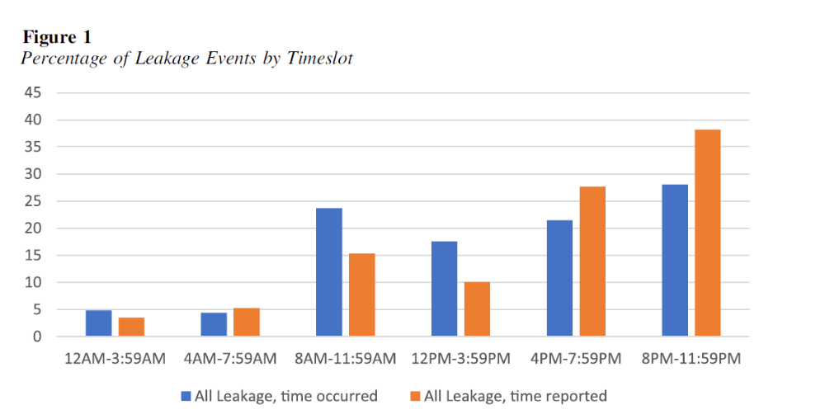
Leakage Warning Behaviors
(Hendrix, et al., 2022)

Slide 77
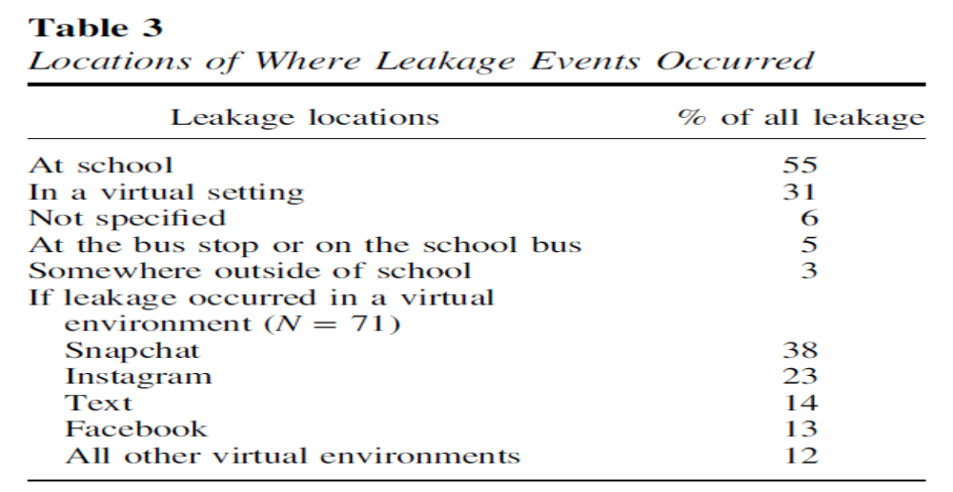
Leakage Warning Behaviors
(Hendrix, et al., 2022)

Slide 78
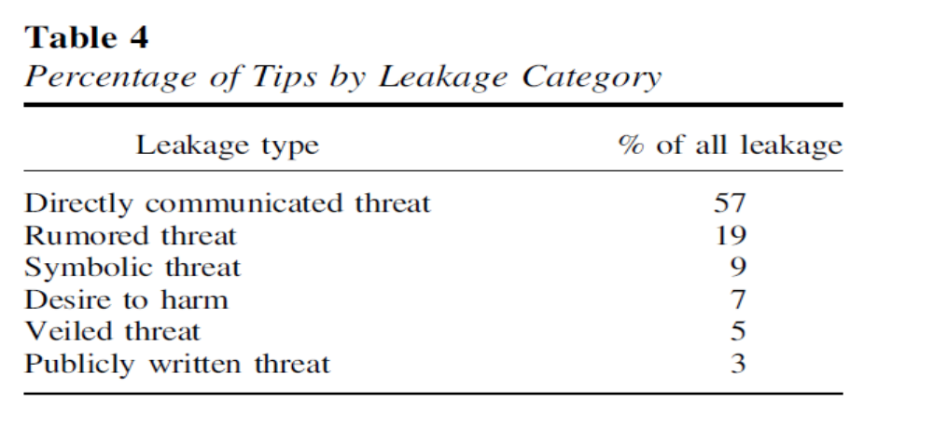
Leakage Warning Behaviors
(Hendrix, et al., 2022)

Slide 79
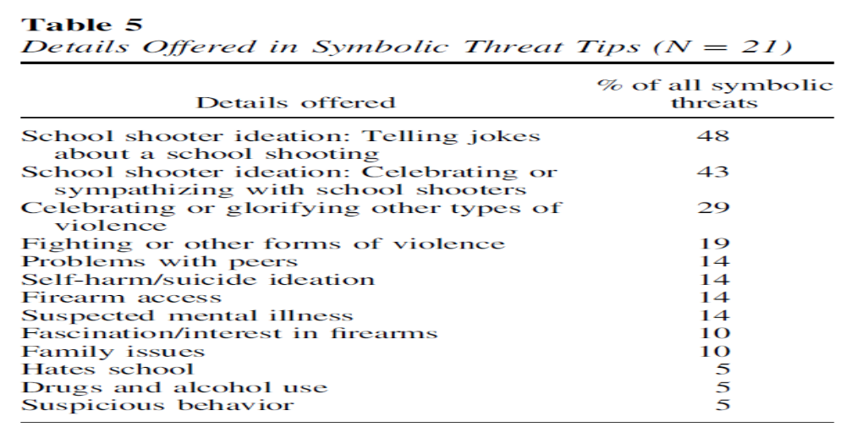
Leakage Warning Behaviors
(Hendrix, et al., 2022)

Slide 80
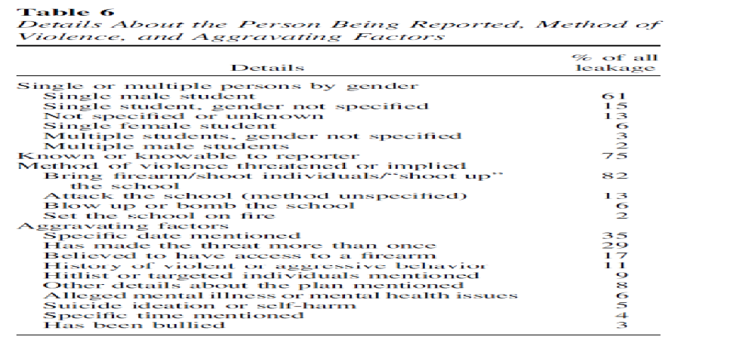
Leakage Warning Behaviors
(Hendrix, et al., 2022)

Slide 81
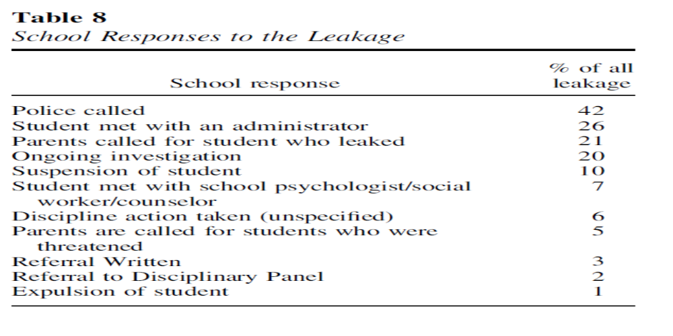
Leakage Warning Behaviors
(Hendrix, et al., 2022)

Slide 82
Leakage Warning Behaviors
1990 to 2014, 58% engaged in some form of leakage (Silver, Horgan, & Gill, 2018)
2000 to 2013 FBI study of active shooters, 56% openly expressed their violent thoughts or intent prior to attacking (Silver, Simons, & Craun, 2018)

Slide 83
Leakage Warning Behaviors
Research suggests - people are often hesitant to report potential mass shooters to law enforcement, even if they observe concerning behavior (Madfis, 2014a; Silver, Simons, & Craun, 2018)
“bystander intervention” increases sense of responbility on self
Reporting of stranger is easier than known persons

Slide 84
Lankford, 2019
N=15 (3/98 – 2/18)
Examined leakage, reports to law enforcement (LE) and weapon acquisition
  leakage of violent thoughts/intent in general
  leakage of specific interest in mass killing
  whether the mass shooter’s concerning behavior reported to LE prior to attack
  whether concerns about the mass shooter’s specific interest in homicide (i.e., killing people) had been reported to LE

Slide 85
Lankford, 2019
Leakage of violent thoughts/intent (87%)
Leakage of specific interest in mass killing (80%)
Concerning behavior reported to LE (80%)
Concerning interest in homicide reported LE (47%)
Firearms in mass shooting acquired legally (80%)

Slide 86
Leakage and Reports to LE
Lankford, 2019
Prevention appears possible in the vast majority of cases
Public should be educated, encouraged, and pressured to report leakage and warning signs to LE
LE needs to be educated and trained on how to more effectively investigate potential threats
Individuals who have admitted homicidal or suicidal thoughts or interest in committing mass shootings should be prohibited from purchasing or possessing firearms

Slide 87
Last resort warning behavior
    Evidence of a violent “time/action imperative” (Mohandie & Duffy, 1999). Increasing desperation or distress through declaration in word or deed, forcing the individual into a position of last resort. There is no alternative other than violence, and the consequences are justified (de Becker, 1997). The subject feels trapped (S. White, personal communication).

Slide 88
Last resort warning behavior
    Evidence of a violent “time/action imperative” (Mohandie & Duffy, 1999). Increasing desperation or distress through declaration in word or deed, forcing the individual into a position of last resort. There is no alternative other than violence, and the consequences are justified (de Becker, 1997). The subject feels trapped (S. White, personal communication).

Slide 89
Directly communicated threat warning behavior
    The communication of a direct threat to the target or law enforcement beforehand. A threat is a written or oral communication that implicitly or explicitly states a wish or intent to damage, injure, or kill the target, or individuals symbolically or actually associated with the target.

Slide 90
Developing Scenarios
Douglas, et al., 2013
Consider all past violence, not just recent
Escalation, including worst case scenario
Assess change in motivation, victim selection and behavioral topography
Improvement, including desistance or best case scenario

Slide 91
Implementation of Threat Assessment and Management

Slide 92
There is no cook-book approach!

Slide 93
Threat Assessment and Management
Goals include:
  Piece together information
  Redirect subject of interest’s motion away from the path toward violence.
  Engage in a non-adversarial manner.
  Involves engaging subject of interest.
  Casts a wide net.
  Behavior of team does not exacerbate the situation.

Slide 94
Threat Management Team Make-Up
Case Manager/Team Leader
Administrative Staff
Teachers/Counselors
Law Enforcement - Community
Security
  Liaison with Police

Slide 95
Threat Management Team Make-Up
External referral sources for Threat Assessment
Mental Health Professional
Attorney
  In-House/Retained externally if needed
Ad-hoc members, as needed

Slide 96
Threat Assessment Team
(Van der Meer and & Diekhuis, 2014)
Each person/member on the team should have an identified task/role
Documentation guidelines
Legal issues
Developing timelines
  Constantly monitored and logged/altered with specific dates/times
Managing information
  Ensure validity, reliability
  Maintain position of healthy skepticism
Referral source educated about providing all information
  silo effect

Slide 97
Threat Assessment/Interview
(Van der Meer and & Diekhuis, 2014)
Interview – Tool for Gathering Information
  Reasons for interviewing
    Collect reliable information on risk and protective factors
    Substantiate or contradict prior identified risk and protective factors
    Finding collateral information from interviewee; examine other sources
    Gather understanding of what is driving the interviewee’s behavior
    Provide information on what the interviewee can and cannot do – violate law
    Most persons appear willing to talk

Slide 98
Threat Assessment/Interview
(Van der Meer and & Diekhuis, 2014)
Interview – Tool for Gathering Information
  Understanding the Interviewee
    Explain at the outset the reason and importance for the interview
    Utilize objective, neutral, non-judgmental stance
    See the situation through their eyes
    Persons who demonstrate paranoid delusions or have paranoid personality traits – reluctant to participate in interview process
    Home visit, or within their environment, if safe and permissible

Slide 99
Threat Assessment/Interview
(Van der Meer and & Diekhuis, 2014)
Interview – Tool for Gathering Information
  Preparing for the interview
    Detailed knowledge of facts, case and timeline
    Identification of relevant behavioral and personality features of interviewee
    Cultural implications for assessment (Hart, 2016; Olver, 2016; Weiss and Rosenfeld, 2012)
    Ensure personal safety during interview
    Awareness that personal safety is vulnerable if questions are aimed at their personal frustration, stressors and other negative matters
    Possibly have two interviewers, if available
    Tape recording to ensure accuracy – can be explained that it is to prevent confusion about what they said, although most persons are very reluctant to consent to recording

Slide 100
Threat Assessment
Cultural Considerations (Hart, 2016)
Identify potential diversity issues that may bias evaluator.
When potential diversity issues exist, evaluator is responsible for education about impact the diversity will have on assessment process (lit. review, colleagues).
Decline case if do not have requisite skills; decline to use instrument/assessment procedures, cautionary statements, identifying limitations.

Slide 101
Threat Assessment-Cultural Considerations (Weiss and Rosenfeld, 2012)
Consider one’s own cultural competence prior to accepting a referral.
Level of acculturation should be considered when administering psychological tests to an individual from another culture.
If interpreters are used, they must be objective, well trained, and provide a verbatim translation of the evaluatee’s responses.

Slide 102
Threat Assessment-Cultural Considerations (Weiss and Rosenfeld, 2012)
Evaluators must consider the reliability and validity of measures used with respect to an evaluatee’s group membership.
The evaluator must acknowledge when the psychometric challenges for use of a measure are insurmountable. If the lack of reliability and validity data prohibit the use of a measure, the evaluator may be forced to rely on other sources (e.g., clinical and collateral interviews, medical and criminal justice records).

Slide 103
Identify risk and threat factors
How they manifest in person
How each is relevant
Assessment
Communication
Management
& Treatment
Low, moderate, high
Intensity of Management
Tailored interventions based on risk and threat factors
Application of risk and threat management strategies
Reassessment on regular intervals

Slide 104
Strategy Planning
Monitoring
Surveillance or repeated assessment
Treatment
Rehabilitation, further assessment
Victim Safety Planning
Enhanced security measures, resources for identified targets
Supervision
Imposition of controls, restriction of movement

Slide 105
Scenario Planning,
Douglas, et al., 2013
Develop scenarios
Evaluate scenarios
Which “possible futures” most deserve attention?
Use scenarios to plan
Which strategies, tactics, and logistics are needed?
What are the “possible futures?”

Slide 106
Ongoing Training
Technical vs. Adaptive Solutions
Goodrum, et al., 2018
Technical solutions are addressed with few small adjustments by one authority and within organizational boundaries (e.g., metal detector, video surveillance system).

Slide 107
Ongoing Training
Technical vs. Adaptive Solutions
Goodrum, et al., 2018
Adaptive solutions include number ongoing TA trainings, assessing more students for threats, and increasing the number of indicators on the TAT screener.

Slide 108
Technical vs. Adaptive Solutions
Goodrum, et al., 2018
Adaptive solutions require multiple authorities, crossover organizational boundaries (e.g., schools, mental health, and criminal justice) but elicit emotional responses, and face resistance.
Adaptive solutions require that school officials share information to promote a “culture of safety,” adopt continuous improvements to threat assessment, monitor quality of threat assessment and engage in safety planning implementation process.

Slide 109
PROTECTING AMERICA’S SCHOOLS: A U.S. SECRET SERVICE ANALYSIS
OF TARGETED SCHOOL VIOLENCE (2019)
U.S. Department of Homeland Security UNITED STATES SECRET SERVICE
National Threat Assessment Center
There is no profile of a student attacker, nor is there a profile for the type of school that has been targeted.
Attackers usually had multiple motives, the most common involving a grievance with classmates.
  83% male; 17% female

Slide 110
PROTECTING AMERICA’S SCHOOLS: A U.S. SECRET SERVICE ANALYSIS
OF TARGETED SCHOOL VIOLENCE (2019)
U.S. Department of Homeland Security UNITED STATES SECRET SERVICE
National Threat Assessment Center
Most attackers used firearms, and firearms were most often acquired from the home.
Most attackers had experienced psychological, behavioral, or developmental symptoms.

Slide 111
PROTECTING AMERICA’S SCHOOLS: A U.S. SECRET SERVICE ANALYSIS
OF TARGETED SCHOOL VIOLENCE (2019)
U.S. Department of Homeland Security UNITED STATES SECRET SERVICE
National Threat Assessment Center
Half of the attackers had interests in violent topics.
All attackers experienced social stressors involving their relationships with peers and/or romantic partners.

Slide 112
PROTECTING AMERICA’S SCHOOLS: A U.S. SECRET SERVICE ANALYSIS
OF TARGETED SCHOOL VIOLENCE (2019)
U.S. Department of Homeland Security UNITED STATES SECRET SERVICE
National Threat Assessment Center
Nearly every attacker experienced negative home life factors.
Most attackers had a history of school disciplinary actions, and many had prior contact with law enforcement.

Slide 113
PROTECTING AMERICA’S SCHOOLS: A U.S. SECRET SERVICE ANALYSIS
OF TARGETED SCHOOL VIOLENCE (2019)
U.S. Department of Homeland Security UNITED STATES SECRET SERVICE
National Threat Assessment Center
All attackers exhibited concerning behaviors.
  Most elicited concern from others, and most communicated their intent to attack.

Slide 114
Comprehensive Student Threat Assessment Guidelines (CSTAG)
Step 1:
TAT evaluates the threat by interviewing subject of interest
Document/note exact content of the threat
What have others observed regarding nature of threat and behavior
Gather information on the circumstances in which the threat was made
What are the circumstances in which threat was made – situational context
Is there communication of intent to harm or behavior suggesting intent to harm
In most cases, the threatening student is interviewed and given an opportunity to explain what he or she meant by the threatening statement or behavior.

Slide 115
Comprehensive Student Threat Assessment Guidelines (CSTAG)
Step 2:
All available information is used by the school teams to consider the credibility and seriousness of the threat.
Humor, rhetoric, frustration, reactive situation that can be easily resolved
Does person retract and then apologize for behavior with consistent de-escalation

Slide 116
Comprehensive Student Threat Assessment Guidelines (CSTAG)
Step 3: TAT respond to a substantive threat
  Take precaution to protect individual
  Warn intended victim and family
  Explore manners to resolve conflict
  Disciplinary procedures, when necessary

Slide 117
Comprehensive Student Threat Assessment Guidelines (CSTAG
Step 4: Serious substantive threats.
  Student screened for mental health services or counseling.
  Potential law enforcement investigation of the case
  Closer examination of probing/planning behavior
  Develop safety plan
  Potential target hardening

Slide 118
Comprehensive Student Threat Assessment Guidelines (CSTAG)
Step 5: Implementation/monitoring safety plan formulated
  Documentation
  Monitoring/surveillance of students
  Assess effectiveness of plan/tactics

Slide 119
Threat Assessment
School Violence Prevention (Cornell, 2020)
Limitations in Predicting Violence in School
Low base rate of ordinary acts of violence - extraordinarily lower base rate of mass violence makes the target even smaller “If the bullseye for homicide is miniscule, the bullseye for mass violence is microscopic.” (pp. 239)

Slide 120
Threat Assessment
School Violence Prevention (Cornell, 2020)
Limitations in Predicting Violence in School
Perpetrators of mass violence are heterogeneous

Slide 121
Threat Assessment
School Violence Prevention (Cornell, 2020)
Limitations in Predicting Violence in School
Identification of reliable risk factors unlikely unless one subdivides the small group into even smaller groups. The microscopic bullseye must be fragmented into pieces that are placed on different targets

Slide 122
Threat Assessment
School Violence Prevention (Cornell, 2020)
Limitations in Predicting Violence in School
Barrier to research is that efforts to validate the accuracy of violence predictions are ethically constrained. It is not permissible to conduct a prospective study to test the accuracy

Slide 123
School Security Measures
Post-Columbine
King & Bracy, 2019
  School Security Personnel – staff, teachers, aides, administrators – remained relatively stable from 1999 (85.4%) to 2015 (89.5%)
  School Based Law Enforcement – including SRO – 1996/1997 (22%) to 2015/2016 (57%)
  CCTV – in 1999 (19.4%) to 2015/2016 (80.6%)
    Unless cameras monitored-less utility
  Emergency Preparedness – 2015/2016 (94.6%) have drills on lock-down procedures
  Active Shooter Drills - 2015/2016 (92%)

Slide 124
School Security Measures
Post-Columbine
Addington, 2018
  Empirical support is lacking that any of these tactics alone or in combination is effective to prevent school shootings

Slide 125
School Security Measures
Post-Columbine
Jonson, 2017
Belief that presence of an armed police officer on campus serves as a deterrent to a potential school shooter - neutralize the threat of a school shooter
As of 2019; little empirical evidence supports the assumption that armed police officers serve as a deterrent to potential school shooters
  School shootings in U.S. with highest casualties Columbine (13), Sandy Hook (26), Santa Fe (10), and Marjory Stoneman Douglas HS – 75% of them had a police or armed security officer assigned to campus

Slide 126
School Security Measures
Post-Columbine
Safety Drills – Utility
Alert, Lockdown, Inform, Counter, Evacuate (ALICE) Institute provide training with no empirical evidence to support their effectiveness (Krisch, 2018)
Potential for negative impact on children and school climate (Krisch, 2018; Magliozzi, 2018; Peterson et al., 2015).
Are students retain and implement what they have learned in a training, especially for students suffering with anxiety or previous exposure to violence (McCoy, Raver, & Sharkey, 2015)

Slide 127
Target Hardening
Ecological and situational controls
  Reduce opportunity for strangers or subject of interest to access location.
  Availability to access/exits.
  Communication device accessibility.
  Law enforcement presence.
  CCTV systems/monitoring.

Slide 128
Hierarchy of Threat Management
(Palarea & Van Horn, 2010)
Incarceration/Jail
Arrest
Hospitalization
Restraining Order/Protection Order
Refer for outpatient mental health counseling
Administrative actions
Ecological/physical measures
Leverage subject of interest’s social network
Notify subject of interest boundaries/consequence
Notify subject of interest about safety measures

Slide 129
Documentation http://www.studentthreatassessment.org/
STUDENT THREAT ASSESSMENT & MANAGEMENT SYSTEM (LEVEL 1 PROTOCOL)

Slide 130
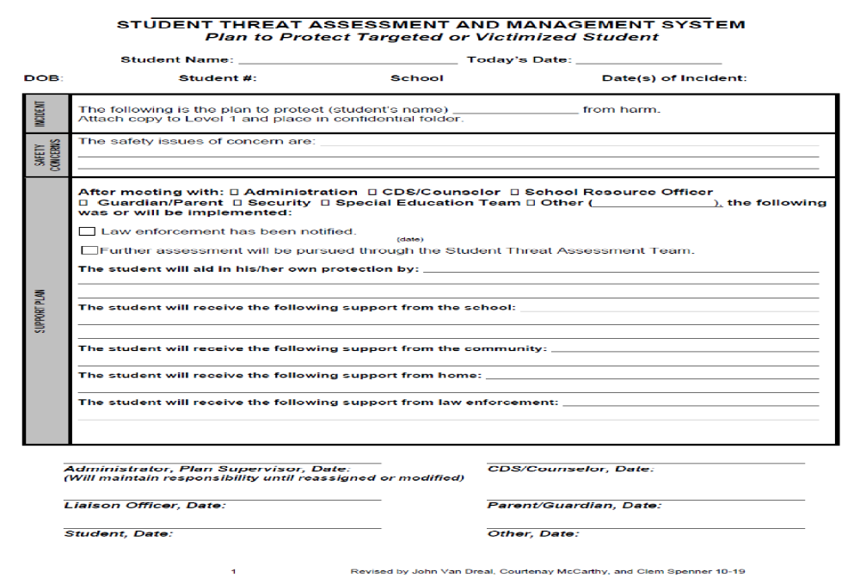

Slide 131
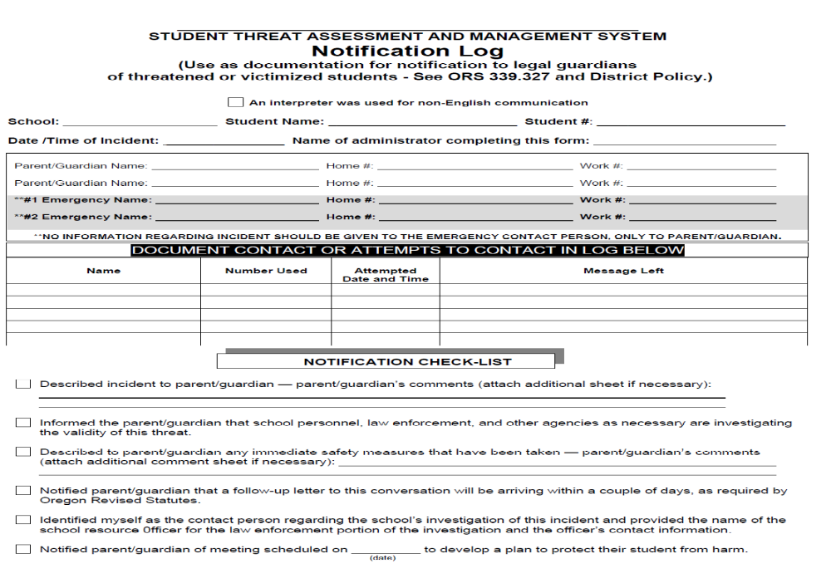

Slide 132
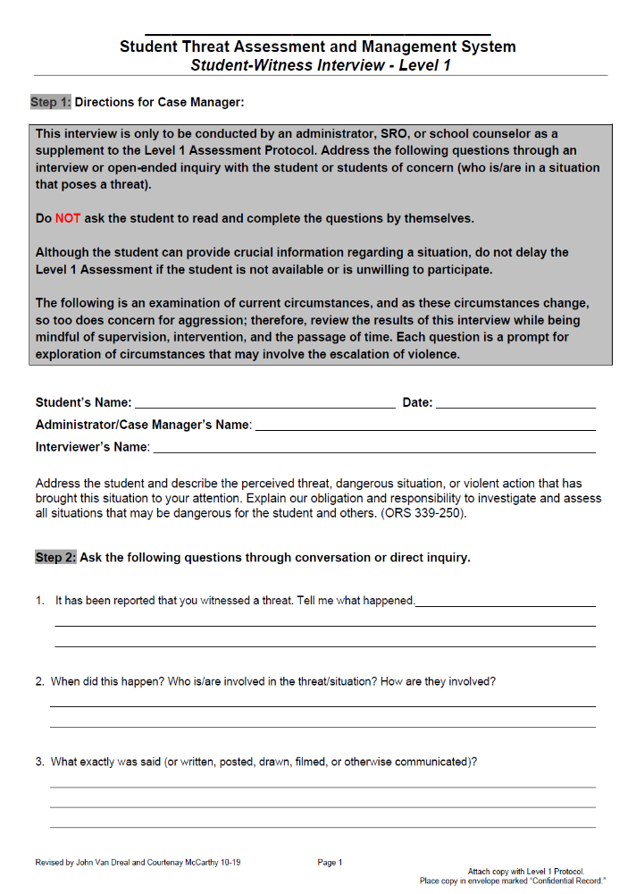
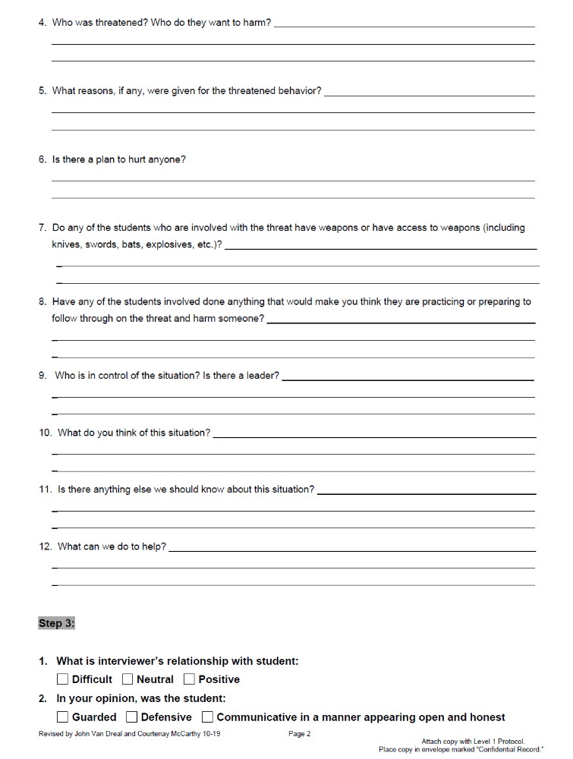

Slide 133
Extreme Risk Protection Orders
“Red Flag Laws,” NYS, 8/24/2019
Goal to keep guns away from persons deemed “high risk” of using against self/others
Not have (possess) a firearm, rifle or shotgun
Not buy a firearm, rifle or shotgun
Not attempt to have or buy a firearm, rifle or shotgun
Give up any firearms, rifles or shotguns
Petitioners include:
  Police officers
  District Attorneys
  Family or household members
  School administrators; including persons chosen by the school – teachers; guidance counselors, school psychologist, school nurse and coaches

Slide 134
Extreme Risk Protection Orders
“Red Flag Laws,” NYS, 8/24/2019
Filed to NYS Supreme Court Judge
Turn-around time rapid; hearing held within 3 - 10 days after the application is filed
  https://ww2.nycourts.gov/erpo
  Outside normal business hours, contact 1-800-430-8457 or emergency@nycourts.gov
Both sides get a chance to tell their side of the story to the judge
ERPO will say the expiration date (up to 1 year)
ERPO must be followed in every state
If the judge decides that a final ERPO is not needed, the case is over

Slide 135
Extreme Risk Protection Orders
“Red Flag Laws,” NYS, 8/24/2019
ERPO DOES NOT ORDER PERSON AT RISK TO STAY AWAY FROM TARGET
ERPO can’t order a person to:
  Stop threatening or committing abuse
  Stay away from your home, job, or school
  Have no contact with you or others
  Follow custody orders
  Pay child or spousal support
An ERPO has no criminal charges or penalties.

Slide 136
NY Secure Ammunition and Firearms Enforcement (SAFE) Act; Mental Hygiene Law, 9.49 (1/15/13)
NYS SAFE Act stops criminals and the dangerously mentally ill from buying a gun by requiring universal background checks on gun purchases
Increases penalties for people who use illegal guns
Mandates life in prison without parole for anyone who murders a first responder
Office of National Instant Criminal Background System (NICS) and SAFE Act provides the guidance to mental health professionals on reporting requirements.
Resource for clinicians on the NY SAFE Act and Section 9.46 of the Mental Health Law.

Slide 137
NY Secure Ammunition and Firearms Enforcement (SAFE) Act; Mental Hygiene Law, 9.49 (1/15/13)
MHL, 9.46 (A) - Reporting Requirements for Mental Health Professionals:
“requires four groups of mental health professionals (i.e., physicians, psychologists, registered nurses, and licensed clinical social workers), in the exercise of their reasonable professional judgment, to make a report as soon as practical to county mental health officials if an individual for whom they are providing mental health treatment is “likely to engage in conduct that will cause serious harm to self or others.”

Slide 138
NY Secure Ammunition and Firearms Enforcement (SAFE) Act; Mental Hygiene Law, 9.49 (1/15/13)
MHL, 9.49 (B) Reporting Standard:
“the reporting standard is “likely to engage in conduct that will cause serious harm to self or others.” This standard is consistent with the “likely to result in serious harm to self or others”
“As such, decision making with respect to a Section 9.46 report requires a clinical
determination that a person’s clinical state creates either: “(a) a substantial risk of
physical harm to the person, as manifested by threats of or attempts at suicide or serious
bodily harm or other conduct demonstrating that the person is dangerous to himself or
herself, or (b) a substantial risk of physical harm to other persons as manifested by
homicidal or other violent behavior which places others in reasonable fear of serious
physical harm1.”

Slide 139
NY Secure Ammunition and Firearms Enforcement (SAFE) Act; Mental Hygiene Law, 9.49 (1/15/13)
MHL, 9.49 (C) Confidentiality and Liability Concerns:
“With any mandatory reporting requirement, concerns regarding confidentiality and liability (for making a report or, conversely, failing to make a report) may be raised.”
“These concerns are addressed as follows: The law specifically provides that mental health professionals will not be subject to any civil or criminal liability if the professional’s decision with respect to whether or not to report was made “reasonably and in good faith.”

Slide 140
Family Educational Rights and Privacy Act (FERPA)
[20 U.S.C. § 1232g – 34 C.F.R. Part 99]
Applies to all educational agencies (i.e., school districts) and institutions (i.e., schools) that receive funds under any program administered by the U.S. Secretary of Education. In K–12, FERPA applies to most public schools.
In postsecondary, FERPA applies to nearly all postsecondary institutions.

Slide 141
Family Educational Rights and Privacy Act (FERPA)
[20 U.S.C. § 1232g – 34 C.F.R. Part 99]
Gives parents the right to access the student’s education records (and to seek to amend any information in the student’s education record that is inaccurate, misleading, or in violation of the student’s right of privacy).

Slide 142
Family Educational Rights and Privacy Act (FERPA)
[20 U.S.C. § 1232g – 34 C.F.R. Part 99]
Requires written parental consent before personally identifiable information (PII) from the student’s education record may be disclosed, subject to certain exceptions.
When a student turns 18 years of age, or enrolls in a postsecondary institution (at any age), the student becomes an “eligible student” and all parental rights transfer to the student.

Slide 143
FERPA – Protect?
Education records are generally defined as those records that are directly related to the student and maintained by (or on behalf of) an educational agency or institution.

Slide 144
FERPA – Protect?
FERPA excludes certain types of records from this definition, including, but not limited to: Records created and maintained by the educational agency’s or institution’s law enforcement unit for law enforcement purposes;

Slide 145
FERPA – Protect?
Records made or maintained by a professional or paraprofessional (e.g., physician, psychologist, etc.) that are made, maintained, or used only in connection with treatment of an eligible student, if certain conditions are met.

Slide 146
FERPA –Key Exceptions
Health and Safety Emergencies. Educational agencies and institutions may disclose PII from education records without consent to appropriate parties (e.g., law enforcement, emergency responders) in connection with an articulable and significant health or safety emergency, if knowledge of the information is necessary to protect the health or safety of the student or other individuals. 34 C.F.R. §§ 99.31(a)(10) and 99.36;

Slide 147
FERPA –Key Exceptions
School Officials. Educational agencies and institutions may disclose PII from education records without consent to school officials (including School Resource Officers), provided they meet the school’s criteria for “school officials” with “legitimate educational interests.” 34 C.F.R. § 99.31(a)(1);

Slide 148
FERPA –Key Exceptions
Judicial Orders/Subpoenas. Educational agencies and institutions may disclose PII from education records without consent in order to comply with judicial orders and lawfully issued subpoenas if the conditions set forth at 34 C.F.R. § 99.31(a)(9) are met;

Slide 149
FERPA –Key Exceptions
Parents of Dependent Students. Educational agencies and institutions may disclose PII from the education records of an “eligible student” without consent to the parents of that student if the parents claim the student as a dependent for federal tax purposes. 34 C.F.R. § 99.31(a)(8).

Slide 150
FERPA –Key Exceptions
Juvenile Justice System. Educational agencies and institutions may disclose PII from education records to state and local officials or other authorities if the disclosure is allowed by a state law adopted after November 19, 1974, and if the disclosure concerns the juvenile justice system and its ability to serve, prior to adjudication, the student whose records are disclosed. The officials and authorities to whom such information is disclosed must certify in writing to the school that the information will not be provided to any other party without written consent, except as provided for under state law. 34 C.F.R. §§ 99.31(a)(5) and 99.38.

Slide 151
Structured Professional Judgment Risk Assessment

Slide 152
Structured Assessment of
Violence Risk in Youth
(SAVRY)

Slide 153
Structured Assessment for Violence Risk in Youth (SAVRY)
Borum, R., Bartel, P., & Forth, A. (2006). Structured Risk Assessment in Youth: Professional Manual. Lutz, FL: Psychological Assessment Resources, Inc.
Focus is on General Risk Assessment
  Structured Professional Judgment
  Systematic
  Empirically Grounded
  Developmentally Informed
  Treatment-Oriented
  Flexible
  Practical
Notes:
Modeled after existing SPJ protocols for adult risk assessment, the SAVRY consists of 24 different risk items and 6 protective items that are derived from existing research and professional literature. Risk items provide a rating choice of either low, moderate, or high, while protective items provide a choice of either present or absent. It is specifically intended to assess the risk of violence in adolescents between the ages of 12 and 18 in order to determine the degree of possible future violence. The purpose of its design is to guide professionals from a variety of disciplines in both risk assessment and intervention planning for the troubled youth. Authors aimed for an assessment guide that was systematic, empirically grounded, developmentally informed, treatment-oriented, flexible, and practical. Systematic in that there are clear cut operational definitions for each primary factor, empirically grounded in that the items of the assessment are based on the best available research in the field, developmentally informed in that both risk and protective factors are the best fit for adolescents, as opposed to small children or adults, treatment-oriented in that the assessment must provide suggestions for treatment, flexible in that it allows for case-specific factors, as well as those grounded in research, and finally practical in that, it should take a certain amount of time to complete the assessment and any additional time after that is really not necessary.

Slide 154
What does the SAVRY measure?
Juvenile risk for violence
Not designed for threat assessment
Notes:
What does the SAVRY measure?
Juvenile risk for violence (used to assist professional evaluators in assessing and making judgments about a juvenile’s risk for violence)
Violence defined (an act of battery or physical violence that is sufficiently severe to cause injury to another person or persons (e.g., cuts, bruises, broken bones, death), regardless of whether injury actually occurs; it is any forcible act of sexual assault; a threat made with a weapon in hand. Should be of sufficient severity that criminal charges either do, or could, result. What is not considered violence: accidental or unintentional injury; or threats in the absence of physical violence; possession of weapon unless used on someone or threatens someone with it.
Reactive Aggression (impulsive; hostile; occurs in response to perceived threat or provocation (real or imagined) Studies show tends to be more girls.
Proactive Aggression (instrumental, controlled, and predatory aggression; violence is goal directed and used as an instrument or tool to achieve a goal other than the physical harm of the victim; do not occur in response to perceived provocation, not impulsive; no high levels of angry arousal). Studies show tends to be more boys.
Dangerousness or “risk” as a construct is now viewed as contextual, or highly dependent on situations and circumstances; it is dynamic, subject to change; continuous.
Used to be many false positives when assessing dangerousness. Now accuracy in prediction is better.

Slide 155
Why was the SAVRY developed?
To assist in structuring risk assessment
Useful in intervention planning/monitoring Resource Management
Considers developmental factors
Notes:
Why was the SAVRY developed?
Adult version not adequate (HCR-20) (contextual/dynamic risk factors equally if not more predictive of future violence than historical risk factors)
Considers developmental factors (time of significant change: physically, intellectually, socially, emotionally. Most youth who are violent during adolescence do not persist in this behavior later in life; nature and degree of violence risk may frequently change or vary; personality traits much less stable than that of adults; makes adolescents “moving targets” and more difficult to characterize based on observations made at any single point in time.)
To assist in structuring assessment
Useful in intervention planning/monitoring (emphasis is on dynamic factors)
An increase in youth violence has led to an emphasis on assessing and reducing violence.
Public attention to mass murders within schools increased the need for proper assessment tools.
Developed by Randy Borum, Patrick Bartel, and Adelle Forth

Slide 156
SAVRY- Population of Use
12-18 years old
Males and females
Juvenile justice system
Psychiatric inpatient/outpatient
Educational settings
Minority youth
Notes:
Who is the SAVRY used with?
Adolescent population
Between the 12-18 years old (can be used in slightly older or slightly younger, it’s not recommended. Suggest to use other SPJs, HCR-20: Assessing Risk for Violence or the Early Assessment Risk List for Boys/Girls: EARL-20B or EARL-21G)
Males and females (research has shown that many risk and protective factors are similar) (exceptions: trauma, particularly sexual abuse, and caregiver disruption has greater impact on girls)
Juvenile justice system (context)
Psychiatric inpatient/outpatient (context)
Educational settings (context) (helpful w/ bullies who can become future adult criminals; will be drawn out due to anti-bullying legislation; intervene here)
Minority youth (not a lot of studies done; however, it was found that items and ratings work with minority youth.)
Not systematically biased against minority youth, esp. African American and Hispanic)

Slide 157
SAVRY-General Principles
Administered by trained probation officers, psychologists, social workers, and psychiatrists.
Structured interviews, family reports, criminal records, probation reports, and other relevant records from the juvenile.
Coded/scored by hand on the SAVRY Rating Form.

Slide 158
Considerations/Limitations
Might not be appropriate for assessing targeted violence
Important to re-assess at regular intervals
Use additional sources to rate items
Most research has been done with males
User qualifications are important
Notes:
Considerations/Limitations
Might not be appropriate for assessing targeted violence (threat of harm to an identified or identifiable person; this requires different approach. Targeted: objective is to appraise whether youth is on path toward violent act against a person or entity, not just whether he may be violent in general.)
Important to re-assess at regular intervals (focus primarily on changes that have occurred in dynamic risk factors, individual or social/contextual, that might lessen or exacerbate risk; important for youth identified as high risk or preceding any transitional stage, transfer to community w/ less supervision)
Most research has been done with males (if a risk factor is known to apply differently to males vs. females, it is noted in the specific item description in the Professional Manual)
User qualification important (must be used by professionals with expertise in conducting individual assessments, in child/adolescent development, and in youth violence)
Use additional sources to rate items (self report, parent/guardian reports, teacher reports, social worker reports, police reports, probation reports, psychological and psychiatric evaluations, school records, juvenile justice records, mental health and/or medical records)

Slide 159
SAVRY Structure - Items
24 Risk Items
  Historical (10)
  Social/contextual (6)
  Individual/clinical (8)
6 Protective Factor Items
Additional Risk Factors
Notes:
SAVRY Structure (cont’d)
24 Risk Items
Historical (looks at prior episodes of violence)
Social/contextual (looks at influence of interpersonal relationships, connection to social institutions, and the environment)
Individual/clinical (looks at youth’s attitudes and key aspects of psychological and behavioral functioning)
6 Protective Factor Items (factors that can reduce the negative impact of (i.e., buffer) a risk factor or otherwise act to diminish the probability of a violent outcome) Examples: strong social support; strong attachment & bonds; resilient personality traits.
Additional Risk Factors (evaluator can list additional factors or situational variables that come up during the assessment that are not listed in any of the risk items or protective factors: example: severe pattern of animal cruelty (not enough research linking animal cruelty to violence to warrant it’s own item)

Slide 160
SAVRY Structure and Scoring
24 risk items that would predict to put the youth at risk for violence
6 protective factors that can influence whether or not the youth will be more at risk for violence.
Rated on a scale of Low, Moderate, and High and are decided by structured judgment from the person giving the test with all the available information.
Six Protective Factors are rated on whether they are absent or present.

Slide 161
SAVRY Structure
Risk Items—3 level rating structure
  Low
  Moderate
  High
Notes:
SAVRY Structure (cont’d)
Risk Items—3 level rating structure (not assigned numerical value; no specified cutoff scores, no data available about degree to which SAVRY rated items correspond to percentile rankings or relative base rate position (at, above, below) for specified reference groups)
Low (when the characteristics or circumstances are not present)
Moderate (risk factor is present to some degree and/or is not severe enough or causes only minor impairment)
High (if the characteristic is prominent and/or is severe or causes significant impairment)

Slide 162
SAVRY Structure
Protective Factor Items—2 level rating structure
  Present
  Absent
Notes:
SAVRY Structure (cont’d)
Protective Factor Items—2 level rating structure (the evaluator must consider whether the factor has been active or present during the preceding year)
Present
Absent

Slide 163
Limitations
Male-centric (can be used on both genders, but most research was on males)
No specific cutoff scores=they cannot equate results to numerical scores as accurately or validly
Dynamic factors are constantly changing- assessment needs to be repeated regularly
Could be viewed as a subjective test from interviewer to interviewer

Slide 164
Historical Risk Factors
History of Violence
History of Nonviolent Offending
Early Initiation of Violence
Past Supervision/Intervention Failures
History of Self-Harm or Suicide Attempts
Exposure to Violence in the Home
Childhood History of Maltreatment
Parental/Caregiver Criminality
Early Caregiver Disruption
Poor School Achievement
Notes:
Historical Risk Factors (is based on past behavior or experiences, they are generally static and not subject to change. History is important because it shares a link to recidivism)
History of Violence (prior violent behavior, looking at frequency and severity not just criminal history)
History of Nonviolent Offending (anti-social behavior and/or prior arrests, linked to violence, however not a good predictor of severity of subsequent violence)
Early Initiation of Violence (earlier onset greater overall frequency of violence)
Past Supervision/Intervention Failures (failed to comply with rules and expectations of correctional and mental health services, or failure to comply with court order)
History of Self-Harm or Suicide Attempts (history of suicide attempts or self harm linked to future violence)
Exposure to Violence in the Home (not directly involved but witnessed, family discord, conflict, violent relationships, aggression. Consider aggression as an acceptable method for dealing with interpersonal conflict, violence is reinforced)
Childhood History of Maltreatment (being a victim of abuse induces predisposing experiences, physical abuse, neglect)
Parental/Caregiver Criminality (parental antisocial behavior and maladjustment within the family system, parental criminality increases risk for violent crime of the child)
Early Caregiver Disruption (early separation from parents or caregivers associated with higher risk for violence, living in a broken or single parent home)
Poor School Achievement (academic failure beginning in the elementary grades is associated with an increased risk for later violence and delinquency)

Slide 165
Historical Risk Factors
History of Violence – prior violence is the best single predictor of future violence
  Score Lo if the juvenile has committed no acts of violence.
  Score Mod if the juvenile has committed one or two acts.
  Score Hi if the juvenile has committed three or more acts.

Slide 166
Historical Risk Factors
History of Non-Violent Offending – juveniles who have committed non-violent criminal or delinquent offenses are at a higher risk for future violence.
  Score Lo if the youth has not engaged in prior non-violent offending.
  Score Mod if the youth has less than five prior acts of non-violent offending.
  Score Hi if the youth has engaged in five or more acts of non violent offending.

Slide 167
Historical Risk Factors (Continued)
Early initiation of violence
  Lo – no known prior acts.
  Mod – first know violent act was between 11 and 13.
  Hi – first known violent act was prior to 11 years.

Slide 168
Historical Risk Factors (Continued)
Past Supervision/Intervention Failure – failure to comply with rules in the legal system.
  Lo – youth has complied with court orders.
  Mod – Youth has failed on less than three occasions.
  Hi – Youth has failed on more than three occasions.

Slide 169
Historical Risk Factors (Continued)
History of Self-Harm or Suicide Attempts
  Lo – Youth has no history of suicide or self-harm
  Mod – has history of self harm but no idea to kill themselves.
  Hi – Has serious self harm or suicide attempts.

Slide 170
Historical Risk Factors (Continued)
Exposure to violence in the home – family discord within the family.
  Lo – Youth has not witnessed violence.
  Mod – Youth has witnessed occasional or one single act of violence.
  Hi – youth has witnessed chronic physical aggression or violence in the home.

Slide 171
Historical Risk Factors (Continued)
Childhood History of Maltreatment – child abuse
  Lo – Youth has not been physically abused
  Mod – Infrequent child abuse or neglect with minimal or no injury.
  Hi – Youth was physically abused or neglected which is chronic or severe.

Slide 172
Historical Risk Factors (Continued)
Parental/Caregiver Criminality
  Lo – Youth's parents have no history of criminal behavior.
  Mod – One or more of youth's parents has history of minor criminal behavior.
  Hi – One or more parents have history of frequent and serious criminal behavior.

Slide 173
Historical Risk Factors (Continued)
Early Caregiver Disruption – separation from parents or caregivers
  Lo – No disruption in continuity of care throughout childhood.
  Mod – Some disruption but has been primarily with caregivers.
  Hi – Significant disruption where youth has spent more than a year away from parents.

Slide 174
Historical Risk Factors (Continued)
Poor School Achievement
  Lo – Youth has no significant achievement difficulties in school. No history of grade failure or poor academic performance.
  Mod – Youth has some educational difficulties and has failed some subjects.
  Hi – has history of grade failures and was left back or put in specialized classes for learning.

Slide 175
Social/Contextual
Risk Factors
6 items
  11. Peer Delinquency
  12. Peer Rejection
  13. Stress and Poor Coping
  14. Poor Parental Management
  15. Lack of Personal/Social Support
  16. Community Disorganization
Notes:
These factors look at the adolescent’s relationships and environment around them.

Slide 176
Social/Contextual Risk Factors
Peer Delinquency – affiliation with delinquent peers.
  Lo – youth does not associate with delinquent peers.
  Mod – Youth occasionally associates with other delinquents.
  Hi – youth frequently associates with other delinquents and regularly engage in antisocial acts and is involved with gang activities.

Slide 177
Social/Contextual Risk Factors
Peer Rejection – liked by few and actively disliked by most.
  Lo – Youth is has not experience peer rejection.
  Mod – Youth is experiencing moderate peer rejection but not severe or chronic.
  Hi – Youth is experiencing significant peer rejection

Slide 178
Social/Contextual Risk Factors
Stress and Poor Coping – deaths, relationship losses, loss of status.
  Lo -Has recently experience only mild stress and no significant losses.
  Mod – Has experienced moderate stress or loss but have coping ability.
  Hi – Youth has significant stress or loss and has poor coping abilities.

Slide 179
Social/Contextual Risk Factors (Continued)
Poor Parental Management – ineffective parenting skills with poor discipline.
  Lo – Receiving consistent and appropriate parental discipline and supervision.
  Mod – Youth is receiving discipline is sometimes inconsistent but not overly strict or overly permissive.
  Hi – Youth is receiving discipline that is extremely inconsistent, either overly strict or overly permissive.

Slide 180
Social/Contextual Risk Factors (Continued)
Lack of Personal/Social Support – Absence of supportive relationships
  Lo – Family offers emotional support and helpful guidance.
  Mod – Family is sometimes available and willing to offer emotional support.
  Hi – Youth has few or no family who are able to offer emotional support.

Slide 181
Social/Contextual Risk Factors (Continued)
Community Disorganization
  Lo – Youth lives in community with low rates of crime, poverty, and violence.
  Mod – Youth lives in a community with some problems related to the above.
  Hi – Youth lives in a community with significant problems related to high rates of crime, poverty, and or violence.

Slide 182
Individual/Clinical
Risk Factors
8 items
  17. Negative Attitudes
  18. Risk Taking/Impulsivity
  19. Substance Use Difficulties
  20. Anger Management Problems
  21. Low Empathy/Remorse
  22. Attention Deficit/Hyperactivity Difficulties
  23. Poor Compliance
  24. Low Interest/Commitment to School
Notes:
These factors analyze the individual’s general attitude, as well as important psychological and behavioral aspects of functioning.

Slide 183
Individual Risk Factors
Negative Attitudes – antisocial attitudes or social cognitive deficiencies.
  Lo – Attitudes do not support the legitimacy of crime or violence and can generate non aggressive solutions to problems.
  Mod – Some attitudes support the legitimacy of crime or violence and has some problems generating non aggressive solutions to problems.
  Hi – clearly endorses attitudes and values that condone violence and has severe difficulty in generating non aggressive solutions to problems.

Slide 184
Individual Risk Factors
Risk Taking/Impulsivity
  Lo – Youth has no problems with risk taking or impulsivity.
  Mod – Youth has some minor or less serious risk taking.
  Hi – Youth has significant risk taking or impulsivity.

Slide 185
Individual Risk Factors
Substance Use Difficulties
  Lo – has no current or past difficulties related to alcohol or drug use.
  Mod – Youth has not recently abused alcohol or drugs but has history of significant substance abuse problems.
  Hi – Youth currently uses alcohol or drugs.

Slide 186
Individual Risk Factors (Continued)
Anger Management Problems – can be a potent activator of aggression.
  Lo – Youth shows age appropriate ability to express and manage feelings of anger.
  Mod – Youth has moderate difficulty with controlling expression of anger.
  Hi – Youth has significant difficulty with controlling expressions of anger.

Slide 187
Individual Risk Factors (Continued)
Low Empathy/Remorse
  Lo – Youth has developed an age appropriate capacity for remorse and empathy.
  Mod – Youth shows moderate impairment in age appropriate capacity for remorse and minimizes the feelings or others and his behaviors on others.
  Hi – Youth show significant impairment and is unaffected by other's distress or misfortune or what their actions do to others.

Slide 188
Individual Risk Factors (Continued)
Attention Deficit/Hyperactivity Difficulties
  No difficulties noted with hyperactivity.
  Mod – Moderate difficulties with hyperactivity.
  Hi – Severe difficulties with hyperactivity.

Slide 189
Individual Risk Factors (Continued)
Poor Compliance – likelihood that the youth will comply with provisions of a risk reduction plan
  Lo – Youth understands the need for intervention and demonstrates positive attitude.
  Mod – Youth does not fully appreciate need for intervention and sometimes expresses negative attitudes towards the intervention.
  Hi – Youth does not believe he/she is at risk or does not appreciate need for intervention and expresses negative attitudes.

Slide 190
Individual Risk Factors (Continued)
Low Interest/Commitment to School
  Lo – Youth shows at least average interest in commitment to school.
  Mod – Youth has a low interest or commitment to school but attends regularly
  Hi – Youth has a low interest or commitment to school and is often truant, late, or does not complete assignments.

Slide 191
Protective Factors
6 items
  Prosocial Involvement
  Strong Social Support
  Strong Attachment and Bonds
  Positive Attitude Toward Intervention and Authority
  Strong Commitment to School
  Resilient Personality Traits
Notes:
The protective factors are considered a short of “buffer” and while the risk factors help professionals determine the likelihood of violence, the protective factors work to reduce their negative impact. In some instances, the factors in this section are also integrated into the youth’s treatment and/or intervention plan.

Slide 192
Protective Factors
Should assess protective and mitigating factors.
Positive Factors
  Factors that are notable for their presence
Negative Factors
  Factors that are notable for their absence
Notes:
Protective Factors (are used to appraise risk or be useful in treatment or intervention planning to enhance of facilitate risk reduction)

Slide 193
Protective Factors
Prosocial Involvement – refers to socially valuable behaviors such as helping, cooperating, negotiating, appropriately expressing emotions, and recognizing others feelings.

Slide 194
Protective Factors
Strong Social Support – Refers to a network of individuals who provide emotional support and concrete assistance in times of distress and need.

Slide 195
Protective Factors
Strong Attachments and Bonds – Warm and affectionate relationships with adults who encourage and recognize a youth's competence and convey an attitude of affection and acceptance.

Slide 196
Protective Factors
Positive Attitude Towards Intervention and Authority – positive attitude towards remediation attempts describe active involvement by youth in lessening risk for violence.

Slide 197
Protective Factors
Strong Commitment to School – school involvement, educational achievement, and a strong bond towards schools may lessen the likelihood of future violence.

Slide 198
Protective Factors
Resilient Personality Traits – Ability to succeed or have positive outcomes, despite adverse conditions.

Slide 199
Additional Risk Factors
Additional factors or situational variables may emerge that are important in understanding a person’s potential for future violence
Appears related to the individual’s risk for interpersonal violence. If factor considered to be significant in the evaluation it would be written as such in the Rating Form.
Notes:
Additional factors or situational variables may emerge that are important in understanding a person’s potential for future violence (these factors also should be considered and weighed when making final conclusions)

Slide 200
Summary Risk Rating
Based on the results of the entire assessment
Number of scores is not a determinant
Risk rating is based upon professional judgment based on the case facts and research
Notes:
Summary Risk Rating
Based on the results of the entire assessment (general correlation between the more risk factors present the higher the risk)
Number of scores is not a determinant
Risk rating is based upon professional judgment based on the case facts and research

Slide 201
SPJ Risk Assessment
Younger Age Children
Early Assessment Risk List for Boys
  (EARL – 20B, Augimeri, et al., 2001 )
    School settings and community
Early Assessment Risk List for Girls
  (EARL – 21G, Levene, et al., 2001)
    School setting and community

Slide 202
EARL-20B Version 2, Augimeri, Koegl,
Webster and Levene, 2001
EARL-21G Version 1, Levene, Augimeri, Pepler,
Walsh, Webster and Koegl, 2001
  Theoretically and empirically grounded items
  Utilized to identify intervention strategies
  Especially helpful in identifying children who are high risk
  Structured professional judgment
  Up to age 12
  No overall score

Slide 203
EARL-20B Version 2, Augimeri, Koegl, Webster and Levene, 2001
EARL-21G Version 1, Levene, Augimeri, Pepler, Walsh, Webster and Koegl, 2001
Three Sections
Family (6 items)
  Family (7 items) Earl 21G
Child (12 items)
Responsivity (2 items)

Slide 204
Family Items
Household Circumstances
Caregiver Continuity
Supports
Stressors
Parenting Style
Antisocial Values and Conduct
  7. Caregiver – Daughter Interaction

Slide 205
Family Items
Household Circumstances
  2 = families experiencing major financial problems with place them below the poverty level
  1= families experiencing financial problems but able to provide for family needs with adequate space
  0=few or no financial difficulties, well-maintained homes

Slide 206
Family Items
Caregiver Continuity
2=multiple caregivers, “kicked from pillar to post” or separation from caregiver, foster care home, residential setting
1=has had one reasonably stable caregiver with few parental disruptions
0=no parenting disruptions for a period of time

Slide 207
Family Items
Supports
Assessment of emotional and instrumental support to family
2=family has few if any effective positive social supports in place; family may be socially isolated or guarded in their willingness to accept help
1=some positive supports in place and can access community resources
0=healthy, well-developed connections to family members, friends and community resources

Slide 208
Family Items
Stressors
2=debilitating stress from major or minor situations, families can report that their lives are “out of control”
1=experiencing one or more stress or a string of minor stresses
0=ordinary stressful events and circumstances

Slide 209
Family Items
Parenting Style
2=parents use violent, punitive or extremely lax or permissive discipline style; do not adequately monitor children; do not enforce rules and do not engage in problem-solving approach
1=generally attentive to children but difficulty setting boundaries, monitoring children, maintaining routines
0=reinforce children’s behavior, monitor behavior, nurturing parenting style; able to enforce rules in collaborative manner, communicate effectively

Slide 210
Family Items
Antisocial Values and Conduct
Focus on immediate family as well as others involved in male’s life
2=reserved for families that embrace a criminal lifestyle; convictions not needed – endorsement of antisocial lifestyle
1=some evidence of unacceptable thinking and involvement in antisocial activities
0=embrace conventional values – minimal to no evidence of antisocial thinking and behavior

Slide 211
Family Items
Caregiver-Daughter Interaction (21G only)
Immediate family members, adults important in girl’s life, incarcerated parents (if applicable) should also be taken into account
2=reserved in cases when one family member was openly involved in illegal activities, evidence within the family of strongly distorted, antisocial thinking with apparent effect on everyday behavior
1=families with some antisocial thinking and activities; not have an extensive history or current involvement in legal system
0=family embraces conventional values, prosocial attitudes, minimal to no evidence of antisocial thinking or behavior

Slide 212
Child Items
Developmental Problems
Physical and cognitive development-obstetrical, neonatal, preschool; sources are primary caregivers and collateral reports
2=difficulty meeting age-appropriate developmental milestones, delays remains
1=experienced difficulties but was able to overcome
0=met developmental milestones on time; no adverse effects on developmental milestones

Slide 213
Child Items
Onset of Behavioural Difficulties
Strictly coded by onset, not frequency
2=prior to age six, serious or persistent oppositional behavior and conduct problems
1=after age 7 but before age 12
0=have not had serious problems before age 12

Slide 214
Child Items
Abuse/Neglect/Trauma
Emotional, sexual and physical maltreatment of children by adults, siblings or peers
2=documented or well-substantiated evidence of maltreatment; includes children diagnosed with PTSD
1=suspicion of evidence but not conclusive
0=not subjected to maltreatment

Slide 215
Child Items
Hyperactivity/Impulsivity/Attention Deficit (HIA)
2=diagnosed with ADHD
1=hyperactive boy, impulsivity, attentional problems in “milder forms”
0=no evidence of hyperactivity, impulsivity and attentional problems

Slide 216
Child Items
Likability
Use data from other adults, parents and caretakers – critical in establishing therapeutic alliance
2=viewed as unlikeable, lack of social skills, unpleasant demeanor, difficult temperament
1=some difficulty in getting along with others, accepted by others
0=gets along with others, sociable, agreeable

Slide 217
Child Items
Peer Socialization
Surrounds self with prosocial and/or antisocial children, friends are age appropriate
2=associates with peers who engage in antisocial acts, beliefs or rejected/ostracized by others
1=some positive influences, but spends most time with children who get into trouble
0=ability to establish positive ties with others, unambiguously prosocial

Slide 218
Child Items
Academic Performance
Is child meeting educational goals appropriate to his age and grade? Review of academic records important
2=marked academic deficits, learning disability or placed in special education classes
1=some academic deficits (e.g., one year below grade level), tutoring for school problems
0=functioning at age/grade appropriate levels

Slide 219
Child Items
Neighbourhood
Assess appropriate social outlets, “seedy” or “dangerous”; may want to visit neighborhood
2=neighborhood considered high risk
1=reputation of “tough” but some supportive outlets
0=relatively safe and crime-free neighborhood, after school programs

Slide 220
Child Items
Authority Contact
Actual contact with authority figures based on his misbehavior; family, police, fire, security or school personnel
2=repeated contacts with authority figures and repeated problems with school officials
1=some negative involvement for minor incidents, where contact is with persons other than police
0=no contact with authority figures due to antisocial behavior

Slide 221
Child Items
Antisocial Attitudes
Perception of the world, identify thought processes, attitudes – including toward authority, attributions
2=clearly embraces antisocial attitudes, value of aggression, seen as manipulative, deceptive
1=some evidence of prosocial thinking, however, tendency to revert to antisocial, counterproductive or self-defeating thinking
0=accurate understanding of right and wrong, prosocial identified

Slide 222
Child Items
Antisocial Behaviour
Severity of behavior, number of behaviors and context/settings
2=one or more serious antisocial act (e.g., assault, bodily harm) or several antisocial acts across settings or diagnoses of CD and ODD
1=engaging in milder forms of antisocial behavior (e.g., theft, vandalism); occur in one or two settings
0=exhibits no conduct problems that are of concern

Slide 223
Child Items
Coping Abilities
are coping abilities adequate for current surroundings, self-confidence, self-discipline, positive outlook and sense of control over events
2=unable to cope with most dimensions in various dimensions
1=able to perform tasks without too much difficulties, some signs of depressive symptoms
0=regardless of life circumstances, able to adapt well
Notes:
Are

Slide 224
Responsivity Items
Family Responsivity
Motivation to participate in treatment
2=reserved for families where there is a clear indication that parents are reluctant to engage in treatment; not likely to follow through, minimize problems faced by child
1=some resistance to treatment, can be difficult to engage, guarded, inconsistent
0=able to work collaboratively, make necessary effort to modify behavior

Slide 225
Responsivity Items
Child Responsivity
Child’s motivation levels
2=clearly opposed to reasonable interventions, difficult to engage, uninterested, uncooperative
1=guarded or resistant, but able, at least minimally, to participate in treatment
0=clearly responsive to treatment and interested in changing behavior

Slide 226
Overall Clinical Judgment
Low, moderate or high
Total score not as important – may be instance when a low scoring child is deemed “high risk”
Generally, speaking a child coded with a higher score is more likely to present a higher risk
Critical items
  Distinctively important to child’s risk – idiographic in nature

Slide 227
THANK YOU!
kostas@drforensic.com

