Slide 1
Behavioral Threat Assessment and Management in K-12 Settings
July 10th, 2023
Nassau County BOCES
Kostas A. Katsavdakis, Ph.D., ABPP
Diplomate in Forensic Psychology
Center for Forensic and Clinical Psychology
New York City
kostas@drforensic.com
Notes:
Understanding a book contract is not difficult -- but it does require reading a lot of fine print.
To illustrate the typical book contract, we have a handout today of the standard 4-page agreement issued by American Psychiatric Press, Inc.
Book publishers like to use a “boilerplate” contract because it is basically a form that specifies the publisher’s usual terms.
Blanks in the form are then filled in with specific details for each new author and work.

Slide 2
Outline of Presentation
Affective and Predatory Modes of Violence
Differences between Risk and Threat Assessment
Warning Behaviors for Targeted Violence
Implementation of Threat Assessment Management Team

Slide 3
There is no “profile” of a
student attacker

Slide 4
School Settings
School Shooters, O’Toole, 2000
Subjects demonstrate some type of warning behaviors
Threats, innuendoes, journal entries, videotaping
Attempted to persuade family or others to help with preparations
Common themes include:
  Violence
  Hopelessness
  Despair
  Hatred

Slide 5
Which states require in-school threat assessment teams?
  According to the National Association of State Boards of Education (NASBE)'s State Policy Database, threat assessment is required by law in:
  18 states
  encouraged in five states
  non-codified policy in 16 states

Slide 6
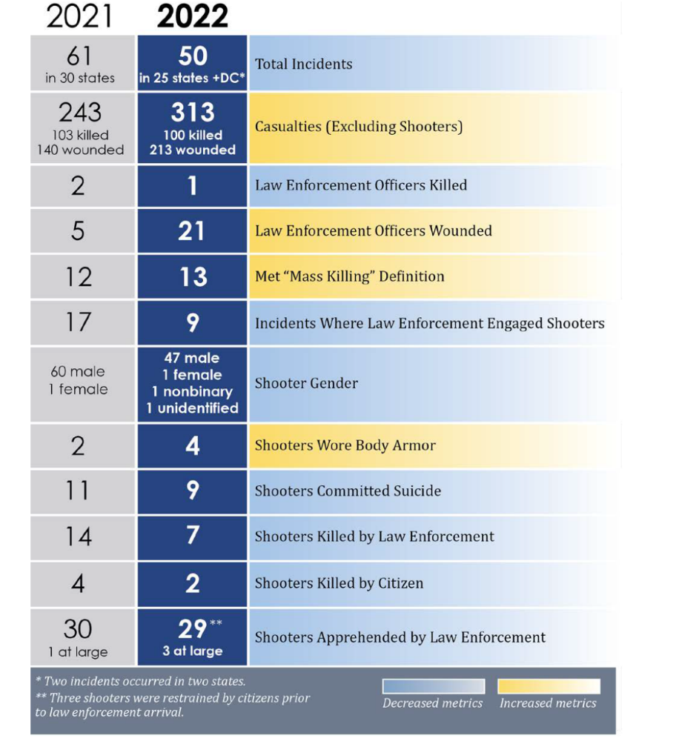
Active Shooter Incidents in the United States, 2022, United States Department of Justice, FBI

Slide 7
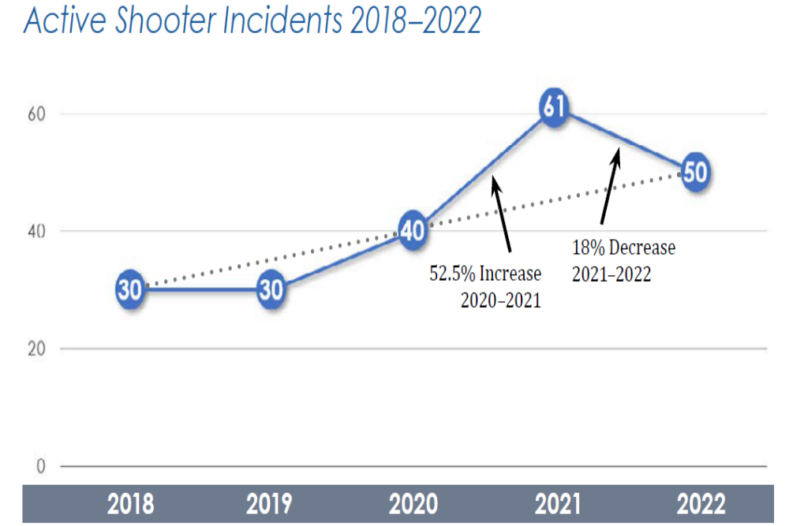

Slide 8
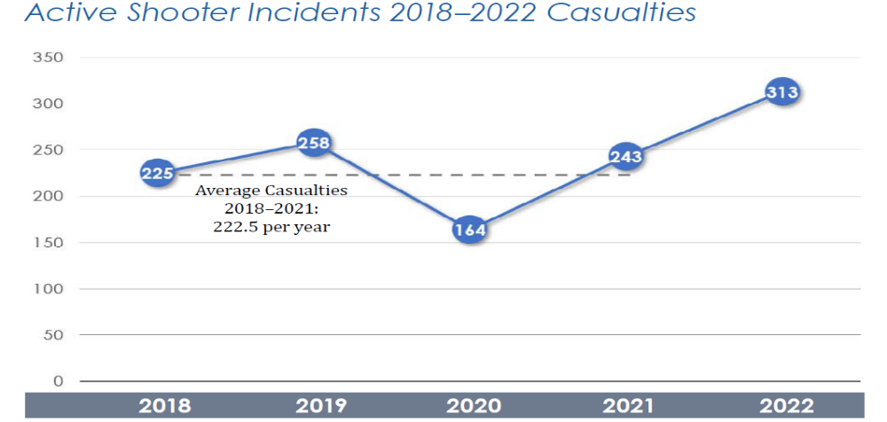
Active Shooter Incidents in the United States, 2022, United States Department of Justice, FBI

Slide 9
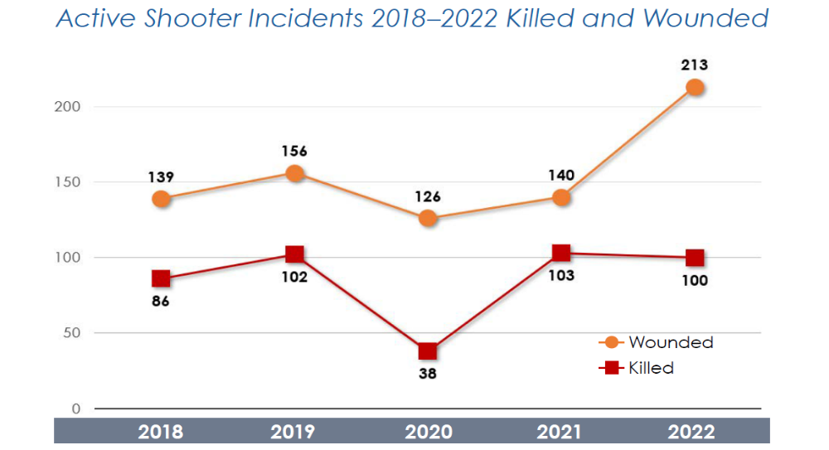
Active Shooter Incidents in the United States, 2022, United States Department of Justice, FBI

Slide 10
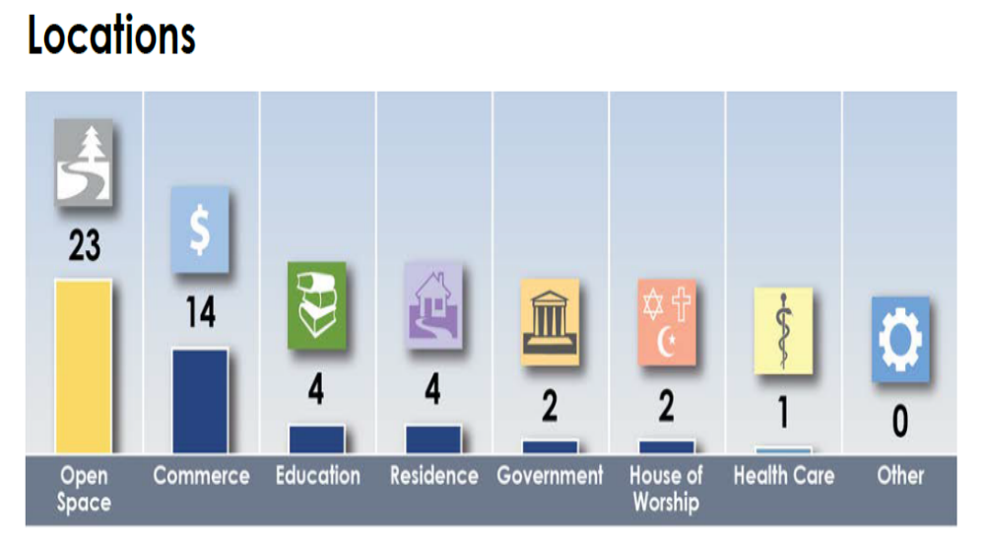
Active Shooter Incidents in the United States, 2022, United States Department of Justice, FBI

Slide 11
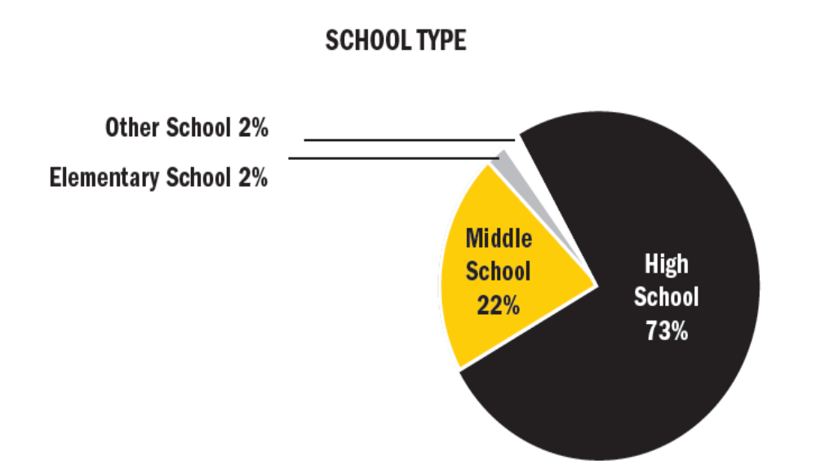
PROTECTING AMERICA’S SCHOOLS: A U.S. SECRET SERVICE ANALYSIS
OF TARGETED SCHOOL VIOLENCE (2019)
U.S. Department of Homeland Security UNITED STATES SECRET SERVICE
National Threat Assessment Center

Slide 12
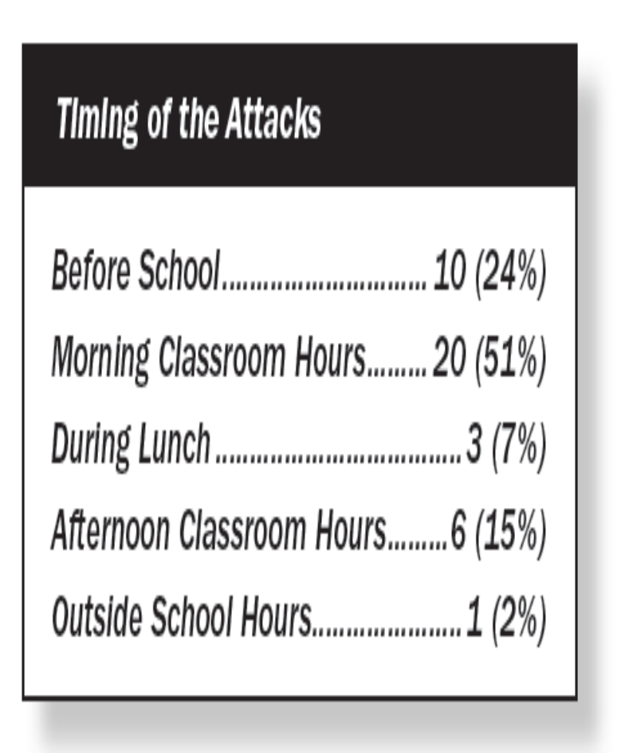
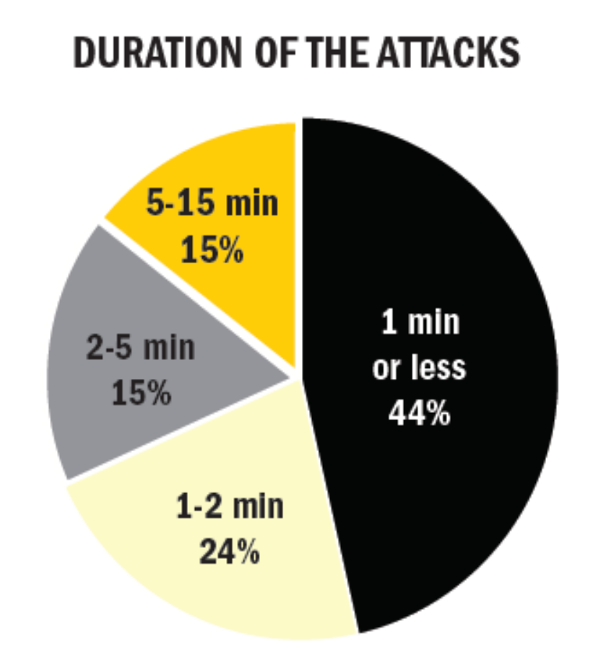
PROTECTING AMERICA’S SCHOOLS: A U.S. SECRET SERVICE ANALYSIS
OF TARGETED SCHOOL VIOLENCE (2019)
U.S. Department of Homeland Security UNITED STATES SECRET SERVICE
National Threat Assessment Center

Slide 13
Affective and Predatory
Modes of Violence

Slide 14
What is violence?
An intentional act of aggression toward another human being that physically injures, or is likely to physically injure, that human being.

Slide 15
Affective & Predatory
Modes of Violence
Intense ANS arousal
Subjective experience of emotion
Reactive and immediate violence
Internal or External threat
Goal is threat reduction
Minimal or no ANS
No conscious emotion
Planned and purposeful
No or minimal threat
Many goals

Slide 16
Affective and Predatory (continued)
Rapid displacement of target
Time-limited behavior
Preceded by public posturing
Primarily emotional
Heightened and diffuse awareness
No target displacement
No time limit to behavior
Preceded by private ritual
Primarily cognitive-conative
Focused awareness

Slide 17
Differences and Similarities between Threat and Risk Assessment

Slide 18
Threat Assessment,
Goodrum et al., 2018
“The threat assessment process seeks to evaluate
the likelihood a person will perpetrate “targeted
violence” (i.e., toward a specific person or group), such as an assassination or a school shooting. In schools, threat assessment procedures seek to evaluate a student’s risk of targeted violence and build a safety plan to support the student.” (pp. 123).

Slide 19
Risk Assessment,
Goodrum et al., 2018
“A risk assessment evaluates the risk and protective
factors present in a person and evaluates the risk for general and specific forms of violence (e.g., intimate partner violence, stalking).” (pp. 123).

Slide 20
Risk v. Threat Assessment (Meloy, et al., 2011)
Violence risk assessment has older provenance
Risk assessment focuses on probability of violence and estimated for an individual based upon his/her comparison to a known group
Typically a history of violence
Classification of low, medium or high risk

Slide 21
Risk v. Threat Assessment (Meloy, et al., 2011)
Threat assessment focuses on targeted violence by a subject of concern and encompasses a behavioral and profiling focus.
Person of focus may have no history of violence.

Slide 22
Differences between TA and RA
Operational context
Dynamic emphasis
Idiographic (case-driven) approach
Very low base rates
Risk management rather than prediction
Subject and potential victim
Predatory (instrumental, intended) violence
Likely urgency

Slide 23
Threat Assessment Model
We don’t focus on predicting what the subject will do in the future. We focus on managing risk for what subject is doing now.
We are not able to anticipate threats with certainty (Meloy, et al., 2014).
We attempt to implement sound practices to identify and intervene with subjects as early as possible on the path toward violence (Cornell, 2010).

Slide 24
Threat Assessment Model
Generally posits that targeted violence is deliberate, planned and well thought out versus expressive/reactive violence
The progress occurs from ideation >> planning >> acquisition>> implementation (Deisinger et al., 2008).

Slide 25
Threat Assessment Model
Pathway to violence is not linear
Iterative such that the person can cycle between the pathway, contingent upon information gathered, increased desperation and monitoring.

Slide 26
Threat Assessment Model
De-emphasizes:
  Psychiatric Diagnoses
  Static variables
  Communicated threats

Slide 27
Implication for Threat Assessment,
(Vossekuil, Fein and Berglund, 2015)
Targeted violence is the end result of an understandable, and often time discernible, process of thinking and behavior.
Targeted violence stems from an interaction among the individual, the situation, the setting, and the target.
An investigative, skeptical, inquisitive mind-set is critical to successful threat assessment.

Slide 28
Implication for Threat Assessment,
(Vossekuil, Fein and Berglund, 2015)
Effective threat assessment is based on facts rather than on characteristics or “traits.”
An integrated systems approach should guide threat assessment inquires and investigations
The central question in a threat assessment investigation or inquiry is whether her person of interest poses a threat, not whether the person of interest made a threat.

Slide 29
Dynamic Factors for
Targeted Violence

Slide 30
Warning Behaviors (Meloy, Hoffmann, Guldimann & James,
BS&L, 2012; 30:256-279
Pathway
Fixation
Identification
Novel aggression
Energy burst
Leakage
Directly communicated threat
Last resort behavior

Slide 31
Warning Behaviors
They are accelerants—focus on accelerating change
Patterns of behavior rather than individual risk factors: pattern analysis
Appear to correlate with targeted violence, but do they predict?

Slide 32
Pathway warning behavior
Any behavior that is part of research, planning, preparation, or implementation of an attack (Fein & Vossekuil, 1998, 1999; Calhoun & Weston, 2003)

Slide 33
Pathway to Targeted or Intended Violence
Adapted with permission from F.S. Calhoun and S.W. Weston (2003). Contemporary threat management: A practical guide for identifying, assessing and managing individuals of violent intent. © 2003 F.S. Calhoun and S.W. Weston. All rights reserved.
Attack
final acts
Probing & Breaches
Pre-attack Preparation
Escalation
Research & Planning the Attack
De-Escalation
decision
Violent Ideation
The “Grievance”
Notes:
33

Slide 34
Grievance
Loss
Humiliation
Anger
Blame

Slide 35
Fixation warning behavior
    Any behavior that indicates an increasingly pathological preoccupation with a person or a cause (Mullen et al., 2009). It is measured by: a) increasing perseveration on the person or cause; b) increasingly strident opinion; c) increasingly negative characterization of the object of fixation; d) impact on the family of the object of fixation, if present and aware; e) angry emotional undertone. It typically causes deterioration of social and occupational functioning.

Slide 36
Identification warning behavior
    Any behavior that indicates a psychological desire to be a “pseudocommando” (Dietz, 1986; Knoll, 2010), have a “warrior mentality” (Hempel et al., 1999), closely associate with weapons or other military or law enforcement paraphernalia, identify with previous attackers or assassins, or to identify oneself as an agent to advance a particular cause or belief system.
    “A fanatic is never discouraged by the impossibility of his righteous mission.”

Slide 37
Characteristics of Identification
Meloy, Mohandie, Knoll & Hoffman, 2015
Pseudo-commando
Warrior mentality
Close association with weaponry, law enforcement, military paraphernalia
Identify with other attackers or assassins
Become an agent to advance a particular cause or belief system

Slide 38
Weapon Access and Background
What is the subject’s familiarity with weapons?
Do they possess weapons?
Do they seek out weapons?
Frequency of attending gun shows
Do they collect/stockpile ammunition
Do they carry/conceal weapons?
Have they made recent purchases?

Slide 39
Weapon Access and Background
Internet searches for weapons?
Does the subject of interest purchase parts from internet sites “swap meet” sites; etc., craigslist
Is the person purchasing attire/clothing related to identification or “pseudo-commando” goals
Does the subject of interest have relatives who possess guns?

Slide 40
Novel aggression warning behavior
    An act of violence which appears unrelated to any targeted violence pathway warning behavior which is committed for the first time. Such behaviors may be utilized to test the ability (de Becker, JACA) of the subject to actually do a violent act, may be a measure of response tendency, the motivation to act on the environment (Hull, 1952), a behavioral tryout (MacCulloch, Snowden, Wood & Mills, 1983), or proof of kill (G. Deisinger, personal communication, 2011).

Slide 41
Energy burst warning behavior
    An increase in the frequency or variety of any noted activities related to the target, even if the activities themselves are relatively innocuous, usually in the days or weeks before the attack (Odgers et al., 2009).

Slide 42
Leakage warning behavior
    The communication to a third party of an intent to do harm to a target through an attack (Meloy & O’Toole, Behavioral Sciences and the Law, 29:513-527, 2011).

Slide 43
Leakage Warning Behaviors
(Hendrix, et al., 2022)
Tip lines
Information collected over 43 months by a state-operated tip (N = 6,006).
Tips were accounted for by 126 Oregon schools (approximately 11% of all schools in the state).
Main focus was on 228 tips reporting one or more persons for mass school violence leakage or for an individual’s direct or indirect communication of an intent or desire to kill multiple individuals at school.

Slide 44
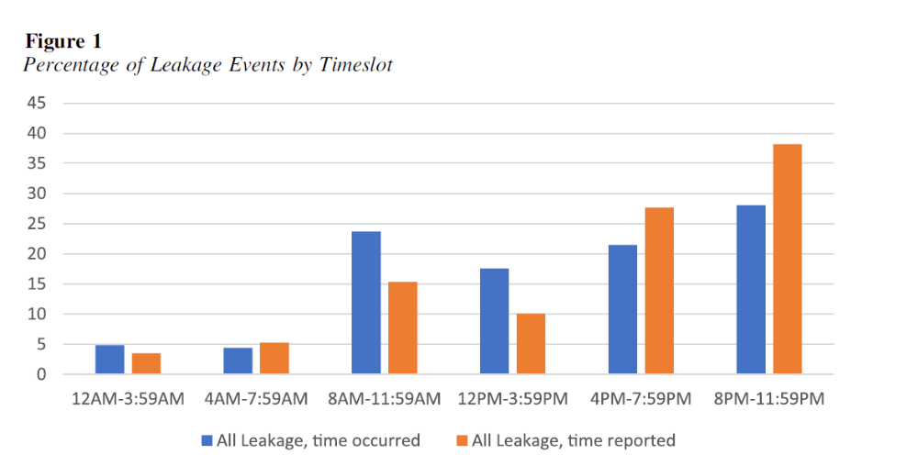
Leakage Warning Behaviors
(Hendrix, et al., 2022)

Slide 45
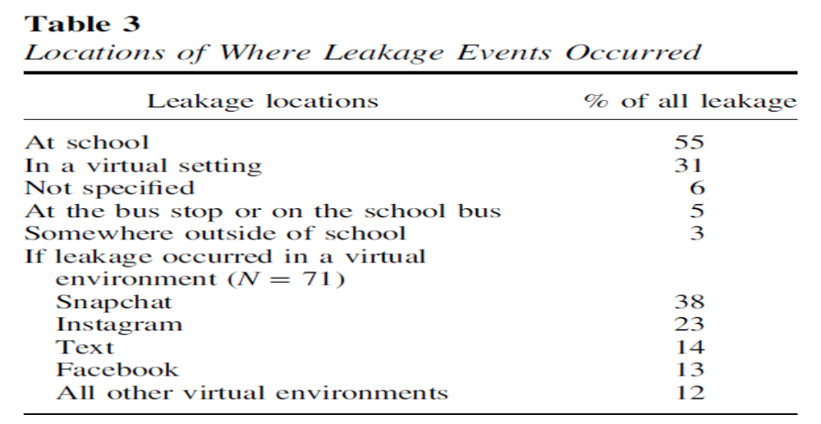




Leakage Warning Behaviors
(Hendrix, et al., 2022)

Slide 46
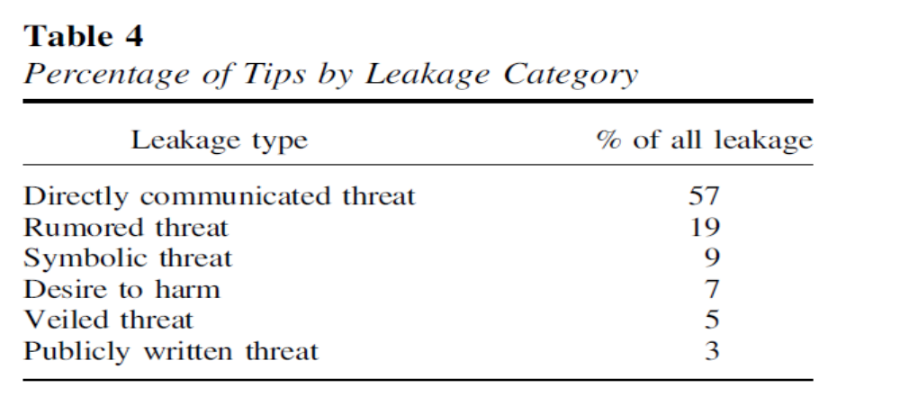


Leakage Warning Behaviors
(Hendrix, et al., 2022)

Slide 47
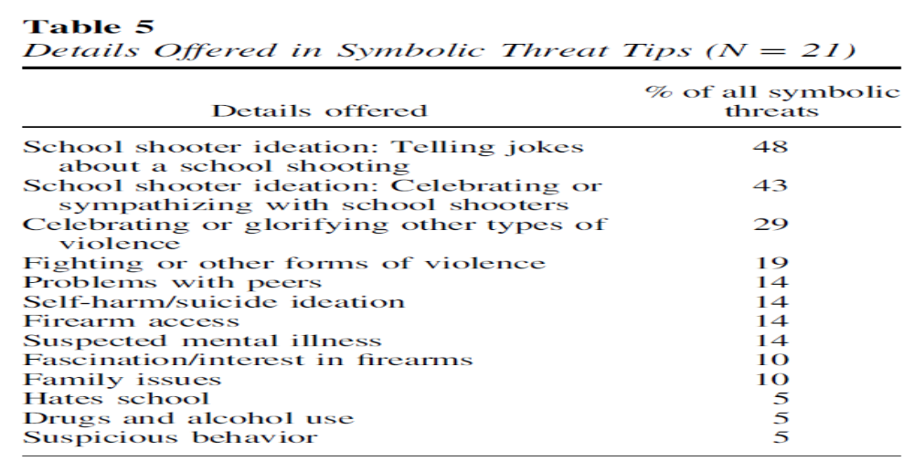
Leakage Warning Behaviors
(Hendrix, et al., 2022)

Slide 48
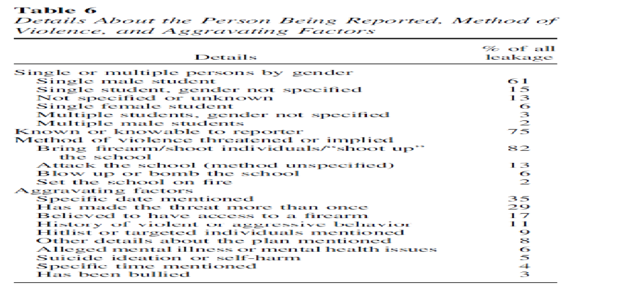
Leakage Warning Behaviors
(Hendrix, et al., 2022)

Slide 49
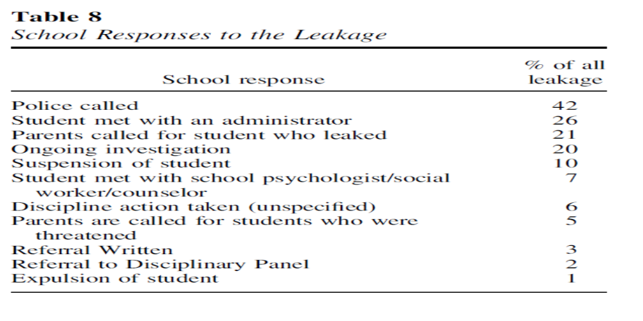
Leakage Warning Behaviors
(Hendrix, et al., 2022)

Slide 50
Leakage Warning Behaviors
1990 to 2014, 58% engaged in some form of leakage (Silver, Horgan, & Gill, 2018)
2000 to 2013 FBI study of active shooters, 56% openly expressed their violent thoughts or intent prior to attacking (Silver, Simons, & Craun, 2018)

Slide 51
Leakage Warning Behaviors
Research suggests - people are often hesitant to report potential mass shooters to law enforcement, even if they observe concerning behavior (Madfis, 2014a; Silver, Simons, & Craun, 2018)
“bystander intervention” increases sense of responbility on self
Reporting of stranger is easier than known persons

Slide 52
Lankford, 2019
N=15 (3/98 – 2/18)
Examined leakage, reports to law enforcement (LE) and weapon acquisition
  leakage of violent thoughts/intent in general
  leakage of specific interest in mass killing
  whether the mass shooter’s concerning behavior reported to LE prior to attack
  whether concerns about the mass shooter’s specific interest in homicide (i.e., killing people) had been reported to LE

Slide 53
Lankford, 2019
Leakage of violent thoughts/intent (87%)
Leakage of specific interest in mass killing (80%)
Concerning behavior reported to LE (80%)
Concerning interest in homicide reported LE (47%)
Firearms in mass shooting acquired legally (80%)

Slide 54
Leakage and Reports to LE
Lankford, 2019
Prevention appears possible in the vast majority of cases
Public should be educated, encouraged, and pressured to report leakage and warning signs to LE
LE needs to be educated and trained on how to more effectively investigate potential threats
Individuals who have admitted homicidal or suicidal thoughts or interest in committing mass shootings should be prohibited from purchasing or possessing firearms

Slide 55
Last resort warning behavior
    Evidence of a violent “time/action imperative” (Mohandie & Duffy, 1999). Increasing desperation or distress through declaration in word or deed, forcing the individual into a position of last resort. There is no alternative other than violence, and the consequences are justified (de Becker, 1997). The subject feels trapped (S. White, personal communication).

Slide 56
Last resort warning behavior
    Evidence of a violent “time/action imperative” (Mohandie & Duffy, 1999). Increasing desperation or distress through declaration in word or deed, forcing the individual into a position of last resort. There is no alternative other than violence, and the consequences are justified (de Becker, 1997). The subject feels trapped (S. White, personal communication).

Slide 57

“If you have the knowledge and inspiration, all that’s left is to take action.”
      Posted one week before April 15, 2013 Boston Marathon bombing by Dzhokhar Tsarnaev

Slide 58
Directly communicated threat warning behavior
    The communication of a direct threat to the target or law enforcement beforehand. A threat is a written or oral communication that implicitly or explicitly states a wish or intent to damage, injure, or kill the target, or individuals symbolically or actually associated with the target.

Slide 59
Implementation of Threat Assessment and Management

Slide 60
Threat Management Team Make-Up
Case Manager/Team Leader
Administrative Staff
Teacher/Counselor/Mental Health Professional
Law Enforcement – Community - SRO
Attorney
External referral sources for Threat Assessment
Ad-hoc members, as needed

Slide 61
Threat Assessment and Management
Establish Multidisciplinary Threat Assessment Team
Identify prohibited and concerning behaviors
Create central reporting mechanism
Determine level threshold for LE intervention
Establish clear assessment procedures
Develop risk management options
Create and promote safe school climates
Conduct training for all stakeholders

Slide 62
Threat Assessment and Management
Goals include:
  Piece together information
  Redirect subject of interest’s motion away from the path toward violence.
  Engage in a non-adversarial manner.
  Involves engaging subject of interest.
  Casts a wide net.
  Behavior of team does not exacerbate the situation.

Slide 63
Comprehensive Student Threat Assessment Guidelines (CSTAG)
Step 1:
TAT evaluates the threat by interviewing subject of interest
Document/note exact content of the threat
What have others observed regarding nature of threat and behavior
Gather information on the circumstances in which the threat was made
What are the circumstances in which threat was made – situational context
Is there communication of intent to harm or behavior suggesting intent to harm
In most cases, the threatening student is interviewed and given an opportunity to explain what he or she meant by the threatening statement or behavior.

Slide 64
Comprehensive Student Threat Assessment Guidelines (CSTAG)
Step 2:
All available information is used by the school teams to consider the credibility and seriousness of the threat.
Humor, rhetoric, frustration, reactive situation that can be easily resolved
Does person retract and then apologize for behavior with consistent de-escalation.

Slide 65
Comprehensive Student Threat Assessment Guidelines (CSTAG)
Step 3: TAT respond to a substantive threat
  Take precaution to protect individual
  Warn intended victim and family
  Explore manners to resolve conflict
  Disciplinary procedures, when necessary

Slide 66
Comprehensive Student Threat Assessment Guidelines (CSTAG
Step 4: Serious substantive threats.
  Student screened for mental health services or counseling.
  Potential law enforcement investigation of the case
  Closer examination of probing/planning behavior
  Develop safety plan
  Potential target hardening

Slide 67
Comprehensive Student Threat Assessment Guidelines (CSTAG)
Step 5: Implementation/monitoring safety plan formulated
  Documentation
  Monitoring/surveillance of students
  Assess effectiveness of plan/tactics

Slide 68
SCHOOL THREAT ASSESSMENT IN FLORIDA:
TECHNICAL REPORT OF 2021-2022 CASE DATA,
Jennifer L. Maeng, Dewey G. Cornell, Jordan Kerere, Francis Huang, Timothy Konold, and Kelvin Afolabi 6/1/23
Threat Severity and Safety
No threat (17.8%)
Case readily resolved as a transient (no serious intent) threat (64%)
Substantive cases classified as serious (13.4%; a threat to fight)
Very serious (4.7%; a threat to kill, rape, or use a lethal weapon)
Findings demonstrate the value of using threat assessment to resolve less serious cases efficiently and concentrate more time and effort on serious cases.
Schools relying on a zero tolerance approach would be removing far more students from school.

Slide 69
SCHOOL THREAT ASSESSMENT IN FLORIDA:
TECHNICAL REPORT OF 2021-2022 CASE DATA,
Jennifer L. Maeng, Dewey G. Cornell, Jordan Kerere, Francis Huang, Timothy Konold, and Kelvin Afolabi 6/1/23
Students referred for threat assessment:
  White (37%)
  Black (37%)
  Hispanic (23%)
  Other racial/ethnic groups (4%)
  Approximately 72% were male students
  33% received special education services through an IEP
  9% received services through a 504 Plan

Slide 70
SCHOOL THREAT ASSESSMENT IN FLORIDA:
TECHNICAL REPORT OF 2021-2022 CASE DATA,
Jennifer L. Maeng, Dewey G. Cornell, Jordan Kerere, Francis Huang, Timothy Konold, and Kelvin Afolabi 6/1/23
Comparison of Results of Threat Assessments by Gender and Race/Ethnicity
  Male students were more likely to receive out-of-school suspension than female students, and female students were more likely to receive a legal action than male students
  Small differences in disciplinary outcomes for Black, Hispanic, and White students who received a threat assessment
  OSS were slightly higher for Black students (27.0%), lower for Hispanic students (24.8%) than for White students (25.9%)
  Expulsions were very low overall, but slightly higher for Black (1.9%) and Hispanic (2.0%) students than White (1.2%) students
  Placement changes were 11.1% for Black students, 13.9% for Hispanic students, and 7.2% for White students

Slide 71
SCHOOL THREAT ASSESSMENT IN FLORIDA:
TECHNICAL REPORT OF 2021-2022 CASE DATA,
Jennifer L. Maeng, Dewey G. Cornell, Jordan Kerere, Francis Huang, Timothy Konold, and Kelvin Afolabi 6/1/23
Comparison of Results of Threat Assessments by Gender and Race/Ethnicity
  Some of these comparisons led to significant differences, samples were large, but magnitude was low
  There were no statistically significant differences in law enforcement actions (i.e., arrest, charges, incarceration) for Black, Hispanic, or White students

Slide 72
Identify risk and threat factors
How they manifest in person
How each is relevant
Assessment
Communication
Management
& Treatment
Low, moderate, high
Intensity of Management
Tailored interventions based on risk and threat factors
Application of risk and threat management strategies
Reassessment on regular intervals

Slide 73
Strategy Planning
Monitoring
Surveillance or repeated assessment
Treatment
Rehabilitation, further assessment
Victim Safety Planning
Enhanced security measures, resources for identified targets
Supervision
Imposition of controls, restriction of movement

Slide 74
Scenario Planning,
Douglas, et al., 2013
Develop scenarios
Evaluate scenarios
Which “possible futures” most deserve attention?
Use scenarios to plan
Which strategies, tactics, and logistics are needed?
What are the “possible futures?”

Slide 75
Ongoing Training
Technical vs. Adaptive Solutions
Goodrum, et al., 2018
Technical solutions are addressed with few small adjustments by one authority and within organizational boundaries (e.g., metal detector, video surveillance system).

Slide 76
Ongoing Training
Technical vs. Adaptive Solutions
Goodrum, et al., 2018
Adaptive solutions include number ongoing TA trainings, assessing more students for threats, and increasing the number of indicators on the TAT screener.

Slide 77
Technical vs. Adaptive Solutions
Goodrum, et al., 2018
Adaptive solutions require multiple authorities, crossover organizational boundaries (e.g., schools, mental health, and criminal justice) but elicit emotional responses, and face resistance.
Adaptive solutions require that school officials share information to promote a “culture of safety,” adopt continuous improvements to threat assessment, monitor quality of threat assessment and engage in safety planning implementation process.

Slide 78
School Security Measures
Post-Columbine
King & Bracy, 2019
  School Security Personnel – staff, teachers, aides, administrators – remained relatively stable from 1999 (85.4%) to 2015 (89.5%)
  School Based Law Enforcement – including SRO – 1996/1997 (22%) to 2015/2016 (57%)
  CCTV – in 1999 (19.4%) to 2015/2016 (80.6%)
    Unless cameras monitored-less utility
  Emergency Preparedness – 2015/2016 (94.6%) have drills on lock-down procedures
  Active Shooter Drills - 2015/2016 (92%)

Slide 79
School Security Measures
Post-Columbine
Addington, 2018
  Empirical support is lacking that any of these tactics alone or in combination is effective to prevent school shootings

Slide 80
School Security Measures
Post-Columbine
Jonson, 2017
Belief that presence of an armed police officer on campus serves as a deterrent to a potential school shooter - neutralize the threat of a school shooter
As of 2019; little empirical evidence supports the assumption that armed police officers serve as a deterrent to potential school shooters
  School shootings in U.S. with highest casualties Columbine (13), Sandy Hook (26), Santa Fe (10), and Marjory Stoneman Douglas HS – 75% of them had a police or armed security officer assigned to campus

Slide 81
School Security Measures
Post-Columbine
Safety Drills – Utility
Alert, Lockdown, Inform, Counter, Evacuate (ALICE) Institute provide training with no empirical evidence to support their effectiveness (Krisch, 2018)
Potential for negative impact on children and school climate (Krisch, 2018; Magliozzi, 2018; Peterson et al., 2015).
Are students retain and implement what they have learned in a training, especially for students suffering with anxiety or previous exposure to violence (McCoy, Raver, & Sharkey, 2015)

Slide 82
Target Hardening
Ecological and situational controls
  Reduce opportunity for strangers or subject of interest to access location.
  Availability to access/exits.
  Communication device accessibility.
  Law enforcement presence.
  CCTV systems/monitoring.

Slide 83
Hierarchy of Threat Management
(Palarea & Van Horn, 2010)
Incarceration/Jail
Arrest
Hospitalization
Restraining Order/Protection Order
Refer for outpatient mental health counseling
Administrative actions
Ecological/physical measures
Leverage subject of interest’s social network
Notify subject of interest boundaries/consequence
Notify subject of interest about safety measures

