Slide 1
Grades 7th & 8th
Lesson 1
Healthy and Unhealthy relationships

Slide 2
What is a healthy relationship?
Healthy relationships include:
Mutual respect.
  Respect each others values & boundaries.
Trust.
Honesty.
The ability to compromise.
  In a healthy relationship, each partner negotiates a win-win solution when there are problems.
Individuality.
  Each person should be supportive of his/her partner wanting to pursue new hobbies or make new friends.
Healthy communication.
  speak honestly and openly to avoid miscommunication. Problem solving fairly
Emotion control.
  Anger, sadness, frustration, jealousy, insecurity
Notes:
Expand on each area, when needed

Slide 3
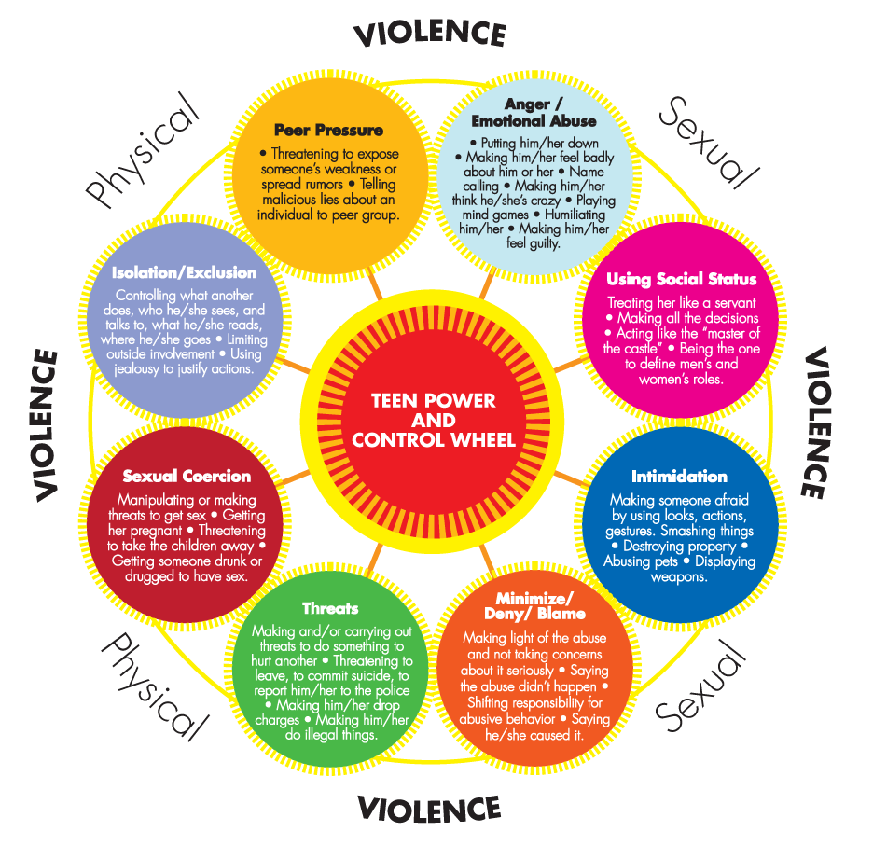
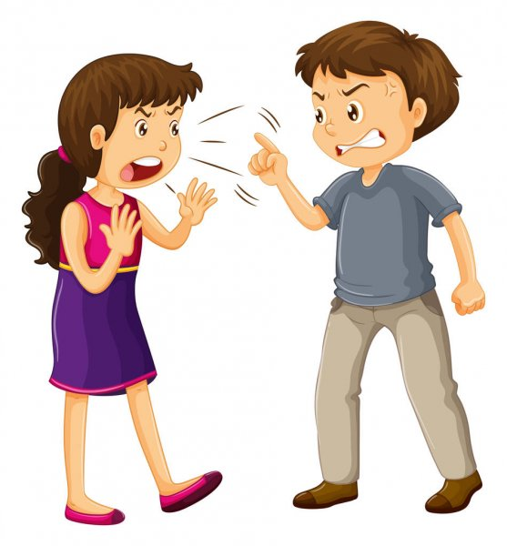
Types of unhealthy relationships….
Notes:
Teacher notes: Always Tell an Adult
• We feel more comfortable when people respect our personal space. We don’t like getting pushed
together in long lines, or being touched unexpectedly, or being sandwiched between strangers on the
bus. In the same way, someone touching us in a way we don’t like or that we know is unsafe makes us
uncomfortable, and we have to tell them to stop.
• We know what interactions we like and what makes us uncomfortable. This is how we set personal
boundaries, and that’s why Tell Them to Stop is a Protect Yourself Rule. It remind us that we have to enforce
those boundaries. What are some ways we can let people know if they are making us uncomfortable?
• Friends and siblings are usually comfortable playing very closeley together, and probably don’t think
twice about touching each other. There is nothing wrong with touching like this, but if someone’s touch
makes us uncomfortable, we have the right to tell them to stop.
• It’s completely normal to ask not to be touched. That is everyone’s right, and it should never be
embarassing or awkward to do. Have you ever asked a friend not to touch you?
• We know that any touch to a private body part is always off-limits. How can we be sure that we don’t
touch someone in any other way that might make them uncomfortable?

Slide 4
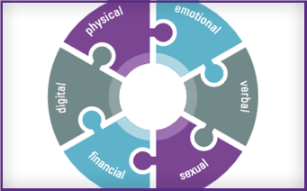
Definitions of Abuse (abuse is about power and control) ...
Physical-inflicting or attempting to inflict physical injury or illness.
  punching, hitting, slapping, kicking, strangling, or physically restraining a partner against their will, forcing alcohol/illegal substances. Driving recklessly or invading someone’s physical space, and making someone feel physically unsafe.
Verbal/Emotional-using words like weapons; undermining, humiliating or shaming the person
Mental/Psychological- instilling or attempting to instill fear; isolation, treats,
Financial/Economic- making or attempting to make a person financially dependent on the partner
Digital- use of technology such as texting and social networking to bully, harass, stalk or intimidate a partner.
Sexual-coercing or attempting to coerce any sexual contact without consent.
Notes:
Expand on each area, when needed

Slide 5
What is sexual abuse?
Sexual abuse can look like a lot of different things and it doesn't need to hurt to be wrong.
It can be someone touching your private parts.
It can be someone making you touch their private parts.
It can be someone looking at your private parts or making you look at theirs.
It can be someone making you look at pictures of other people's private parts.

Slide 6
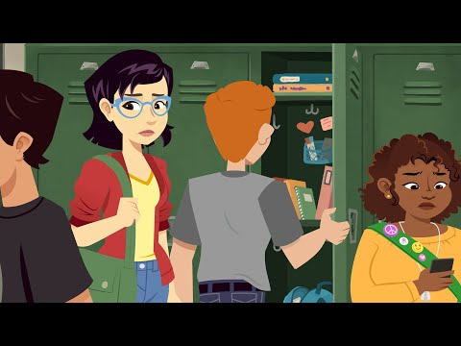
but no matter what it looks like, or how much it happens, sexual abuse is always wrong!
Notes:
Expand on each area, when needed

Slide 7

Personal space vs. setting boundaries
https://video.link/w/L316c
How to set boundaries-
Notes:
Expand on each area, when needed

Slide 8
WHO CAN I TALK TO?
ANY SAFE ADULT
  PARENTS
  TEACHERS
  COUNSELORS
  FRIENDS
  CLERGY
  TRUSTED FAMILY MEMBER

Slide 9
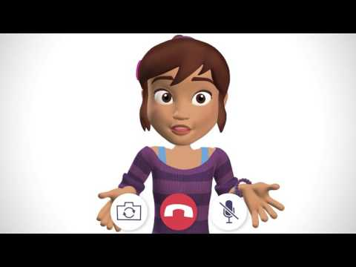
Internet Safety
Notes:
What is an unsafe touch?
Who can you tell if you experience an unsafe touch?
What can you say to someone who makes you feel uncomfortable?
Now that the class has watched the video, it’s time to talk about the lesson in-depth. Use the following
suggested topics to open up a discussion about the lesson. Call on students to contribute or invite comments
from volunteers.
• Everyone experiences their share of awkward social moments. It can be hard to know if we’re coming on
too strong or being overbearing or just having fun. How can we use The Protect Yourself Rules to be sure
we never cross the line and make someone else feel uncomfortable or unsafe?
• We have the power to protect our personal space by being vocal and assertive. If someone we know (like
a friend or relative) invades our personal space, how can we be respectful when asking them to stop?
• There is nothing wrong with flirting, but you can never touch someone without permission. As we saw in
the video, flirting is not permission to touch.
• What can you do if someone talks to you or touches you in a flirtatious way and you don’t want them
to? You have to tell them to stop, right away. Don’t let behavior that makes you uncomfortable go on; tell
them to stop, and tell an adult if they don’t.
• An Unsafe Touch is any touch to a private body part. Unsafe Touches are against the law, and minors can
never give permission for others to touch them there, even to people their own age. How can we use The
Protect Yourself Rules to prevent or react to Unsafe Touches?
• If someone makes you feel uncomfortable or unsafe, the first thing you should do is tell them clearly to
stop. Make them understand that they are crossing the line. How can we communicate clearly to someone
that they are making us feel uncomfortable

Slide 10
Lets Practice:
Break into small groups. How would you respond to the following scenarios?
SCENARIOS
A relative shows you pornographic video. What do you do?
A friend invites you to a game sight, you are not allowed to visit; what do you do?
In a group text, the group gets a picture of a half dressed person. What do you do?
Someone you do not know, contacts you; in a game, email, text message, or on your phone. What do you do?
Your coach has a habit of touching you on the shoulder, and you want them to stop. What do you do?

Slide 11
Bystander intervention...
If you or another is experiencing harm, take action! Do not be a Bystander.
Anyone who uses their position or strength to bully, harass or abuse another person is a bully or abuser.
It doesn’t matter if they are an adult or youth. There is always something you can do.
Stop the situation
Step in, and use words to instruct the participants to disengage.
Yell No, leave me or him/her alone
Telling a person directly, “NO” usually works. If it doesn’t, leave the situation and go someplace safe.
Go find help
Don’t be a bystander – they are just as bad as the person doing the harm. Engage others to assist.

Slide 12
FOR MORE INFORMATION:
The following websites have great information for students who are looking for help:

