Slide 1

Erin’s Law
A Parent’s Guide

Slide 2
1 in 4 girls and 1 in 6 boys are victims of sexual abuse before the age of 18.

Slide 3
Over 90% of the time children are being abused by someone they know and trust.

Slide 4
Erin’s Powerful Message:
This is Erin’s recent interview on CNN.
https://www.cnn.com/videos/justice/2018/05/14/erin-merryn-erins-law-sexual-abuse-safety-education-paul-dnt.cnn

Slide 5

What is Erin’s Law?
Erin’s Law is named after childhood sexual assault survivor, author, speaker and activist Erin Merryn..
After Erin introduced the legislation in her home state of Illinois, the bill was named “Erin’s Law” after her. Illinois was the first state by law to mandate child sexual abuse prevention.
As of July 2019 Erin’s Law has been passed in 37 states.

Slide 6
Requirements
Erin’s Law requires that all public schools in each state implement a prevention-oriented child sexual abuse program which teaches:
1 School personnel all about child sexual abuse
2 Students in grades K – 8th, age-appropriate techniques to recognize and report child sexual abuse
3 Parents & guardians the warning signs of child sexual abuse, plus needed assistance, referral, or resource information to support sexually abused children and their families

Slide 7
What will my child be learning?
Erin’s Law is not sex education
It teaches personal body safety, what is a good secret versus a bad secret, & it empowers kids to find a safe adult if they feel something isn’t right.
Erin’s Law teaches kids about safe and unsafe touches by giving them examples.
It teaches that parents should never force their children to give people hugs and kisses. Allow them to make that decision. They need to be empowered and know they are the boss of their own bodies.

Slide 8
Can I opt out of this curriculum?
The New York State Mandate does not allow for parents to opt their children out of the lessons presented.

Slide 9
Talking with Your Child About Body Safety
Begin as soon as language is developed
Explain to them their private parts are “the areas covered by your swimsuit”.
Nobody including a parent or caregiver – should see or touch them unless they’re keeping them clean, safe, or healthy.
I Said No! Kimberly King

Slide 10
Talk with Your Child About…
Trusting their intuition
Leaving an uncomfortable situation and finding a safe adult
The differences between safe and unsafe secrets
Safe and unsafe touches
Empower them to know they are the boss of their bodies
The Right Touch by Sandy Kleven
Have ongoing discussions about personal body safety (every 6 months)

Slide 11

Healthy touches for children...

Slide 12
Warning Signs of an Abused Child
Nightmares
Trouble sleeping
Bed wetting
Change in appetite
Fear of certain people, places, activites
Mood swings: Rage, Anger, Fear, anxiety, insecure or withdrawn
Depression
Aggression
Feeling shameful or guilty
Isolating oneself
Withdrawal from someone
Resisting removing clothes when appropriate times (bedtime, bathtime)
Change in academics
Running away from home
Suicidal thoughts
Acting out sexually
Exhibits adult sexual behaviors, knowledge, and language.

Slide 13
Signs more common in Adolescents
Eating Disorders
Self Injury
Drug and Alcohol Abuse
Promiscuous activity
Running away
Suicidal
Depression and Anxiety
Fear
Academic problems

Slide 14
Definition of Grooming
A process by which a person prepares a child, significant adults, and the environment for the abuse of a child.

Slide 15
Goals of Grooming
Gaining access to the
child
Assessing the child’s
compliance
Maintaining the child’s
secrecy to avoid disclosure

Slide 16
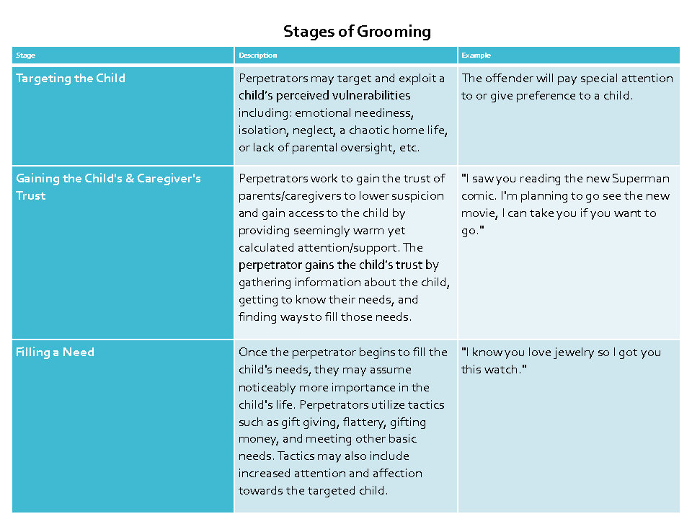

Slide 17
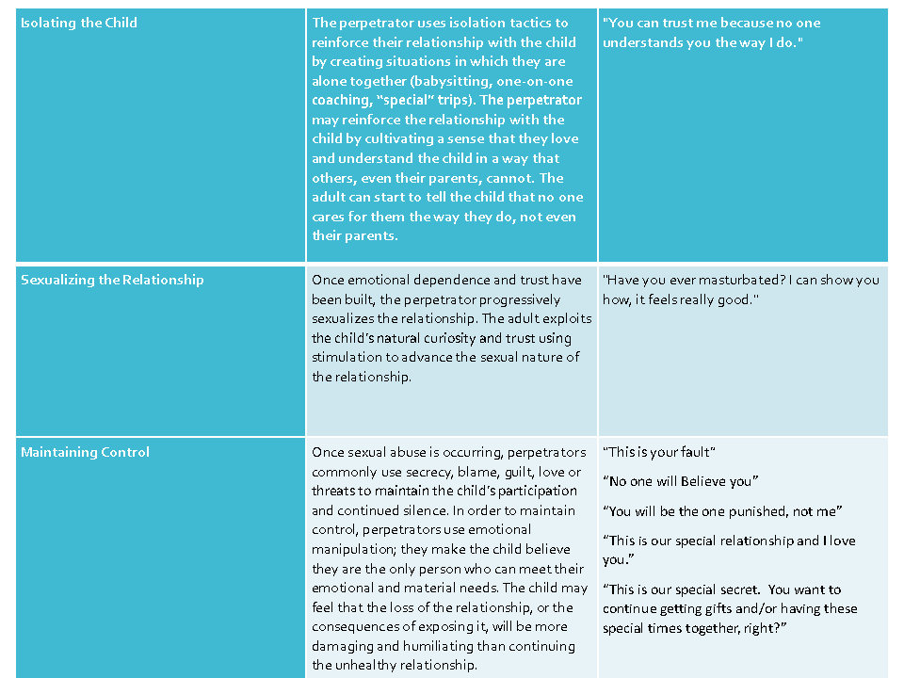

Slide 18
What is Child Sexual Exploitation?
Report
Online enticement of children for sexual acts
Child Sex Trafficking
&
Tourism
Unsolicited obscene
materials
sent to
children
Misleading
Domain
Names
Misleading
Words or
Digital
Images
on the
Internet
Child
Sexual
Molestation
(Non-
Familial)

Slide 19
Signs an adult may be sexually abusing your child:
Giving a child special attention
Trying to spend a lot of time alone with a child
Buying child gifts or giving them money
Treating a child as a “favorite” from other children
Physical affection towards child: Kissing, hugging, holding hands, or wanting to be very close to a child.

Slide 20
If a Child Discloses Abuse
Listen
Let
Tell
Say
Let
Report
Listen to the child
Let them know they did the right thing by telling
Tell them this is not their fault
Say you believe them
Let child know they are safe now and won’t be hurt again
Report abuse immediately to police

Slide 21
Resource:
To report incidents of sexual abuse on-line
CyberTipline.org
https://www.missingkids.org/gethelpnow/cybertipline
Notes:
Presenter to share with parents that if they come across child pornography or concerns of seeing sexual abuse on the internet this is the website they can report the inofmraiton to.

