Slide 1
Understanding
Erin’s Law
A Parent’s Guide
Notes:
The focus of these slides are for elementary and primary school parents.

Slide 2
What is Erin’s Law?
Erin’s Law is named after childhood sexual assault survivor, author, speaker and activist Erin Merryn, who is the founder and President of Erin’s Law, which is registered with the State of Illinois and the IRS as a 501 (c)(4) non-profit social welfare organization.
In August 2019, New York State became the 37th state to sign Erin’s Law into legislation. Erin’s Law requires public schools to teach child sexual abuse and exploitation prevention classes to students in kindergarten through eighth grade. Under the new law, all students must attend.
Source: Erinslaw.org

Slide 3
What are the district’s requirements under the new legislation?
“Erin’s Law” requires that all public schools in each state implement a prevention-oriented child sexual abuse program which teaches:
1Students in grades K – 8th grade, age-appropriate techniques to recognize child sexual abuse and tell a trusted adult
2School personnel all about child sexual abuse
3Parents & guardians the warning signs of child sexual abuse, plus needed assistance, referral or resource information to support sexually abused children and their families Source: Erinslaw.org
Source: Erinslaw.org

Slide 4

Erin Speaks
https://www.cnn.com/videos/justice/2018/05/14/erin-merryn-erins-law-sexual-abuse-safety-education-paul-dnt.cnn
Please click the link to be directed to Erin’s video message (4 minutes)

Slide 5
Can I opt my child out of the lessons?
The NYS mandate does not allow for parents to opt their children out of the lessons presented.

Slide 6
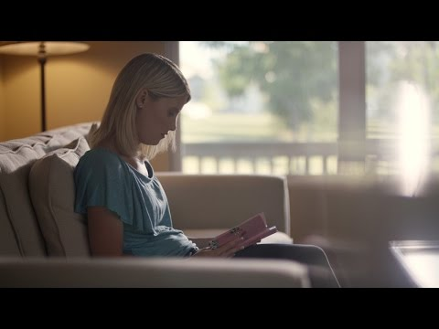
What can parents do?
Notes:
Later in this presentation, we will review the lessons that will be presented to the students throughout the year.

Slide 7
What can parents do?
Talk to your child regularly about body safety:
As soon as language starts and can be understood, it is a great time to begin. (see attached scripts for how to start the conversation).
Talk to your child about trusting their intuition. That feeling in your tummy that something doesn’t seem right likely isn’t. Even if nothing has happened empower your child that they can leave a situation and find another safe adult. That might mean calling someone if they are alone with only one adult making them feel uneasy.
Abusers almost always tell a child to keep it a secret. They may tell them they will be in trouble if they tell anyone. Get across to your child they will not be in trouble. That this is not their fault. Abusers can threaten children to stay silent by saying they will hurt them or someone in their family. Let your child know no matter what they have been told you don’t keep this is a secret. You will be protected once you report it. Teach them the differences between safe and unsafe secrets.
Notes:
Make bullet point
Start the conversation early
Simple language
Ask me first
No One touches your private parts ever
Always tell
Continue the conversation.
Look for grooming behavior

Slide 8

Healthy Touches:
Talk to your kids about safe and unsafe touches.
Examples of safe touches:
Giving a hug.
Giving a high five.
Examples of unsafe touches.
Touching your private parts.
Getting kicked.
Hair pulling.
Never force children to give hugs and kisses. Let them make that decision. Empower them to know they are the boss of their bodies and decisions about their body.
Make the conversation an ongoing one.
Source:erinslaw.org

Slide 9
Recognizing the signs and symptoms of child sexual abuse:
May include but not limited to:
Nightmares
Trouble sleeping
Bed wetting
Change in appetite
Fear of certain people, places, activites
Mood swings: rage, anger, fear, anxiety, insecure or withdrawn
Depression
Suicidal thoughts
Acting out sexually
Exhibits adult sexual behaviors, knowledge, and language

Slide 10
Signs more common in adolescents:
May include but not limited to:
Eating disorders
Self-injurious behavior
Drug and alcohol abuse
Promiscuous activity
Running away
Suicidal (ideation/thoughts)
Depression and anxiety
Fear (unrealistic/abnormal)
Change in academic performance

Slide 11
Warning signs of a child being abused:
A child receiving special attention; from one human consistently
An adult creating opportunities to spend alone time with child
Buying a child expensive gifts or giving them money
Favoritism towards that child
Physical affection towards that child: Kissing, hugging, holding hands, or wanting to be very close to a child
Notes:
human= Adult; peer, family member, sibling, coaches, religious powers, teachers, childcare givers,
Presenter should say how these are signs of adults (general) however abuse can come from a peer or child slightly older than the victim.

Slide 12
What to do if a child discloses abuse:
Listen to the child
Thank them for sharing with you
Reassure them it is not their fault
Explain that you will work to develop a plan to keep them safe
Review confidentiality
Report abuse immediately

Slide 13
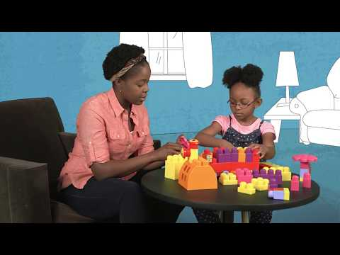
Talking to your child about sexual predators:
Notes:
We know that this conversation is uncomfortable and difficult to have. Here are some videos to help you start the conversation with your child.

Slide 14
Sample Lessons

Slide 15

https://video.link/w/MxU6c

Slide 16
What is the district’s plan for implementing the new mandate?
Notes:
District will add their individual plan

Slide 17
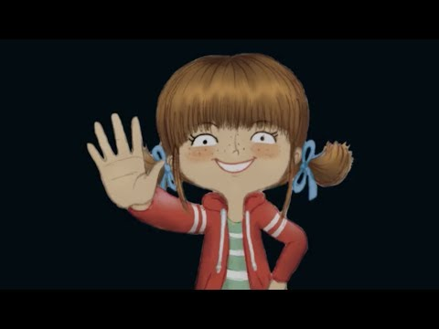
7 Key Body Safety Messages
Some Secrets Should Never be Kept By: Jayneen Sanders
Book read aloud for grades K-5

Slide 18
Who can I call if I need support?
Our mental health staff are here to help and always ready to support our families.
Primary Buildings:
Elementary Buildings:
Middle School:
High School:
Notes:
Each district will complete their protocol of procedures for support

