Slide 1


May 2021
Erin’s Law

Slide 2

Erin’s Law
In August 2019, New York State became the 37th state to sign Erin’s Law into legislation. New York State’s law (Chapter 187 of the Laws of 2019) – known as Erin’s Law – requires public schools to teach child sexual abuse and exploitation prevention classes to students in grades K-8
Erin’s Law is named for Erin Merryn, an abuse survivor and activist against child sexual abuse who has advocated for similar laws nationwide for over a decade.

Slide 3

Erin’s Law
Erin’s Law is intended to help children, teachers, and parents in New York State schools identify sexual abuse, and to provide awareness, assistance referral, or resource information for children and families who are victims of sexual abuse.

Slide 4
Erin’s Law
NYSED Guidance Memo- Dated October 2020 - http://www.nysed.gov/common/nysed/files/programs/curriculum-instruction/erins-law-memo-commissioner.pdf
Erin’s Law FAQ - http://www.nysed.gov/common/nysed/files/programs/curriculum-instruction/erins-law-memo-commissioner.pdf

Slide 5
Erin’s Law
In the Spring and Summer of 2020, The New York State Education Department worked with partners such as the Department of Health, the NYSED Offices of Student Support Services, Office of Children and Family Services, and the New York State Center for School Health to develop a website and resources.
http://www.nysed.gov/curriculum-instruction/erins-law

Slide 6
Erin’s Law
The NYSED encourages local school districts to have advisory councils that include parents, school psychologists, school counselors, school social workers, school board members, school personnel, students, and community members to give recommendations in the development of the instruction designed to educate students, parents, teachers and other school personnel about the prevention of child abuse and child sexual exploitation.
Local school districts have the flexibility and responsibility to identify appropriate content and resources to implement instruction aligned to the benchmarks that were created.
Although curriculum remains a local decision in New York State, the resources provided on the website can serve as a foundation in curriculum development.

Slide 7
Erin’s Law Grade Banded K-2 Objectives
Students will be able to recognize healthy and unhealthy relationships.
Students will understand that abuse can occur in ANY relationship.
Students will understand that their body is theirs and it deserves respect as well as know if some parts of their body are private.
Students will be able to identify and define whether a touch is “comfortable” or “confusing.”
Students will be able to understand how to refuse uncomfortable touches.
Students will be able to identify by name two trusted adults who can help with any issues or problems, or, identify a safe adult if lost, hurt, or in need of help.
Students will be able to identify the difference between a safe and unsafe secret, when there is an unsafe secret, they must tell a trusted adult
Students will be able to comprehend “NO. Go and Tell.”
Students will know what keeps them safe when on the Internet: including not sharing personal information.
Students will be able to identify adults that they can trust and talk to about uncomfortable touch or unsafe secrets.
Students will be aware of unknown individuals who claim to know the child or his/her family.
Students will be able to understand that abuse, including exploitation and trafficking, is never the student’s fault.

Slide 8
Erin’s Law Grade Banded 3-4 Objectives
Students will be able to recognize healthy and unhealthy relationships.
Students will understand that abuse can occur in ANY relationship.
Students will be able to identify the bathing suit zone.
Students will have a deeper understanding of “comfortable”, “uncomfortable” or “confusing” touch.
Students will be able to use “NO. Go and Tell” to seek help from a trusted adult.
Students will know what keeps them safe when on the Internet; including not sharing personal information.
Students will be able to recognize that their body belongs to them and they have the right to say when and how someone else can touch it.
Students will be able to set personal boundaries and respect the personal boundaries of others.
Students will be able to identify and seek help if unhealthy and unsafe behaviors and situations occur, including bullying and abuse
Students will be able to quit or refuse to play games involving inappropriate touching.
Students will be able to understand that abuse, including exploitation and trafficking, is never the student’s fault

Slide 9
Erin’s Law Grade Banded 5-6 Objectives
Students will be able to identify and seek help if unhealthy and unsafe behaviors and situations occur, including bullying and abuse.
Students will be able to identify safe adults that they can report to when confronted with potentially unhealthy or unsafe situations.
Students will be able to recognize healthy and unhealthy relationships.
Students will understand that abuse can happen in ANY relationship.
Students will be able to describe and understand healthy and safe personal choices.
Students will be able to use “NO. Go and Tell” to seek help from a trusted adult.
Students will know what keeps them safe when on the Internet; including not sharing personal information.
Students will be able to refuse to go alone to meet online acquaintances/strangers
Students will understand the basic concept of manipulations and lures.
Students will be able to identify different ways that perpetrators might use “lures”.
Students will be able to understand that abuse, including exploitation and trafficking, is never the student’s fault.

Slide 10
Erin’s Law Grade Banded 7-8 Objectives
Students will be able to recognize healthy and unhealthy relationships, including romantic relationships.
Students will understand how to set personal boundaries and limits on relationships and honor the boundaries of others.
Students will understand that abuse can occur in ANY relationship and understand the various types of manipulations and lures.
Students will understand they can stand up for themselves and say “no” without feeling guilty.
Students will be able to help a friend who is in a potentially abusive situation find a trusted adult.
Students will know what keeps them safe them on the Internet by refusing to post, send, or forward inappropriate images of self of others and know how to set privacy settings on social media
Students will be able to identify abuse that may occur in person and online: physical, sexual, emotional, and neglect.
Students will identify safe adults and peers or seek professional help such as help/abuse lines, counselors, etc.
Students will understand the risk caused by sending, requesting, and/or sharing inappropriate materials.
Students will be able to understand the importance of keeping personal information private while online.
Students will understand that abuse, exploitation, and trafficking, is never the student’s fault and help is available.

Slide 11
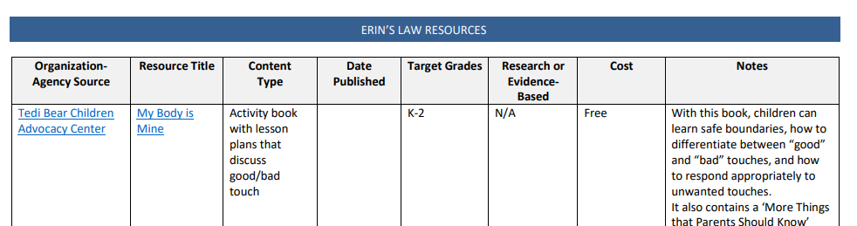
Erin’s Law Resource Grid For Schools
http://www.nysed.gov/common/nysed/files/programs/curriculum-instruction/erins-law-resource-grid.pdf

Slide 12
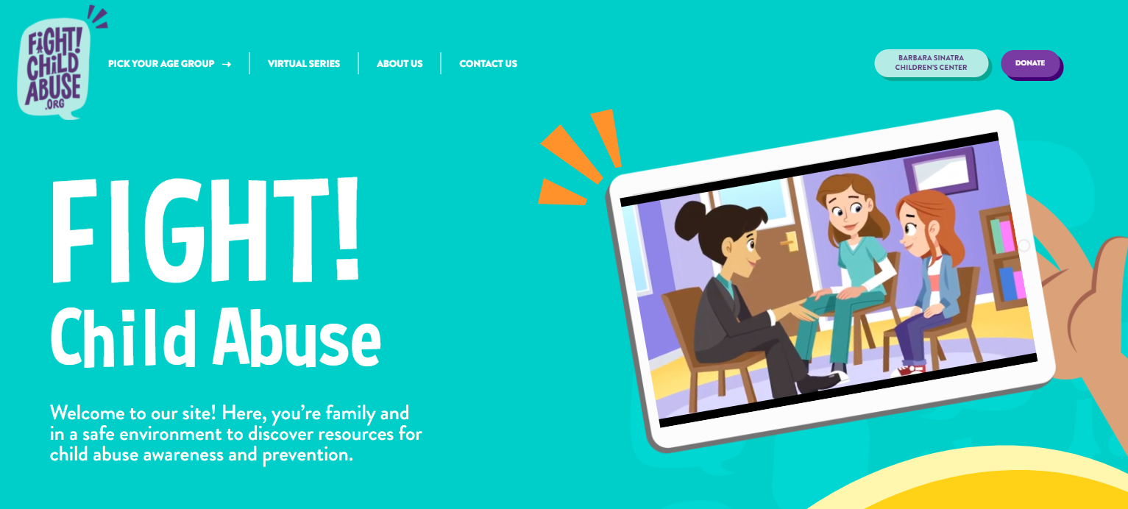
Erin’s Law

Slide 13
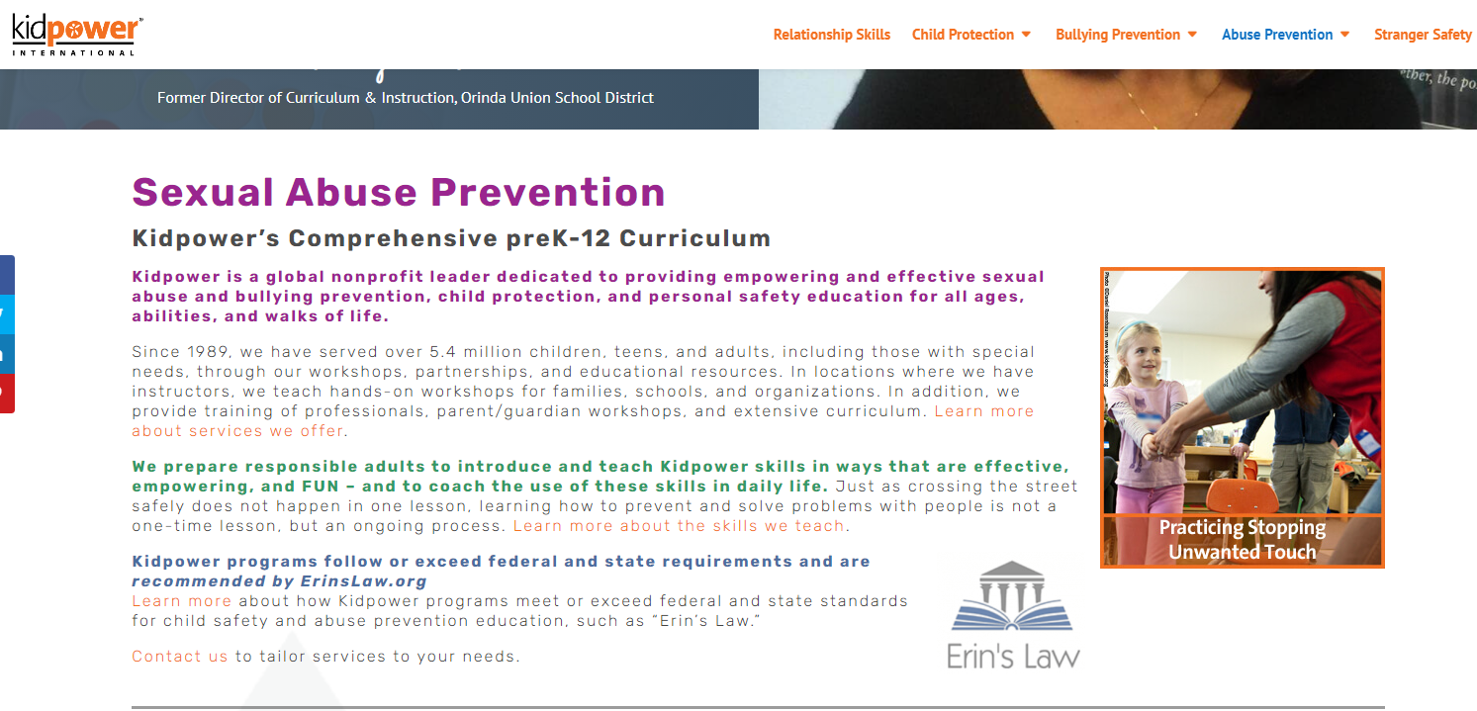
Erin’s Law

Slide 14
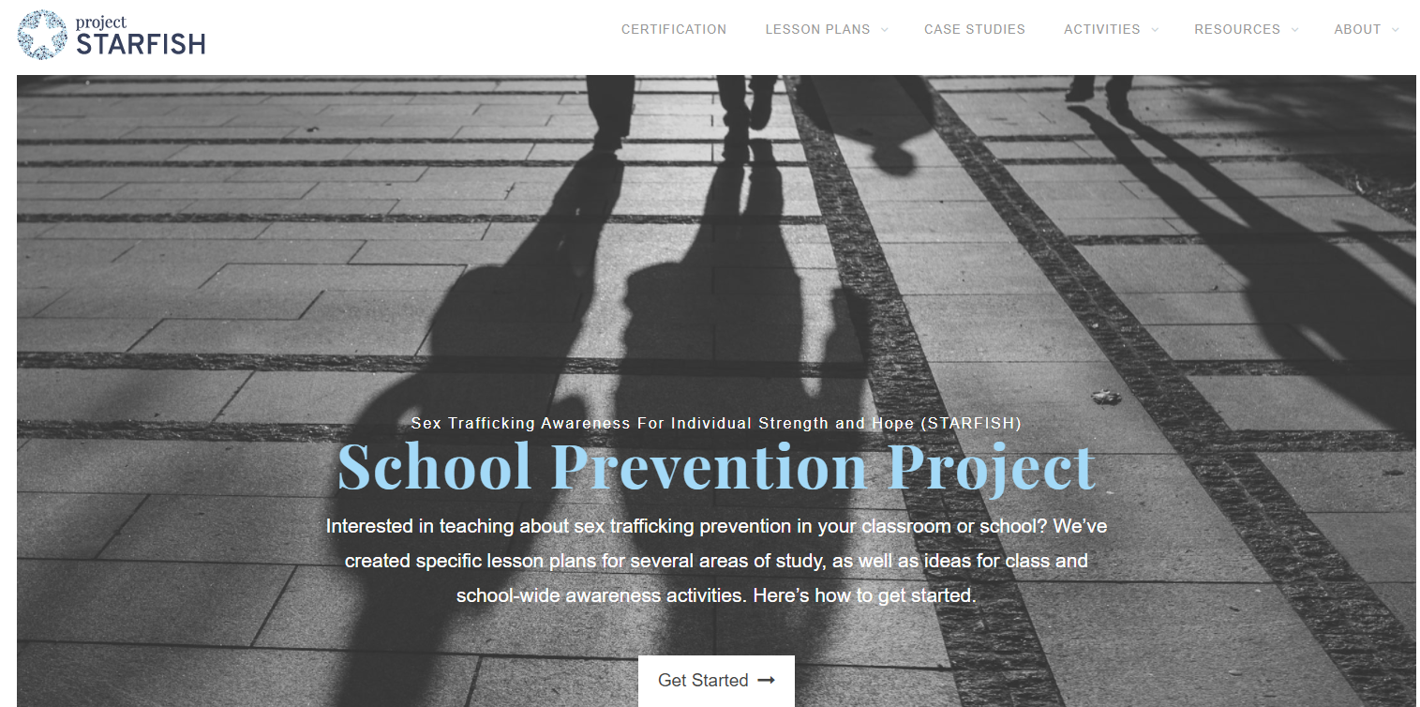
Erin’s Law

Slide 15
Erin’s Law
Parent Resources
Parents tend to talk to their children about strangers and staying away from people who they do not know, but some may not talk to their children about sexual abuse, feeling unsafe and/or what they should do in uncomfortable situations.
The NYSED has developed a resource grid that parents can easily access to help them better discuss some of these topics with their children, as well as gain a better understanding of what Erin’s Law is and how it is intended to protect children from sexual abuse and exploitation.
Link
http://www.nysed.gov/common/nysed/files/programs/curriculum-instruction/erins-law-family-resources.pdf

Slide 16
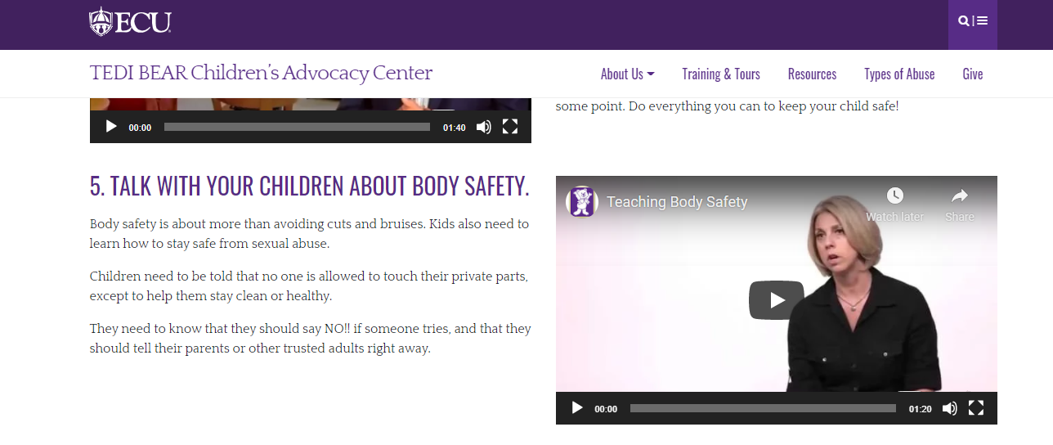
Erin’s Law

Slide 17
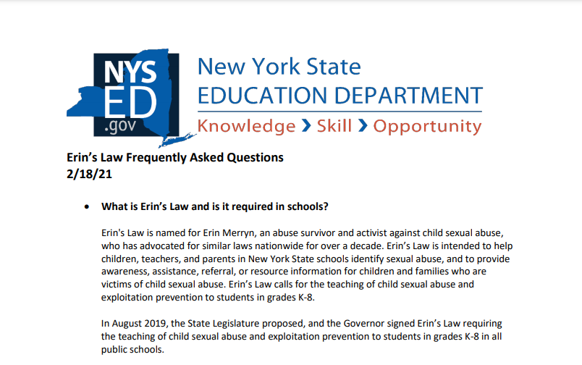
Erin’s Law
FAQ – very helpful - http://www.nysed.gov/common/nysed/files/programs/curriculum-instruction/erins-law-faqs.pdf

Slide 18
Erin’s Law
Nassau BOCES will moderate a collaborative project to create age-appropriate units that cover mandates of Erin's Law.
Group will be moderated by Dr. Donna Bacon, Ph.D., LCSW, MSW. Dr. Bacon is the chair of the health studies department at Nassau Community College. Dr. Bacon is also a Certified Facilitator and Trainer for the Identification and Reporting of Child Abuse and Neglect and School Violence and Intervention Workshop. Her expertise will be called upon to direct teachers to develop engaging, relevant and age appropriate units in sexual abuse and exploitation prevention education as required by Erin’s Law.
If you are interested in working on this project this summer- please fill out this application. All selected persons will be notified by of work schedule by May 30th . Work to begin after July 1.

Slide 19
Erin’s Law
Nassau BOCES Mental Health Consortium presents
Erin Merryn

