Slide 1

And what about the pandemic?
Two negative consequences:
Teachers build in a natural progression of gradually reducing supports (scaffolding) for executive skills, so that each grade level expects just a bit more from students. The pandemic disrupted that process. (think of a ladder with missing rungs).
Because of the disruptions caused by the pandemic, students also had 2 years of practicing bad habits (procrastination, impulsivity, short fuses). It’s hard to tear down those neural circuits!

Slide 2

Working Memory
The ability to hold information in memory while performing complex tasks. It incorporates the ability to draw on past learning or experience to apply to the situation at hand or to project into the future.

Slide 3

“WM allows us to hold and manipulate information in the mind over short periods of time. It’s like a mental workspace or note pad where we manipulate important information in the course of our every day lives. But it is very limited in two fundamental ways:
The length of time it can hold new information;
The amount of information it can juggle at any one time.
In fact, one of the most salient features of working memory is its time and space limitations.”
~Bailey, F. & Pransky, K. (2014). Memory at work in the classroom. Alexandria VA: ASCD

Slide 4
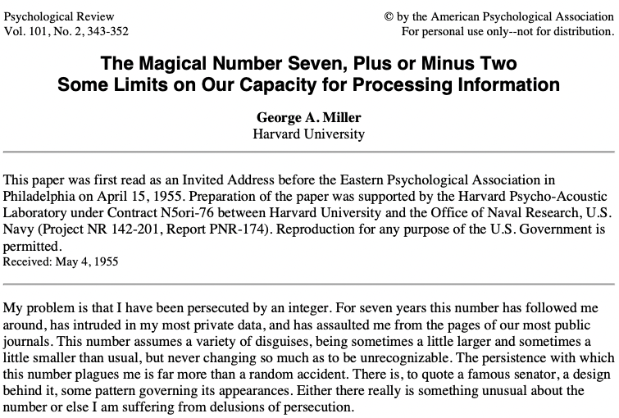

Slide 5
Limits of Working Memory
Working memory has a capacity of about four chunks in young adults (and fewer in children and old adults).
~Cowen, N. (2005). Working Memory Capacity.

Slide 6

Try this...
Say your phone number backwards. That’s do-able, right?
Now let’s make it a little harder: With the forward sequence of your phone number, add 1 to the first number, 2 to the second number, three to the third number. Keep the sequence going for 10 numbers—how far can you get before you lose track and have to regroup?

Slide 7
Teachers ask: What can we do to increase working memory?
Psychologists offer 2 strategies:
Strategy #1: Wait
Strategy #2: Nothing
“There is no workout regime that students can undertake, no diet they can follow, and no computer games they can play. WM develops on its own schedule, and—at least so far—we don’t know how to create artificial improvement.”
~Watson, A. C. (2017). Learning Begins: The Science of Working Memory and Attention for the Classroom Teacher.

Slide 8
What causes working memory overload?
Asking students to process too much information
Giving students too many instructions at once
Giving students too many choices
Technology

Slide 9
Examples of working memory challenges that you see
Don’t hear instructions 1st time
Forget to bring materials to class
Forget to charge iPad
Forgot yesterday’s lessons
Jackets when it’s 20 below zero
Frequent absences
Misremember instructions
Misinterprets instructions
Miss portions of instructions

Slide 10

What does working memory overload look like?
Difficulty processing while remembering
Atypical distractibility
Catastrophic failure (i.e., surprising difficulty with simple cognitive processes)

Slide 11
Let’s recap
Research shows that WM is crucial for learning, small in both capacity and duration, and impervious to artificial improvement.
So, where does that leave us?
We must become experts at teaching
within our students’ WM limits.

Slide 12

Classroom strategies to support working memory

Slide 13
Provide Cues and Supports
Augment
Augment verbal instructions with a visual (explain to the class that because it’s hard to remember everything, you will give kids a visual to remind them—prompt them to check the visual before they ask for your help).
Use
Use a unique or a phrase to signal that you want students to stop everything else and pay attention to what you’re saying
Tell
Tell students that you will ask a random student to repeat the directions after you give them.

Slide 14
Strategies to Help Kids Remember
Visualization—have kids use vivid visual imagery to help them remember
Movement—have kids act out what they’re trying to remember
Teach rehearsal strategies
Use rhymes, songs, or other mnemonic devices to help kids remember
Model your own use of memory strategies (e.g., checklists, post-it notes) and explain why you're using them
Have students make an association between what they need to remember and a familiar cue

Slide 15

https://www.youtube.com/watch?v=tx0aY0TZ87k

Slide 16
Create a Classroom Routine

Slide 17
Embedding executive skills into daily classroom routines
List the steps in the routine
Explain why the routine is helpful
Walk students through the steps repeatedly
Create a visual that outlines the routine
Fade the prompts by having students use the visual to follow the routine
Periodically talk with kids about the steps in the routine and why they’re important

Slide 18
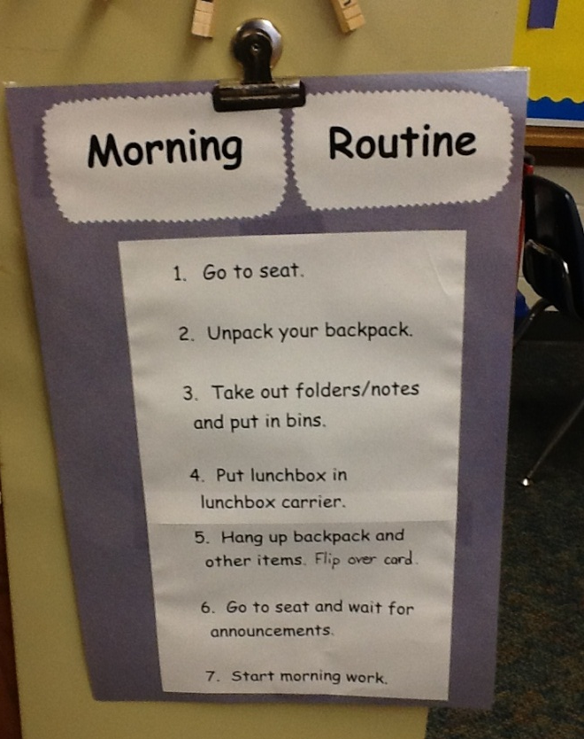
Beginning of the Day Routine
Questions to ask kids:
Why is this routine helpful?
Why do I post the routine so everybody can see it?
What would happen if we didn’t have a routine to get the day started?
Ask about specific items (Why do we unpack our backpacks? What would happen if people put their lunchboxes anywhere they wanted?)

Slide 19
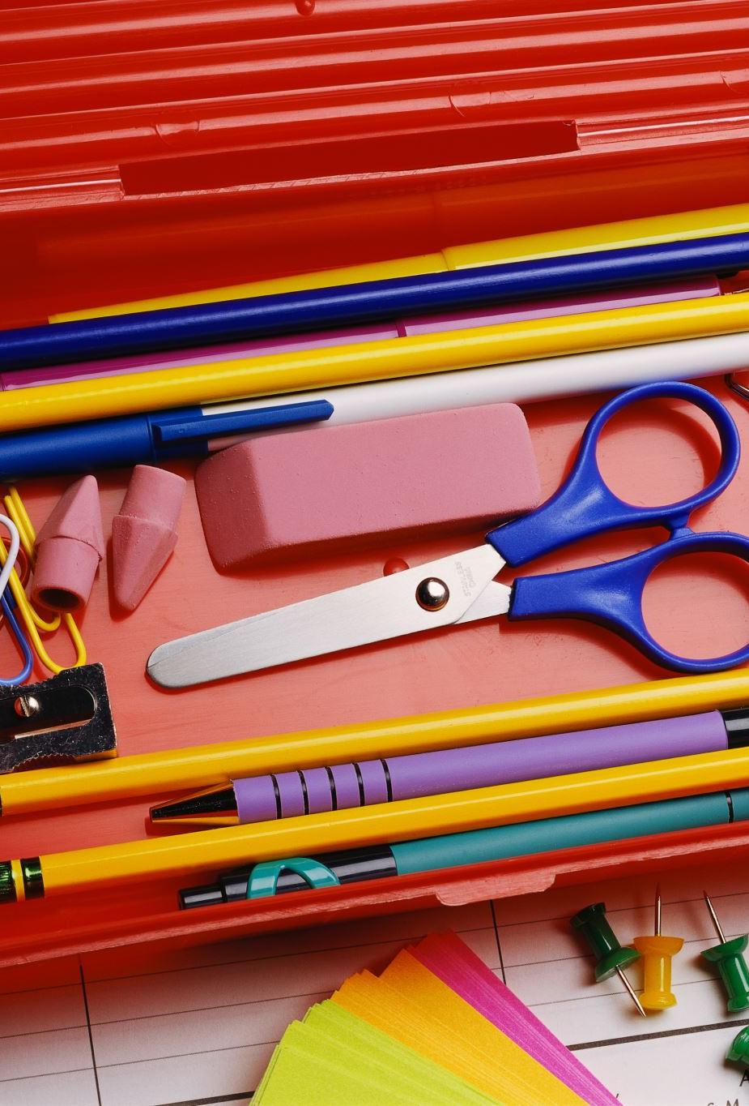
End of Day Routine
Give each student a homework folder (choose a color that is easily identifiable)
Explain to class that at the end of class, you will list on the board every item students need to bring home (books, worksheets, permission slips)
Have students work in pairs to make sure everything is in the homework folder
Routine is done when all homework folders are off the desk, placed in students’ backpacks

Slide 20
Set a Classroom Challenge

Slide 21
Set a Classroom Challenge
CHALLENGE FOR THE DAY:
Everybody remembers to put their homework on the top of their desk as soon as they get to the classroom
CHALLENGE FOR THE DAY:
Everyone does each step in the getting ready for school routine
CHALLENGE FOR THE DAY:
Everybody puts everything in their backpacks that need to go home at the end of the day

Slide 22
Adaptations for individual children
You can create routines and checklists for individual students as well
As much as possible, create the routine or checklist with input from the student.
For students who are easily overwhelmed, some teachers create a checklist with one item per page and they put the checklist in a 3-ring binder. As the student does each step, they turn to the next page to see the next step.

Slide 23
ACTIVITY:
Decide how you want to use the information included in this presentation to incorporate working memory accommodations and strategies into your classrooms.
[NOTE: If you want to design classroom routines to support working memory, your handout includes a planning form]

Slide 24
Additional Resources
https://www.dropbox.com/sh/whlg4tmcusb1fle/AACpXFuquCJZwkD2PjptABb9a?dl=0 (ES Supplementary Materials)

