Slide 1
Response Inhibition:
Key Components
Student input
Clear target behavior
Practice with feedback
Leadership roles for kids (kid “coaches”)
Picture cues for reminders

Slide 2
Whole Class Intervention
Example: Response Inhibition
EXECUTIVE SKILL | Response Inhibition
Behavior | Calling out
Time/Place | Whole group instruction

Slide 3
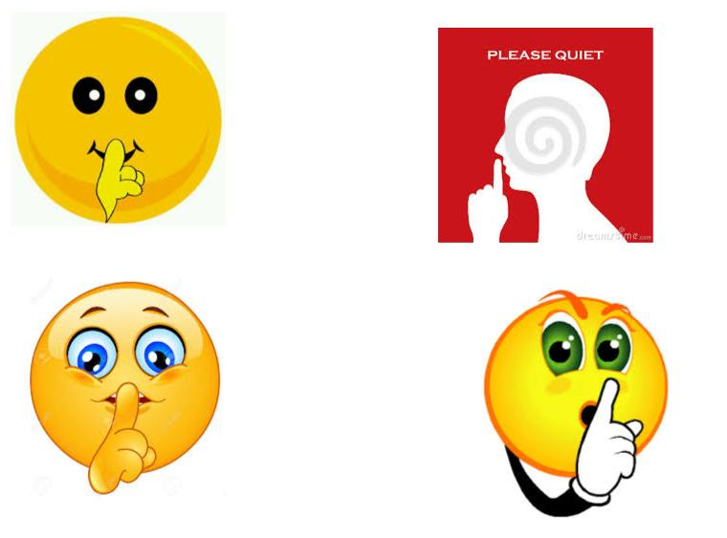
Whole Class Intervention
Example: Response Inhibition

Slide 4
Whole Class Intervention Outcomes
Response Inhibition
TEACHER | DATE | BEHAVIOR COUNT (call-outs during circle time)
1 | December | 25 for two 15-minute sessions (ca. 1 per minute)
 | May | 10 for two 15-minute sessions (1 every 3 minutes)
2 | December | 10 for two 15-minute sessions 1 every 3 minutes)
 | May | 3 for two 15-minute sessions (1 every 10 minutes)
3 | December | 16 for two 15-minute sessions (ca. 1 every 2 minutes)
 | May | 25 for two 15-minute sessions (ca. 1 per minute)

