Slide 1
Executive Skills Recap

Slide 2
3 Key Concepts about Executive Skills
What they are: brain-based skills that take a minimum of 25 years to reach full maturation.
Until these skills are fully mature, it’s the job of parents and teachers (and adults who work with kids) to act as surrogate frontal lobes.
It is also the job of parents, teachers, etc. to ensure that kids grow their own executive skills.

Slide 3

An interesting take on child development…
https://www.nytimes.com/2021/04/16/opinion/ezra-klein-podcast-alison-gopnik.html?referringSource=articleShare
Alison Gopnik runs the Cognitive Development and Learning Lab at UC Berkeley and is in both the philosophy and the psychology departments and is part of the A.I. working group.

Slide 4

Food for thought…from Alison Gopnik
I think a really deep idea that comes out of computer science originally — in fact, came out of the original design of the computer — is this idea of the explore or exploit trade-off is what they call it. So if you’re thinking about intelligence, there’s a real genuine tradeoff between your ability to explore as many options as you can versus your ability to quickly, efficiently commit to a particular option and implement it. And it turns out that even if you just do the math, it’s really impossible to get a system that optimizes both of those things at the same time, that is exploring and exploiting simultaneously because they’re really deeply in tension with one another.

Slide 5
Food for thought…from Alison Gopnik
So you’ve got one creature that’s really designed to explore, to learn, to change. That’s the child form. And then you’ve got this other creature that’s really designed to exploit, as computer scientists say, to go out, find resources, make plans, make things happen…And the idea is that those two different developmental and evolutionary agendas come with really different kinds of cognition, really different kinds of computation, really different kinds of brains, and I think with very different kinds of experiences of the world.

Slide 6
Food for thought…from Alison Gopnik
So what you’ll see when you look at a chart of synaptic development, for instance, is, you’ve got this early period when many, many, many new connections are being made. And then you’ve got this later period where the connections that are used a lot that are working well, they get maintained, they get strengthened, they get to be more efficient. And then the ones that aren’t are pruned, as neuroscientists say. They kind of disappear. The consequence of that is that you have this young brain that has a lot of what neuroscientists call plasticity. It can change really easily, essentially. But it’s not very good at putting on its jacket and getting into preschool in the morning.

Slide 7
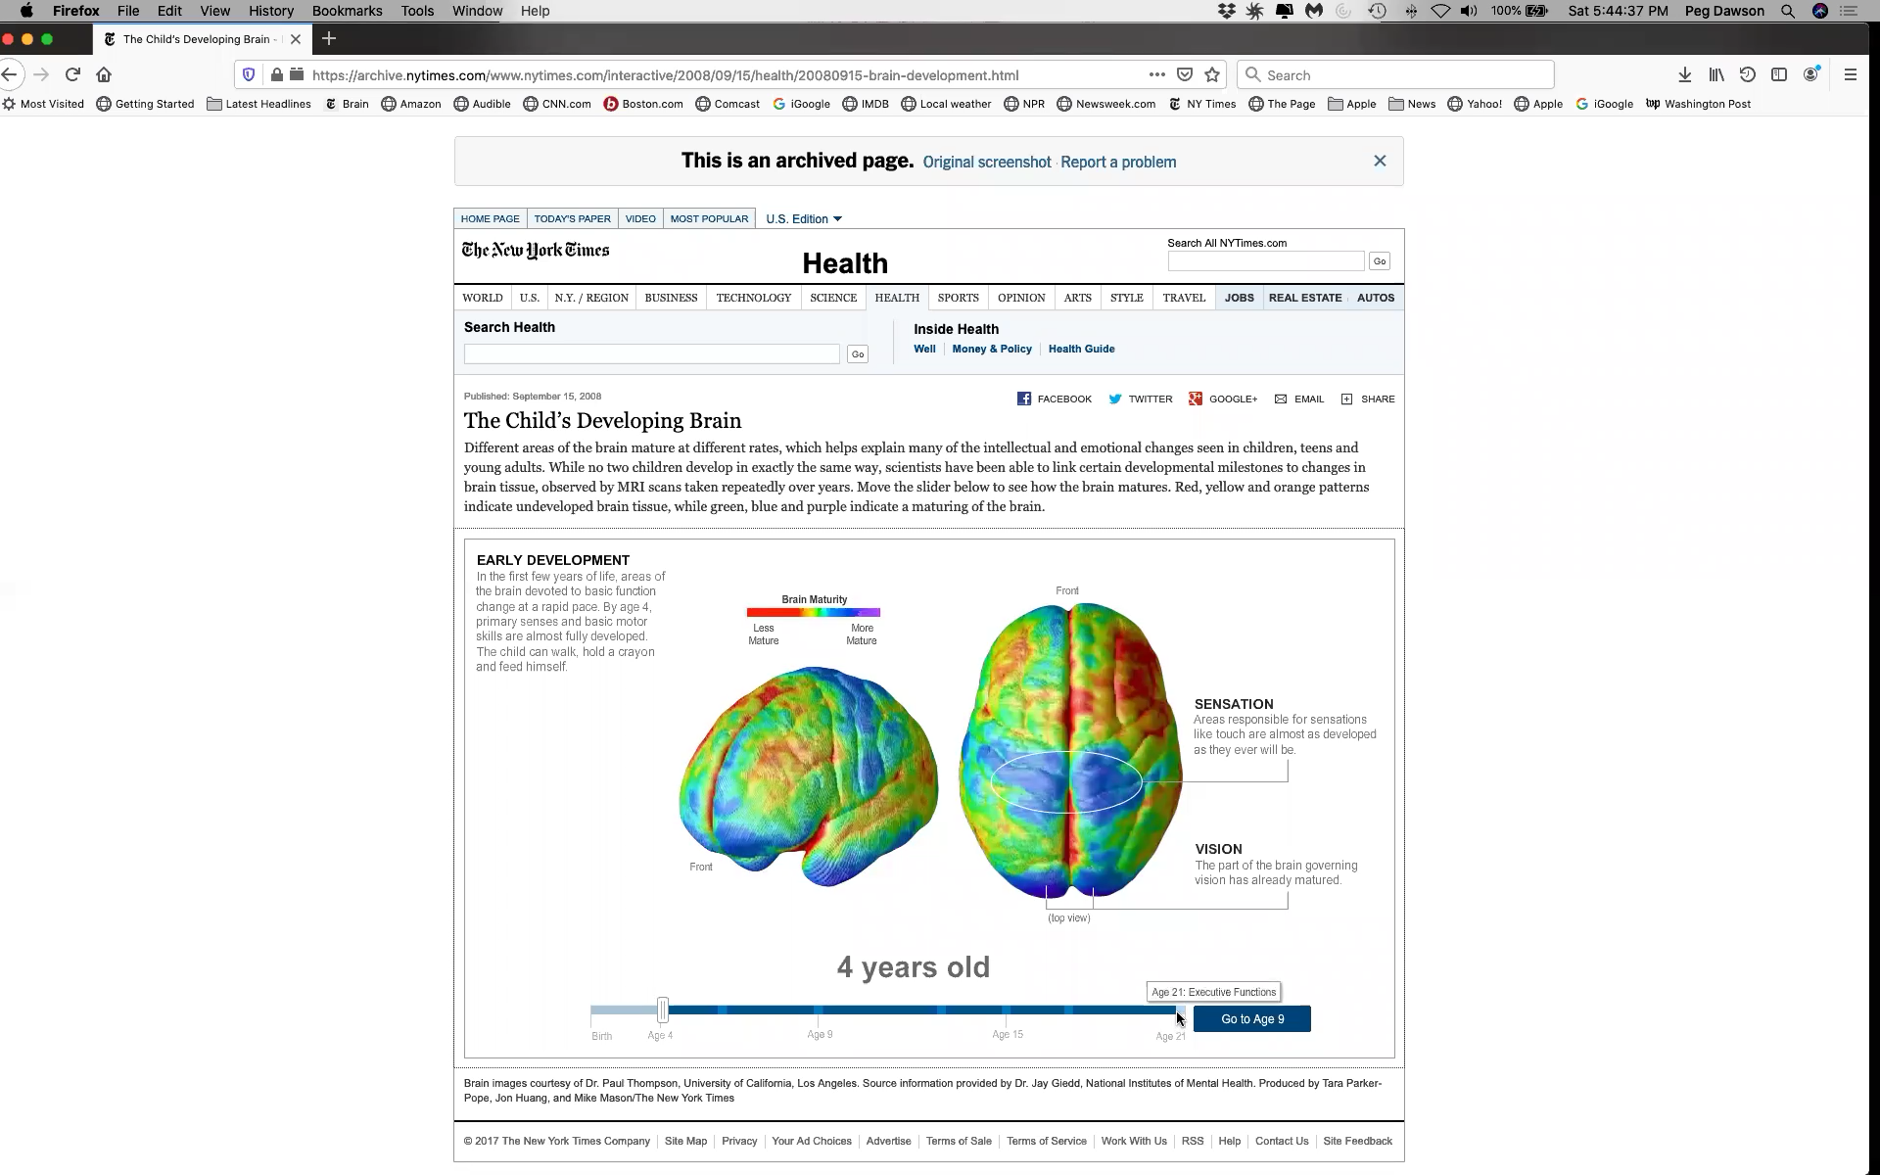

Slide 8
Executive Skills that Underlie
School Success
Foundational Skills
Advanced Skills
Response Inhibition
Working Memory
Emotional Control
Flexibility
Sustained Attention
Task Initiation
Planning/Prioritizing
Organization
Time Management
Goal-Directed Persistence
Metacognition

Slide 9
Response Inhibition
The ability to stop and think before you say or do something

Slide 10
What specific behaviors are associated with response inhibition in young children?
Several examples:

Slide 14
Ten classroom strategies to support response inhibition

Slide 15
Super Heroes

Slide 16

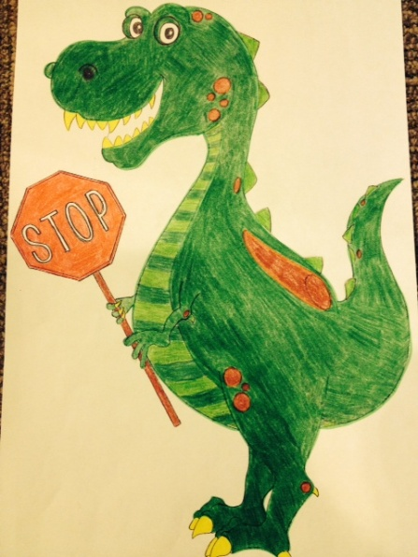
Super Heroes

Slide 17
Created by Mara Berkin and Nicola Dakin, the Montcrest School, Toronto, Canada
(available from http://efs2therescue.com)
NOTE: These are copyrighted materials. Pleasure purchase them for use.
“Stop-A-Tron is an amazing inhibition robot, and his best power is that he stops before he gets his best ideas…The most important feature of Stop-A-Tron is the giant stop sign on his chest.”

Slide 18
Created by teachers at Moharimet Elementary School, Madbury NH
STOP-A-SAURUS
“Think of a time when you were told to WAIT or STOP”
Waits turn
Listens to and follows all directions
Listens to the person talking
Thinks of others’ feelings
Respectful
Raises hand
Personal space
  (hands and feet to self)

Slide 19
Posters

Slide 20
Stop And Think
Does your body ever move too fast for your brain?
Stop what you’re doing.
Freeze like a statue.
Take a few deep breaths.
Think about what to do next.
Get help if you need it.
Stop aTron
Response Inhibition

Slide 21
Posters
Created by Ingrid Baron (available from Teachers Pay Teachers)

Slide 22
Teach Lessons

Slide 23
Teach Lessons
https://www.dropbox.com/sh/kxcn8hpa2h442ys/AADs8twDyP4JKwBsQ5lXKnTwa?dl=0

Slide 24
Train Your Brain Lesson

Slide 25
Train Your Brain Lesson
https://www.dropbox.com/sh/kxcn8hpa2h442ys/AADs8twDyP4JKwBsQ5lXKnTwa?dl=0
(Sesame Street: “The Waiting Game”)

Slide 26
Play Games

Slide 27
Play Games
Simon Says
Red Light Green Light
See Ingrid Baron’s ideas at Teachers Pay Teachers

Slide 28
Read Stories

Slide 29
Read Stories
Interrupting Chicken by David Ezra Stein
Waiting Is Not Easy! by Mo Willems
Goldilocks and the Three Dinosaurs by Mo Willems
If You Ever Want to Bring an Alligator to School, Don’t! by Elise Parsley
Ricky Sticky Fingers by Julia Cook

Slide 30
Create Scenarios

Slide 31
Create scenarios/vignettes to practice response inhibition
What could you say to yourself if… OR
What could you do if…
You really wanted to say something during morning meeting but someone else was talking
You wanted a turn on the swings at recess, but all the swings were taken
You want to get up and move, but you have to stay at your desk until you finish your math

Slide 32
Set a Classroom Challenge

Slide 33
Set a Classroom Challenge
CHALLENGE FOR THE DAY:
No more than 5 call-outs during story time
CHALLENGE FOR THE DAY:
Everyone checks their work before handing in their math
CHALLENGE FOR THE DAY:
Everyone listens to ALL the instructions before beginning science activity

Slide 34
Post Positive Feedback

Slide 35
Give Kids Recognition for
Showing Response Inhibition

Slide 36
Teach Kids to Self-Monitor

Slide 37
Teach Kids to Self-Monitor

