Slide 1
School-wide example:
Teaching Organizational Skills
Salinas Kansas Model
Curtis.Stevens@usd305.com

Slide 2

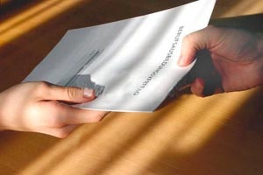
SALINA SOUTH MIDDLE SCHOOL
STUDENT ORGANIZATION SYSTEM

Slide 3
Cougar HONOR Code… | Classrooms | Halls/ Outside | Lunchroom | Assemblies Concerts & Special events | Athletic Activities & locker rooms
Honesty - adherence to moral and ethical principles; soundness of moral character; integrity | Be honest Be trustworthy Engage in honest and ethical behavior Ex. Do your own work; Give your personal best; Respond honestly | Do the right thing Engage in honest and ethical behavior. Ex. Take lost items to the office; report to an adult supervisor when others are engaging in negative or harmful behavior. | Be inclusive – invite others to join you Take only what you can eat Practice good manners Eat your own food Leave others food/utensils alone | Support the performers/presenters with your attention and appropriate applause. Model positive behavior | Accept officials calls Follow all guidelines set up by the event Ex. Pay admission fee, stay in designated area, follow directives of adults
Ownership - trait of being answerable to someone for something; able to make rational decisions on one's own | Be on time Be prepared for class. Comply with classroom rules and expectations Ex. Listen when others are talking. Assignments are completed and turned in on time. Materials are brought to class. | Take care of yourself, your belongings, and your school. Arrive and leave at appropriate time. Ex. Wait at grade level door, keep lockers clean, pick up trash. | Clean up after self. Use lunch time wisely. Ex. The student’s area is clean after they leave. Eat first, talk later, pick up area. | Take care of personal needs before/after event. Stay in designated areas Ex. Get drink, use restroom; Follow directions from adults | Help keep the facility clean. Take care of facility and equipment. Ex. Pick up and throw away trash when you leave. Don’t jump on bleachers.
Communication - to express thoughts, feelings, or information easily and effectively | Communicate in a positive manner Appropriately participate in discussions Speak respectfully with a positive attitude. Ask questions, as needed Ex. Politely ask for help, not answers. | Use appropriate and courteous verbal and non verbal language. Ex. Use appropriate language and volume. Say “excuse me” when passing in a crowded hallway. | Use appropriate language and volume level Ex. No profanity; Talk using a “three foot voice.” | Limit conversations to appropriate times Applaud politely. Ex. Turn off/silence cell phones. | Report problems to appropriate adults. Communicate in a positive manner Ex. Ask an administrator or staff member for help. Encourage each other on the court.
organization - to put together into an orderly, functional, structured whole; to arrange in a coherent form | Have binder and materials with you Complete planner Keep papers where they can be easily found. | Walk on right side of hallway/sidewalks Keep locker neat and clean | Keep area free of debris – pick up spills Go through lines as directed by staff Line up appropriately in designated areas | Sit in assigned areas Enter/exit area without bothering others | Have appropriate equipment for PE/practice Keep items locked in lockers Take home and launder clothes Have activity ticket or admission.
respect - proper acceptance or courtesy; show regard or consideration for; a sense of the worth or excellence of a person | Be courteous Treat others the way you want to be treated Respect self, others and property Allow everyone to learn in their own way Ex. Everyone uses “please” and “thank you.” | Respect others’ personal space Help others. One’s behavior does not interfere with others. Ex. A student drops his books, someone helps pick them up. Leave others’ lockers alone, keeping hands/feet to self. | Be courteous to lunchroom staff and others. Good manners are practiced. Ex. Students raise hand to ask permission. Use “please” and “thank you.” | Attention is on the speaker, sit quietly, keep hands to self Be on time and stay until the event is over Ex. Applaud positively at the appropriate time. | Show sportsmanship. Do not bully, threaten, or harass others in the locker room Encourage SMS teams in a positive manner. Ex. Cheer for SMS teams and not taunt the opposing team, officials, etc.
DURING THIS TRAINING SESSION STUDENTS WILL LEARN HOW TO STAY ORGANIZED.

Slide 4

2 BASIC GOALS
COMPLETE THE WORK
TURN THE WORK IN

Slide 5
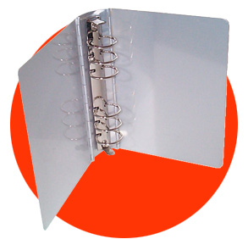
THE 5 BASIC
RULES OF THE BINDER
DIVIDE SUBJECTS WITH TABS
TRASH ASSIGNMENTS NO LONGER NEEDED
PUT DUE DATES ON ALL ASSIGNMENTS
POCKET FOR INCOMPLETE HOMEWORK /COMPLETED HOMEWORK
KEEP IT WITH YOU ALL OF THE TIME

Slide 6

PROVIDE A VISUAL OF THE WORKLOAD
INCOMPLETE
HOMEWORK
COMPLETED
HOMEWORK

Slide 7

IMPORTANT COURSE DOCUMENTS
MATH
SCIENCE
ENGLISH
SOCIAL S.
PROGRESS
*KEEP NOTES IN THIS SECTION ON LOOSE LEAF PAPER.
*KEEP ALL ASSIGNMENTS THE TEACHER
WANTS YOU TO HAVE YEAR LONG.

Slide 8
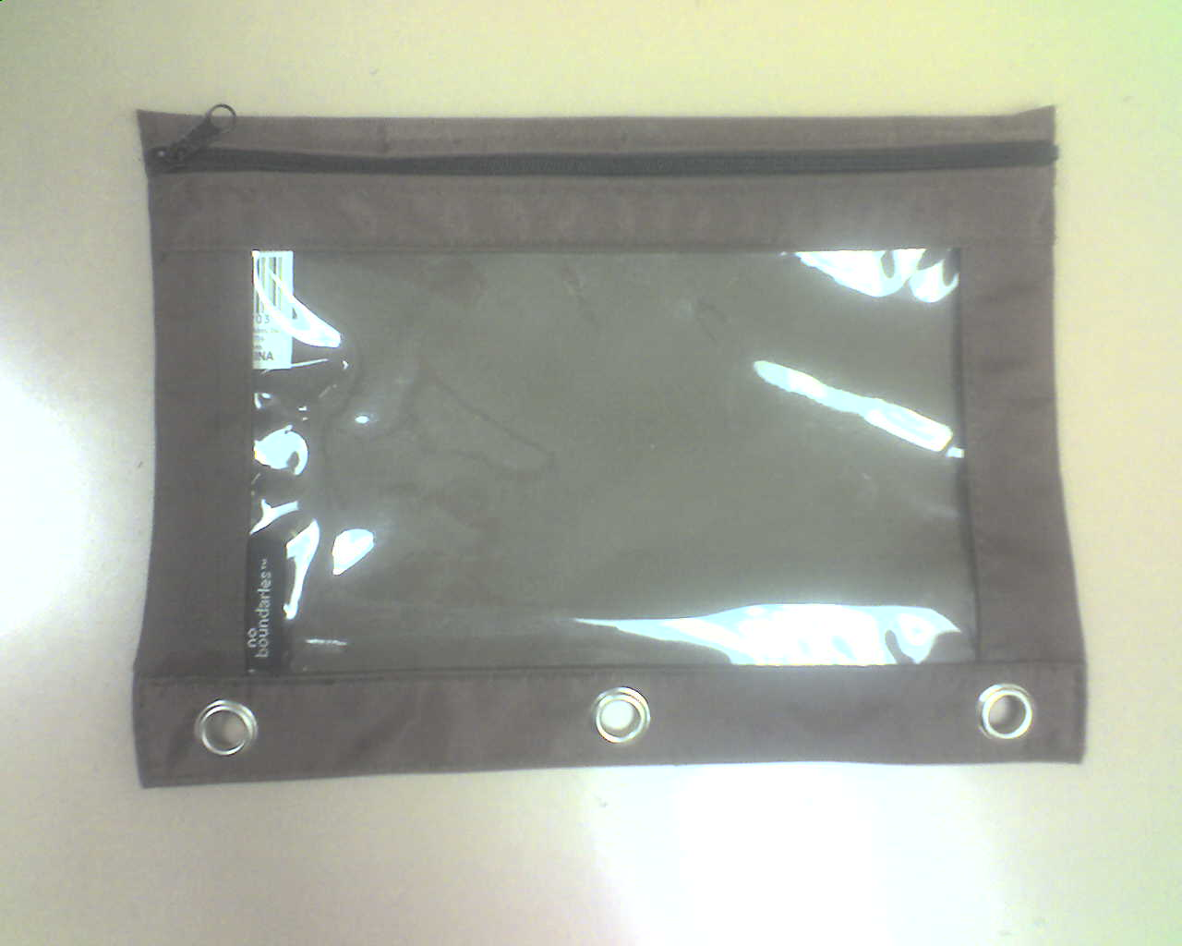




PENCIL BAG: PENCILS, ERASERS, PAPER CLIPS, PENS, AND CALCULATOR

Slide 9

LOOSE LEAF PAPER

Slide 10
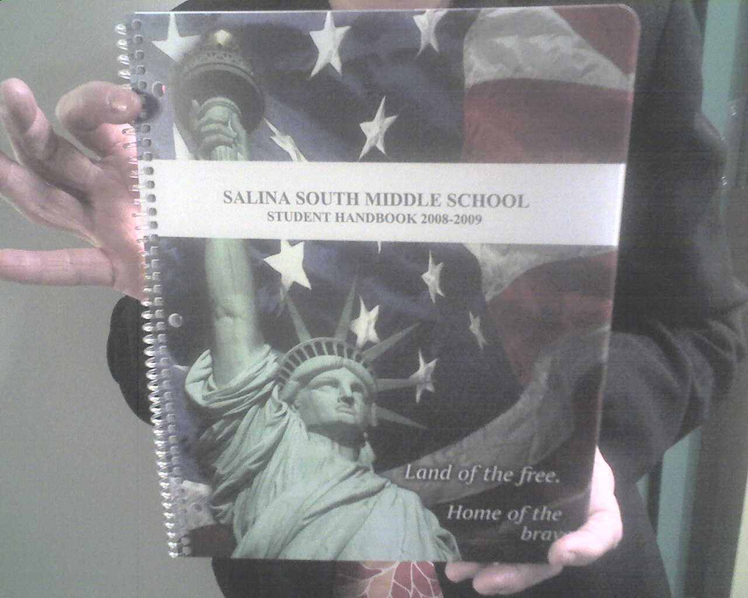
STUDENT PLANNER/HANDBOOK
Planner needs to be filled out weekly on Mondays.

Slide 11
Write Due Dates at the top of each page.
HOMEWORK
ASSIGNMENT
DUE DATE: 4-1-09
INCOMPLETE
HOMEWORK
COMPLETED
HOMEWORK

Slide 12
Prioritize assignments by due dates.
DUE 3-12-10
DUE 2-12-10
DUE 1-1-10
INCOMPLETE
HOMEWORK
COMPLETED
HOMEWORK

Slide 13
STUDENT ALWAYS
KNOWS WHERE
COMPLETED WORK IS
LOCATED.
DUE 2-12-10
READY TO TURN IN.
DUE 1-1-10
INCOMPLETE
HOMEWORK
COMPLETED
HOMEWORK

Slide 14
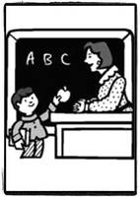
TURNING THE ASSIGNMENT IN
DUE
TODAY!

Slide 15
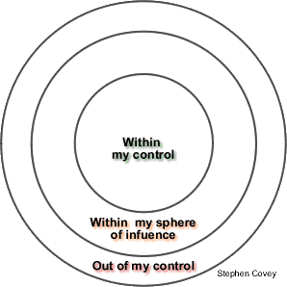
ORGANIZED STUDENTS LEARN THAT GRADES ARE WITHIN HIS/HER CONTROL
GRADES
GRADES

Slide 16
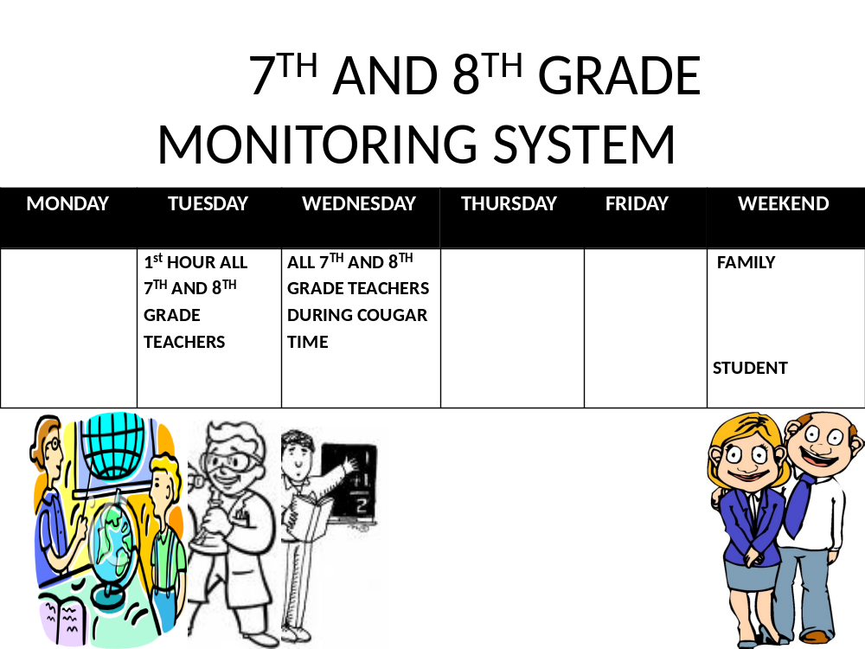
SCHOOL-WIDE
MONITORING SYSTEM

Slide 17
