Slide 1
What Should I Do
After High School?

Slide 2
Options
Short-term training program
2-year college
4-year university
Work, including apprenticeships/on the job training
Military

Slide 3
Short-Term Training Program
These can take anywhere from a couple of months to a year or so. Think places like Devry, College of Healthcare Professionals, Everest College, Universal Technical Institute.
Includes training for jobs in the healthcare field (phlebotomist, x-ray tech, dental assistant, EMT, medical billing and coding, pharmacy tech or vet tech, etc), massage therapy, cosmetology, mechanics, culinary, police, firefighting, welding, real estate, HVAC.
Training may take all day for a few months, and then you’ll earn a certification or license and begin working right away. You will not earn an associate degree at these schools.

Slide 4
Short-Term Training Program
These schools typically do not have a core curriculum (no English, math, etc); students have classes related to their career choice only.
Be sure to check the accreditation for any school you are considering to ensure you are attending a quality school.
The jobs you would be trained for at a trade school have a large variety of pay scales. They also have a wide variety of working hours.

Slide 5
2-Year College
(Junior College or Community College)
Two-year colleges are schools that offer core classes and associate degrees.
Two-year colleges are great places to transition from high school to a four-year university.
Two-year colleges are usually cheaper and they still offer financial aid.
Two-year colleges also offer many certificates and programs in addition to traditional classes.
Consider a two-year college if you are unsure of a career, if you need to work on your GPA, or if you want to save a lot of money.
Many two-year colleges will only require a high school diploma for admissions (check each school for more information).

Slide 6
2-Year College
(Junior College or Community College)
These are colleges like TCC, Texas State Technical College, Blinn, Austin Community College.
You would earn an associate degree, or 2-year degree.
These include some of the jobs listed on the last slide, plus many more. Training for becoming an LVN, dental hygienist, computer programmer, air traffic controller, aviation mechanic, interior designer, paralegal.
You can get a job once you earn your associate degree, or you can transfer to a 4-year university and continue on to your bachelor degree.

Slide 7
4-Year University
Four-year universities are traditional schools that offer associate, bachelor, master, and even doctoral degrees.
Four-year universities offer on-site housing.
Four-year universities have higher admission requirements. You must submit an ACT or SAT score, unless the school has gone test-optional.
Four-year universities will have many options for majors and will specialize in certain areas.
The first two years at a four-year university will be spent working on the core curriculum and then the last two years will be spent working on classes in the major area.

Slide 8
4-Year University
A bachelor degree typically takes 4 years to complete. After that you can:
  go straight to work
  pursue your master degree (an additional 2 years)
  apply to medical school, vet school, law school
  after your master degree, then pursue your doctoral degree, or PhD (more than 2 more years since you also have to complete your dissertation).
There are a lot of jobs that require a bachelor degree or higher.
  Engineers, RNs, business, education, to name a few

Slide 9
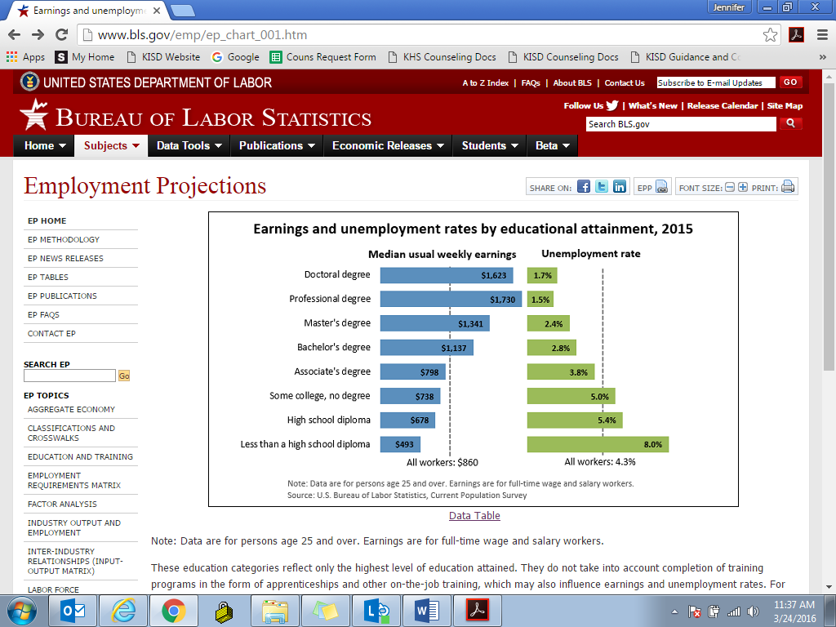
The more you learn, the more you earn!

Slide 10

The more you learn, the more you earn!

Slide 11
Work
You may decide to join the workforce immediately after you graduate from high school, but remember, it will be difficult to go back to school after you’ve been out for a while.
Depending on each job, you will be required to do some sort of training.
There are a wide variety of jobs available to go in to after high school. Some pay very low, others pay pretty well.

Slide 12
Work
Obviously, you could get a job at a restaurant, retail store, maybe even as a receptionist at a business. Some of these may not have room for growth, others will.
There are a lot of jobs where you can start at the bottom and work your way up. Some are apprenticeships, such as electrical or plumbing, where you get on-the-job training.
Other places you can work your way up: banks, restaurants, retail, general businesses.

Slide 13
Military
Talk to a recruiter for specific information on each branch of the U.S. military. Do not sign any paperwork without discussing your decision and choice with your parents. Recruiters are often on the high school campuses to talk with students.
Students can earn college credit while in the U.S. military.
The U.S. military can pay for some or all of your college tuition.
College ROTC programs can help you prepare for the U.S. military while attending college.
You must take the ASVAB Career Inventory Program and Test your junior or senior year to determine the type of job for you in the U.S. military. Your recruiter can set this up for you if you don’t take it at your high school when it is offered.

Slide 14
Military Academies
If you are interested in applying to a service academy, start planning early. Begin with the recruiter and your guidance counselor. Research the admission requirements and demands of being in the academy to make sure you are the right fit. You will need to apply for a nomination from your senator or state representative in the spring of your junior year. All academies require a nomination except for the Coast Guard.
The military academies are
  United States Military Academy—West Point (Army)
  United States Naval Academy (Navy and Marine Corps)
  United States Coast Guard Academy
  United States Merchant Marine Academy
  United States Air Force Academy
The difference between going to a military academy and just enrolling in the military is that if you finish the academy, you will come out already an officer.

Slide 15
Careers in the Military
http://www.careersinthemilitary.com/
  Careers in the Military: Careersinthemilitary.com is the leading career information resource for the military world of work. Explore a variety of careers across the Military Services (Army, Navy, Air Force, Marine Corps, and Coastguard) to find out what people in those occupations do and what their usual work environment is like. Learn about training and advancement opportunities and which services offer each occupation.
The military offers a variety of different jobs that they will train you for, along with opportunities for college.
The military pays you a salary as well, along with veteran benefits when/if you unenlist (once you’ve completed your commitment).

Slide 16
How Do I Decide?
Career interest inventories are the best way to figure out your skills and interests. Once you’ve done that, you can figure out which way you want to go and then figure out what kind of training you’ll need, and where.
My favorites:
  https://www.iseek.org/careers/clusterSurvey ISEEK Career Cluster Interest Survey: This free survey will give you several different career clusters to explore based on your personal qualities and interests.
  http://www.texascaresonline.com/ip/ipmenu.asp Texas Cares Interest Profiler: Texas Workforce Commission’s free interest inventory.
  https://www.mynextmove.org/explore/ip O*Net Interest Profiler: My Next Move 60-question interest inventory.
  http://assessment.texasgenuine.org/ Texas Genuine: Free career interest inventory based on the state career clusters.
  https://bigfuture.collegeboard.org/?excmpid=vt-00061 College Board Big Future: career search, as well as college and scholarship searches

Slide 17
How Do I Decide?
After you’ve found some ideas for careers, then research what training is required for the job, and where you would go to get it.
A great website to use to research careers is http://online.onetcenter.org/

Slide 18

Questions?

