Slide 1
College searches and college applications
How to Navigate the Process

Slide 2
How do I do a college search?
First think about what kind of college you’re interested in.
Criteria to consider:
  Type (2-year, 4-year, or trade school)
  Location (close to home or far away)
  Size (small, medium, large)
  Public or private, religious, liberal arts, etc.
  Cost
  Available majors

Slide 3
How do I do a college search?
The internet has many resources for college searches.
KISD’s CCMR website: https://www.kellerisd.net/departments/college-career-military-readiness
See other great ones on your handout
If you’re interested in Texas schools only, this one is good too: https://www.comptroller.texas.gov/programs/education/msp/
There are websites where you can search for schools by major, like doctors, nurses, or engineering, to name a few.

Slide 4
Check admission requirements
Under the admissions or prospective student tab, there will be information on a college’s admission requirements.
There you can find out what ACT/SAT score they require based on your GPA and/or rank, if they’re not test optional.
This can help you determine if this is a safety school or a reach school for you.
Top 10% rule (UT is top 6%)

Slide 5
Other research options
Speak to an admissions counselor at schools you are considering
Ask for information on what criteria they look for in an applicant and change yourself accordingly (ie: join more clubs, take a more challenging schedule, do community service)
Put yourself on their mailing list
Go visit the college (or do a virtual tour if this isn’t feasible)
Read over their website for more information
Find out if your dual credit or AP credits will transfer

Slide 6
How do I apply?
Most college applications consist of 3 main parts:
  the application (including the application fee)
  your official transcript
  your official ACT and/or SAT scores (if required)

Slide 7
How do I apply?
Some colleges require other pieces such as:
  recommendation letters
  essays (usually a part of the application)
  counselor reports
  teacher reports
  interviews (usually for elite schools or students under review)
  auditions or portfolios (for special programs such as music or art)
  anything else a school deems necessary to their application process

Slide 8
How do I apply?
Applications are online in several formats:
  Texas public universities: www.applytexas.org
  Private universities, both in and out of Texas: www.commonapp.org
  Coalition app or Common Black College (HBCU) app
  University websites: if a school doesn’t use Apply Texas or Common App, they will have their own application. You can find it under prospective students, incoming freshmen, or similar wording.

Slide 9
How do I order a transcript?
To order an official transcript, go to https://kellertx.scriborder.com/.
To view and print your unofficial transcript, go to your Aeries student portal.
Also, don’t forget that you will need to send a final official transcript to whichever college you decide to go to at the end of senior year.

Slide 10
ACT vs SAT: What’s the difference?
The SAT is a test of reading, writing and language, and math. The scores range from 400 to 1600 (200 to 800 per test).
The ACT is a test of English, math, science, reading, and optional writing. The highest score is a 36.
SAT time length: 3 hours on paper, short online
ACT time length: 2 hours + 55 minutes (with optional writing, adds 45 minutes)

Slide 11
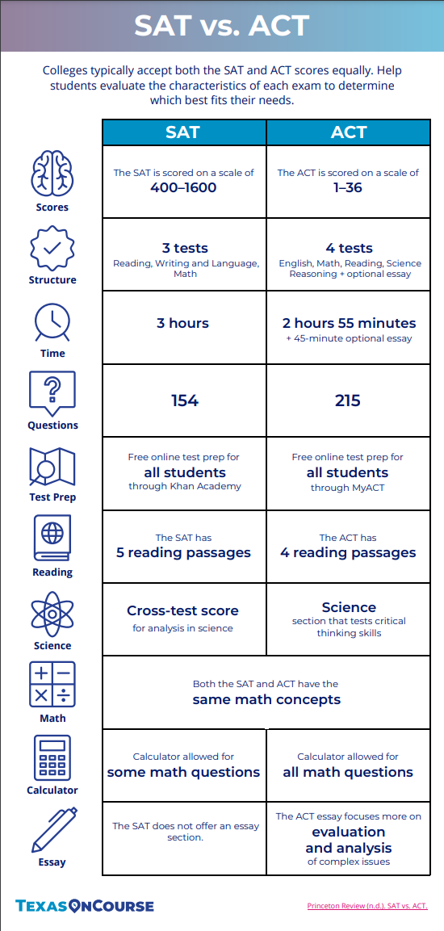

Slide 12
How do I sign up and how do I prepare?
For SAT, go to www.collegeboard.org. You will click on Register for the SAT, and it will ask you to create an account.
For ACT, go to www.actstudent.org. Click on Register for the ACT, and it will ask you to create an account.
Free online test prep:
https://academy.act.org/ or www.actonlineprep.com or myACT.org
www.khanacademy.org or www.satpractice.org
www.march2success.com
https://www.olive-book.com/

Slide 13
How do I send my SAT/ACT scores?
If you list your college(s) before or on test day, you can send your scores for free.
If you wait till after test day, they will charge you per score report.
Some students choose to wait so they can see the test scores they send.
Log in to your ACT Student or College Board account and click on “send test scores,” and it will walk you through the process.

Slide 14
Which scores should I send?
Most colleges don’t care if you send ACT or SAT scores. Either is fine.
A college only needs one test score—ACT or SAT, but some students send more than one in case the college superscores.
What is superscoring?

Slide 15
College Essays
What is an admissions office looking for in an essay?
  Your essay is the main way the college admissions officers get to know you personally aside from your GPA and test scores.
  Imagine reading hundreds of essays. What would make an essay interesting to you?
  Think of an opening line, then an opening paragraph, that will grab the reader right away and make them want to read on.
  Tell them something they won’t see anywhere else in your application.
  You want to show them your personality, allow them a glimpse into who you are as a person, and let them see what you want to do with your life.
  Always have an adult proofread your essay, and use spellcheck.

Slide 16
Resumes
Feel free to browse the internet for a resume template you like. Using a template is a good idea, but be careful with the template you choose.
You can use Microsoft Office or Google Docs resume templates. Some are better than others.
Other places to find templates:
  https://resumegenius.com/resume-templates
  https://templates.office.com/en-us/Simple-resume-TM00002110

Slide 17
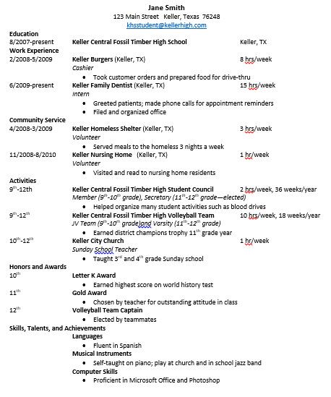
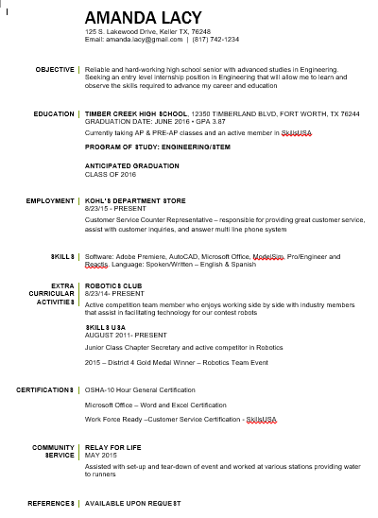
Sample Resumes

Slide 18
Recommendation Letters
Many college and scholarship applications require one or more recommendation letter.
You want to choose people who can tell anecdotal stories about you and who have known you for a significant amount of time.
It is customary to give recommenders at least two weeks to write your letter. When you ask them to do so, you will want to include your resume and possibly answers to some of the questions listed on your handout.

Slide 19
Application complete?
Once your college receives all required parts of your application, it will go into the complete pile for review by an admissions counselor.
Colleges handle notifying students of admission, denial, wait-list, articulation agreement, etc, in different ways, including rolling admissions or a set date for notifications.
You can still send things to update your file, like new test scores or an updated transcript with 7th semester grades on it.

Slide 20
Application complete?
If your application requires recommendation letters or other things you are dependent on other people to send, give those people plenty of notice to complete them and then make sure to follow up with them to make sure the items are submitted.
Also many colleges offer an online way to check your application status and missing items. For some schools, this is also where you may find information on your acceptance.

Slide 21
STUDENT ATHLETE?
If you are planning to participate in D1 or D2 sports in college, don’t forget to take care of all the NCAA or NAIA requirements.
Work with your counselor to make sure you meet all course requirements, register with NCAA or NAIA, and send your transcript and test scores.

Slide 22
Deadlines!!!!!
Make sure you pay close attention to deadlines for applications for admissions and scholarships. Colleges do not extend deadlines for anyone!
The earlier you apply, the better your chance for admission and scholarship money.
Pay special attention to early decision/early action dates.

Slide 23
Now what?
After you finish your admissions applications, it’s not over! Then you will need to start on scholarships and financial aid. We will tackle that subject next month.

Slide 24

Questions?

