Slide 1

Team Special Education
SEAC: September 2024

Slide 2
1
Who are we?

Slide 3
Special Education Administrative Team

Slide 4
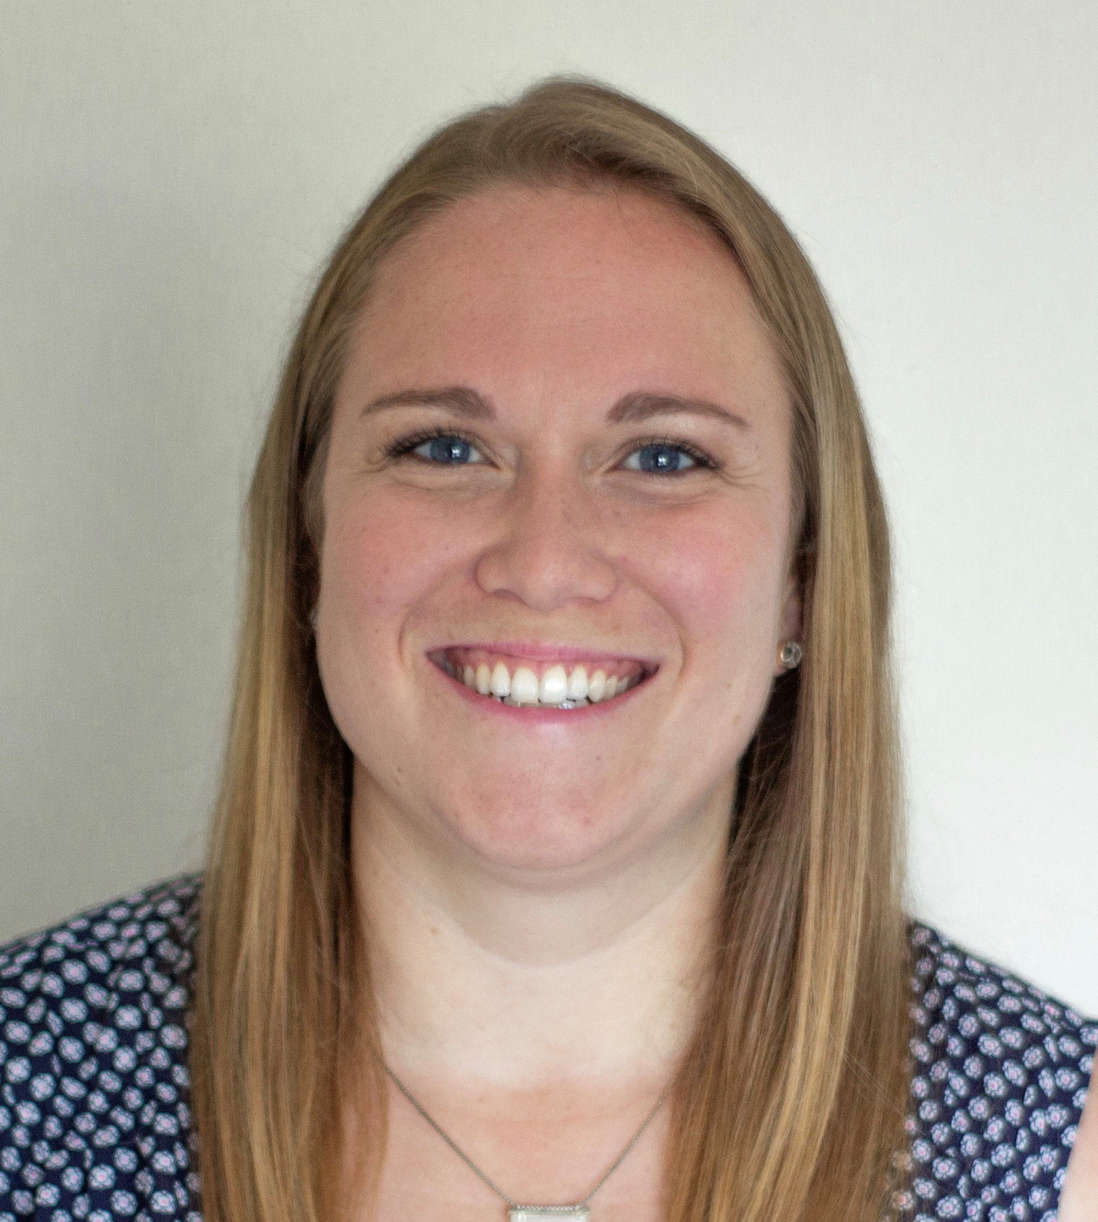
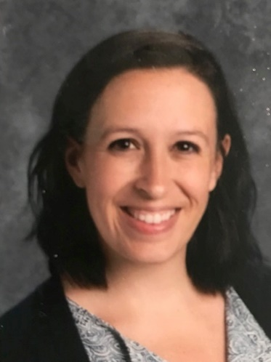
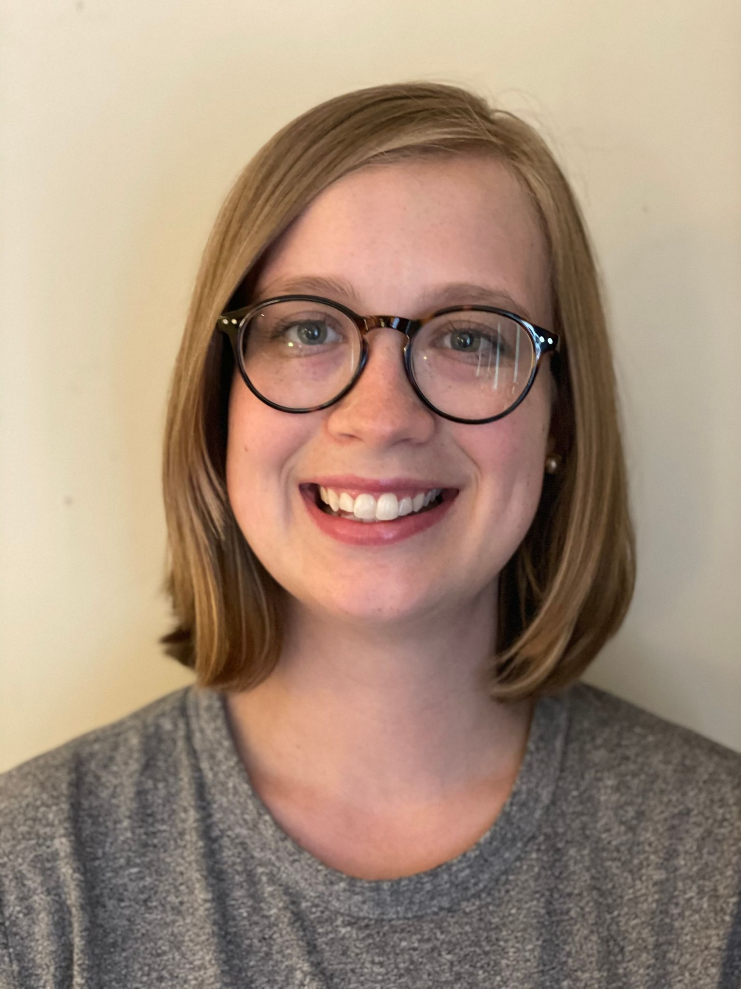
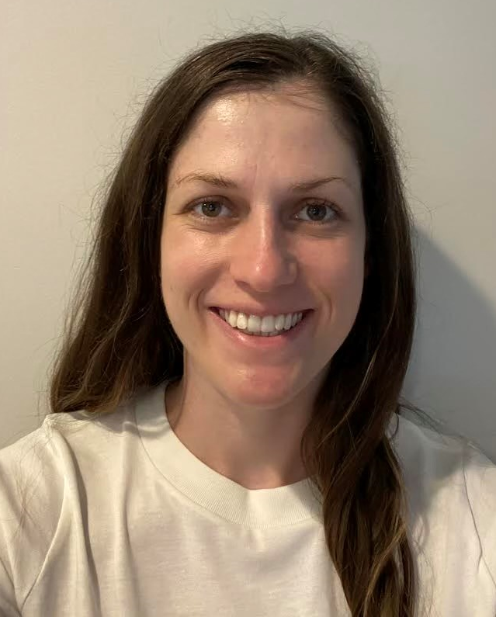
Special Education: Administrative Team
 | Valerie Parks Special Education Coordinator CSA (Private/Residential) | Ruth Tapscott Special Education Coordinator High School/Middle School
 | Emily Skelton Special Education Coordinator Ivy Creek/ISC/Elementary | Julia Petro Special Education Coordinator ECSE

Slide 5

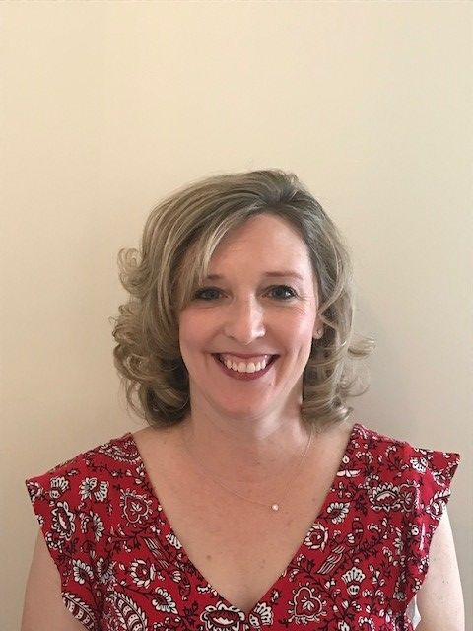
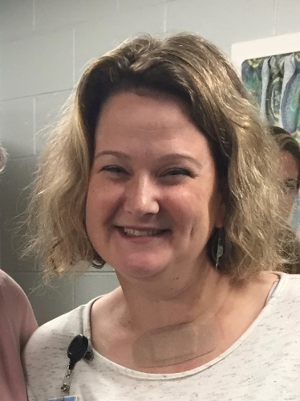
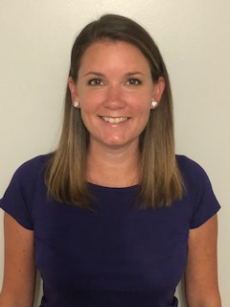
Special Education: Administrative Team
 | John Kinney Special Education Coordinator Elementary/Middle School Katy Compel Director Special Education | Kristin Kress Special Education Coordinator Elementary School
Ashley Struzik
Assistant Director of Special Education/
Post High

Slide 6
Office of Special Education Contacts
Katy Compel Director of Special Education Ext. 13218 kcompel@k12albemarle.org Ashley Struzik Assistant Director of Special Education Ext. 68501, astruzik@k12albemarle.org John Kinney Special Education Coordinator Ext. 13226, jkinney2@k12albemarle.org Kristin Kress Special Education Coordinator Ext. 13216 kkress@k12albemarle.org | Emily Skelton Special Education Coordinator Ext. 13217 eskelton@k12albemarle.org Ruth Tapscott Special Education Coordinator Ext. 13223 rtapscott@k12albemarle.org Valerie Parks Special Education Coordinator Ext. 13219, vparks@k12albemarle.org Julia Petro Special Education Coordinator Ext. 13215, jpetro2@k12albemarle.org

Slide 7
Special Education Department

Slide 8
The Glue

Slide 9

Ethel Johnson
Management Analyst
ejohnson2@k12albemarle.org
X13212

Slide 10
BRJDC

Slide 11
Principal | Teachers
Tanner Boyle | Timothy Allen Tomacine Crouch Harry Hill* Ben Keyser Kyle Truitt Ahmad Hawkins Art Teacher: Vacant

Slide 12
CATEC

Slide 13
Teacher | Teaching Assistants
Constance Wyant | Candice Cummings Grace Ringwood*

Slide 14
Floater Staff

Slide 15
Teaching Assistants
Robin Mast: Driver Grace Ringwood: Driver/CATEC

Slide 16
Itinerant Staff

Slide 17
Teachers
Mike Armstrong: PSA Jesse Hagen: TBVI Colleen Mitchem: TBVI B.J. Pankau: APE Vacant: TDHH Emily Shepherd: TDHH B.J. Thomas: ARJ

Slide 18
Occupational Therapists

Slide 19
OT
Jeff Anderson Shannon Lenox Erin Lewicki* Heather Standish* Janelle Starck Ashley Yost

Slide 20
Physical Therapists

Slide 21
PT
Racheal Dulaney Sandra Holbrook Heather Russell

Slide 22
PK Eval Team

Slide 23
PK
Caroline Bump Elaine Hagan (SLP) Peggy Kalister* Nicole Santoro Christina Wallace (Psych) Vanessa Dunn-Tolman

Slide 24
Post High

Slide 25
Teacher | Teaching Assistant | Nurse
Hannah Farney Candy Taberner Lindsay Winston | Reva Agee Sarah Barker Sherry Blane Michelle Dowell Madisen Morris Becca Tichner | Carrie Smith

Slide 26
School Psychologist

Slide 27
Psychologist
MJ Cardin Karen Ferrer Kayla Hearl (Intern)* Janie Irons Kim Konold Darcie Lugus Claire Manderfield Aly McElroy Jamie Ryland* Lauren Servis Jen Sims Tana Strike Shelia White (Intern)* Stephanie Worczak

Slide 28
Specialists

Slide 29
Autism Specialists | Behavior Specialist | Learning Specialist
Megan Atthowe Jared Walding Emily Wampler Vacant | Megan Williams | Ann Lancaster

Slide 30
Speech/Language Pathologist

Slide 31
SLP
Jane Addison Andrea Bailey* Andrea Brewer Meredith Franco* Christy Frankfurth Marilu Harl Cherri Hartzog Margaret Hess Jen Johnson Savannah Krouch* | LG McMillan Melanie Mendelson Krystal Osborn Rose Propes* Emily Riedel Kelsey Thompson Kristine Thompson Blake Tyson Brittany Woods* 1.2 FTE Vacant

Slide 32
Intensive Support Center

Slide 33
ISC
Megan Marshall (Admin) Shannon Berry (Teacher)* Taylor Dollins (BCBA) | Anna DeAngelis Wendy Ford-Brown Amanda Helfrich New Story Staff (2)

Slide 34
Medicaid Specialist

Slide 35
Valerie Washington

Slide 36
2
Who do we serve?

Slide 37
ACPS Special Education Programs

Slide 38

Special Education - Generalists
(i.e. Resource, Push-In, Pull-Out, Collaborative Classes)
-
Speech and Language Pathologists
School Psychologists
Occupational Therapists
Physical Therapists
Teachers of Deaf/Hard of Hearing
Teachers of Blind/Visually Impaired
CROSS-CATEGORICAL PROGRAMS
  A continuum of services
  At all public schools
Notes:
Special education, or specialized provided by a special education teacher is available at all our schools. These teachers typically target instructional barriers for kids and serve kids with a variety of disabilities. Related services are offered across the division at each of our schools.

Slide 39
Early Childhood Special Education
VPI Blended Classroom
  Stone Robinson Elementary
ECSE
  Agnor Hurt Elementary
  Baker Butler Elementary
  Broadus Wood Elementary
  Brownsville Elementary (2)
  Greer Elementary
Notes:
After that - we start to specialize. We offer special services to children aged 2 through 5 at some of our elementary schools as well as in the community.

Slide 40
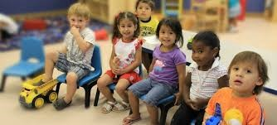
Early Childhood Special Education
ECSE (con’t)
  Hollymead Elementary
  Mountain View Elementary
  Stone Robinson Elementary
  Stony Point Elementary
Self-Contained: Autism Interventions
  Agnor Hurt Elementary
  Broadus Wood Elementary
  Stone-Robinson Elementary
Notes:
After that - we start to specialize. We offer special services to children aged 2 through 5 at some of our elementary schools as well as in the community.

Slide 41
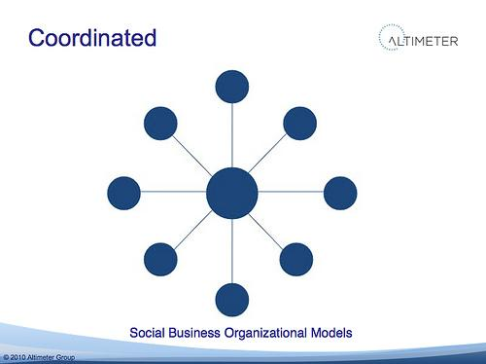
Autism-BASE
(Building Appropriate Supports with Evidence – Autism)
  ELEMENTARY
  Agnor-Hurt (2)
  Baker-Butler (2)
  Brownsville (2)
  Crozet
  Greer (2)
  Hollymead (2)
  Murray
  Mountain View (2)
  Scottsville
  Stone Robinson (2)
  Stony Point
  Woodbrook (2)
Notes:
For students with Autism, instructed in the general curriculum, working on grade level standards, we have created what is also known as A-BASE. One teacher and up to four Autism Assistants are specially trained to support students with Autism in the regular classroom.

Slide 42
A-BASE
(Building Appropriate Supports with Evidence – Autism)
Autism BASE - Middle
  Burley (x2)
  Journey
  Henley (x2)
  Lakeside
  Walton (x2)
Autism BASE - High
  Albemarle (x3)
  Monticello (x2)
  Western Albemarle (x2)
Notes:
This service delivery model is also available at certain middle and high schools.

Slide 43

Behavior-BASE
(Building Appropriate Supports with Evidence – Behavior)
  ELEMENTARY
  Agnor-Hurt
  Broadus Wood
  Brownsville
  Greer
  Hollymead
  Red Hill
  Woodbrook
Notes:
Some students with disabilities exhibit behavioral challenges. For these students we now offer what is also known as B-BASE. Again, a resource model with one teacher and two behavior assistants whose focus is on supporting students in the general education classroom through restitution / problems solving / relationship based set of interventions. These resources are available at certain elementary...

Slide 44
B-BASE
(Building Appropriate Supports with Evidence – Behavior)
Behavior BASE - Middle
  Burley
  Journey (x2)
  Lakeside
  Walton
Behavior BASE - High
  Albemarle (X2)
  Monticello (x2)
  Western Albemarle
Notes:
Middle and high schools.

Slide 45

  CBASE: Elementary
  Baker Butler (x2)
  Broadus Wood
  Brownsville
  Greer
  Hollymead
  Mountain View (x2)
  Murray Elementary
  Stone-Robinson
Notes:
For students that demonstrate a significant intellectual disability, require intensive assistance to learn the standards and cannot generalize their learning, instruction in alternate, although grade level standards is available at various elementary schools...

Slide 46
CBASE - Middle
  Burley
  Henley (x2)
  Journey
  Lakeside (x2)
  Walton
CBASE - High
  Albemarle (x3) + AHS PH
  Monticello (x2)
  Western Albemarle
  Post High Program (x3)
Notes:
As well as some middle and high school locations.

Slide 47

Other Programs
Intensive Support Center
Vocational Services at CATEC
ISAEP (GED Preparation)
Center for Learning and
Growth
Notes:
We also have some smaller support efforts. Like those mentioned here that support students with disabilities as they are nearing the end of their academic careers.

Slide 48
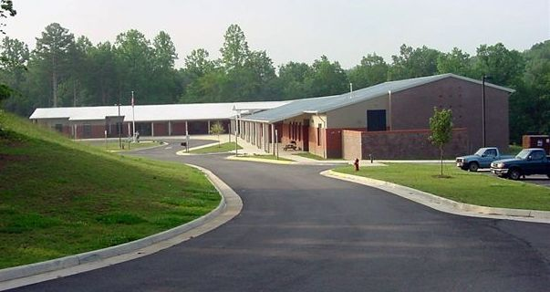
Piedmont Regional Education Program
Ivy Creek School
Services for O&M
Assistive Technology Specialist
Notes:
We also contract with the Piedmont Regional Education Program or PREP to help us with low incidence populations as well as a public day school, Ivy Creek School for kids with intensive emotional needs that cannot be supported successfully at their neighborhood schools.

Slide 49



Children’s Services Act
Private Day Placement
Residential Services
Wrap Around Services
Notes:
When all these services fail, we have, as we have seen earlier, resorted to private day schools and even residential schools to educate students in order to provide them meaningful educational benefit.

Slide 50
4
Disproportionality

Slide 51
What is Disproportionality?

Slide 52
Disproportionality
What is it?
VDOE calculates a race risk ratio for each school division in all race and disability categories.
Based on that ratio, VDOE determines if students are overrepresented in a certain category compared to their representation in the overall population.
Threshold - 3.00 = cited for being disproportionate 2.00 = warning that headed towards citation
Disproportionality data has been collected yearly since 1999. ACPS stands ALONE (and not in a good way).

Slide 53
Comprehensive Coordinated Early Intervening Services (CCEIS)
If a division is above the 3.00 threshold in any race risk ratio category, the division is cited and becomes a CCEIS division.
ACPS is a Comprehensive Coordinated Early Intervening Services (CCIES) school division, meaning we are required to set aside 15% of Part B Federal Funds towards CCEIS.
The extra “C” is mandated by VDOE, which must approve the
CCEIS Plan annually (new focus next year).

Slide 54
Current State in ACPS

Slide 55
Comprehensive Coordinated Early Intervening Services (CCEIS)
ACPS is a Comprehensive Coordinated Early Intervening Services (CCIES) school division currently.
Based on 2022-23 data (a 1 year lag)
ACPS will NOT be CCEIS for the first time (1999)
for the 2024-25 year.
Why? Let’s take a look (and CELEBRATE)!

Slide 56
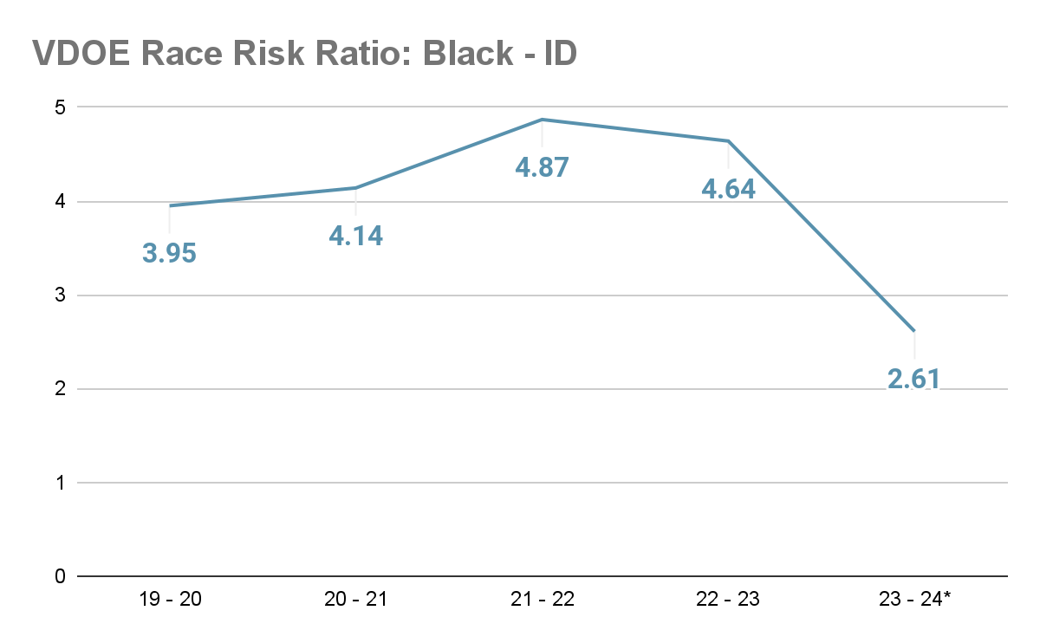
CCEIS
CITED THRESHOLD
WARNING
THRESHOLD

Slide 57
Comprehensive Coordinated Early Intervening Services (CCEIS)
How did we do it?
Professional development on culturally and linguistically sensitive assessments
Developed common practices amongst evaluation teams for assessing students where ID is being considered.
SPED Central Admin Team attends all referrals/eligibilities where ID is being considered.

Slide 58
Comprehensive Coordinated Early Intervening Services (CCEIS)
How did we do it?
Detailed file review of all students currently eligible for ID
  Reviewed if appropriate or not
  If not appropriate, took steps to determine appropriate eligibility process.
Any new referral for ID must go through the Psych PLC and SPED Admin team as a case review before going to eligibility.

Slide 59
CCEIS
ACPS will utilize the required 15% set aside for
CCEIS funds in the 2024-25 school year for:
11-Month
Special Education
Evaluation and
Eligibility Team
1 Speech and Language Pathologist
2 School
Psychologists
1 Early Childhood Special Educator
1 K-12
Special Educator

Slide 60
CCEIS
This team will lead all:
Initial evaluations and eligibilities where intellectual disability is being considered.
All re-evaluations where intellectual disability is being considered.
All Special Education evaluations and eligibilities outside of the typical school year calendar.

Slide 61
CCEIS
CCEIS PLAN JUSTIFICATION
During the 2023-24 school year, we focused on one team doing all ID initial evaluations, re-evaluations and reviewing transfer students and data from this process shows significant positive impact.
The last area of need for us to fill is the need for evaluations outside of the 10-month school year window.
Note: We are still 1 student away from being back in the warning area. We cannot let up.

Slide 62
Issue on the Horizon

Slide 63
Black - ED
Must be over 3.00 for 3 consecutive years to become CCEIS
ED - Black race risk ratio is on the rise.
  If we do not do something about it now, we will be cited again but in ED - Black category.
  We CANNOT be ok with this trend.
  What does this say about our belief about Black Students who have behavioral challenges compared to their Non-Black peers?
Let’s take a look at the data.

Slide 64
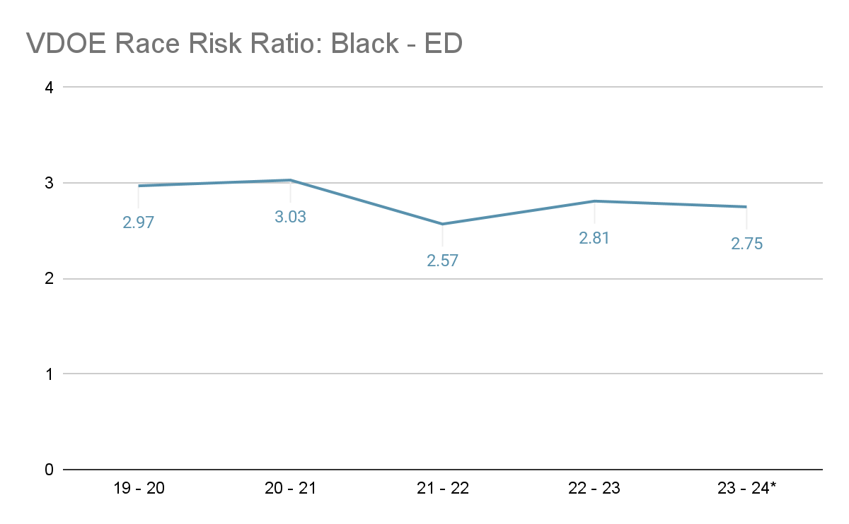
CITED THRESHOLD
WARNING
THRESHOLD

