Slide 1
Welcome to SEAC!
September 10, 2024

Slide 2

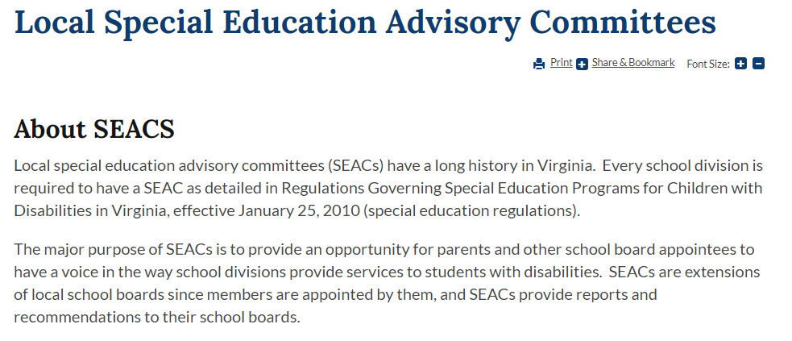
https://www.doe.virginia.gov/data-policy-funding/virginia-board-of-education/board-committee-meetings/state-special-education-advisory-committee-sseac/local-special-education-advisory-committees

Slide 3
Local Special Education Advisory Committee (SEAC)
“A local advisory committee for special education, appointed by each local school board, shall advise the school board through the division superintendent.”
8 Va. Admin. Code 20-81-230(D)

Slide 4
SEAC Membership Requirements
A majority of the committee shall be parents of children with disabilities or individuals with disabilities.
The committee shall include one teacher.
Additional local school division personnel shall serve only as consultants to the committee.
8 Va. Admin. Code 20-81-230(D)(1)

Slide 5
Albemarle SEAC Membership - Bylaws
Maximum of 30 voting Members
Must be residents of Albemarle County
Members approved by Director of Special Education, at the direction of the Superintendent and School Board
Goal: One voting member representing each school, with additional space for up to 5 at-large and community representatives
  Up to 2 representatives per school (primary and alternate)
Minimum 2/3rds of members shall be parents of children requiring special education services
Special Education Administrator for Albemarle County (or designee) serves as consultant, but has no vote

Slide 6
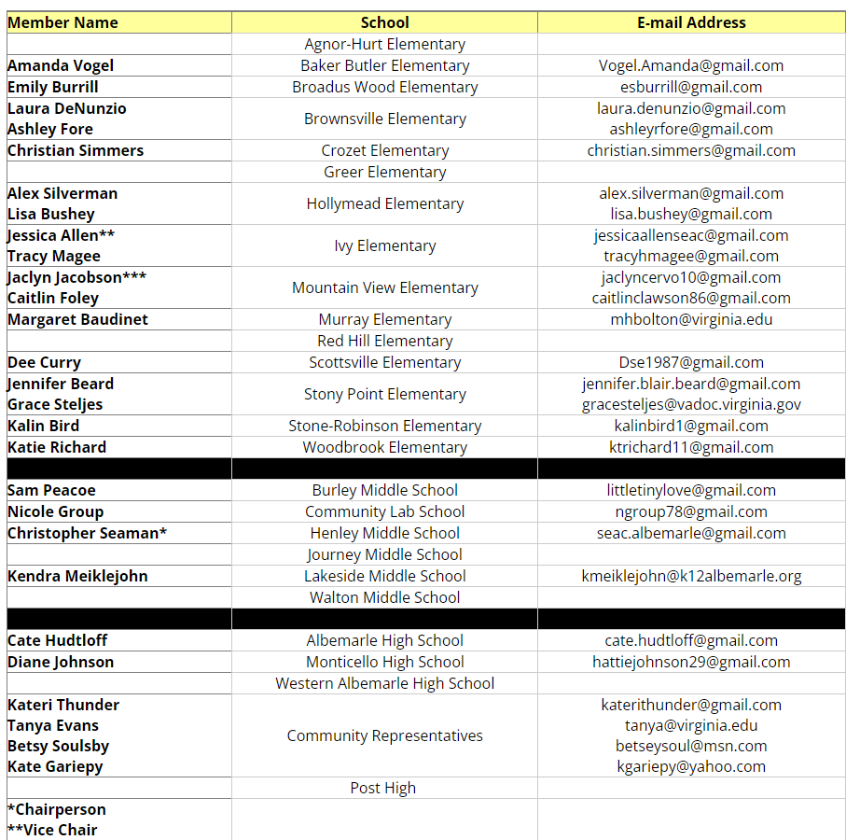
2024-2025 Albemarle SEAC Membership

Slide 7
SEAC Leadership Team for 2024-2025
Chair: Chris Seaman (Henley)
Vice-Chair: Jessica Allen (Ivy)
Secretary: Jaclyn Cervo-Jacobson (Mountain View)

Slide 8
SEAC Functions
Advise the local school division of needs in the education of children with disabilities;
Participate in the development of priorities and strategies for meeting the identified needs of children with disabilities;
Submit periodic reports and recommendations regarding education of children with disabilities to the division superintendent for transmission to the local school board
Assist the local school division in interpreting plans to the community for meeting the special needs of children with disabilities for educational services;
Review the policies and procedures for the provision of special education and related services prior to submission to the local school board; and
Participate in the review of the local school division's annual plan...
8 Va. Admin. Code 20-81-230(D)(2)

Slide 9

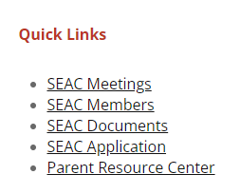
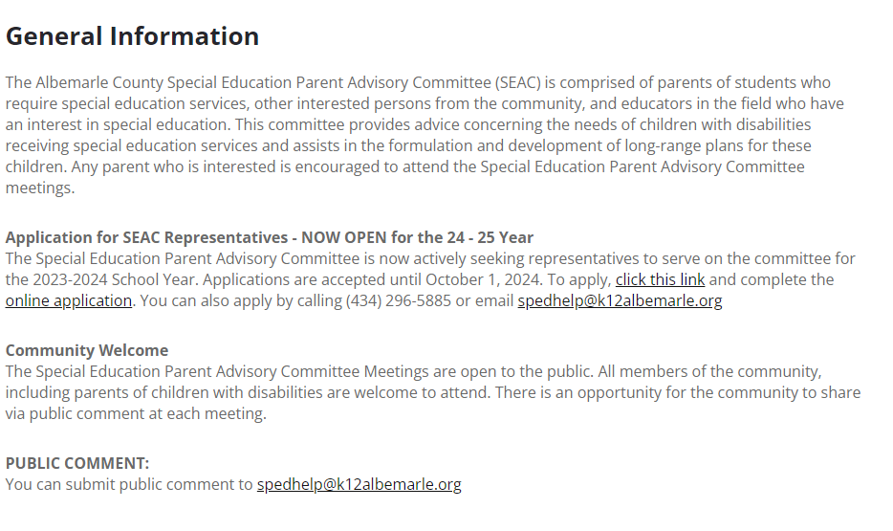
SEAC Website
https://www.k12albemarle.org/our-departments/special-education/special-education-advisory-committee

Slide 10
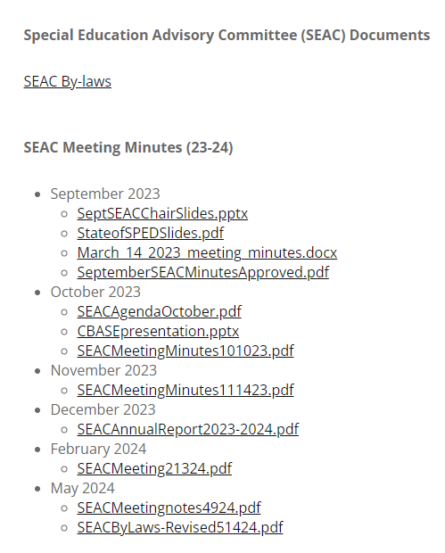
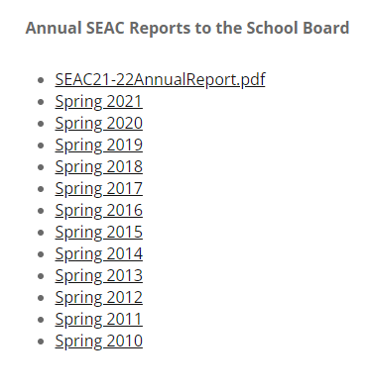
SEAC Website - Documents
https://www.k12albemarle.org/our-departments/special-education/special-education-advisory-committee/docs

Slide 11
SEAC Meetings
Open to the public
Monthly meetings (second Tuesday of each month)
In-person (up to 2 virtual per year for illness or out-of-town travel)
Quorum to do business: 1/3 of members
Meeting minutes (attendance, agenda items, votes)
Public comment period (in person and electronic)

Slide 12
SEAC Meeting Schedule, 2024-2025
Future Meetings (starting at 7 pm):
Tuesday, Oct. 8
Tuesday, Nov. 12
Tuesday, Dec. 10
Tuesday, Jan. 14
Tuesday, Feb. 11
Tuesday, Mar. 11
Tuesday, Apr. 8
Tuesday, May 13
Also Thursday, Dec. 12 – School Board meeting (SEAC annual report)

Slide 13
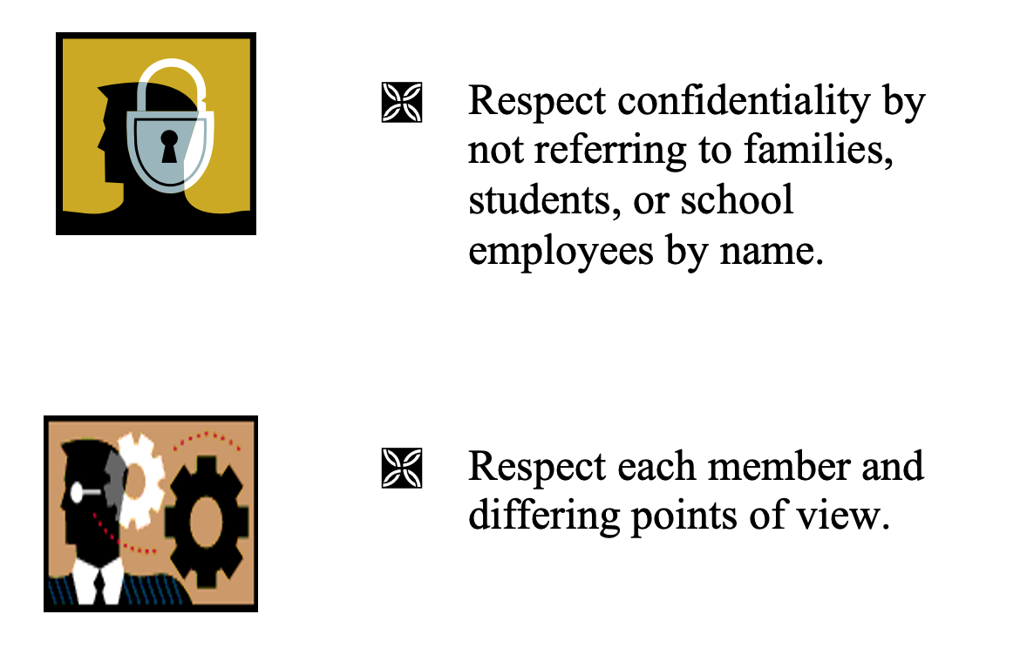
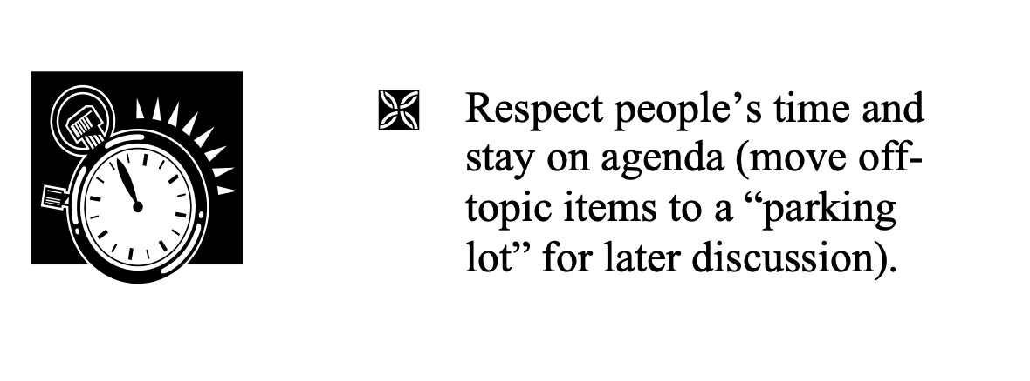
Team Rules

Slide 14
Fall Events / Timeline
SEAC Family Survey – late September/early October
Discussion of items for annual report – Oct. 8 meeting
Survey results – mid-October
Draft of annual report circulated to SEAC members by Nov. 1
Comments on draft report to leadership team by Nov. 11
Vote on SEAC annual report – Nov. 12 meeting
Presentation to School Board – December 12

Slide 15
Spring Items / Timeline
Annual Budget (February/March)
Annual Special Education Plan and Application for Federal Funds
Collaboration with UVA Law – Eligibility process and outcomes

Slide 16
Ongoing
Engaging with your school community and encouraging feedback
Advising school division and providing input
Policy review and input

