Slide 1








9th Grade Presentation
@KHS_CounselingDept

Slide 2


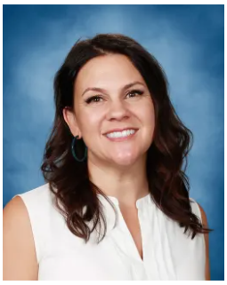
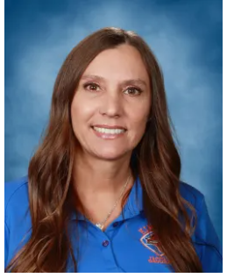
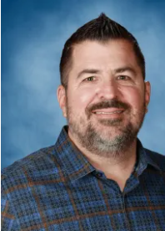
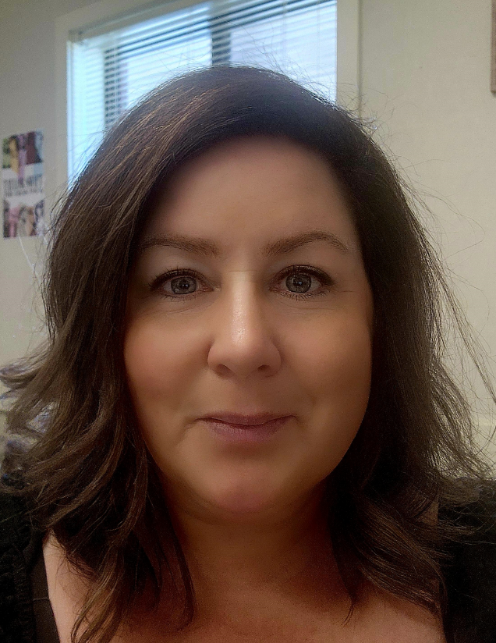
Counselors
Caseloads are assigned by student's last names & special programs
Mrs. Strong
Mrs. Rivera
Mr. Berris
Ms.
Banchero
A-D
AVID
E-Mon
Moo-S
T-Z
MHSA
jstrong@tusd.net
trrivera@tusd.net
wberris@tusd.net
sbanchero@tusd.net

Slide 3

To-Do List
01
How to be successful
02
High School Grad &
A-G Requirements
03
How to have fun &
get involved

Slide 4


Counseling Office Hours
8:00AM to 4:30PM
How to contact your counselors
Student Drop-In Hours
Before AND after school
During both lunches
Counselors are also available by email
Interested in setting up an appointment? Check-in with our Counseling Secretary!

Slide 5



HS Counseling Department
Counseling Secretary
Mrs. Leslie Ibarra Castaneda
Registrar
Mrs. Ana Vela-Telles
Career Technician
TBD
School Psychology
Mrs. Lexi Mantor
Parent Liasian
Ms Roxana Rivas

Slide 6




  Counseling Website
  Mental Health Links
  Staff
  Counselors
https://kimballhigh.tracy.k12.ca.us/academics-programs
Mental Health Resources

Slide 7
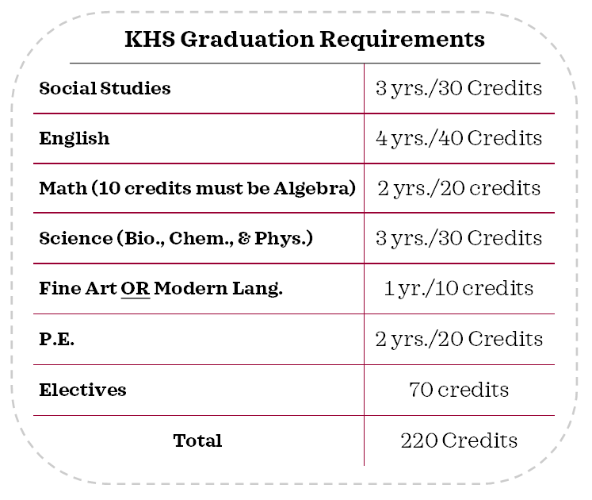
Graduation Requirements
Each year you are enrolled in 6 classes, you earn 5 credits per class, per semester for a total of 60 credits a year.
You must take and pass specific subject courses.
It is important that you pass your classes each semester, so you do not need to go to Summer School or Adult School in order to make up the credits you are missing to graduate on time.
Bio, Chem or Physics, Science

Slide 8
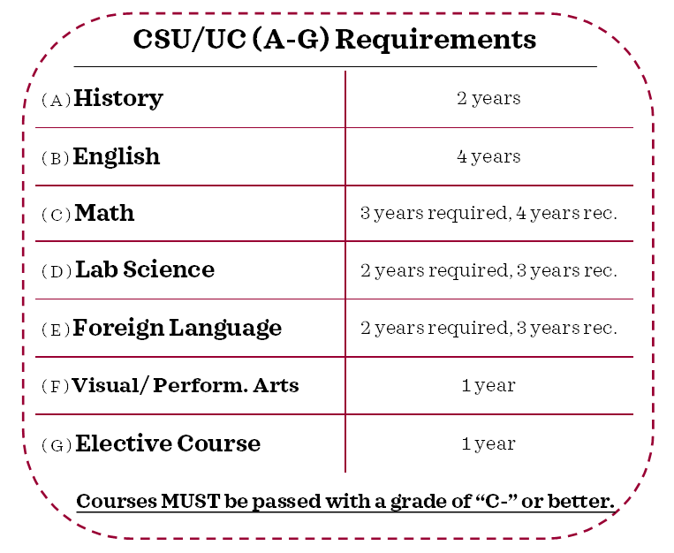
A-G Requirements (UC/CSU)
A – History 2 years
B – English 4 years
C – Math 3 years (4 years recommended)
(Algebra 1, Geometry, Algebra 2)
D – Lab Science (2 required, 3 recommended)
E – Foreign Language 2 years (3 years recommended)
F – Visual & Performing Arts 1 year
G – College Prep Elective 1 year

Slide 9
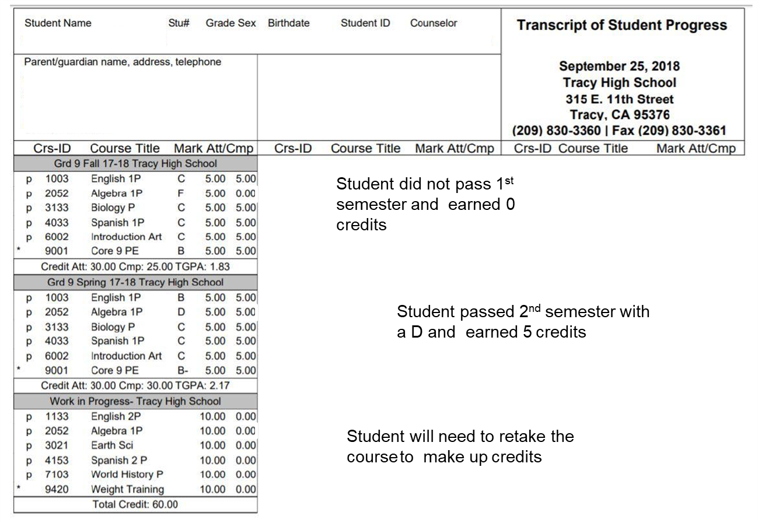
Kimball, Jaguary
John C Kimball High School
This is an example of what your high school transcript will look like after 9th grade.
If you pass all of your classes, you should earn 60 credits.

Slide 10


How to Calculate Your GPA
A = 4 points
GPA Calculator
Add all grades together and divide by 6.
B = 3 points
C = 2 points
D = 1 point
Note: Sports eligibility is a 2.0 & NO F's!
F = 0 points

Slide 11


Getting Involved!
Why Get Involved
  Meet friends w/similar interests & helps develop interests
  Keeps students engaged
  Improved academic outcomes when students are connected
  Good for mental and/or physical health
  Looks good for college admissions
How to Get Involved
  Play Sports
  Join Leadership
  Join Clubs
  Volunteer
  Attend Activities
  Club Rush Sept 4th & 5th

Slide 12
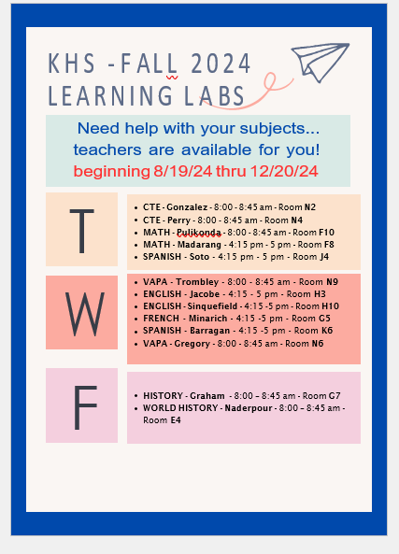
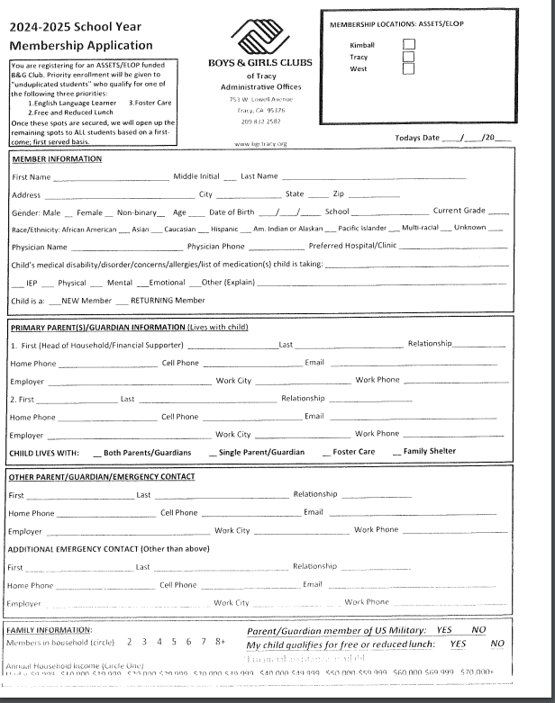

Slide 13

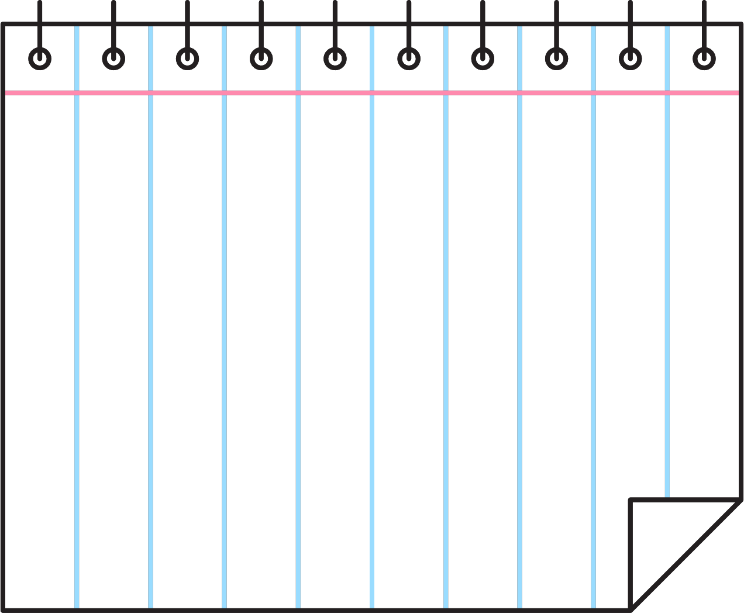









Questions?
@KHS_CounselingDept

Slide 14

Questions?
Follow us on Instagram!

