Slide 1
English IV Week 4 Vocabulary Review

Slide 2
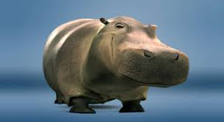
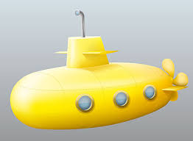

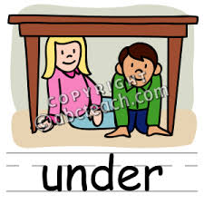
1. Hyper
1. Above (normal)
2. Below (normal)
3. Hypo
4. Sub
2. Super
3. Less/Under
4. Above/extra

Slide 3
1. Hypertension
Above (normal)
Above / Extra
1. Hyper
2. Super
2. Hyperactive
4. Supernatural
3. Hypercritical
5. Supererogatory

Slide 4
7. Hyposensitize
Below normal
Below / Under
Sub
Hypo
8. Subaqueous
6. Hypotension
9. Sublethal
10. Subservient

Slide 5
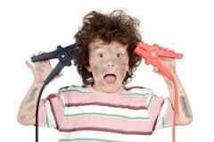


1. Hyperactive
Excessively active.

Slide 6
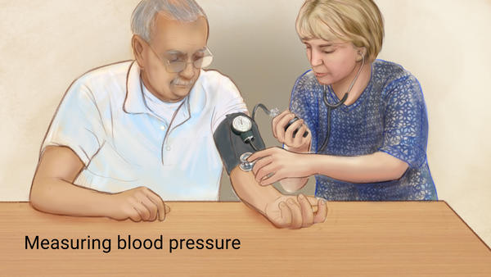
2. Hypertension
Abnormally high blood pressure

Slide 7


3. Hypercritical
Criticizing other people or things too strongly or too often.

Slide 8
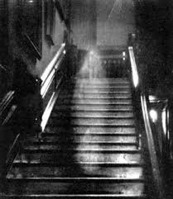
4. Supernatural
Beyond what is natural or observable.
Not explainable by the laws of nature.

Slide 9
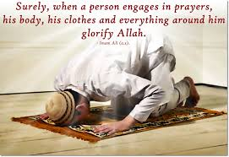
5. Supererogatory
Beyond the requirements of duty.

Slide 10
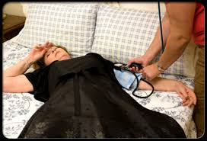
Answer
6. Hypotension
Abnormally low blood pressure.

Slide 11
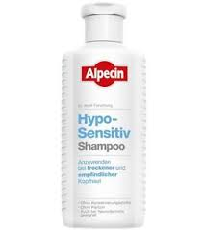
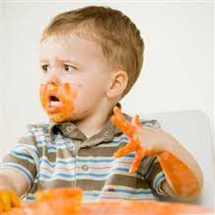
7. Hyposensitize
Make less sensitive.
The state or process of being reduced in sensitivity especially to an allergen

Slide 12
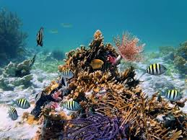

8. Subaqueous
Underwater.
Existing, formed, or taking place in or under water.

Slide 13
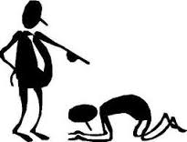
9. Subservient
Excessively submissive.

Slide 14
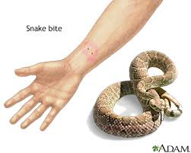
10. Sublethal
Not quite lethal.
Insufficient to cause death.

