Slide 1
Week 3 Vocabulary Review English

Slide 2

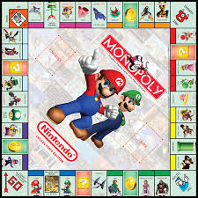

Mono = 1
Q1? Explain what you know of the monopoly game

Slide 3
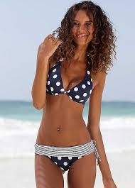
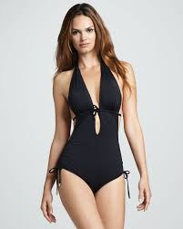
Mono = 1
Think carefully, if the first picture shows a girl in a bikini,
Then,
What is this girl wearing?

Slide 4
Mono = 1
Monokini
bikini

Slide 5
Mono = 1
Q2?: Think of 3 other words that start with mono
that have one component or mean one.
Example:
monomania = talks about one subject only.

Slide 6
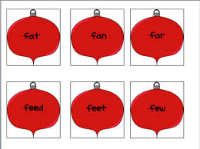
1. Monosyllabic
One
Two
Car
Fair
Having one syllable

Slide 7
Monosyllabic
Q3?: Think of other 10 words that are monosyllabic

Slide 8
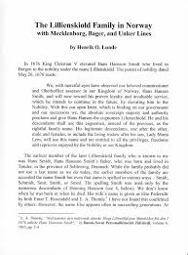
2. Monograph
One topic paper
Learned treatise on a particular subject; scholarly article.

Slide 9
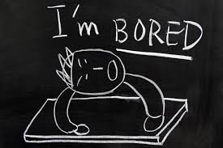
3. Monotonous
Tiresome because of lack of variety.

Slide 10
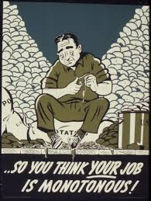
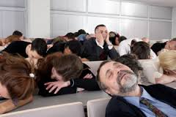
3. Monotonous
Q4?: Think of something that is monotonous to you.

Slide 11
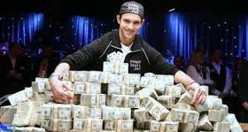
Multi = many
Example:
Multimillionaire = a person with assets worth several million dollars..
Multi = many

Slide 12
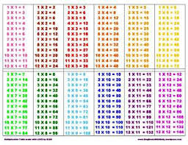
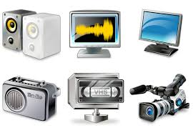

Multi = many
Q5?: Look at the following pictures:
Guess the words that start with the prefix -many
Multi = many

Slide 13
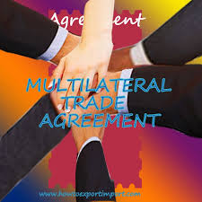
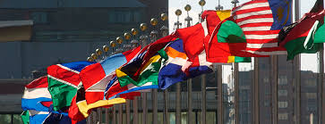
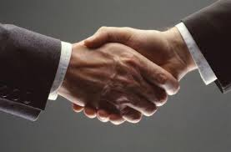
4. Multilateral
Having many sides
Participated in by more than two participants.

Slide 14

4. Multilateral
Q6?: Why are all these geometrical figures multilateral?

Slide 15
4. Multilateral
Q7?: http://www.fws.gov/international/laws-treaties-agreements/bilateral-and-multilateral-agreements/index.html
Q7?: Copy and paste the web address, look at the article and say why are these agreements multilateral? What countries are involved?

Slide 16


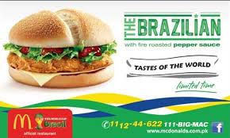
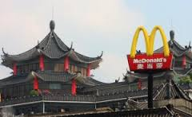
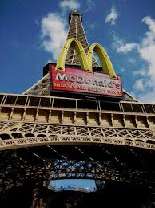
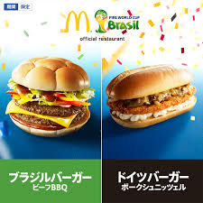
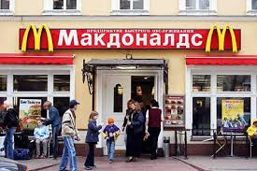
5. Multinational
Q8?: Did you know that you can get McDonalds in different countries?. From the pictures, mention three countries where you could get McDonalds.

Slide 17

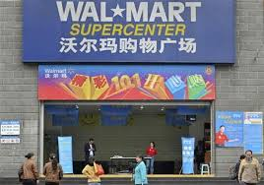

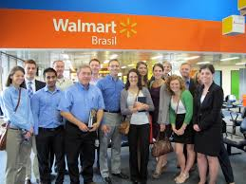
5. Multinational
Q9?: Wal Mart and McDonalds are Multinational Companies. What do you think multinational means?

Slide 18
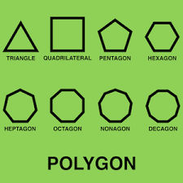
Poly = Several

Slide 19
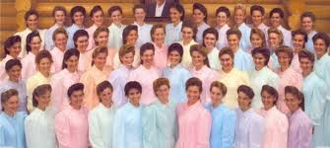
6. Polygamist
Q?: What do you think of being able to marry different wives/husbands?
Would you have money for all the kids you would have with them?

Slide 20
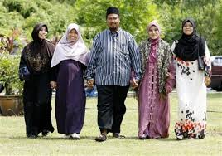
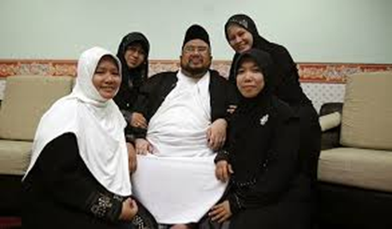
6. Polygamist
Q?: How many wives does this man have?

Slide 21
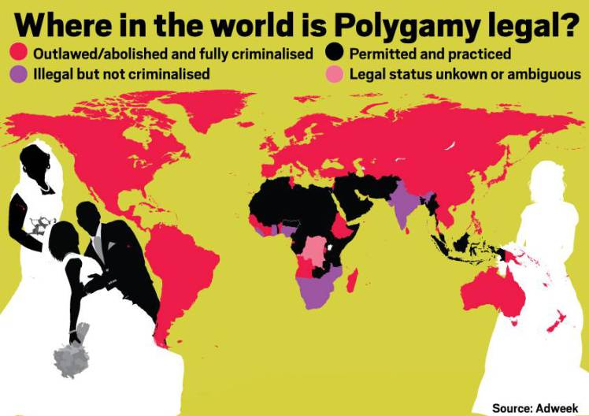
6. Polygamist
Q10?: In which part of the world is polygamy still accepted.

Slide 22
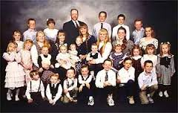
6. Polygamist
Person married to two or more mates at the same time.

Slide 23
Q11?: Most of you are able to understand or speak two languages, because of that, you are called ______________.

Slide 24
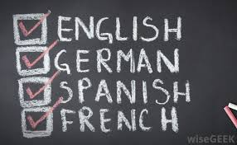
7. Polyglot
Person who speaks or writes several languages.

Slide 25
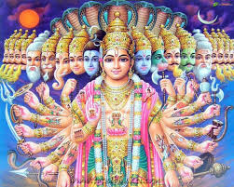
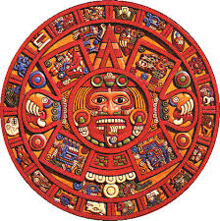
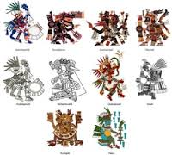
8. Polytheistic
Believing in more than one god.

Slide 26
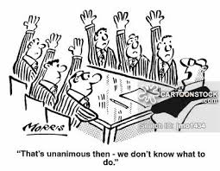

9. Unanimous
Jonathan agrees!
Alexander agrees!
Alejandro agrees!
Souksaly agrees!
Mrs. Persin agrees!
Gilberto agrees!
Nick agrees!
Ricky agrees!
Lilly agrees!
Gabby agrees!

Slide 27
9. Unanimous
Jonathan agrees!
Alexander agrees!
Alejandro agrees!
Souksaly agrees!
Q11?: What do you think unanimous means?
Mrs. Persin agrees!
Gilberto agrees!
Nick agrees!
Ricky agrees!
Lilly agrees!
Gabby agrees!

Slide 28
9. Unanimous
Being of one and the same opinion.
Showing complete agreement.

Slide 29
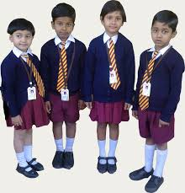
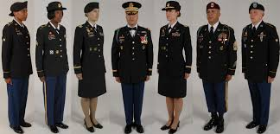
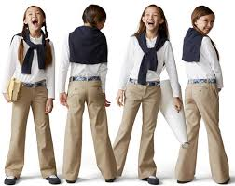
10. Uniform
Q12? What is uniform?
Define from what you know.

Slide 30
10. Uniform
Always the same; not varying in form, degree, or manner.

