Slide 1
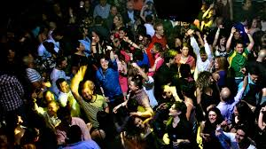
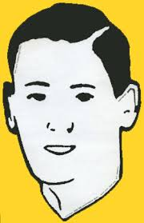
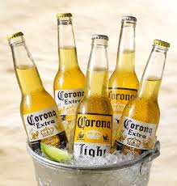
John Doe loved to party!

Slide 2
But inviting John Doe to a party was problematic…
Let me tell you why…

Slide 3
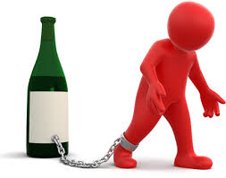
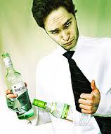
He loved alcoholic beverages!!!!
John had an uncontrollable craving for alcoholic beverages. He was a…
1. Dipsomaniac

Slide 4

He loved to talk about parties, parties, parties!!!!
That is all he could talk about.
Party, party, party, party
Party, party, party, party
Party, party, party, party
Mono = 1
Mania - Obsession

Slide 5
Party, party, party, party
Party, party, party, party
He loved to talk about parties, parties, parties!!!!
That is all he could talk about.
Party, party, party, party
He had a derangement of the mind to talk about one subject only. He had a…
2. Monomania
Mono = 1
Mania - Obsession

Slide 6


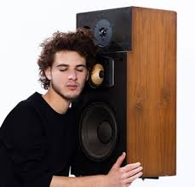
He loved to listen to music, but the sound had to be perfect, high-fidelity sound reproduction or it was not good.
He was an…
Audio= Sound

Slide 7
Selecting the place and time for the party was troublesome…

Slide 8
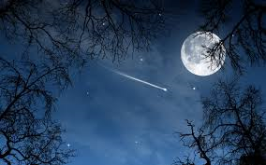
He could only go to parties at night…
John hated light…
He was…
4. Photophobic
Photo=Light
Phobia=fear of…
Aversion

Slide 9

He could not go to parties in small spaces.
John hated closed or narrow spaces…
He suffered from…
5. Claustrophobia
Phobia=fear of…
Aversion

Slide 10
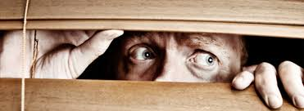
He could not go to public spaces, he’d rather being indoors.
John feared of being in crowds, public places, or open areas.
John suffered from…
6. Agoraphobia
Phobia=fear of…
Aversion

Slide 11
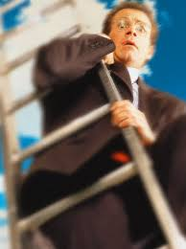
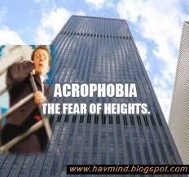
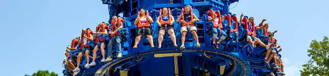
The party could not be in high places.
John had an abnormal fear of being in high places.
He suffered from…
7. Acrophobia
Phobia=fear of…
Aversion

Slide 12
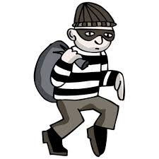
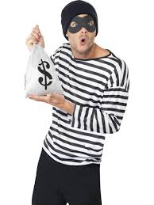
People had to watch for their possessions.
John had a persistent neurotic impulse to steal, though not in need.
John was a…
8. Kleptomaniac
Mania=Aversion

Slide 13
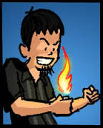
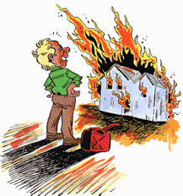
People had to watch for fire.
John had an insane impulse to start fires.
John was a…
9. Pyromaniac
Mania=Aversion

Slide 14
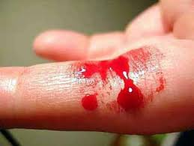
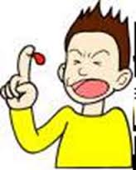

Finally…
You could not keep sharp objects around…
John could bleed excessively from minor injuries. John was a bleeder.
John was a…
10. Hemophiliac
Hemo = blood

Slide 15
The question is…
Would you invite John to a party? Explain in detail why or why not!
Hemo = blood

Slide 16
Mania =
Exaggerated enthusiasm, mad impulse.

Slide 17
Phobia=
Abnormal and persistent fear, dislike, or hatred.

