Slide 1
Week 1 Vocabulary Review (English IV)

Slide 2
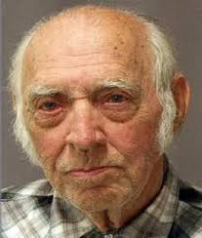
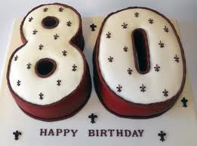
Person in his or her eighties.
Octogenarian.

Slide 3
My grandfather, who is considered a __________ because he is 83 years old, still acts as if he is in his twenties.
octogenarian
centenarian
tithe
millennium

Slide 4
A. octogenarian

Slide 5
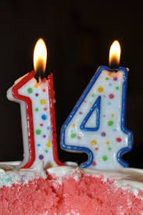
Period of fourteen days; two weeks.
Fortnight.

Slide 6
I left for the islands for a(n) __________, which gave me the time to escape the hustle of the big city.
decimate
score
fortnight
tithe

Slide 7
C. fortnight

Slide 8
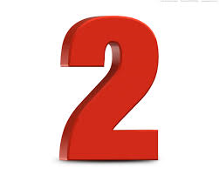
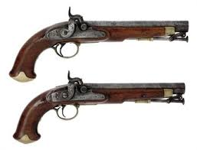
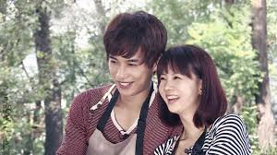
Two of a kind, pair, couple.
Brace.

Slide 9
After the job interview, David__________ himself for whatever news he would hear about him getting the job or not.
BICENTENNIAL
PENTAGON
SCORE
BRACE

Slide 10
d. BRACE

Slide 11
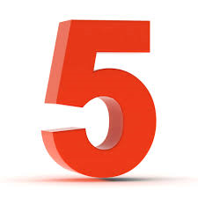
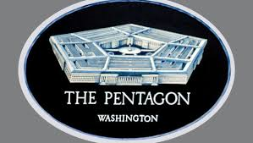
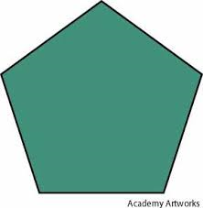
Plane figure of five sides and five angles.
Pentagon.

Slide 12
The math teacher’s lesson for the day was to teach the students all the uses of the ___________.
octogenarian
pentagon
centenarian
fortnight

Slide 13
B. pentagon

Slide 14
All the people that attended that church had to give a __________ of 10% of their yearly earnings.
tithe
Decimate
millennium
score

Slide 15
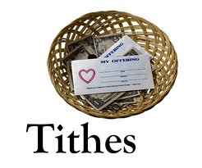
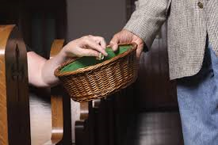
One-tenth, tenth part of a person’s income paid as a contribution or tax to support a religious establishment.
Tithe.
(Diesmo)

Slide 16
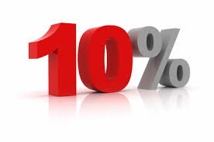
One-tenth, tenth part of a person’s income paid as a contribution or tax to support a religious establishment.
Tithe.
(Diesmo)

Slide 17
a. tithe

Slide 18

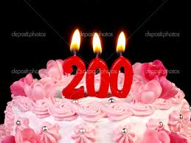
200th Anniversary.
Bicentennial.

Slide 19
The coin was minted especially for the 200th year __________ of the united states’ declaration of independence from Britain.
millennium
centenarian
bicentennial
pentagon

Slide 20
c. bicentennial

Slide 21
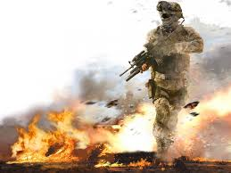
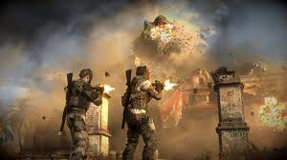
Destroy ten percent or more or a large portion of.
Decimate.

Slide 22
I’m going to have to __________ all the competition that is going against me in the 200 meter race tomorrow.
decimate
brace
score
tithe

Slide 23
A. decimate

Slide 24

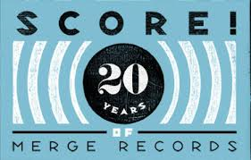
Group of twenty.
Score.

Slide 25
Although the __________ from Tchaikovsky's The nutcracker was not well received at first, the public now knows it as one of the composer’s best.
millennium
score
bicentennial
brace

Slide 26
b. score

Slide 27
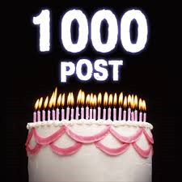
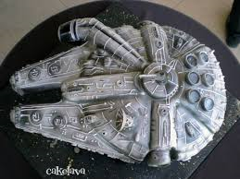
1000 years; 1000th anniversary.
Millennium.

Slide 28
At the turn of the last __________, people feared that it would be the end of the world.
bicentennial
pentagon
octogenarian
millennium

Slide 29
d. millennium

Slide 30

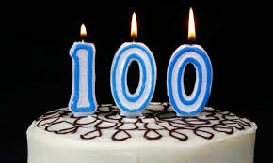
One who is 100 or older.
Centenarian.

Slide 31
Being over 100 years of age, most of Henry’s young friends nicknamed him the __________.
centenarian
millennium
fortnight
octogenarian

Slide 32
a. centenarian

