Slide 1
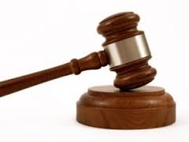
ADJOURN
To close a meeting or suspend business.
The judge chose to adjourn court until Monday morning due to bad weather.

Slide 2
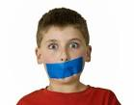
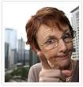
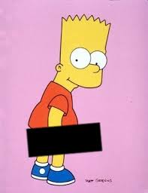
CENSURE
Act of blaming, expression of disapproval (often a look)
Alia could see the look of censure in Dad’s eyes; she knew that he thought she was being rude.

Slide 3



DISSENT
Disagree, object, differ in opinion.
George liked the pink tuxedo he tried on the Goodwill store, but Annie voiced her dissent quickly and loudly; he was not wearing that tux in their wedding!

Slide 4
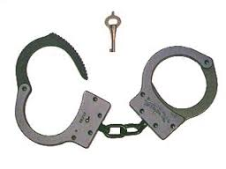
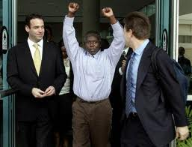
EXONERATE
Free from blame, acquit.
The new DNA evidence presented in the appellate court was able to exonerate the innocent man who had been wrongly convicted.

Slide 5



EXTEMPORANEOUS
Offhand, impromptu, improvised
Joe had not prepared a speech, so he had to speak extemporaneously when he won the award.

Slide 6
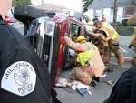
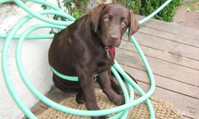
EXTRICATE
Disentangle, free from difficulties.
Mom had to extricate herself from the pile of blankets and puppies in her lap to answer the doorbell.

Slide 7


ILLEGIBLE
Hard to read.
If your test answers are illegible, I will mark them wrong; if I can’t read it, I can’t grade it.

Slide 8

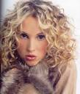
PERMANENT
Lasting, enduring, stable.
The building had a solid foundation so the town expected it to be a permanent part of its history.

Slide 9


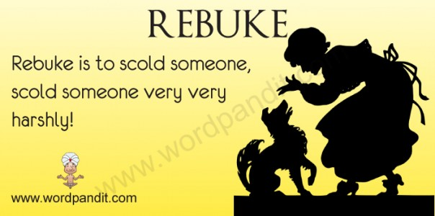
REBUKE
Express disapproval of; criticize sharply (generally verbal).
When he broke curfew for the third time, Stefan got more than a verbal rebuke from Dad; he lost his car and his phone for three weeks, too!

Slide 10


TRANSIENT
Staying for only a short time.
The vagrant was homeless and transient; he moved around from town to town, staying in one place for only a couple of days at a time.

