Slide 1
Week 6 Vocabulary (English II)

Slide 2
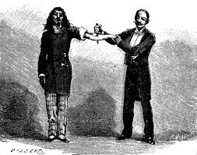
1.
To make a hole through
Perforate

Slide 3
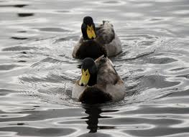
2.
to happen, go, or come before (something or someone)
Precede

Slide 4
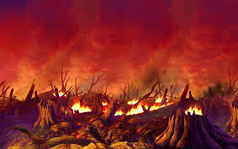
3.
To do away with completely so as to leave no trace.
obliterate

Slide 5
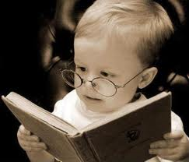
Precocious
4.
Of a child; having or showing the qualities or abilities of an adult at the unusually early age

Slide 6
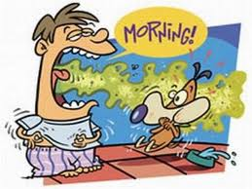
5.
Permeate
To pass or spread through something

Slide 7

6.
Premeditate
To think about and revolve in the mind beforehand.

Slide 8


7.
Relating to the thing that is being thought about or discussed.
Pertinent

Slide 9
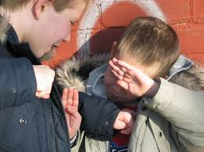
8. To become involved with something or to become noticeable in an unpleasant or annoying way.
Obtrude

Slide 10
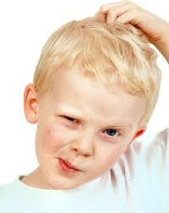
9.
To make unable to grasp something clearly or to think logically and decisively about something
Perplex

Slide 11

10.
To make (something) impossible; to prevent (something) from happening.
Preclude

