Slide 1
Week 3 Vocabulary Review (Eng. II)
Directions: Watch all the power point studying the words.

Slide 2
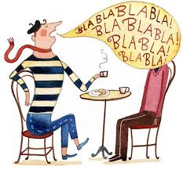

Continuing without interruption; ceaseless; unending
1.
1. Incessant

Slide 3

An intervening episode, period, space, etc.
2.
Interlude

Slide 4
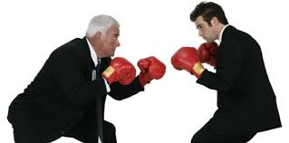
A prolonged public dispute, debate, or contention; disputation concerning a matter of opinion.
3.
Controversy

Slide 5
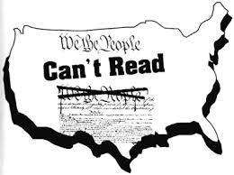
Unable to read and write; having or demonstrating very little or no education.
4.
Illiterate

Slide 6
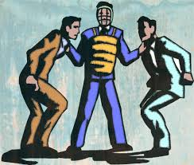
5.
To act or interpose in behalf of someone in difficulty or trouble, as by pleading or petition.
Intercede

Slide 7
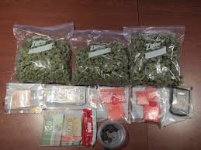
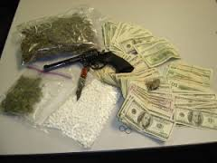
Anything prohibited by law from being imported or exported.
6.
Contraband

Slide 8
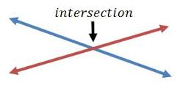
To cut or divide by passing through or across.
7.
Intersect

Slide 9

Not relevant; not applicable or pertinent.
8.
Irrelevant

Slide 10

To revoke or cancel (a command, order, etc.)
9.
Countermand

Slide 11


Free from spot or stain; spotlessly clean.
10.
Immaculate

Slide 12
ANSWERS
Incessant
Interlude
Controversy
Illiterate
Intercede
Contraband
Intersect
Irrelevant
9. Countermand
10. Immaculate

