Slide 1

The fact of being either male or female.
Gender

Slide 2
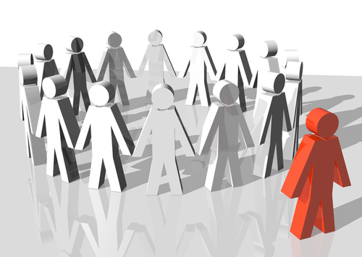
Unfair treatment of someone because of their gender, race, or other personal features.
Discrimination

Slide 3
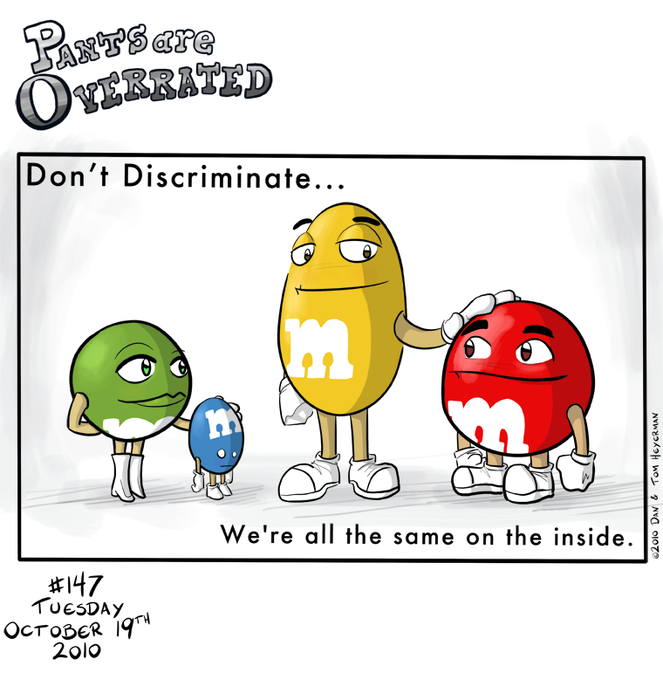

Slide 4
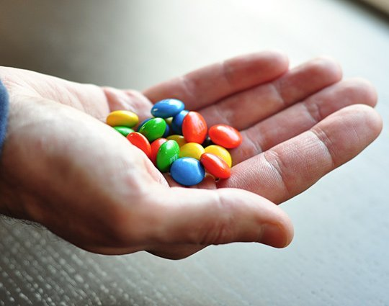
A very small number of people or things.
Handful

Slide 5
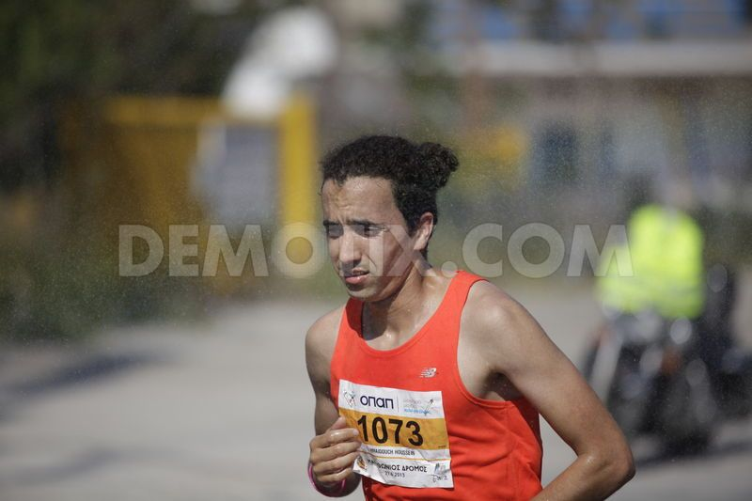
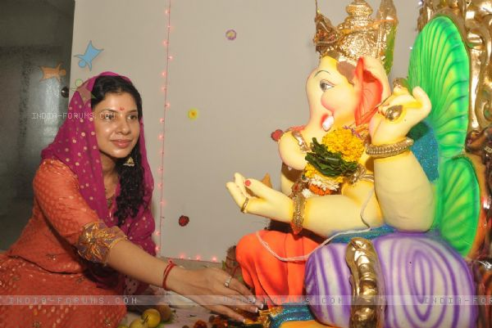
If you ______ yourself ___ something, you spend most of your time and effort doing it.
Devote to….

Slide 6
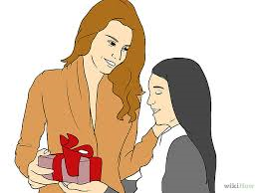
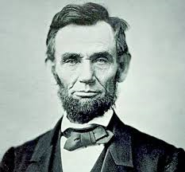
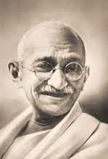
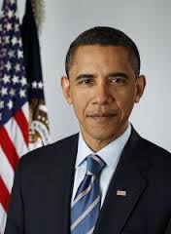
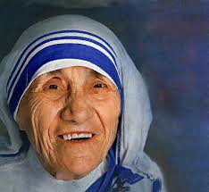
Significant.
Very important, large or noticeable.

Slide 7

Significant

Slide 8
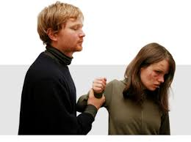
Domestic Violence.
Violence that takes place in the home between family members, especially adults.

Slide 9
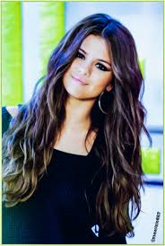
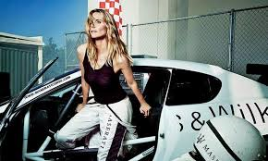
High-profile
Person or thing is often seen in public or on TV, or mentioned in newspapers.

Slide 10
High-profile
A______Person or thing is often seen in public or on TV, or mentioned in newspapers.

Slide 11

Appreciation
The feeling you have when you are grateful to someone.

Slide 12

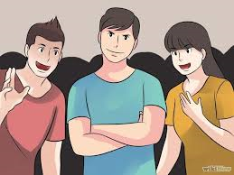
Draw attention to…
If you ____ ____ ___, you make people notice it.

Slide 13
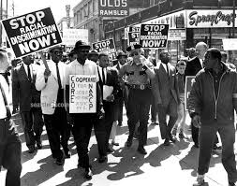
Protest
A strong complaint or disagreement.

Slide 14
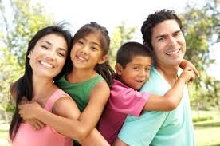
Dependent
When you need someone in order to live or succeed.

Slide 15
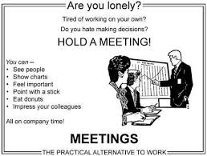
Hold
If you ____ a meeting or event, you organize it.

Slide 16
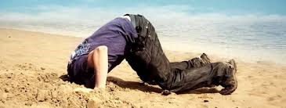

Unthinkable
When you need someone in order to live or succeed.

