Slide 1
2015-2016 Ohio’s State Tests
Information for Students and Families

Slide 2

Giving All Students a High-quality Education
Notes:
Ohio’s State Tests measure students’ progress toward Ohio’s Learning Standards. They help us make sure every student in our district [school] receives a high-quality education.

Slide 3

Knowledge and Skills for Success
Notes:
Student test results show whether our children in every grade are building the knowledge and skills they need to stay on track for high school graduation, as well as success in college or a career. The results also give parents an idea of their children’s learning progress.
Although Ohio law permits local school districts to control most day-to day-decisions about education, federal and state laws do require state testing for specific grades and subjects.

Slide 4
Why do we have
Ohio’s State Tests?
Notes:
Ohio’s State Tests provide information about student progress, as well as information about strengths and weaknesses in students’ knowledge and skills. Schools then use this information to know how and what to teach in the coming school year. Ohio’s State Tests also give parents a way to compare their children’s progress, if they wish, to that of their classmates and their peers throughout the state.
State tests are NOT meant to give feedback that will help guide teaching for the rest of the same school year. This is what we use our locally developed tests for.
[NOTE – this is the section where you should be putting information about the score reports that families will be receiving this year in November from last year’s tests – and an idea of what kind of info they get from the tests - We have to emphasize that

Slide 5

Results show how all students are performing in school
Notes:
The results from state tests also tell our community how our students are performing. Student scores on Ohio’s State Tests are the basis for the annual report card Ohio gives every district and school, each year. These report cards shows where our district and schools need additional support, and they recognize where we have done a great job of helping all of our students learn.

Slide 6
How are
Ohio’s State Tests
different this year?

Slide 7

Ohio’s State Tests
Shorter than last year.
Given during one window.
Notes:
In response to feedback from the first year of Ohio’s State Tests, the state is making changes this school year:
Ohio’s State Tests will be:
Shorter than those given last school year;
Given once during the year; and
Given closer to the end of the school year.
High schools also may give end-of-course state tests at the end of the first semester; and
Elementary schools will choose to start giving Ohio’s grade 3 English language arts test in November or December.
Like last year, Ohio’s State Tests are still are matched to Ohio’s Learning Standards, and they will still focus on making sure kids are on track for success in the next grade – or beyond high school.
[OPTIONAL] – This year’s state tests will be available in two versions that districts can choose from: paper and pencil, and computer-based tests. Our district [school] will give [fill in format] tests.

Slide 8

Ohio Educators Will Select Which Questions Go On the Test
Notes:
The new state tests in math and English language arts state will be Ohio tests developed by Ohioans. That’s because Ohio educators will help select test questions that line up with Ohio’s Learning Standards.

Slide 9

Each of Ohio’s State Tests will be about three hours.
Notes:
Each Ohio State Test will be approximately three hours long and CAN BE divided into two parts. Our district will decide whether our students will take the whole test in one sitting or split it into two 90 minute sessions.

Slide 10
Which tests will your student take?

Slide 11

StateTest Grades and Subjects
Students Grades 3-8
Students Grades 4,6
Students Grades 5,8
English Language Arts and Math
Social Studies
Science
Notes:
--Students in Grades 3-8 will take English language arts and mathematics tests
--Students in Grades 4 and 6 will take the social studies test
--Students in Grades 5 and 8 will take the science test

Slide 12

Third Grade Reading Test
Grade 3 English language arts:
Nov. 30-Dec. 11, 2015
Spring 2016
Notes:
Our elementary schools also will choose one or two days between Nov. 30 and Dec. 11 to give Ohio’s Grade 3 English Language Arts Test. Our elementary schools will give the grade 3 English language arts test again next spring.
This means our third-graders will have two times during the school year to take the test for the Third Grade Reading Guarantee—that’s two chances to show they are reading at the level needed to advance to the fourth grade.
[If you district offers them, also explain that struggling readers may take alternative tests, which will give them additional opportunities to show they are reading on grade level.]

Slide 13
High School:
Classes of 2018 and Beyond
English Language Arts I and II;
Algebra I,
Geometry or Integrated Mathematics I & II;
Biology or Physical Science
American History
American Government
Notes:
Let’s talk about high school tests.
Our classes of 2018 and 2019, this year’s freshmen and sophomores, will need to earn a total of 18 points on seven end-of-course state tests as one way to meet their graduation requirements.
The seven tests are:
English language arts I and II;
Algebra I;
Geometry;
Integrated mathematics I and II;
Biology (or physical science for the class of 2018 only); and
American History
American Government.

Slide 14
High School:
This year’s juniors and seniors
Ohio Graduation Tests, American history, American government
Notes:
Our classes of 2016 and 2017, this year’s juniors and seniors, will still take Ohio Graduation Tests to meet graduation requirements. They also will take Ohio’s State Tests in American History and American Government.

Slide 15
How will
students take
Ohio’s State Tests?

Slide 16


Districts Select Test Format
Computer
Paper and Pencil
Notes:
As I said earlier, our district can choose this school year to test only on computers, only in paper format or a combination of the two.

Slide 17
What Are the Spring Dates for
Ohio’s State Tests?

Slide 18

Spring StateTests
Each student will take appropriate tests sometime between
April 4 and May 13
Notes:
To test all grades from 3-12, our district will chose 15 consecutive school days for computer tests or 10 consecutive school days for paper tests. The test period we select will be sometime between Monday, April 4 – Friday, May 13. This does not mean your child will be taking tests for 10 or 15 days. It simply means that our district needs that many days to test all students in every grade.
We will receive test results for grade 3 reading by June 15 and for all other tests by June 30.

Slide 19
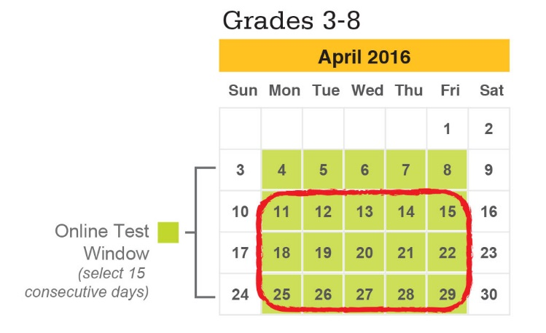
Spring State Tests - Online Example
Notes:
To test all grades from 3-12, our district will chose 15 consecutive school days for computer tests or 10 consecutive school days for paper tests. The test period we select will be sometime between Monday, April 4 – Friday, May 13. This does not mean your child will be taking tests for 10 or 15 days. It simply means we will be testing different students in different subjects and grades during this time period.
We will receive test results for grade 3 reading by June 15 and for all other tests by June 30.

Slide 20
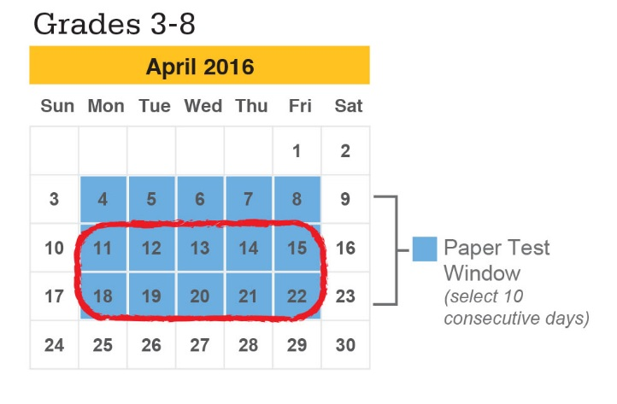
Spring State Tests – Paper Example
Notes:
To test all grades from 3-12, our district will chose 15 consecutive school days for computer tests or 10 consecutive school days for paper tests. The test period we select will be sometime between Monday, April 4 – Friday, May 13. This does not mean your child will be taking tests for 10 or 15 days. It simply means we will be testing different students in different subjects and grades during this time period.
We will receive test results for grade 3 reading by June 15 and for all other tests by June 30.

Slide 21
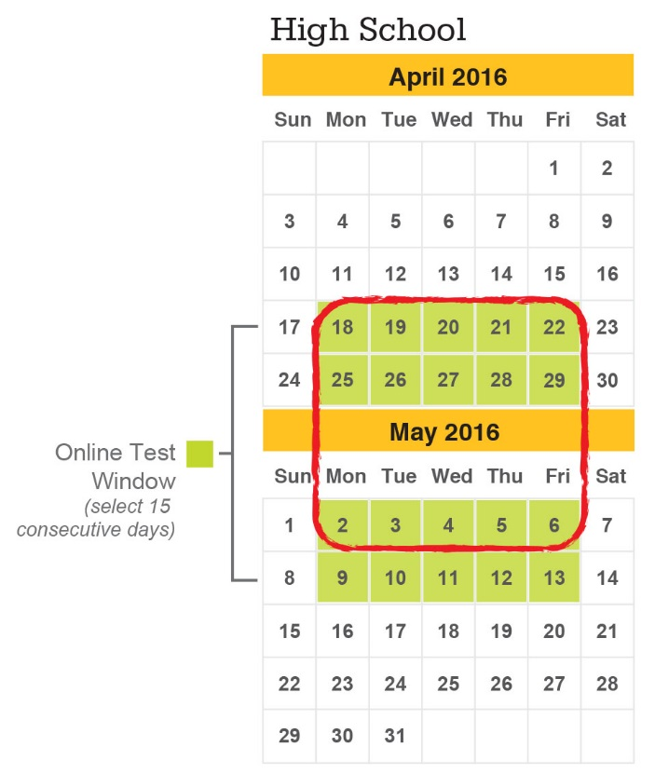
Spring State Tests – Online Example
Notes:
To test all grades from 3-12, our district will chose 15 consecutive school days for computer tests or 10 consecutive school days for paper tests. The test period we select will be sometime between Monday, April 4 – Friday, May 13. This does not mean your child will be taking tests for 10 or 15 days. It simply means we will be testing different students in different subjects and grades during this time period.
We will receive test results for grade 3 reading by June 15 and for all other tests by June 30.

Slide 22
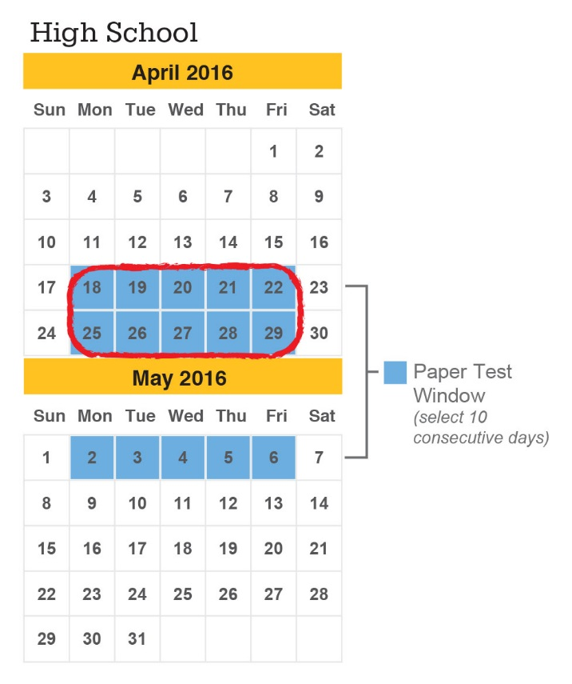
Spring State Tests – Paper Example
Notes:
To test all grades from 3-12, our district will chose 15 consecutive school days for computer tests or 10 consecutive school days for paper tests. The test period we select will be sometime between Monday, April 4 – Friday, May 13. This does not mean your child will be taking tests for 10 or 15 days, It simply means we will be testing different students in different subjects and grades during this time period.
We will receive test results for grade 3 reading by June 15 and for all other tests by June 30.

Slide 23
Where is the best place to find information about testing?

Slide 24

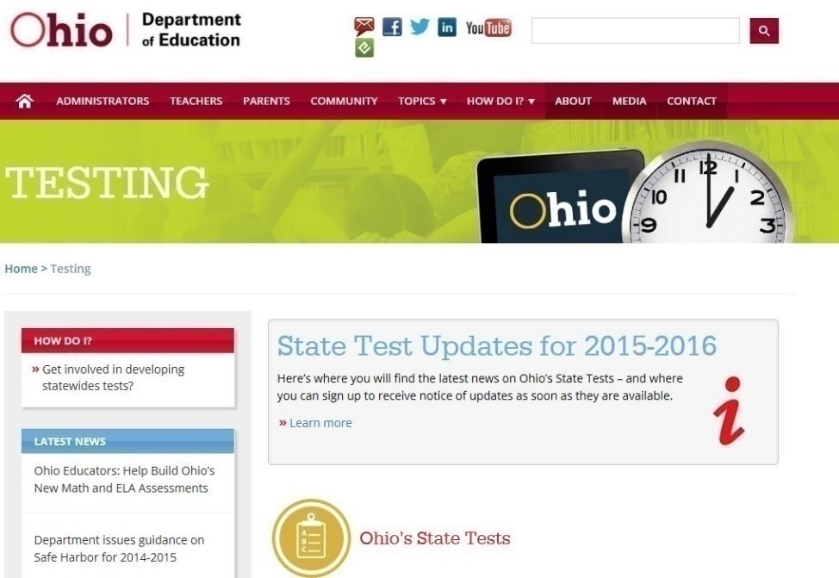
education.ohio.gov
Search: State Tests or click on the Green Testing Button
Notes:
Please visit the 2015-2016 State Tests Updates website at http://education.ohio.gov/testing-updates and register to receive updates when they are posted.
But also feel free to call your school principal or your child’s teacher if you have questions about particular state tests for your child. We will be happy to take time to talk with you.

Slide 25

education.ohio.gov

