Slide 1




CollegE
Selection
& Admissions
Seminar
10/24/23
Mr. Henrysen & mrs. moffett
Tina Luey
Paige Miller
Leah Cobette
Genaro Robles

Slide 2
Schedule for the Evening
Overview of the college selection & admissions process.
College Admissions Representatives will give specific information about their school.
The panel of experts will be available to answer general questions.

Slide 3
College Selection
Major/Academics
Size of college; size of classes
Location
Clubs/Sports/Activities
Affordability
Admissibility
Services

Slide 4

Types of applications/Admission
School Specific Application – on the school’s website
Common Application – www.commonapp.org
Coalition Application – www. coalitionforcollegeaccess.org
PA State Universities – www.passhe.edu
Rolling Admission
Early Action
Early Decision
Regular Admission
Priority – Penn State November 1st

Slide 5
College admissions criteria – varies depending on the school!
High School Transcript
Standardized Test Scores
Recommendation Letters
Extracurricular Activities
Essays/Personal Statements
Interview

Slide 6
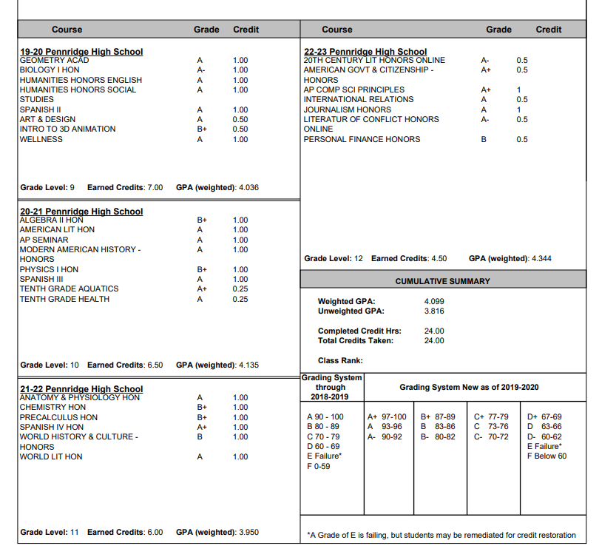
PHS Transcript
Rigor of Classes - AP, Honors, Academic
Type of Classes - Major Subjects & Electives
Cumulative GPA
Cumulative Class Rank
Final Grades Recorded

Slide 7
SAT/Act
Test optional – to send or not to send?
SAT – all digital starting with March 9th administration

Slide 8
SAT vs. ACT
 | SAT | ACT
Why Take It | Colleges use SAT scores for admissions and merit-based scholarships. | Colleges use ACT scores for admissions and merit-based scholarships.
Test Structure | Reading Writing & Language Math | English Math Reading Science Reasoning Essay (Optional)
Length | 3 hours | 2 hours, 55 minutes (without essay) 3 hours, 40 minutes (with essay)
Reading | 5 reading passages | 4 reading passages
Science | None | 1 science section testing your critical thinking skills (not your specific science knowledge)
Math | Covers: Arithmetic Algebra I & II Geometry, Trigonometry, and Data Analysis | Covers: Arithmetic Algebra I & II Geometry, Trigonometry, and Probability & Statistics
Calculator Policy | Some math questions don't allow you to use a calculator. | You can use a calculator on all math questions.
Essays | None | Optional. The essay will test how well you evaluate and analyze complex issues.
How It's Scored | Scored on a scale of 400–1600 | Scored on a scale of 1–36
SAT – offered at PHS November 4th & March 9th
ACT – offered at PHS September 9th & April 13th

Slide 9

√Recommendation Letters
√Extracurricular Activities
√Essay/Personal Statement
√Interview
√College Visit

Slide 10
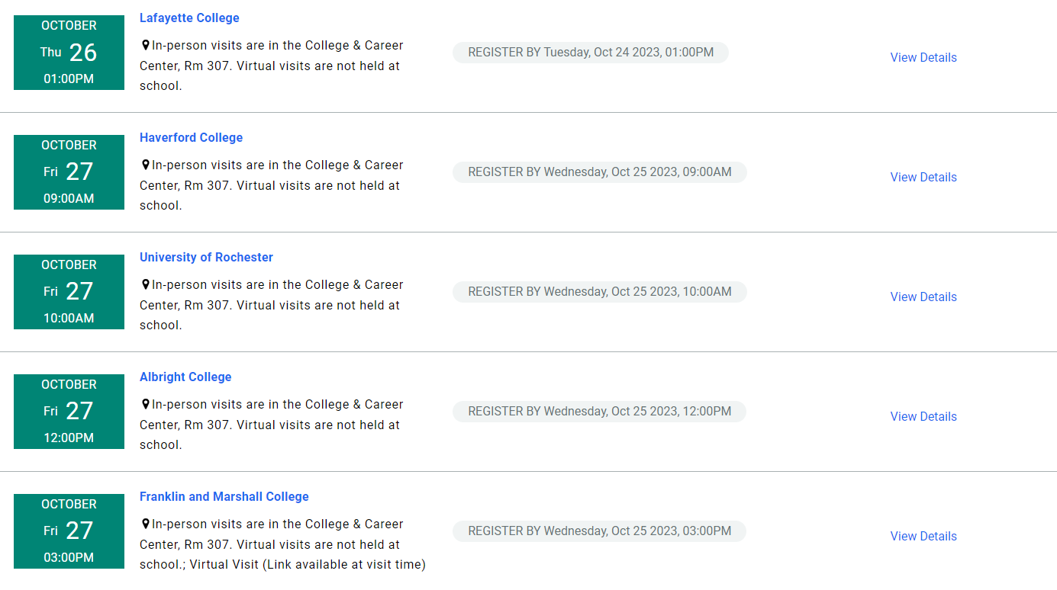
Sign up for visits with college reps!

Slide 11


Slide 12

Pennridge Application Process
REQUEST RECOMMENDATIONS LETTERS FIRST! Complete the brag sheet in Naviance and request letters at least 3 weeks prior to any deadline! Students should ask teachers in person, prior to sending official request.
BE AWARE OF DEADLINES! It takes up to 10 SCHOOL DAYS to process transcript requests.
1. Apply to your college
2. Request transcripts in Naviance
  Do not request transcripts until your application has been submitted
  Self-Reporting Grades! Some colleges do NOT require a high school transcript until a student accepts their offer of admission. At that time, students will request a transcript on Naviance.
    (Penn State and Pitt use self-reporting! )
3. Send SAT/ACT scores through the testing company if you did not request during the test registration process (4 schools are free)

Slide 13



What tools are available to help
School Counselor
Guidance Website
Canvas Class of Pages
Naviance
BigFuture by College Board
PHEAA (Financial Aid)
College and Career Center
College Admissions Representative

Slide 14
thanks to our college admissions panel
Tina Luey - Penn State University
Paige Miller - Ursinus College
Genaro Robles - Kutztown University
Leah Cobette - Bucks County Community College

