Slide 1


How to Facilitate an IEP
Presented by Jennifer Henig, Program Specialist

Slide 2

In this training you will learn:
Facilitation Tasks
How to identify Outcomes and create an agenda
Assigning Roles
Listen first, talk second
Active Listening!
Tips to provide helpful resources
Identifying Next Steps

Slide 3
Key Facilitation Tasks
Purpose
Introduce the meeting
Introduce
Introduce what the meeting is about and present the agenda
Ask
Ask that all players introduce themselves, as well as their role
On-Task
Keep the group to the agenda and decision-making process
Focus
Hep maintain meeting while focusing on one item at a time
Help
Help everyone to participate
Engage
In Active Listening and encourage others to do so too

Slide 4
So, You have been asked to Facilitate an IEP…
Reasons: The student is high-needs, with lots of providers, and the team is all over the place (perhaps too may cooks in the kitchen) and is having trouble facilitating the meeting, getting across what they need to convey and share and then following up and executing decisions.
Reasons: The parents are frustrated and have expressed this to the team, perhaps rightly so, and have lost trust with the team, and its execution of the IEP. Trust and effectiveness have become an issue.
Reasons: The team is just large, but effective, and needs someone to make sure all the I’s are dotted and T’s are crossed.
Reasons: An advocate has become involved and is speaking on behalf of the parent, the team needs an advocate of sorts to move them through this meeting.

Slide 5
Facilitating an IEP vs. a Facilitated IEP
What’s the Difference?
  Intent
  Training
  Stakes
  You are FACILITATING AN IEP

Slide 6
You will Become Wise and Knowledgeable
Call it a Sherpa of sorts or a spirit animal of the IEP, regardless, to facilitate an IEP is to take control and be the “cruise director” of sorts for the student’s Individualized Education Plan. This is generally not your typical IEP meeting, otherwise the case manager would be facilitating the meeting.
A meeting does not have to be contentious for it to require a facilitator, but how to facilitate an IEP is a bit different and much more explicit, and yet not entirely different than A Facilitated IEP (which is typically done by a neutral party and/or the District’s attorney).
You can be an administrator or a neutral party, or you can be an active team member, but regardless you are tasked with taking the team through the IEP, from start to finish
Pre-planning is key: staffing is often the first step in facilitating an IEP. Don’t skip this step, embrace it!

Slide 7

Yikes!
So, what are your biggest concerns, questions or trepidations about completing this task?

Slide 8
Some Do's and Some Dont's of a Well-Run IEP

Slide 9

Let’s Discuss

Slide 10
Staffing
When asked to facilitate an IEP, it is generally best practice to staff before hand, especially, if you don’t know the student!
This will give you an idea of the strengths and needs of the students, as well as the strengths and needs of the team!
If a staffing can not be arranged, then having information such as the current IEP and/or student information is extremely helpful.

Slide 11

Why are we Here?
Establish an agenda with key team members before the meeting begins
The facilitator doesn’t generally write the agenda but should review the agenda days prior to the meeting to establish the flow if the meeting.
The agenda must cover all elements of the IEP
The agenda should allow for time for parent input/parent questions
Always allow for time in the agenda for follow-up and setting up additional meetings
Pace items out by time
Review agenda at the outset of the meeting an (quickly) gain input

Slide 12
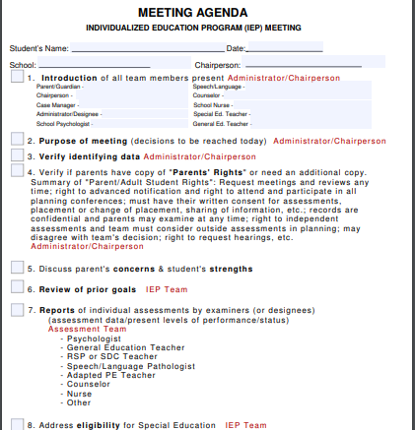
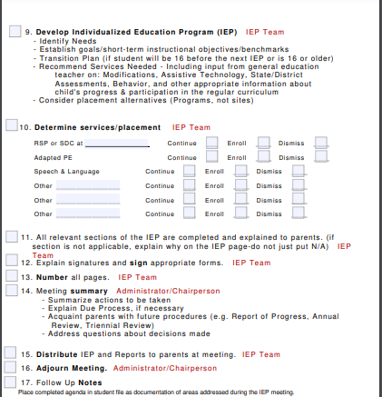

Slide 13
Roles and Titles
All participants must be introduced, including titles.
1
Be sure to recognize the parents and the student!
2
Establish timeframes, and time limitations
3
Determine roles for IEP team members
4
Timekeeper
Note taker
Task master/Charter

Slide 14
Allow the IEP to take the wheel
The IEP as a document is a sequential, step-by step, process—allow the documents to lead you through the meeting
Make sure that all participants are participating!
  You may have to invite participants in—ask open-ended questions: “ Can you describe ________ strengths”? “What do you see as ________ needs”? What does a classroom period look like with _________”?
BUT! Keep participants on task and keep to clarity
  It helps to ask that when information is shared that direction is provided, “ Please share strengths, needs and then make recommendations”

Slide 15
Listen First, Ask second
Parent often give us the information that we are looking for, but at their own time and in their own way. For example, parents' concerns can often be met with a “none”, but as you go through the IEP you hear a parent expressing a concern. Circle back and restate and ask if this is an area of concern.
It’s always important to emphasis a student’s strengths, promote collaboration and carefully consider every detail.
As a facilitator, you have the opportunity to “catch” nuances that others within the team can not.
When needed ask for clarification, a parent says when talking about homework completion: “this just isn’t working”… follow-up and ask “can you give the team an example of the two most difficult aspects of ________’s math homework”.
When meeting on older student’s it’s important to read the room and ensure that the student is being heard, ask for their input and their willingness to go along with the plan!

Slide 16
Active Listening
https://www.youtube.com/watch?v=7wUCyjiyXdg

Slide 17
Resources
Be clear with people that can be reached for further questions: their names, roles and their extensions and/or emails.
If a parent is asking for further information, make sure to include this on next steps.
If you have specific and/or nuanced knowledge, share that!

Slide 18
Next Steps
Make a list of specific tasks
Assign a specific person tasks
Be concrete
Create timelines
Don’t assume that people will “remember”, assume they will forget
Assign a task-master
If setting another meeting, do it then and there!

Slide 19
Answering or Responding to Questions
Sometimes parents will ask for services or staff or methodology and you don’t feel prepared to answer this questions (most especially when you are the admin designee). It is often prudent to clearly document the parent’s request and then state that you and/or the Special Education Director will be addressing their request (make sure you add to your next steps that you contact the relevant parties and circle back to the parents).

Slide 20

Questions?

Slide 21

Thank you!
Jennifer Henig jhenig@sbcoe.org

