Slide 1

Severe Weather Carline

Slide 2
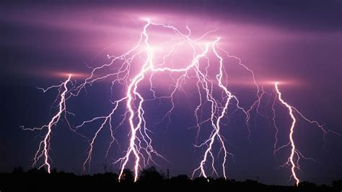
Thor Guard/ Lighting
  Thor Guard is a lighting alert system. Our horn and light system is located on the back of phase 2, near the field.
  There are four states of detection
    All clear-Green
    Caution (within 15 miles) White
    Warning (moving in your direction)Yellow
    Red alert(storm is here)-External 15 second horn and flashing strobe lights-Red
  There are three different horns
    15 second horn-Red alert-take cover
    3 short horns-safe to return to outside activity
    A repeated horn every .5 second for one minute-Emergency Notification

Slide 3
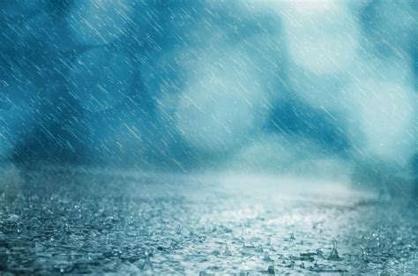
Inclement Weather
  Inclement weather can mean:
    Severe rain or wind
    Yellow Alert on Thor Guard
    Lightning
    It is not safe to be outside
  When there is inclement weather, we will do the following:
    Students and teachers will stay in classrooms
    Parents will be required to drive through carline, pull up to a station, exit vehicles, and bring tag to cafeteria doors.
    The student driveline numbers will be entered
    Students will be matched with parents and dismissed through the cafeteria doors

Slide 4
Inclement Weather
  Exceptions:
    Weather can be tricky, and timing has a big impact on decisions.
    Depending on how far into carline we are, you may be asked to do something different than normal.
    Please pay close attention to communication and any directions
  Reminders:
    Please DO NOT PARK.
    Please do not exit your vehicle until you are at a station.
    You must bring your carline tag to the cafeteria door.

