Slide 1
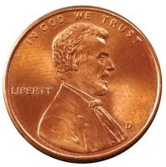
Penny for your thougts
This Photo by Unknown Author is licensed under CC BY-NC-ND

Slide 2
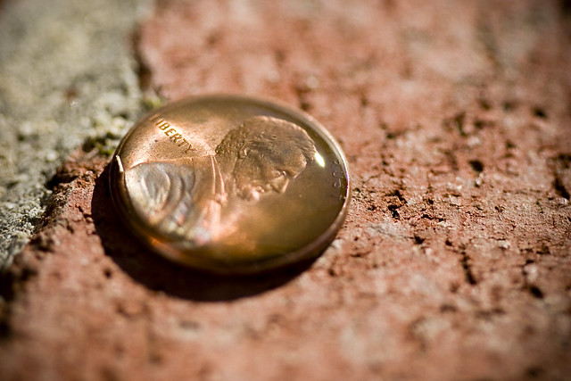
Overview
How many drops can fit on a penny. During this activity, participants will guess how many drops will fit on top of penny. Next the pennies will be washed with detergent and tried again.
Will a clean penny or dirty penny hold more water?

Slide 3
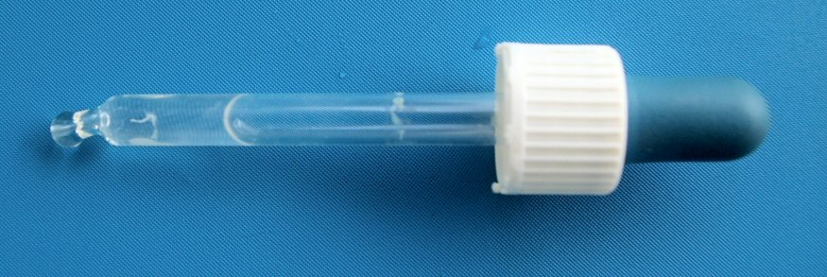
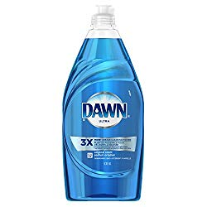
Materials
Pennies
Water
Detergent
Droppers

Slide 4
What to do
Using the dropper, slowly drop the water on a penny, counting the drops, until the water runs off the side. Dry the penny and repeat with the next participant. Count how many drops each participant can get to fit on top of the penny.
Observe what the water looks like before it runs of the side.
Rinse the penny in the soapy water, how did it affect the amount of water the penny can hold

Slide 5
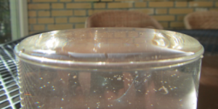
The science
Water is cohesive, this means water sticks to itself. In other words water molecules are attracted to each other. Water is also adhesive with many other substances. This means water molecules are attracted to other surfaces like glass or a penny. Because of this stickiness, water molecules can pile up on top of a penny making the dome you observed. This is also why water can make a dome over a glass without spilling out

Slide 6
More science
The detergent keeps the water from sticking to each the other and surfaces. That is why the soapy penny held less water… also why detergents help clean things.

