Slide 1
Water Boats
How do metal boats float?
How can design a boat to be the most buoyant?

Slide 2
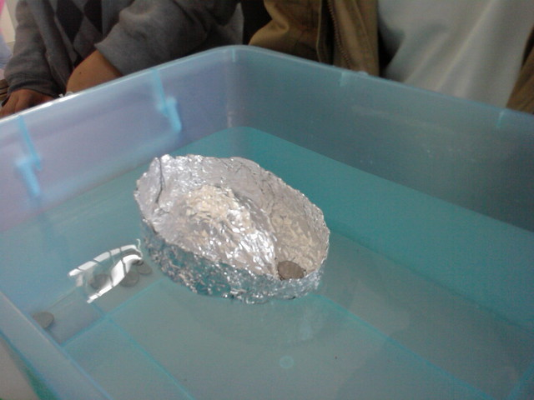
Overview:
You will use foil to design a boat that can hold the most pennies. In order to make it a fair contest, control the amount of foil that given to each participant.

Slide 3
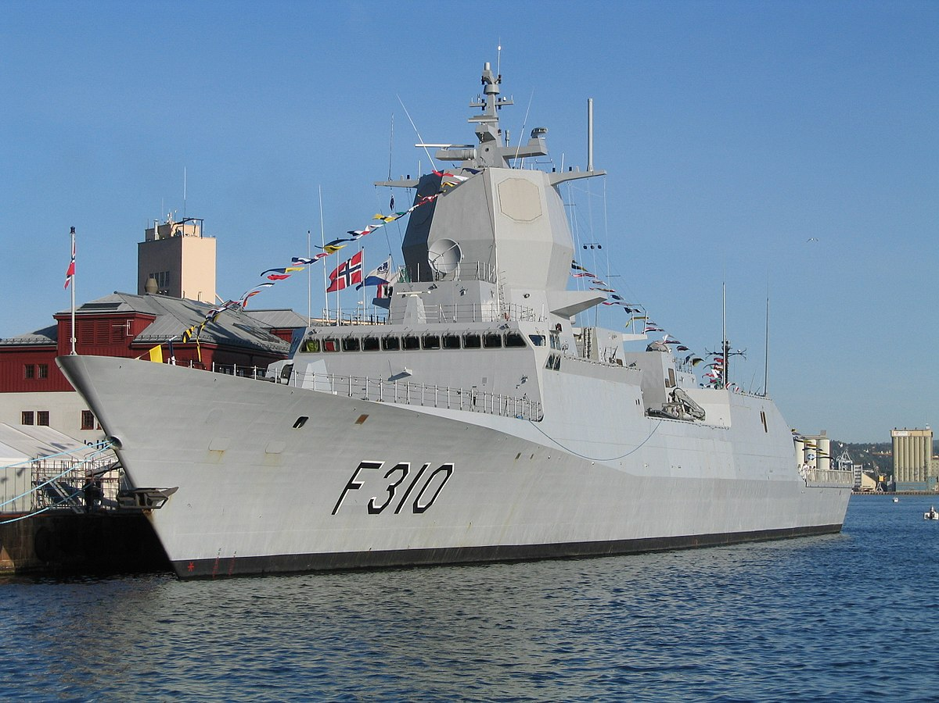
Ever wonder how a steel boat floats? When we think of steel we often think of a heavy object that sinks, so how do they get a steel boat to float?

Slide 4
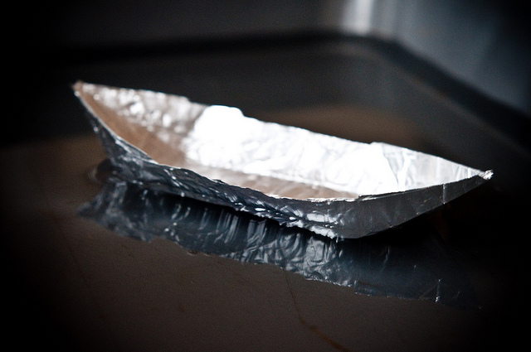
What to do
Give everyone an equal size piece of foil.
Set a timer for 2 minutes (time is flexible) and have each participant design aluminum boat.
After two minutes, test each boat that to see which one can hold the most pennies.
Hand out more foil squares, set the timer again and do a redesign.
Retest

Slide 5
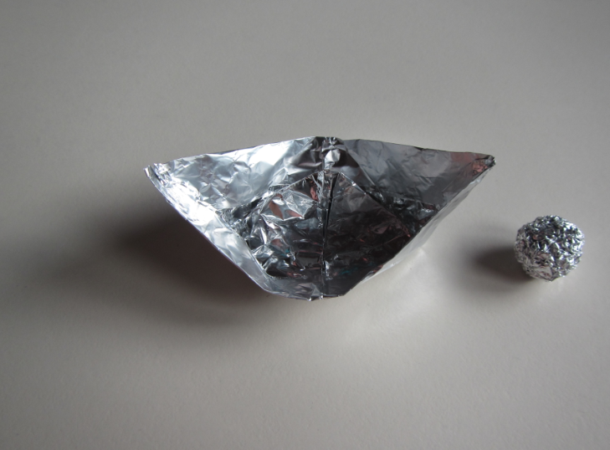
What did you observe
Which design held the most, what was it about the winning boat that allowed it to hold more?
How did the designs change after the first round? Did you learn from other participants designs?

Slide 6
The science:
Buoyancy is determined by DISPLACEMENT – the amount of water an object moves when it is in the water. In order for an object to float it is has to displace… or move away its own weight in water. So a 1000lb boat has to move 1000 pounds of water or more to float.
You probably found the widest boat held the most pennies, because it displaces the most amount of water. You feel this in the water, when you breath in and hold your breath in a pool you float… when you exhale most people sink. Another test, roll up the foil and drop in the water.. What will happen?

