Slide 1
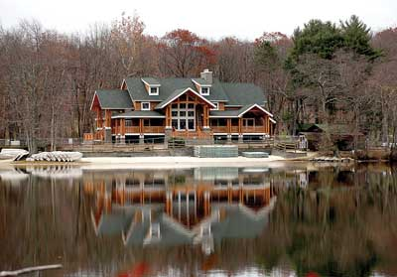

Welcome to the
Fairview Parent Overview

Slide 2
When is my child’s trip
Trips are organized by science teacher
Trip 1 (4/15-4/16)
Bartlinski
Bondi
Duffy
Leach
Kennish
Pinello (pd 5)
Sacks
Trip 2 (4/29 – 4/30)
Burns
Cintron
Cravo (pd 5)
Dudek
Perno
Robertson
Zhao
Trip 3 (4/30-5/1)
Chup
Corraza
Cravo (pd 9)
Dery
Grinshpun
Madison
Pinello (Pd 9)
Player
Santos
Sudol
Molnar

Slide 3
Introductions
Ryan Higgins, Supervisor of Science
Fairview Coordinators (4 per trip)
  Trip 1 (4/15-4/16)
  Joseph Bondi
  Katherine Kennish
  Debra Leach
  Clare Moloughney
  Trip 3 – (4/30-5/1)
  Kristen Dery
  Vanessa Pinello
  Valona Santos
  TBD
  Trip 2 – 4/29-4/30
  Maggie Burns
  Angela Cintron
  Kelly Perno
  Sarita Robertson

Slide 4

Where are we going?
Fairview Lake YMCA Camp in Newton, NJ

Slide 5
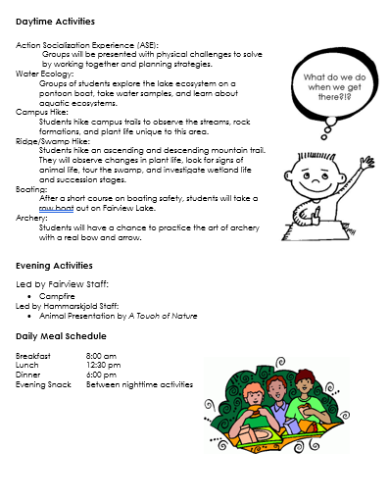
What do we do at Fairview?

Slide 6
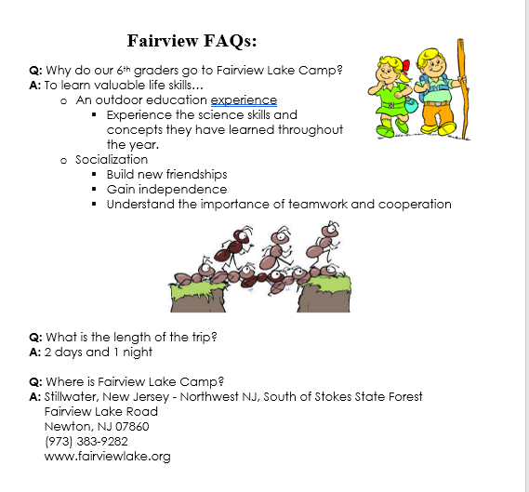
experience

Slide 7

Fairview
Video

Slide 8
Packing List
There is no bad weather, just bad clothing.
-Norwegian Proverb
Pack rain gear and layers!

Slide 9
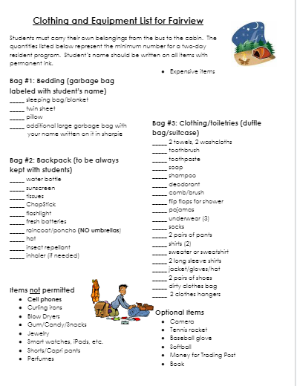
What to pack?

Slide 10

Dining Hall and/Meals
The meals include “kid friendly” food.
  Chicken fingers, fries, turkey sandwiches, baked ziti, grilled cheese
  Cereal, fresh fruit and bread are served daily

Slide 11
Dining Hall and/Meals
Meal Times
  Breakfast at 8:00 (on day 2)
  Lunch at 12:30
  Dinner at 6:00
  Snack before returning to bed at night
Parent chaperones eat each meal with their child.
Non-meat and special diets can be accommodated.

Slide 12

Dining Hall and/Meals
No outside food can be brought to camp.

Slide 13
How to sign up
Permission slips, Non-Attendance Form and Medical Forms
Online Payment Permission Forms and Medical Documents
Thank you to EB Financial Services Department

Slide 14
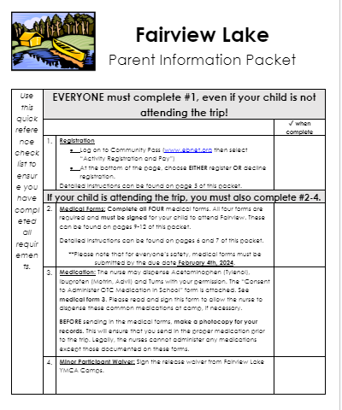

Did you get a
parent packet?

Slide 15
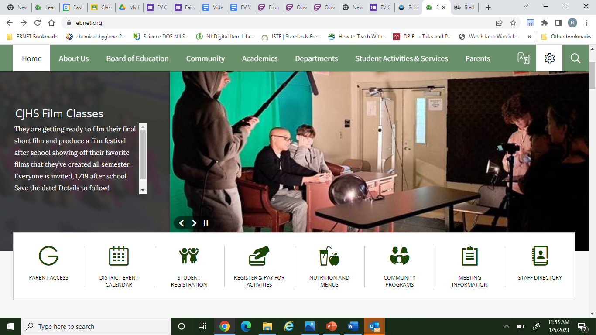
Go to Ebnet.org
Select Register and Pay for Activities
Registration opens 11/27

Slide 16
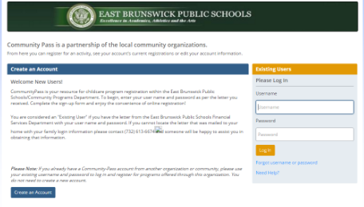

Log in using your Community Pass username and password.
Select Register here.

Slide 17
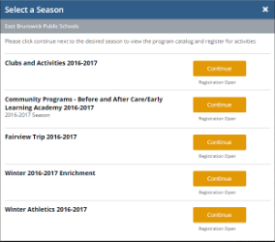
Select: Fairview Trip 2023-2024 then verify your family information and child you are registering or declining.
2023-2024

Slide 18
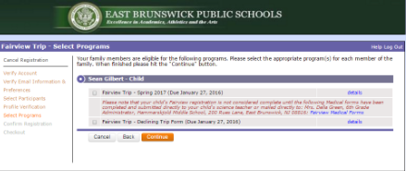
Decline or Agree to Register

Slide 19
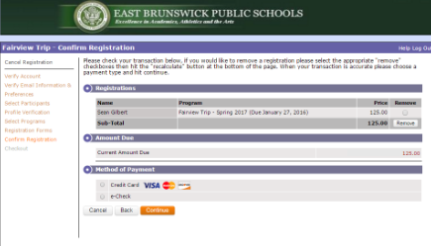
Read and accept the parental agreement.
Complete the check-out page.
Complete your payment information.

Slide 20

Reminder!
If you have trouble with the community pass process…
contact Financial Services by:
1. Emailing to ebonlinepayments@ebnet.org
2. Calling: 732-613-6674

Slide 21

How do I access the Fairview Medical forms?
Access online at the end of registration, on the school website or at the end of this packet. Complete all forms for prescription and/or over the counter medications.
Packet Page 4

Slide 22
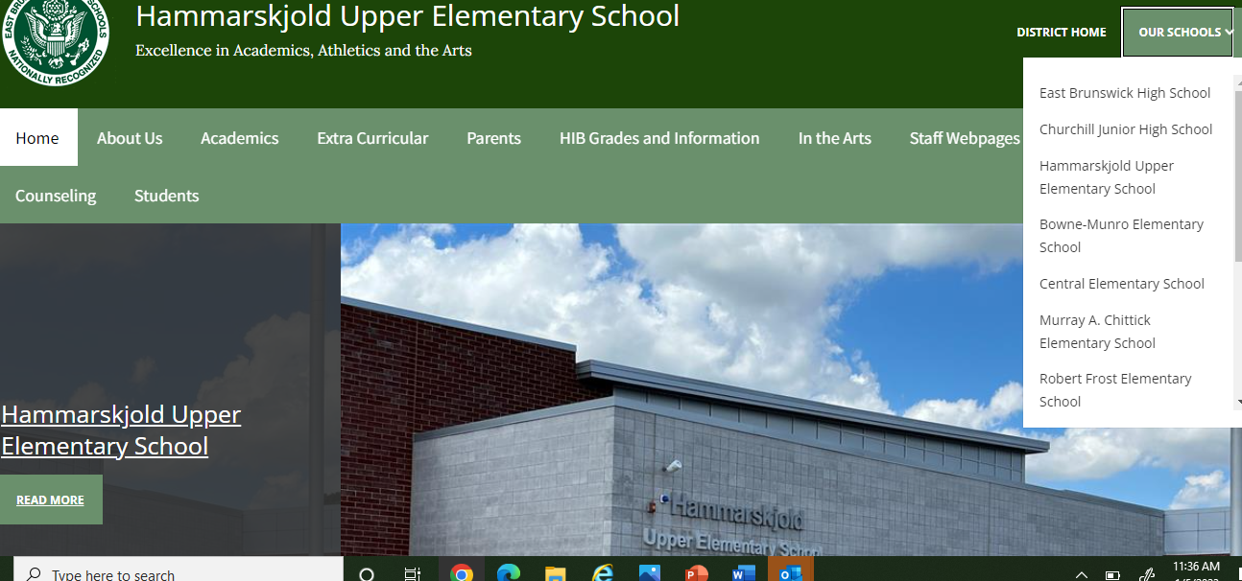
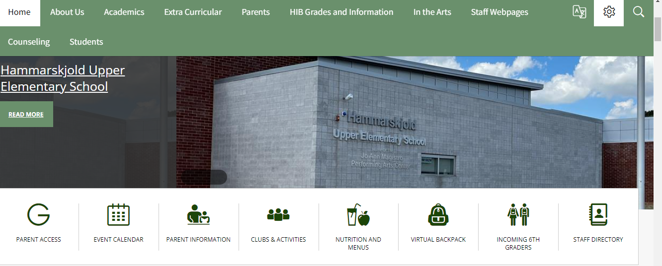
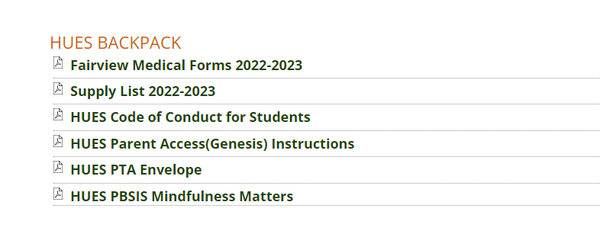
Go to ebnet.org and select Hammarskjold Upper Elementary school
Go to virtual backpack
Select Fairview Medical Forms
#1
#2
#3

Slide 23
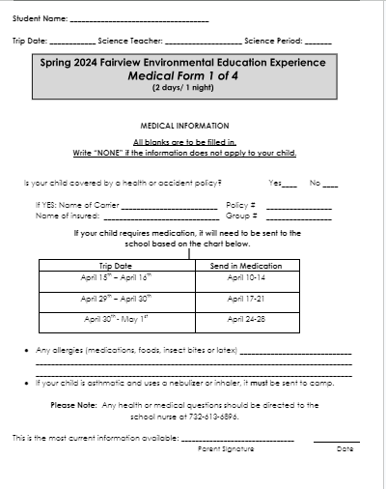
Send in meds according to the trip attending
Must Sign

Slide 24
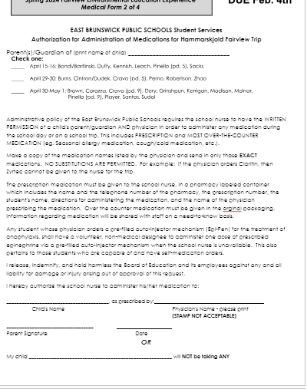
Page 9
ord
A doctor’s name if giving over the counter or prescription meds.
Must Sign

Slide 25
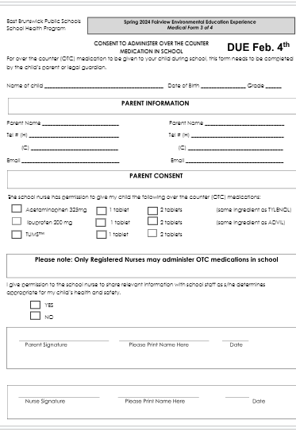
Form 3:
Meds the nurse will have!
Must be signed even if not allowing-
Must Sign

Slide 26
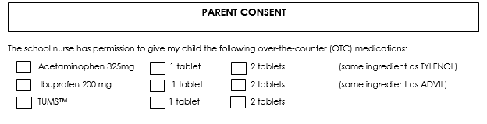
The ONLY over the counter meds that DON’T need a doctor’s signature!

Slide 27
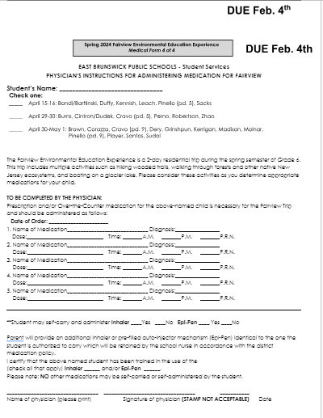

Make sure to print a copy so you can send the exact meds the doctor ordered.
No Substitutions will be permitted!
Doctor must sign here if meds are to be dispensed.
Parent Must Sign

Slide 28

Seasonal Allergies
Keep in mind the time of year!

Slide 29

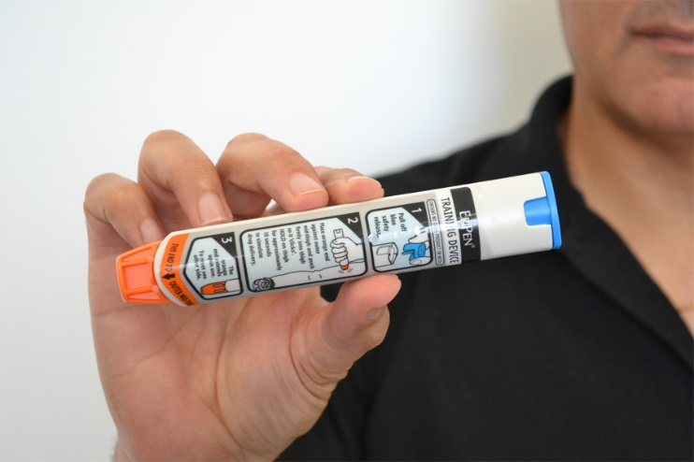
Self (student) Administration of Medication

Slide 30


Departure from HUES
Arrive at HUES at 7:45 am SHARP
Students cannot ride the school
bus to school the day we leave or
home on the day we come back.
We will be taking coach buses!

Slide 31
Arrival back at HUES
A message will be sent on the day we come home to give parents an anticipated arrival time, planning around 4:00pm
Students cannot ride the school bus to school the day we leave or home on the day we come home.

Slide 32

Students CANNOT bring cell phones!
In Case of Emergencies:
(9am – 4pm) call Hammarskjold
(4pm- 9pm) call camp office 973 –383 -1339

Slide 33

Common Concerns
Grade 12 Exit Survey (indicates a very memorable enjoyable trip)
Separation (generally busy and surrounded by friends which helps)
Privacy (Contact coordinator with specific concerns)
Bed Wetting (Contact coordinator with specific concerns)

Slide 34
Chaperones
Why Chaperone?
  Perk!!! No cooking/cleaning for 2 days – students are “cruisers”
  Quality time with your child
  Selection – Randomly selected
  Child must be registered to be considered

Slide 35
Chaperones Responsibilities
Cabin supervision
Activity supervision
Observe and report. If you see something concerning report to a Trip Supervisor (Mr. Higgins), a Coordinator or Teacher Chaperone.

Slide 36
Opposite Gender Parent Chaperone (Dad and Daughter)
Schedules will be arranged so you can enjoy the activities with child. Care is taken to arrange cabin groups and activity groups so parent/child are together during day.

Slide 37
Possible “switch” within your household
Let us know in the chaperone from if you are willing to switch with another guardian in case more parents of another gender are needed.

Slide 38
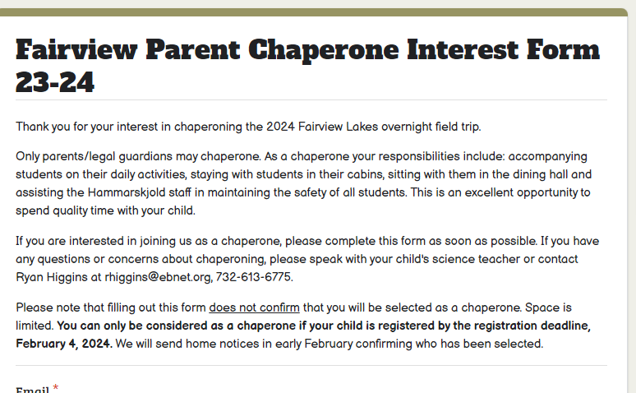

Slide 39
General Information
The camp is nut free
No daily visitors
No chaperones can be chosen until the students are all registered
Process for choosing chaperones
Chaperones do not pay or register
WE select all groups-make us aware of separations

Slide 40

Any Questions?

