Slide 1


Slide 2
Education Track Dual Credit with Bethany College
Alan English, Ph.D.
Bethany Education Department Chair

Slide 3

Classes
“Teaching as a Career”
(juniors and seniors)
ED100 (1 hour)
“Teaching Internship”
(seniors)
ED200 (3 hours)

Slide 4
Logistics
$100/credit hour
No additional taxes, textbooks, or fees
Both courses are required for all Bethany education majors
Can be used as electives for Bethany non-education majors

Slide 5
Selling Points
Affordability
Decide on a major earlier
Accelerate college graduation
Get a college preview

Slide 6
Other Notes
Optional – May take either “Teaching as a Career” or “Teaching Internship” for high school credit only or dual credit
Credits are transferable to other institutions

Slide 7
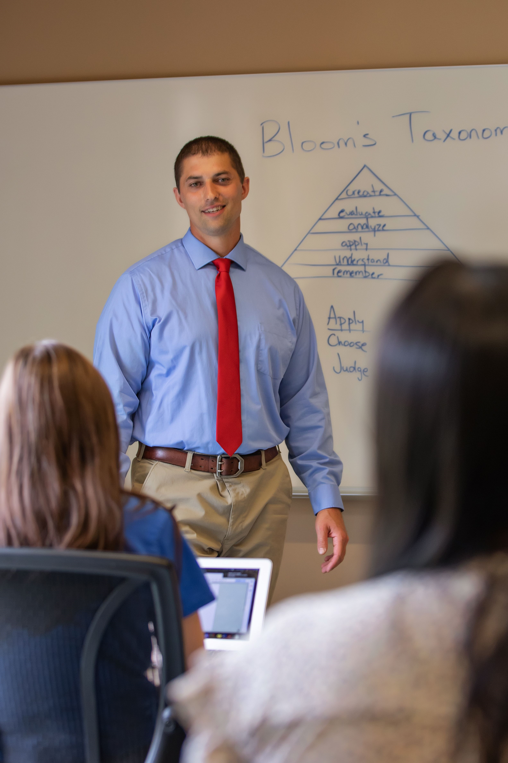
Email: Englishae@bethanylb.edu

