Slide 1
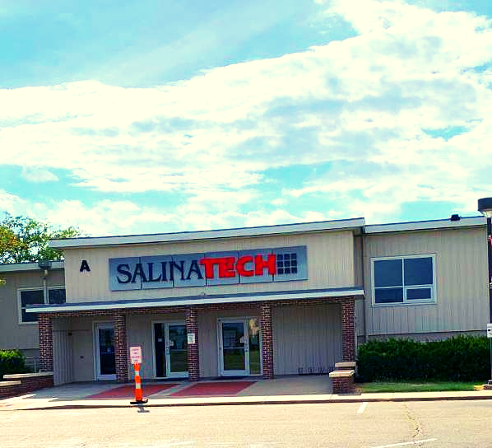

2024
Salina
Area Technical College
Spring Concurrent Enrollment

Slide 2
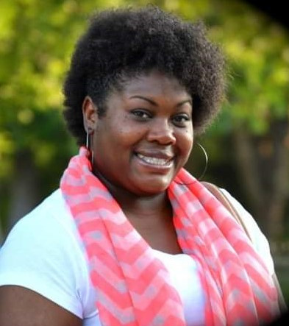

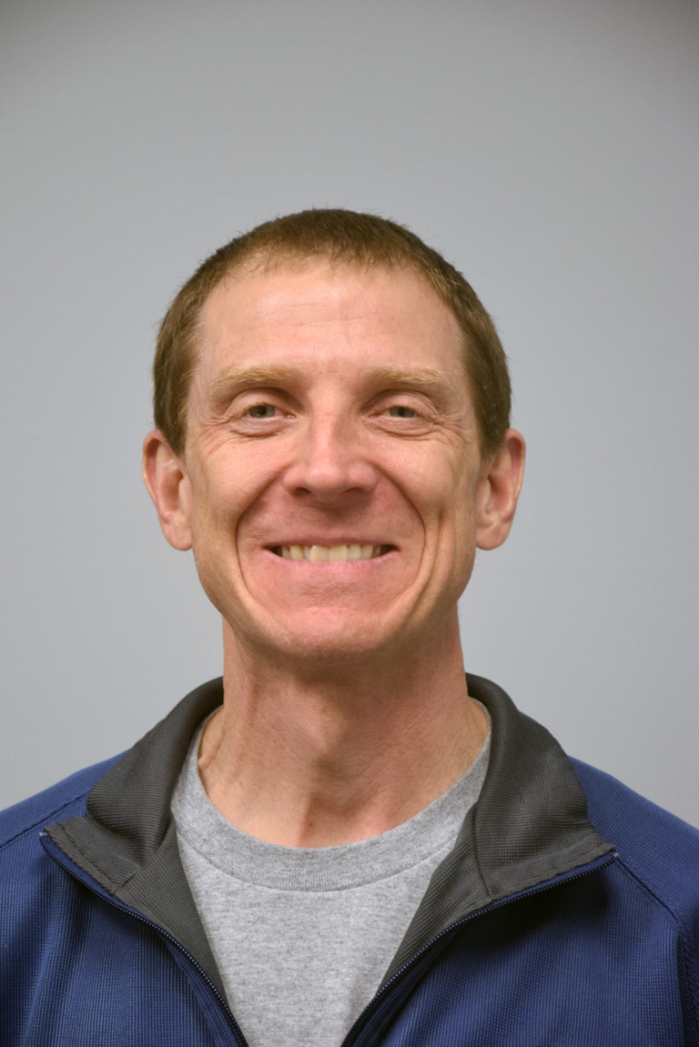
Rachel Holt
Felipe Contreras
Ryan Weber
Concurrent Enrollment Specialist
Recruiter
Director of Enrollment Services

Slide 3
Fall 2024-2025 Enrollment

Slide 4
Concurrent Enrollment
  HS teachers teach courses offered by SATC at your high school.
  Students will receive dual credit for both high school and college.
  Must be a high school sophomore, junior or senior.
(Freshmen with a gifted IEP are eligible to apply)
  Preferred GPA of 2.0 or better.

Slide 5
Dual
Enrollment
  Courses offered by SATC, taught by SATC online or on SATC campus.
  Students will receive dual credit for both high school and college for some courses
  Must be a high school junior or senior for technical courses on SATC campus.

Slide 6
Costs
Fall 2024
Concurrent Enrollment (Classes taken at the high school by high school teachers) that are General Education: $95 per credit hour
Technical Courses: FREE! State of KS CTE funds cover (some testing/uniform costs are not included)
Public University Tuition for General Education - Kansas avg $124 / credit hour

Slide 7
Courses Offered
Fall 2024

Slide 8

Concurrent Courses
Sophomores to Seniors
English Comp
College Algebra
Trigonometry
Computer Applications
Financial Accounting
Physics
Welding (Central Campus)
Taught at
Courses vary by school and by semester.
Courses for Fall 2024 are not yet published.

Slide 9
Dual Courses
English Comp
College Algebra
Trigonometry
Computer Applications
Financial Accounting
Physics
General Psychology
Sociology
Microbiology
Medical Terminology
and More!
Sophomores to Seniors
Taught by
Courses vary by school and by semester.
Courses for Fall 2024 are not yet published.

Slide 10
Tech Programs
Juniors and Seniors
CNA and CMA
Auto Collision and Refinishing Technology
Automotive Technology
Business Administrative Technology
Computer Aided Drafting
Construction Technology
Diesel Technology
Early Childhood Education
Fire Science Technology
HVAC
Machining and Manufacturing Technology
Police Science
Welding Technology
Taught at

Slide 11

Enrollment Deadlines

Slide 12







March 1 - Welding Applications Due
March 15 - Allied Health Applications Due
April 2 - Concurrent Enrollment Fall Open
May 3 - Spring Semester Ends
May 28 - Summer Semester Begins
August 22 - First Day of Class at SATC
August 30 - Course Enrollment Ends
September 1 - Concurrent Enrollment Ends
Enrollment Deadlines

Slide 13
What’s next?
  Meet with your high school counselor to determine which classes/programs fit your goals and class schedule.
  Go www.salinatech.edu
    Admissions and click on High School Students
      “Apply”

Slide 14
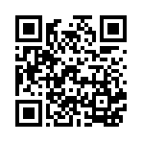
To apply for courses:
www.salinatech.edu

Slide 15
Tips for enrolling
  Start early! The earlier you start the better the odds of getting into a program or class!
  Utilize your personal email and check it regularly.
  Talk to your counselors and SATC Enrollment Specialists
  If you attended classes before, make certain you have your balance paid before enrollment.
  Ask questions!

Slide 16
Questions

Slide 17
Who do you contact?
High School Contact
Concurrent Enrollment Specialist
rachel.holt@salinatech.edu
785-309-3116
Rachel Holt

Slide 18
Who do you contact?
Recruiting
Felipe Contreras
Tours and events
felipe.contreras@salinatech.edu
785-309-3106

