Slide 1

Policy Workshop
August 12, 2024

Slide 2
August Workshop Topics
Policy 102.6: Nondiscrimination – Transgender and Gender Diverse Employees
Policy 211: Graduation Requirements
New Policy: Telepresence

Slide 3

Policy 102.6: Nondiscrimination – Transgender and Gender Diverse Employees

Slide 4
Policy 102.6 – Purpose
New Policy
Purpose:
  The Board is committed to creating a safe and inclusive working environment for all employees that is free from discrimination, regardless of sex, sexual orientation, gender identity, or gender expression. Employees who identify as transgender, non-binary, or another gender diverse identity have the same access, rights, responsibilities, and protections to which all employees are entitled.
  This policy facilitates compliance with District policy and state and federal laws concerning harassment and discrimination.

Slide 5
Policy 102.6 – Definitions
Deadnaming: Occurs when an individual, intentionally or not, refers to the name that a transgender or gender diverse individual used at a different time in their life. Regardless of intent, deadnaming has a harmful impact.
Gender Identity: Refers to one’s internal sense of gender, which may be different from one’s assigned sex, and which is consistently and uniformly asserted most or all of the time, or for which there is other evidence that the gender identity is sincerely held as part of the individual’s core identity. It is one's innermost concept of self as male, female, a blend of both or neither. One's gender identity can be the same or different from their sex assigned at birth.
Gender Diverse: An umbrella term that is used to describe gender identities that demonstrate a diversity of expression beyond the binary framework.
Gender Expression: Refers to external cues that one uses to represent or communicate one’s gender to others, such as behavior, clothing, hairstyles, activities, voice, mannerisms, or body characteristics.

Slide 6
Policy 102.6 – Definitions
Misgender: To refer to an individual using a word, especially a pronoun or form of address, that does not reflect the individual’s gender identity. This may be unintentional and without ill intent or can be a maliciously employed expression of bias. Regardless of intent, misgendering has a harmful impact.
Non-Binary: A term used to describe gender identities that exist between, beyond, or outside of the man-woman gender binary.
Pronouns: The words used to refer to a person other than their name. Common pronouns are they/them, he/him, and she/her. Pronouns are not preferred; they are a statement of fact.
Sex: Refers to anatomical, physiological, genetic, or physical attributes that determine if a person is male, female, or intersex. These include both primary and secondary sex characteristics, including genitalia, gonads, hormone levels, hormone receptors, chromosomes, and genes.
Sex Assigned at Birth: Refers to the sex designation listed on one’s original birth certificate.
Transgender: An adjective describing an individual whose gender identity is different from the individual’s assigned sex. “Transgender boy” and “transgender male” refer to an individual assigned the female sex at birth who has a male gender identity. “Transgender girl” and “transgender female” refer to an individual assigned the male sex at birth who has a female gender identity. Other terms that can have similar meanings are transsexual and trans. An individual can express or assert a transgender gender identity in a variety of ways, which may but do not always include specific medical treatments or procedures. Medical treatments or procedures are not considered a prerequisite for one’s recognition as transgender. Being transgender does not imply any specific sexual orientation. Therefore, transgender people may identify as straight, gay, lesbian, bisexual, etc.

Slide 7
Policy 102.6 – Definitions
Harassment: Verbal, written, graphic or physical conduct relating to an individual's race, color, national origin/ethnicity, gender (including gender identity or expression), age, disability, sexual orientation or religion when such conduct:
  (1) Is sufficiently severe, persistent or pervasive that it affects an individual's ability to participate in or benefit from an educational program or activity or creates an intimidating, threatening or abusive educational environment;
  (2) Has the purpose or effect of substantially or unreasonably interfering with an individual's academic performance; or
  (3) Otherwise adversely affects an individual's learning opportunities.

Slide 8
Policy 102.6 – Guidelines
Harassment and Discrimination
  Complaints alleging discrimination or harassment based on a person’s actual or perceived gender identity or expression are to be taken seriously and handled in a manner consistent with Board policies, law and regulation.
Privacy and Confidentiality
  All employees have a right to privacy and this right includes the right to keep one’s transgender or gender diverse status private at work.
Personnel Records
  In compliance with Federal Equal Employment Opportunity laws, the District is required to maintain and report mandatory personnel records that include an employee’s legal name and legal sex.
  To the extent that the District is not legally required to use an employee’s legal name and legal sex on school and employment records or documents, such as employee ID badges or staff directories, the District will use the name and gender identified by the employee.
  The District will change an employee’s official personnel record to reflect a change in legal name or gender upon receipt of documentation that such change has been made pursuant to a court order, or through amendment of state or federally-issued identification.
  The District shall ensure that protected health information and personnel records relating to transgender and gender diverse employees shall be kept confidential in accordance with applicable state and federal privacy laws.

Slide 9
Policy 102.6 – Guidelines
Names and Pronouns
  Every employee has the right to be addressed by a name and pronoun that corresponds to their gender identity. A court-ordered name or gender change is not required, and the employee need not change their official records. Intentional or persistent refusal to respect an employee’s gender identity (e.g., misgendering, deadnaming) can constitute harassment and is a violation under this policy.
Gender-Neutral Language
  To the extent possible, employees should use gender-neutral language in written and verbal communication with employees, students, parents/guardians, or other third parties. This includes employing “they” (singular) instead of “he/she.”
Dress Code
  Transgender and gender diverse employees have the right to dress in a manner consistent with their gender identity or gender expression. The District shall not enforce or impose policies regarding dress codes more strictly against transgender and gender diverse employees than it does all employees.
Restrooms and Facilities
  With respect to all restrooms and facilities, employees shall have access to restrooms and facilities that correspond to their gender identity.
  Employees who are uncomfortable using a sex-segregated restroom or facility, regardless of the reason, may use or request to use a separate single occupancy restroom or facility, where feasible. No employee shall be required to use a restroom or facility that is inconsistent with their gender identity.
  No employee shall be required to use a separate restroom or facility because they are transgender or gender diverse.
Other Gender-Based Activities, Rules, Policies and Practices
  As a general rule, in any other circumstance where employees are separated by gender, for instance at field trips, classroom activities, school ceremonies and school photos, each employee should be permitted to participate in a manner consistent with their gender identity.

Slide 10
Policy 102.6 – Compliance
In order to maintain a program of nondiscrimination practices that is in compliance with applicable laws and regulations, the Board designates the Chief Human Resources Officer as the District's Compliance Officer. All nondiscrimination notices or information shall include the position, office address, telephone number and email address of the Compliance Officer.
The Compliance Officer shall develop administrative regulations to implement this policy and shall maintain records documenting compliance.
The Compliance Officer shall publish and disseminate this policy and complaint procedure at least annually to employees to notify them of where and how to initiate complaints under this policy.
The Compliance Officer shall be responsible to ensure adequate nondiscrimination procedures are in place, to recommend new procedures or modifications to procedures, and to monitor the implementation of nondiscrimination procedures.

Slide 11
Policy 102.6 – Training and Professional Development
The District shall implement ongoing professional development to build the skills of all staff members to prevent, identify, and respond to harassment and discrimination. The content of such professional development shall include but not be limited to:
Terms, concepts, and current understandings of gender identity, gender expression, and gender diversity.
District policies regarding harassment and discrimination based on gender identity and gender expression.
Strategies for communicating about gender identity and gender expression.
Strategies for identifying, preventing, and intervening in situations where harassment and discrimination based on gender identity and gender expression may be occurring.

Slide 12

Policy 211: Graduation Requirements

Slide 13

Policy 211 – Purpose
Purpose:
  It shall be the policy of the Board to establish graduation requirements in the educational interests of students and acknowledge successful completion of the instructional program and the graduate profile by awarding diplomas and certificates at graduation ceremonies.

Slide 14
Policy 211 – Guidelines
The Board hereby establishes minimum requirements for graduation from the District, as outlined below. Requirements outlined apply to students in Grades 9 through 12. However, should a student elect to take either Algebra or World Language prior to entering Grade 9, the student may receive high school credit so long as they pass the course or meet criteria of an equivalent graduation pathway by state law or regulations. Each student shall complete the course credit requirements, the student portfolio requirements set forth in this policy, or meet the requirements of their Individualized Education Program (IEP) to meet the minimum requirements for graduation. IEPs should include the graduation requirements set forth by this policy to the maximum extent the requirements are appropriate. The transcripts of students who have transferred to the District will be reviewed on an individual basis to ensure proper allocation and award of credits earned prior to attendance at the District.

Slide 15

Policy 211 – Guidelines
Beginning with the graduating class of 2028, each student shall be required to meet the minimum requirements of twenty-four and a half (24.5) credits or to meet the requirements of their IEP for graduation.

Slide 16
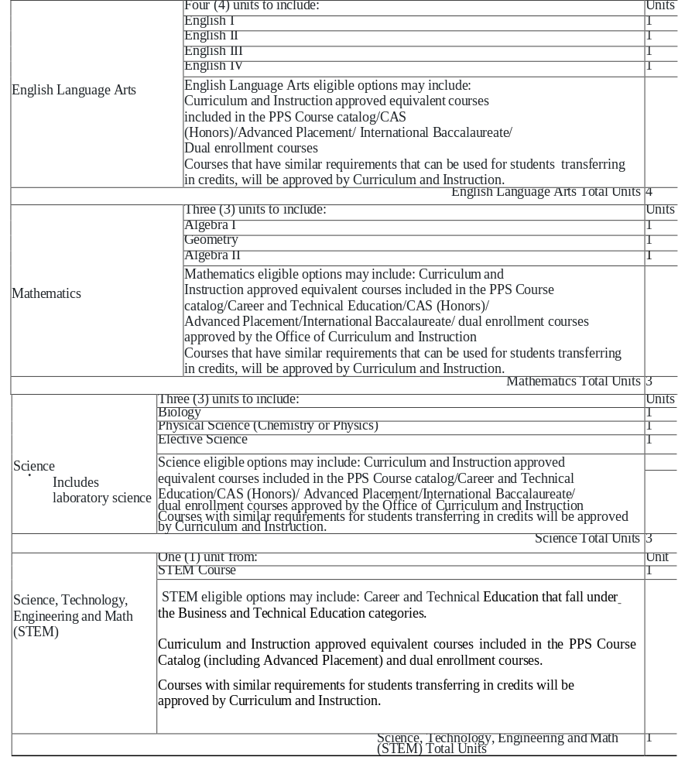
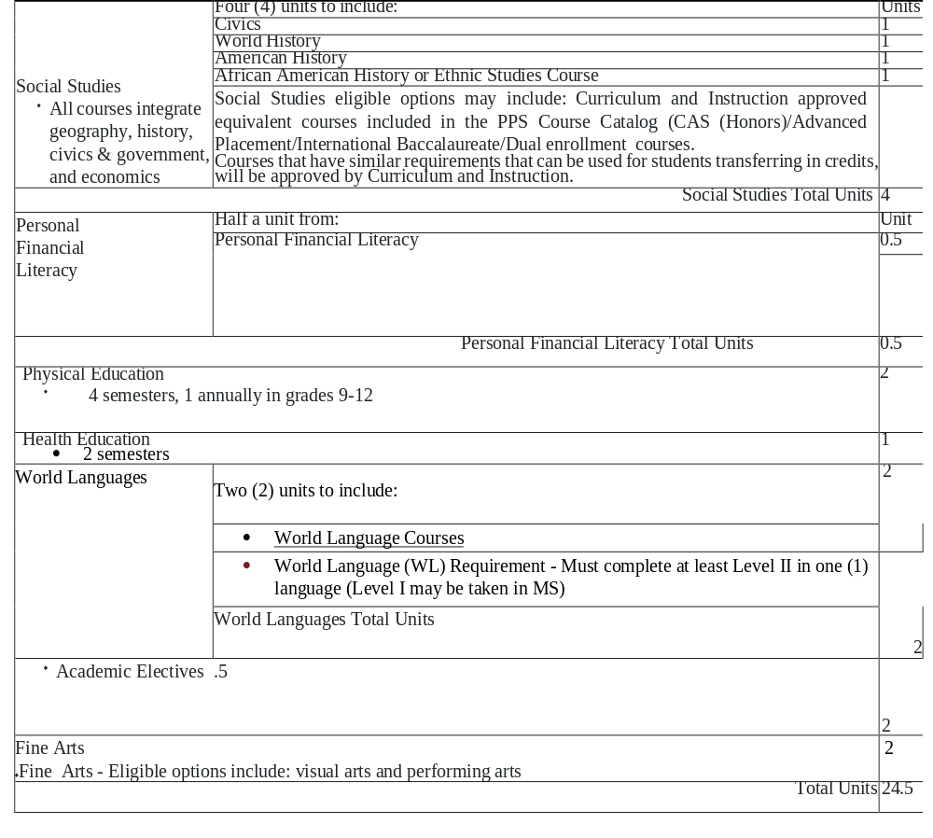
Units to be Earned in Grades 9-12

Slide 17
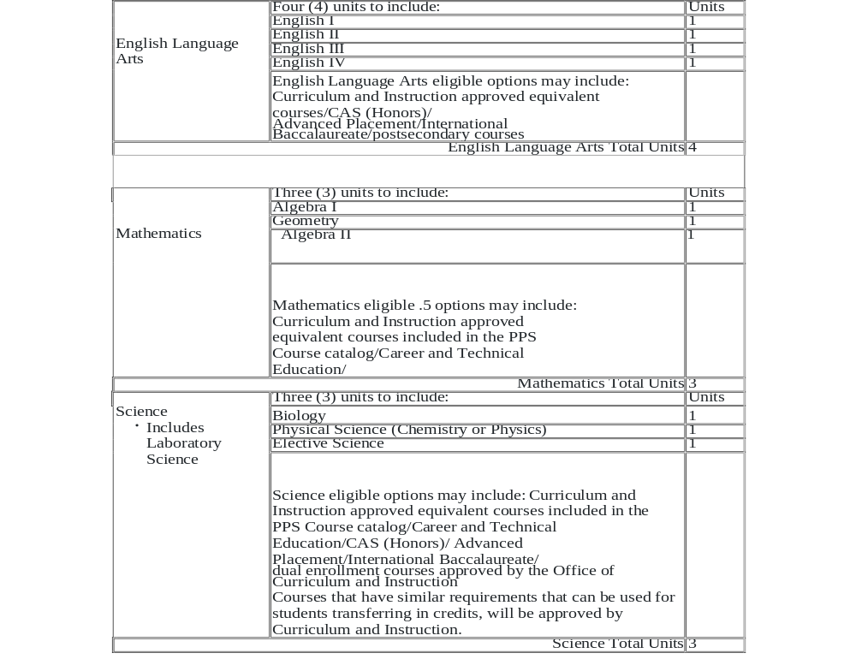
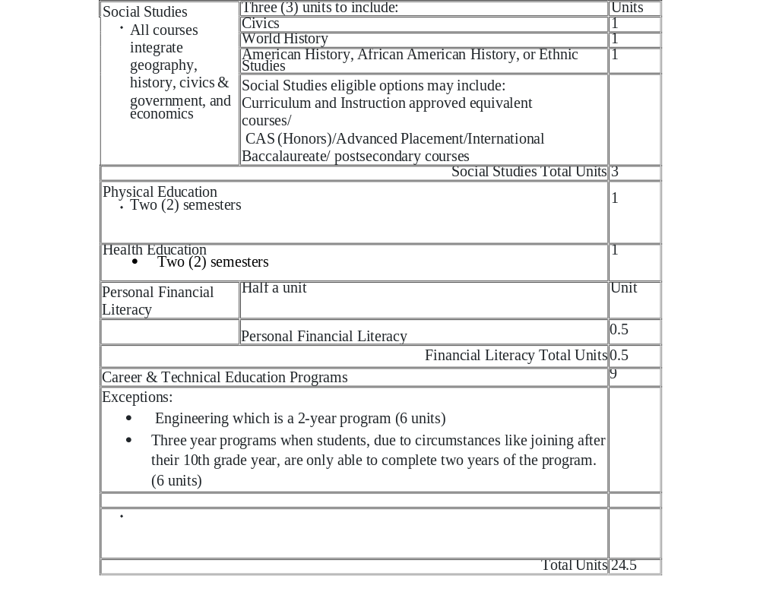
UNITS TO BE EARNED IN GRADES 9 THROUGH 12 FOR STUDENTS ENROLLED IN A CAREER AND TECHNICAL EDUCATION PROGRAM

Slide 18
Policy 211 – Graduation Requirements Legal Compliance
The Class of 2023 and beyond shall meet statewide graduation requirements set forth by state law and regulations (e.g., Act 158 of 2018, Act 6 of 2017, and Act 55 of 2022) beginning in 2023
Act 158 of 2018 provides students with multiple pathway options to demonstrate academic proficiency and fulfill the state requirements. Those pathways include: Keystone Proficiency, Keystone Satisfactory Composite, Alternative Assessment, Career and Technical Pathway, and Evidence-Based Pathways.
In an effort to ensure students who are experiencing educational instability receive the necessary resources to graduate from high school in a timely manner, Act 1 of 2022 was signed into law. Educational instability is defined as one or more school changes in a year due to homelessness, an adjudication of dependency or delinquency, or a court ordered under a voluntary placement or custody agreement. It applies to students returning to their former school, starting a new school or engaging in school after an extended absence. In accordance with Act 1 of 2022, A graduation plan shall be developed to facilitate this process for students in grades nine (9) through twelve (12) who are experiencing educational instability. Each school shall have an established “point of contact” to assist in the transition to the school.

Slide 19
Policy 211 – Children of Active-Duty Military Families
The District shall provide supports to facilitate the on-time graduation of children of active duty military families in accordance with the Interstate Compact on Educational Opportunity for Military Children, state law and Board policy.

Slide 20

Telepresence Policy

Slide 21
Telepresence Policy - Purpose
The Board recognizes that livestream video may be helpful to the District and its employees in both fulfilling its educational mission and in expanding the reach of school events and activities to those not able to attend in person. The Board further recognizes that without parameters, livestream video may pose legal risks to the District and its employees and may otherwise disrupt the educational environment.
Notes:
New policy – needed for grant purposes

Slide 22
Telepresence Policy – Definition
Livestream video, as used in this policy, shall mean utilizing any camera located in the District and/or District property to broadcast live video content through the Internet, including through a social media platform. It will also include livestream videos by District employees and/or District personnel offsite for educational purposes.

Slide 23
Telepresence Policy – Guidelines
Student-Initiated Use of Livestream Video
The Board prohibits student-initiated use of livestream video at any time during the school day or at a District sponsored event that is not open to the general public, unless the program sponsor and/or building administrator has authorized the use of livestream video by giving written consent.
Employee-Initiated Use of Livestream Video
The Board authorizes the use of livestream video for instructional and other educational purposes at the direction of teachers, administrators, and other employees, if approved by the program supervisor and/or building administrator.
Any in-school use of livestream video by students for educational purposes shall be supervised by a professional employee or by an administrator.
Prior to approving the use of livestream video for educational purposes, the program supervisor and/or building administrator shall ensure that adequate precautions are in place to ensure that students limit the sharing of personal information with individuals not directly affiliated with the District.

Slide 24
Telepresence Policy – Guidelines
Livestream of Classroom Instruction/Distance Learning
The Board authorizes the use of livestream video to deliver academic and special education instruction remotely when approved by the building administrator.
Students shall be notified prior to the use of a livestream in their classroom or other areas of the school where they may be captured on the livestream.
Livestreams shall be set up to visually capture the teacher/instructor and their materials but may unintentionally capture other students attending to the same instruction in-person.
Prior to approving instruction via livestream, the building administrator shall determine if such instruction shall be recorded, and if so, how long such recording shall be maintained to provide student access. Access shall be provided to students only through a secure password-protected classroom management system and no such recordings shall be posted publicly on the Internet. Students shall be notified prior to a livestream being recorded.
Videos of distance-learning livestreams are the property of the District. Students are prohibited from filing, photographing or reposting such videos on the Internet, removing them from the classroom management system, and/or from sharing them with other individuals.
Videos of the distance- learning livestreams are intended only for the viewing of the student on homebound instruction. Other students not on homebound instruction are not to participate in shared livestreaming lessons from the classroom.
The District’s media release forms do not prohibit a student’s voice or likeness from appearing in a video of classroom instruction. Such videos are not posted publicly and are maintained temporarily for student access.
Students who access academic instruction via livestreaming shall be considered present for attendance purposes during those hours during which they received instruction.

Slide 25
Telepresence Policy – Guidelines
Livestream Video in Lieu of Homebound Instruction
Upon acceptance of a physician or practitioner of the healing arts recommendation that homebound instruction is medically necessary, the Board directs that consideration be given to whether the student should receive livestream access to his/her essential academic classes in lieu of homebound instruction.
Consideration must be given to:
  The severity of the student's medical condition, and whether the student can benefit from livestream academic instruction.
  The recommendation of the student's physician.
  Input from the student's parents/guardians.
  The age and specific needs of the student, including whether the student has the technical proficiency to access the livestream at home.
  Whether providing livestream instruction may be counter-productive, in that it may prolong the student's absence from school.
Students who access their essential academic instruction via livestreaming shall be considered present for attendance purposes during those hours during which they receive instruction. Livestream access to academic instruction is in lieu of and not in addition to homebound instruction.
The decision whether to provide livestream access to academic instruction in lieu of homebound instruction rests in the sole discretion of the local educational agency. Nothing in this policy shall be construed to require the local education agency to provide livestream access to any particular student.

Slide 26
Telepresence Policy – Guidelines
Livestream Video in Times of Special Circumstances
Upon approval of the Superintendent and/or their designee, it is recognized that special circumstances may arise in which approval at the state or board level would allow livestream video to be utilized for an extended period of time of absence from the school building. The Board directs that consideration be given to whether the student should receive livestream access to their essential academic classes in lieu of attending the actual school site.

Slide 27
Telepresence Policy – Guidelines
Telepresence Robots
The Board authorizes the use of telepresence robots in the District's buildings when approved by a Student's IEP or Section 504 team due to a long-term illness or disability preventing regular school attendance, and when the student has been deemed as requiring homebound instruction, as outlined in the considerations above. The use of telepresence robots shall be considered an employee-initiated livestream, subject to the conditions outlined above. The District Superintendent or designee shall develop procedures outlining employee responsibilities regarding the use of such robots in the District's schools.

Slide 28
Telepresence Policy - Guidelines
Livestream Video for Routine Illness & Absences
No teacher or administrator shall be required to provide a livestream of academic instruction for a student's routine illness or absence. If a student or parent/guardian requests access to such a livestream due to extenuating circumstances, the decision of whether to provide such a livestream shall be in the sole discretion of the teacher and building administrator.
Proper Attire/Code of Conduct
Any student participating in a livestream for academic instruction must abide by the District's Code of Conduct and may be held accountable for violations of the code of conduct while participating in the livestream. Students participating in a livestream of academic instruction must also comply with the District dress code.

Slide 29
Telepresence Policy – Guidelines
Acceptable Use of District's Network
If a livestream utilizes the District's Internet connection, the local educational entity’s Acceptable Use Policy applies and is incorporated herein by reference.
Use of Personal Devices
If any livestream authorized pursuant to this policy utilizes a personal mobile device, the school’s mobile device policies apply and are incorporated herein by reference.
Accommodations for Disabilities
The Board directs that public livestreams of District events be as accessible as reasonably feasible for individuals with disabilities as for non-disabled members of the public.
Nothing in this policy shall affect the provisions or use of live-streaming as stated in an Individualized Education Program or Section 504 Service Agreement.

Slide 30
Telepresence Policy – Technical Assistance
The AT consultants will be the liaison between the Office of Information Technology and the families when they require technical assistance with equipment or software. The AT material facilitator will assist with equipment and software troubleshooting. The student, teacher, parents/ guardians, related-service providers to follow the district’s procedure of contacting the AT department and email support@pghschools.org and put “AT- telepresence” in the subject line. An AT consultant will receive the message and work with the Team to come up with a solution.

Slide 31

What Questions Do You Have?

Slide 32

Thank You
Lynne Sherry, Esquire
Assistant Solicitor for the School District of Pittsburgh
Weiss Burkardt Kramer LLC
(412) 391-9890

