Slide 1
American Rescue Plan Act (ARPA) Funds, 2021
JAMESTOWN CITY SCHOOL DISTRICT

Slide 2
American Rescue Plan Act, 2021
President Biden signed the American Rescue Plan Act of 2021 into law, March 2021
  Intended to combat COVID-19 pandemic public health & economic impact
New York allocated nearly $9 billion in ARPA-ESSER funds
  90% going to local education agencies, include public schools
2021-22 NYS budget requires local education agencies to create and post a plan of how funds will be spent
Jamestown City School District has been allocated $21,121,558
  20% must be reserved and used to combat learning loss

Slide 3
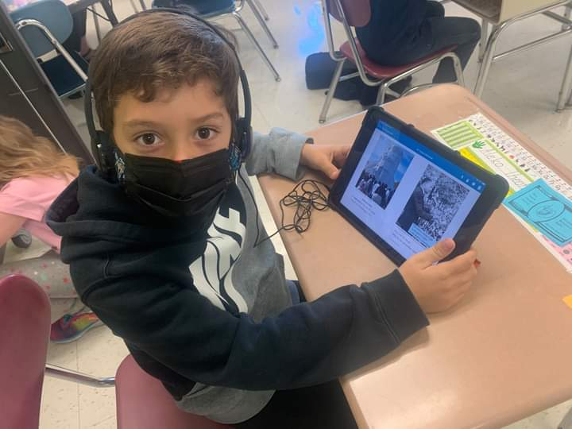
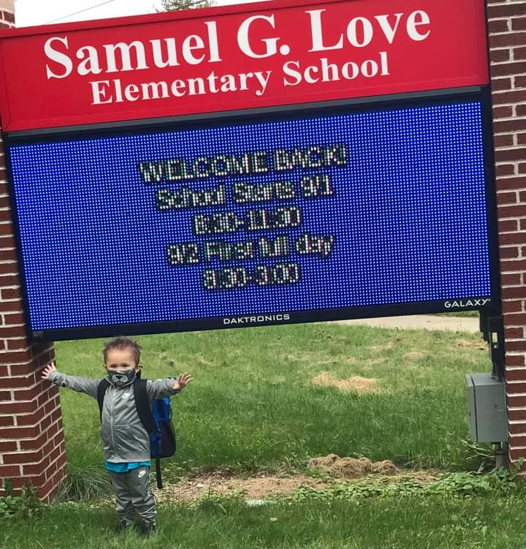
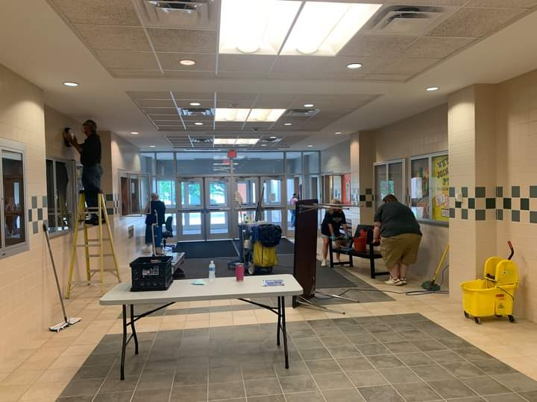
ARPA Funds Allowable Use
Districts should prioritize spending on non-recurring expenses in the following areas:
Return to In Person Instruction
Operations and Technology
Addressing the impacts of COVID-19

Slide 4
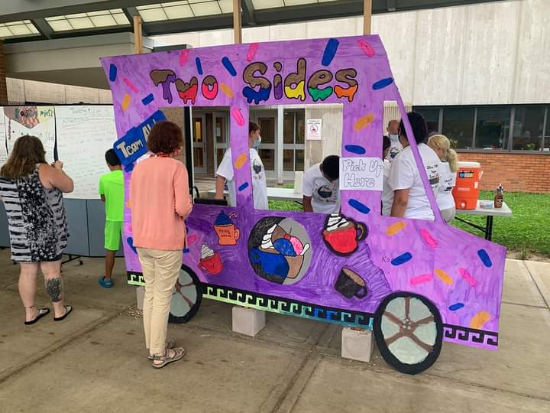
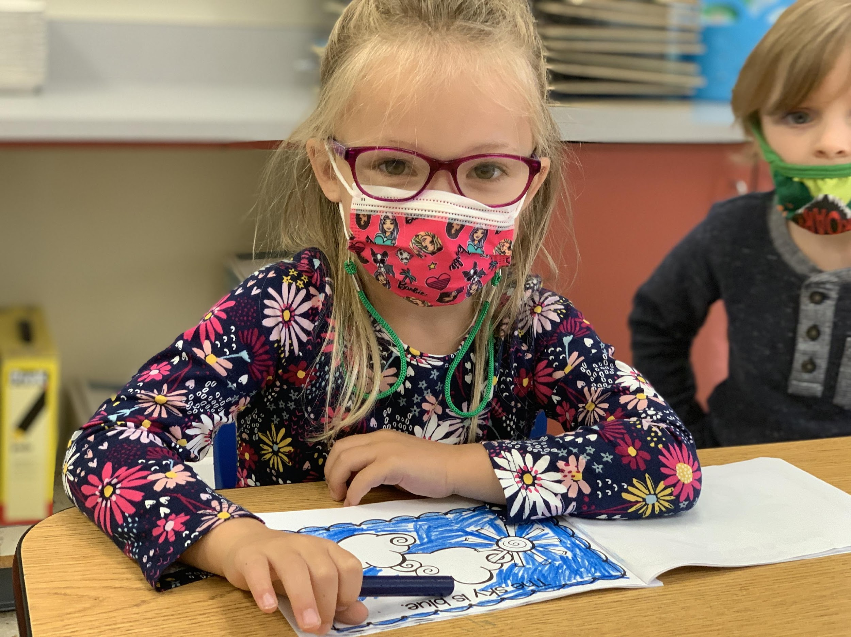
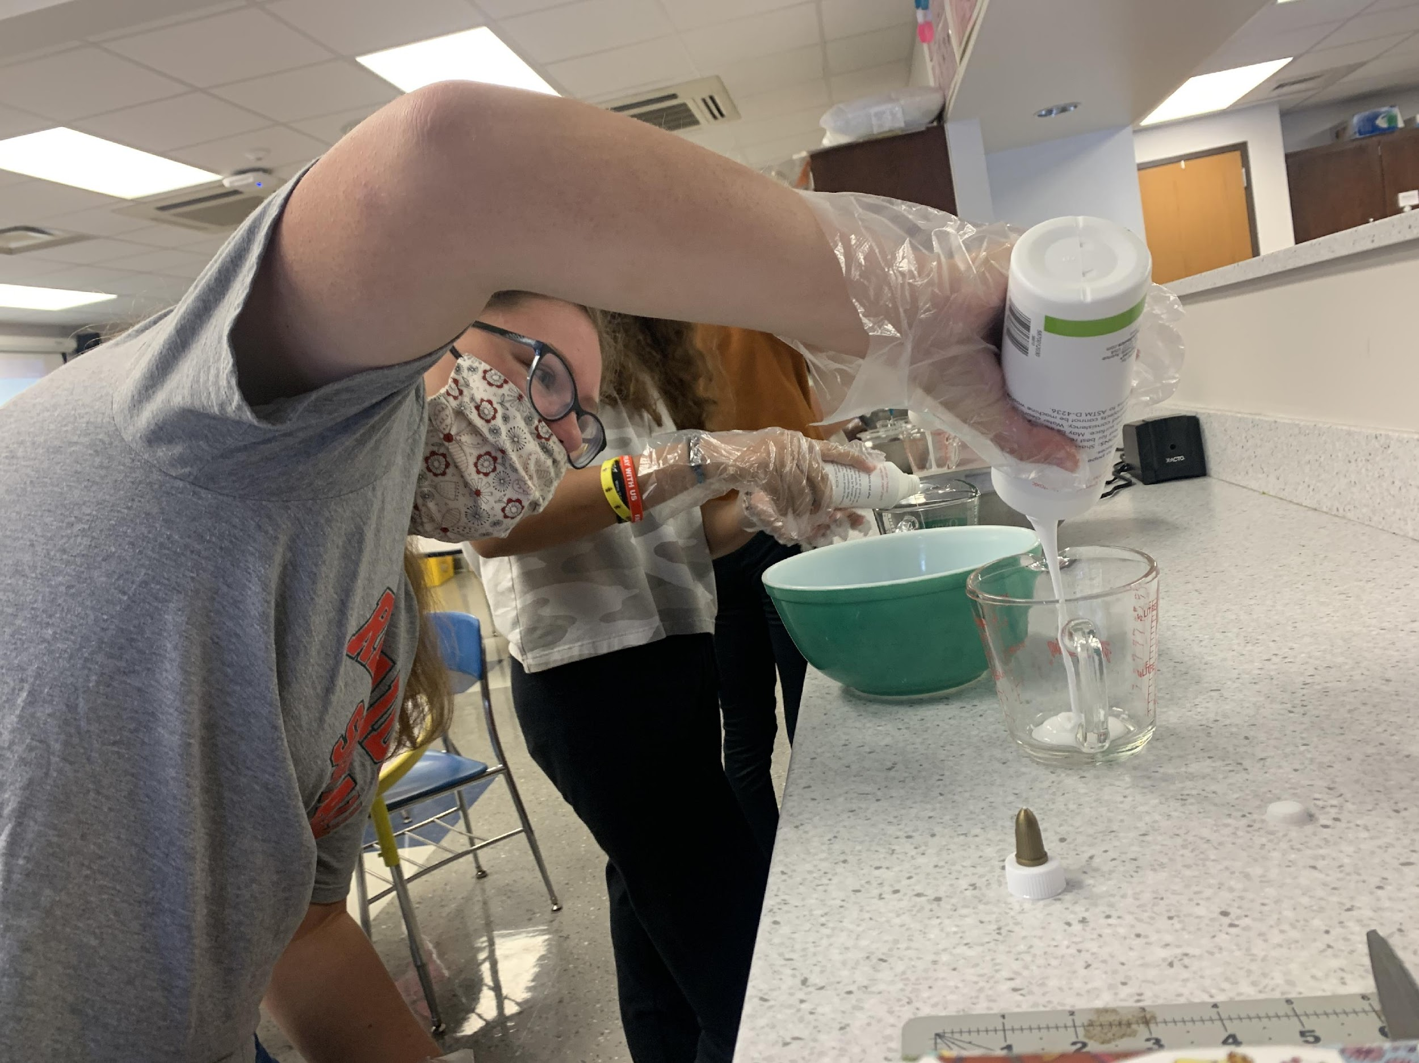
Current Use ARPA Funds for JPS
What have we used funds for to date?
  PPE such as masks, thermometers, etc.
  Accommodations for social distancing
  Replace technology
  Charging stations for technology
  Summer Programming
  Staff for COVID-19 Requirements
  Literacy Coordinator

Slide 5
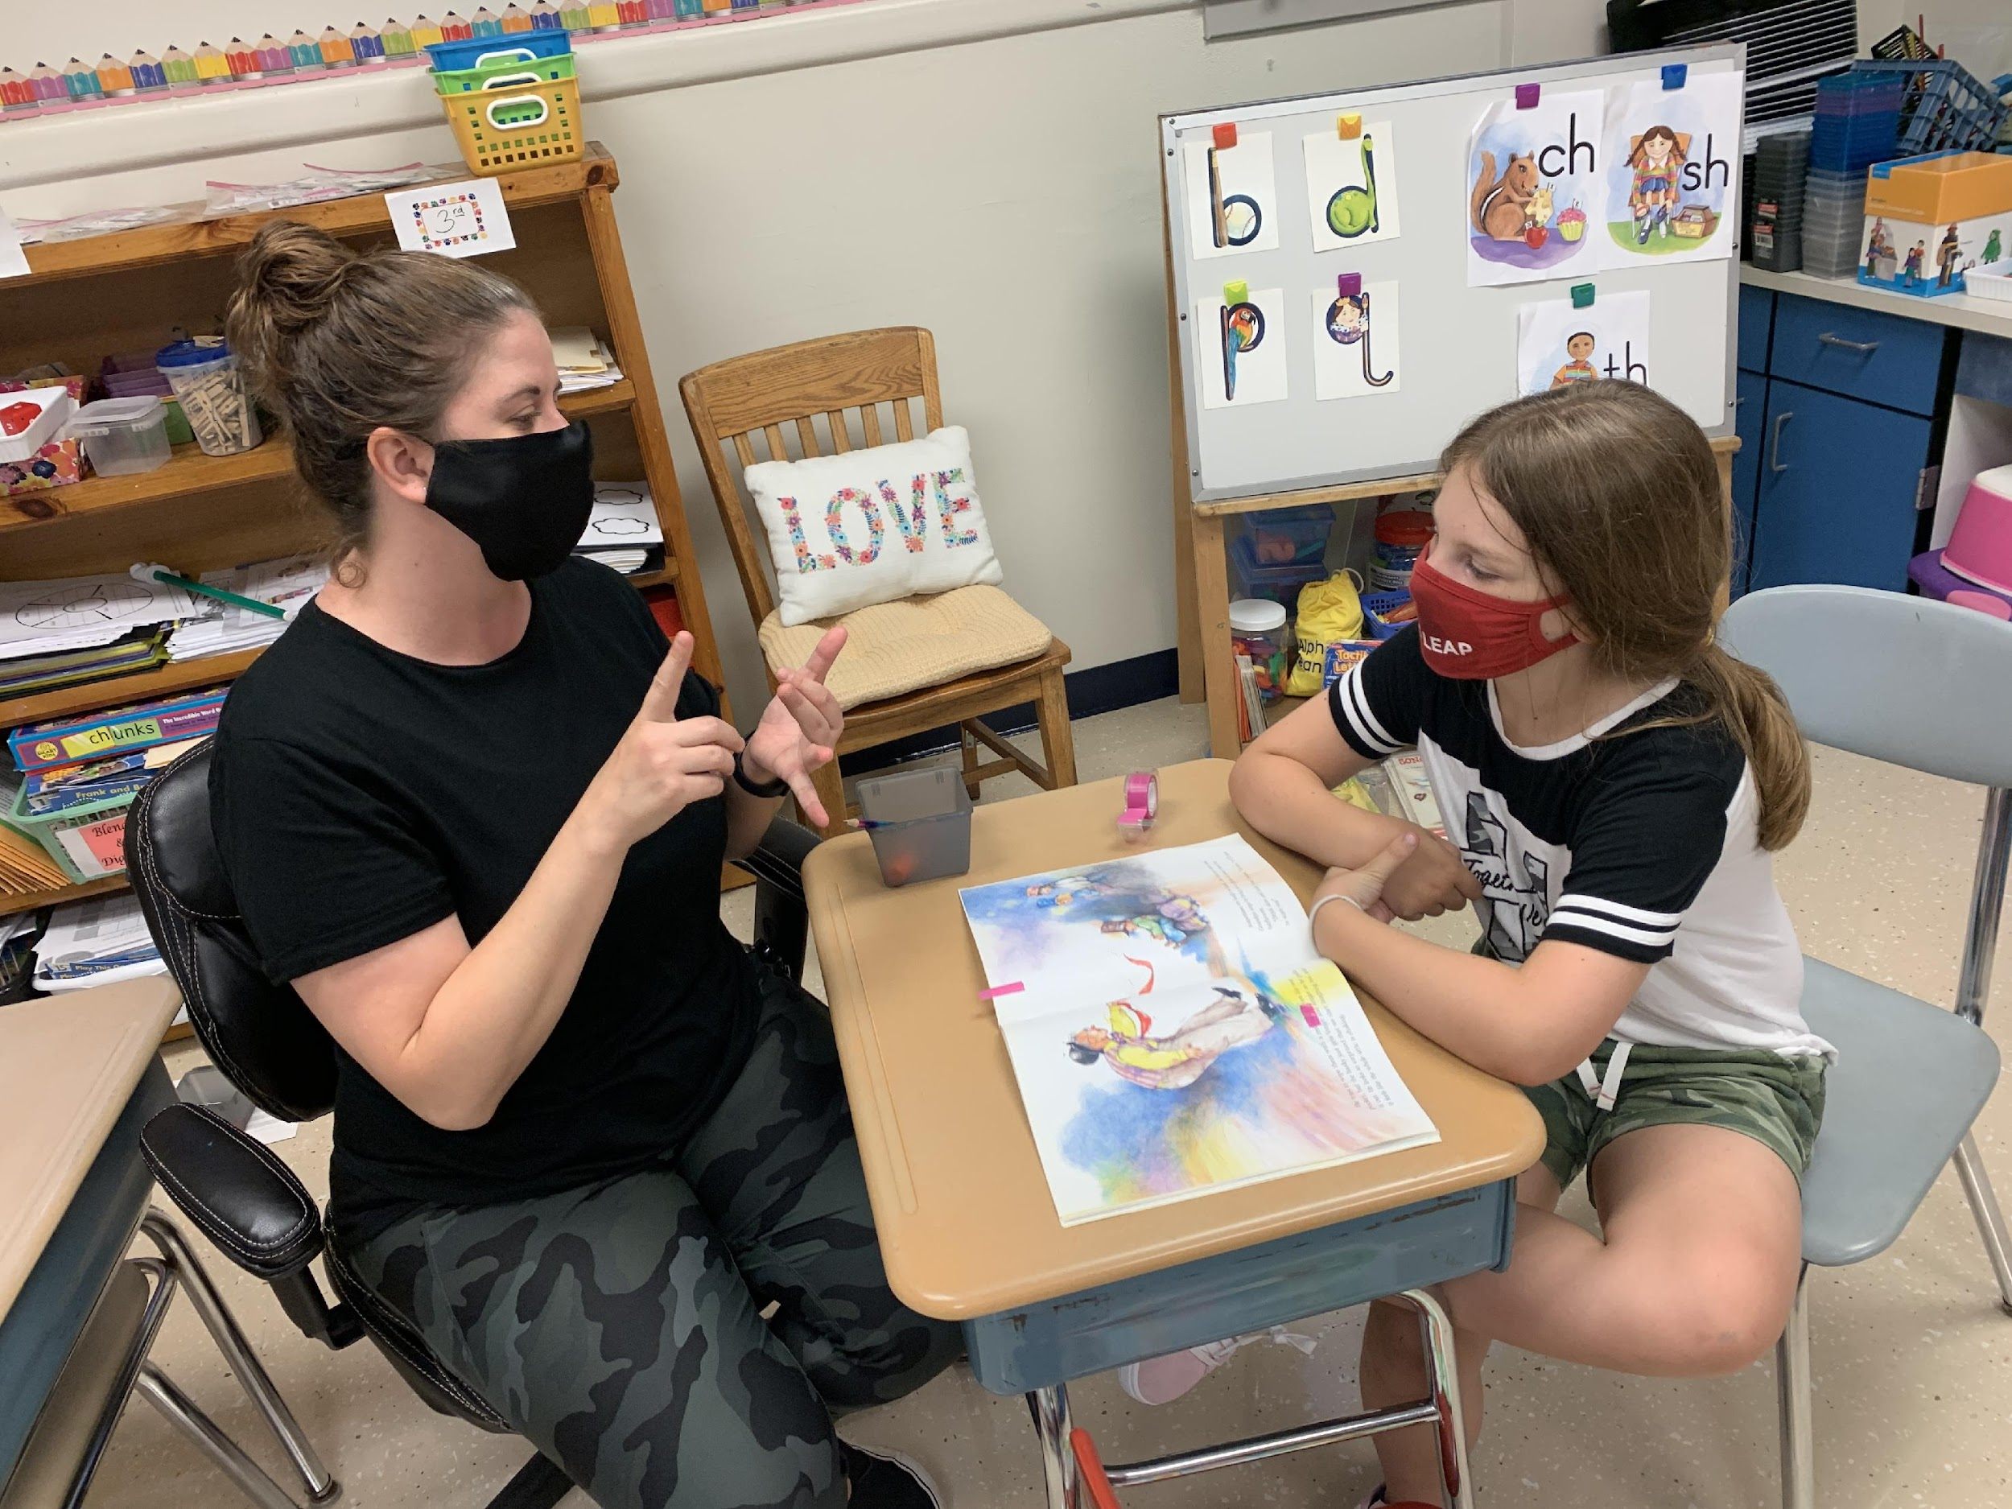
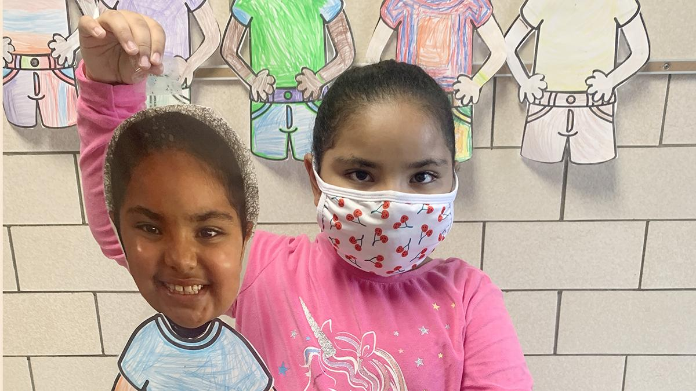
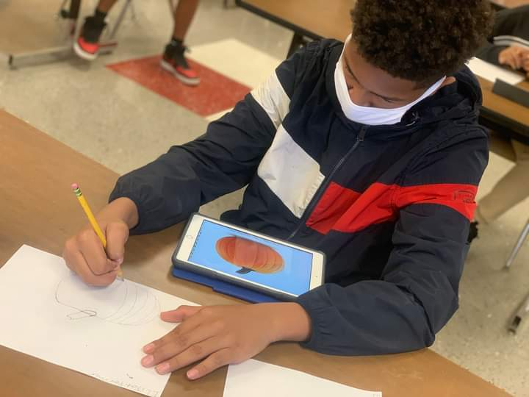
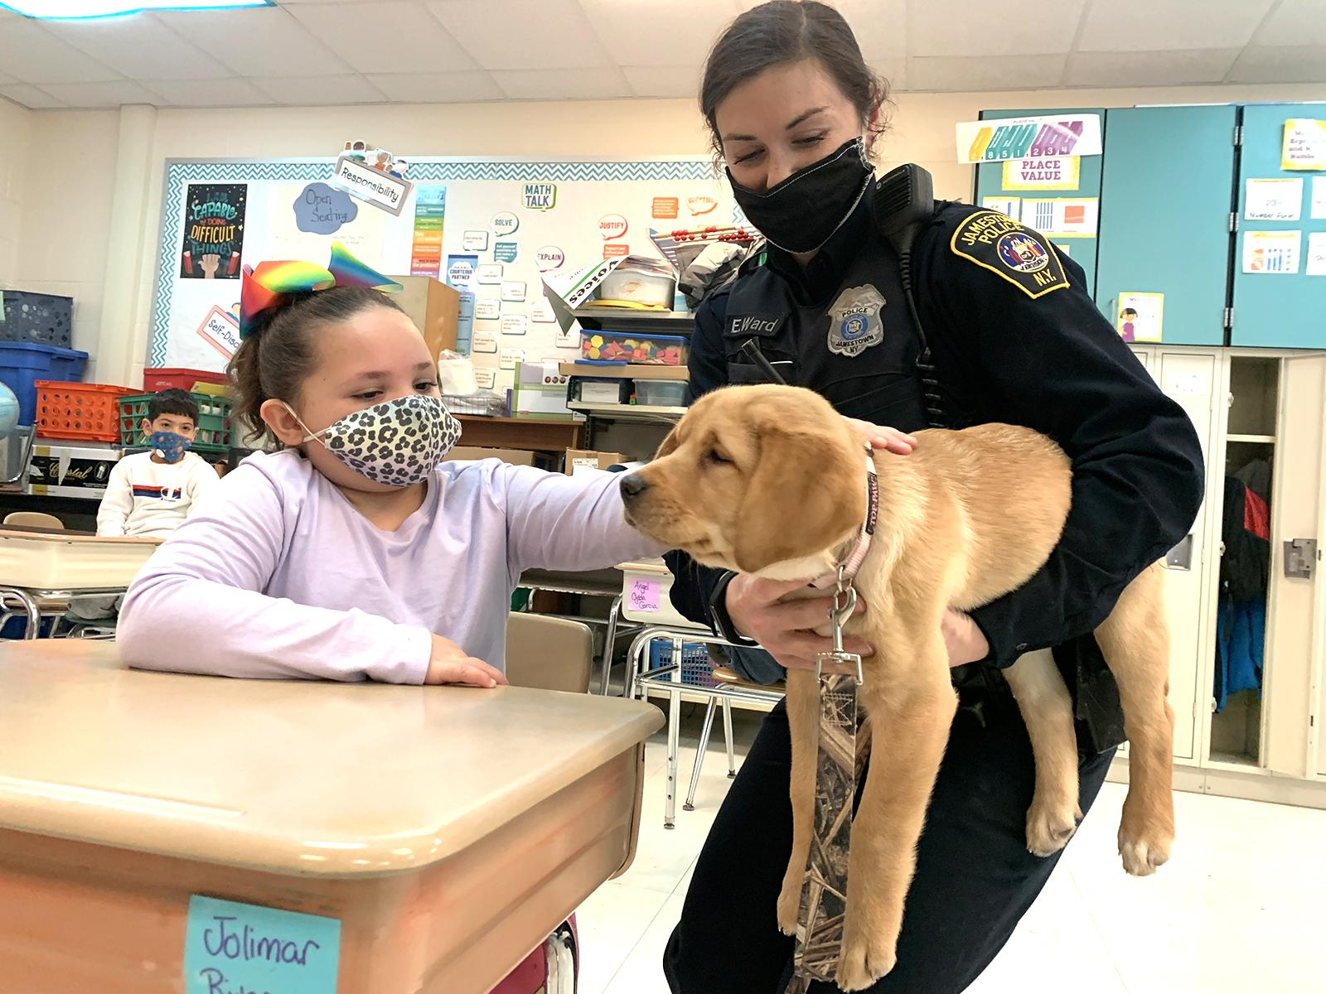
Future Use ARPA Funds for JPS
  Social Emotional and mental health supports
  Instruction and PD
  Equity and Inclusion efforts
  Staff support and retention
  Community Engagement
  Technology and Equipment
  Air Quality/HVAC Upgrades
  School Operations
  Technical and career pathways
  School supplies
  Extended School Day support
  Tutoring and AIS
  Talent outreach, support and development

Slide 6

Next Steps
  Continue to survey stakeholders
  Implement and support initiatives
  Monitor Spending
  Update stakeholders
  Repeat
  Contact Information:
    Brittnay Spry
    brittnay.n.spry@jpsny.org
    716-483-4497

