Slide 1
VISALIA UNIFIED SCHOOL DISTRICT
[SCHOOL NAME]
Second School Site Council Meeting
[Date]

Slide 2
Our Core Beliefs & Commitments
We believe and are committed to
All students can achieve at high levels and demonstrate continuous growth
Providing high-quality learning experiences that allow all students to reach their fullest potential
Equipping students and staff with the educational tools necessary for achievement and growth
Family and community engagement is key to student success
Providing families and community members pathways of connectivity to the education system
Facilitating timely and consistent communication to position families to participate in their students’ learning experiences
Learning environments should be safe, supportive, and innovative
Creating physical and social-emotional safety in all learning environments
Providing all students the academic and social supports needed to be successful
Designing learning environments that drive innovative practices to improve student outcomes
Ensuring all students are known by their name, welcomed each day, and connected to meaningful activities
Our Priorities
BE READY
BE PRESENT
BE SUCCESSFUL
BE CONNECTED
2

Slide 3
AGENDA
Call the Meeting to Order
Roll Call of Members
Reading/Approval of Minutes
Public Comment
School-Parent Compact Development and Approval
Uniform Complaint Procedures and Williams Settlement Requirements
School Plan for Student Achievement Timeline
School Site Data & SPSA Review
Review Budget Transfers
School/District Committee Reports
Review and Input on Comprehensive School Safety Plans
School Accountability Report Card (SARC)
Next Meeting December/January

Slide 4
School Site Council (SSC)
Public Comment
Time for the public to address the council
*The council may not take any action on any item of business unless that item appeared on the posted agenda.

Slide 5
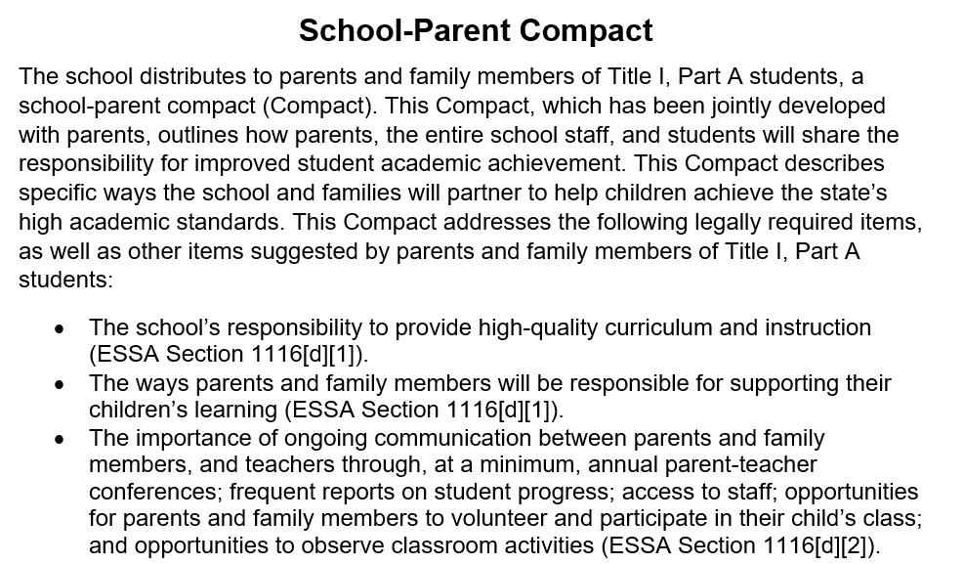
School-Parent Compact
Vote to Change/Approve
*Jointly Developed by Parents
Use SSC Minutes to Record
Notes:
From Title 1 meeting https://docs.google.com/document/d/1QNMU2KpaXFS0hsoDvwL86qbPz89QbecI/edit?usp=drive_link&ouid=112808476807921484942&rtpof=true&sd=true

Slide 6
School Site Data
Review School Accountability Report Card
Review CA Dashboard Data and site level achievement data
Review SPSA data and goals
Notes:
How does the data look in relation to the SPSA

Slide 7
Site Specific Parent Information
How does the site communicate important information?
What opportunities do parents have to volunteer on campus?
What procedures must be followed for parents to volunteer on campus

Slide 8
SPSA Timeline
Sept/October
Approve any updates to 2024-2025 School Plan
November
Review Student Data and Progress
December
Continue to Monitor SPSA services and Student Data
January
Analysis of Mid-Year Data and SPSA evaluation
March/April
Evaluation of School Plan and Needs Assessment
May
Approve 2025-2026 School Plan

Slide 9
School Plan for Student Achievement (SPSA)
Goals of the Plan
All students will advance towards proficiency in every subject at each grade level, achieved through the implementation of innovative methods, collaboration, continuous staff development, and the effective integration of technology.
All students will be actively engaged and prepared for learning daily, achieved through providing equitable access to academic, behavioral, and social-emotional support
Our community and families will actively support students and schools through empowerment, effective two-way communication, engagement, and collaboration.

Slide 10
School Data & SPSA Review
Review actions from SPSA:
Based on available data are the current actions addressing student learning
Are any changes needed to the actions in the SPSA?

Slide 11
School Site Council (SSC)
Review Uniform Complaint Procedures
(pages 11-13 of District Information Directory)
The intent of the Williams Case was to provide public school students with equal access to instructional materials, safe and decent school facilities, and qualified teachers.
As a result of the Williams case, the California Department of Education (CDE) proposed changes to the School Accountability Report Card to help all schools report the overall condition of their facilities, the number of teacher mis-assignments, and the availability of textbooks or instructional materials.

Slide 12
Comprehensive School Safety Plan
Review the CSPP
Gather input from the SSC
Timeline: Review the CSSP in October and Approve at the January Meeting prior to the February board meeting.

Slide 13
School Accountability Report Card
Review and Approve School Accountability Report Card 2023/2024 link on District website. (Must be approved in Dec ahead of the Jan Board meeting)
Select: SARC/SPSA/Safety Plans/LEA Plan/ELMaster Plan
Select your school

Slide 14
School/District Committee Reports
Committee Reports
Discuss input and feedback gathered from ELAC and other school committees
Discuss items that were covered at previous DAC/DELAC meeting

Slide 15
School Site Council (SSC)
Budget Transfers
Reason for transfer(s)
Vote to approve transfer(s)

Slide 16
End of Meeting
Next Meeting:
December/January

Slide 17
Notes:
Please submit yearly schedule of meetings to rbeltran@vusd.org & upload documents to the Google Drive

