Slide 1
VISALIA UNIFIED SCHOOL DISTRICT
SCHOOL NAME HERE
First School Site Council Meeting
Type Meeting Date Here

Slide 3
Agenda
Call the Meeting to Order
Roll Call of Members
Public Comment
Purpose of LCAP and Title I funding
School Site Council (SSC) Training
Election of Officers/District Advisory Committee Representative
SPSA Review and Approval
School Safety Plan Review and Approval
Review Budget Transfers
Next Meeting: October/November
3

Slide 4
School Site Council (SSC)
Review
Appropriate use of Title I and LCAP funds
4

Slide 5
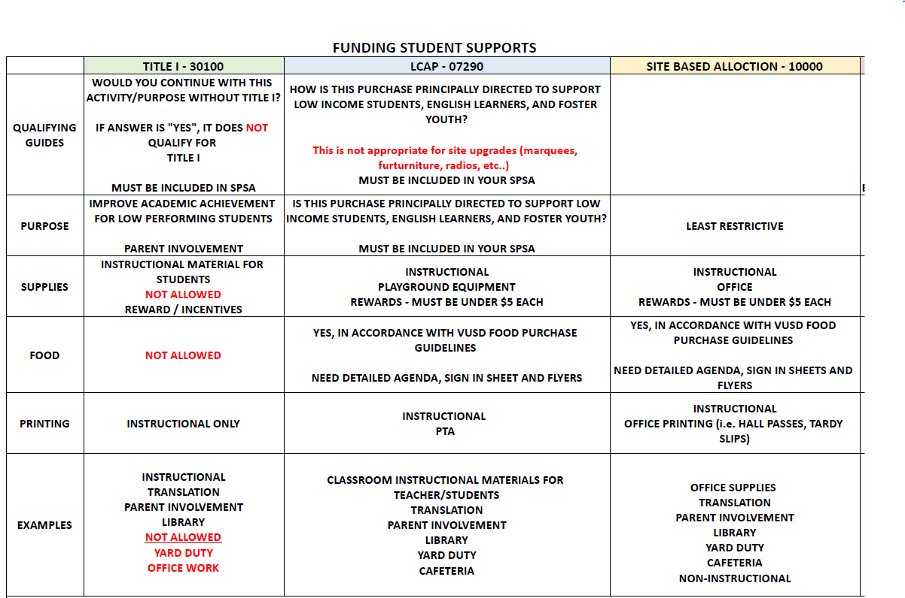
5

Slide 6
School Site Council (SSC) Training
6

Slide 7
Basic Principle for Legislating School Site
The California Legislature believes that the individuals who are most affected by the operation of the school should have a major role in the decisions regarding how a school functions.
Legislative Intent
Education should be a joint effort of parents, teachers, administrators, and other school staff.
7

Slide 8
SSC Responsibilities
The California Education Code requires school site councils to:
Measure effectiveness of improvement strategies at the school.
Seek input from school advisory committees (PTA, ELAC, CTE, etc).
Reaffirm or revise school goals.
Revise improvement strategies and expenditures.
Recommend the approved School Plan for Student Achievement (SPSA) to the governing board.
Monitor implementation of the SPSA.
8

Slide 9
Other SSC Responsibilities
Provide input on District LCAP through the District Advisory Committee
Provide input on school allocated LCAP fund expenditures
9

Slide 10
Definitions regarding selection/ election of SSC members:
“The council shall be composed of the principal and representatives of:
Teachers selected by teachers at the school;
Other school personnel selected by other school personnel at the school;
Parents of pupils attending the school selected by such parents; and
In secondary schools, pupils selected by pupils attending the school.”
Community members may serve on the SSC if they are selected by parents.

Slide 11
The SSC in an elementary school shall be composed of the both of the following two groups (EC Section 65000[c][1]):
The members of the SSC represent the composition of school’s pupil population and notwithstanding the size of the school, the composition of the SSC shall ensure parity between the groups (EC Section 65000[a]).
School Group Members (Elementary Schools):
The principal of the school or his or her designee;
school personnel employed at the school who are not teachers, selected by school personnel employed at the school who are not teachers, and
classroom teachers employed at the school, selected by classroom teachers employed at the school; The classroom teachers selected shall constitute a majority of the school members selected (EC Section 65000[c][1][A]); and
Parent and/or Community Group Members (Elementary Schools):
Parents of pupils attending the school, or other members of the school community, selected by parents of pupils attending the school. The number of parent and/or community members selected shall equal the number of school members selected (EC Section 65000[c][1][B]).
In other words, the minimum number of SSC members at an elementary school is a total of ten (10) (1 principal or his or her designee, 1 other school personnel, 3 classroom teachers, and 5 parent/community members).
11

Slide 12
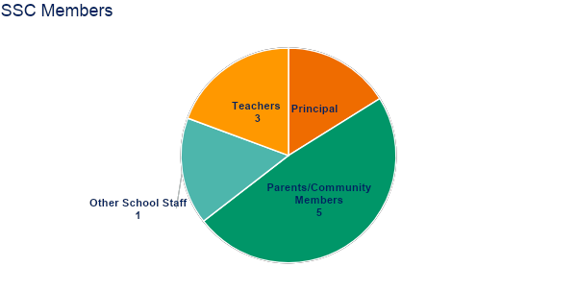
Elementary Composition

Slide 13
Definitions regarding selection/ election of SSC members:
“The council shall be composed of the principal and representatives of:
Teachers selected by teachers at the school;
Other school personnel selected by other school personnel at the school;
Parents of pupils attending the school selected by such parents; and
In secondary schools, pupils selected by pupils attending the school.”
Community members may serve on the SSC if they are selected by parents.

Slide 14
The SSC in a secondary school shall be composed of the following two groups (EC Section 65000[c][2]):
School Group Members (Secondary Schools):
The principal of the school or his or her designee;
school personnel employed at the school who are not teachers, selected by school personnel employed at the school who are not teachers, and
classroom teachers employed at the school, selected by classroom teachers employed at the school; The classroom teachers selected shall constitute a majority of the school members selected (EC Section 65000[c][2][A]); and
Parent and/or Community and Pupil Group Members (Secondary Schools):
Parents of pupils attending the school, or other members of the school community, selected by parents of pupils attending the school; and pupils attending the school, selected by pupils who are attending the school. The number of parent and/or community members and pupil members selected shall equal the number of school members selected (EC Section 65000[c][2][B]).
In other words, the minimum number of SSC members at a secondary school is a total of ten (10) (1 principal or his or her designee, 1 other school personnel, 3 classroom teachers, 5 parent/community members and pupil members).

Slide 15
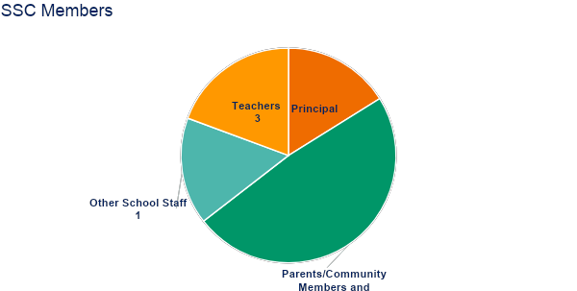
Secondary Composition
4
6
Parents/Community/Students

Slide 16
School Site Council (SSC) Training
Check Bylaws First
Schools are encouraged to have procedures for the selection/election of members written into the SSC’s bylaws.

Slide 17
School Site Council (SSC) Training
The Principal
The principal is an active member of the school site council. He/she has no administrative authority over the council.
SSC attendance and responsibilities CANNOT be assigned to a vice principal or other designee. The principal must be an active participant of SSC.
In addition, the principal may not veto a decision of the council nor make plan or budget changes without SSC approval.

Slide 18
The Principal’s Responsibilities
Is a voting member of the council;
May not veto a council decision;
May not change the approved plan;
Provides training to SSC members on their roles and responsibilities;
Provides leadership to the council on federal and state regulations;
Assists the chairperson in establishing agendas for the meetings;
Provides or coordinates budget and plan updates to the council;
Provides student achievement information to the council;
Provides council with planning information (e.g., program requirements);
Provides council with budget information (e.g., personnel costs, allowable expenditures); and
Assumes responsibility for the implementation of the approved plan.
See your site’s School Innovations & Advocacy, Administrator’s Guide to School Site Councils for all SSC rules and requirements to maintain.

Slide 19
Conducting the Meeting
(Greene Act)
The council cannot act on any item that was not included on the posted agenda.
Exception: If an action is needed and was not known at the time the agenda was posted, the SSC may, by unanimous vote, add the item on the agenda for action.
Questions and brief statements for clarification may be made as long as there is no impact on students or staff.
If these procedures are violated, upon demand of any person, the council must reconsider the item at its next meeting, after allowing for public comment on the item.

Slide 20
Agenda Requirements
Must be posted in a public place 72 hours prior to the meeting.
Includes the date, time, location, and each item of business.
Provides time on the agenda for public comment.

Slide 21
Conducting the Meeting
Provide a sign-in sheet for attendees.
Provide copies of the agenda and all materials to SSC members and the public.
Follow the contents of the posted agenda.
Use an agreed upon procedure (e.g., Roberts’ Rules of Order - 10th Edition) for conducting business.
Provide opportunities for all members to discuss items on the agenda.
Maintain minutes of the meeting.
Forward a copy of the agenda, minutes, and sign in sheet to the District Office.
Maintain minutes of the meeting for 3 years.

Slide 22
Effective School Site Councils ...
Focus on improving student achievement for all students
Maintain a high degree of collaboration
Provide opportunities for shared leadership
Demonstrate good problem solving skills
Allow for all members and the public to freely express their opinions and points of view
Recognize and respect the individuality and creativity each member brings to the team

Slide 23
Effective School Site Councils ...
Come prepared with their materials and good ideas;
Communicate with the larger school community about their progress;
Encourage the use of good listening skills;
Seek out information from broader school community; and
Utilize a procedural guide (e.g., Roberts’ Rules of Order ) to assure that meetings are properly managed.

Slide 24
School Plan for Student Achievement (SPSA)
Explain the purpose of the plan
Discuss how the plan addresses school needs
Goals of the Plan
All students will advance towards proficiency in every subject at each grade level, achieved through the implementation of innovative methods, collaboration, continuous staff development, and the effective integration of technology.
All students will be actively engaged and prepared for learning daily, achieved through providing equitable access to academic, behavioral, and social-emotional support
Our community and families will actively support students and schools through empowerment, effective two-way communication, engagement, and collaboration.

Slide 25
School Plan for Student Achievement (SPSA)
Discuss what supports and services are being provided for all students and specifically for English Learners, Students with Disability, Low Income Students, and Foster Youth
Discuss the role of Student Data and Student Progress in the School Plan
Review SPSA for 2024-2025 – vote to approve any changes

Slide 26
District Advisory Committee (DAC)
2024-2025 Meetings
9/30/24
10/28/24
12/9/24
1/27/25
3/24/25
4/28/25
5/19/25
*Select a parent Representative to attend DAC Meetings

Slide 27
School Safety Plan
Review School Safety Plan

Slide 28
Budget Transfers
Reason for Transfer(s)
Vote to Approve Transfer(s)

Slide 29
Future Meetings:
List all meeting dates:
[Send these dates to Rocio Beltran, at State & Federal Projects Dept.]

