Slide 1

2024 – 25 School year
What to Expect
Notes:
NOTE:
To change the image on this slide, select the picture and delete it. Then click the Pictures icon in the placeholder to insert your own image.

Slide 2

Objectives
Student Demographic Sheet updates
Book Order Loan Request process updates
Updates and reminders on requests for Supplies & Materials, and Hardware & Software

Slide 3
Student Demographic Sheet
Purpose
Content

Slide 4
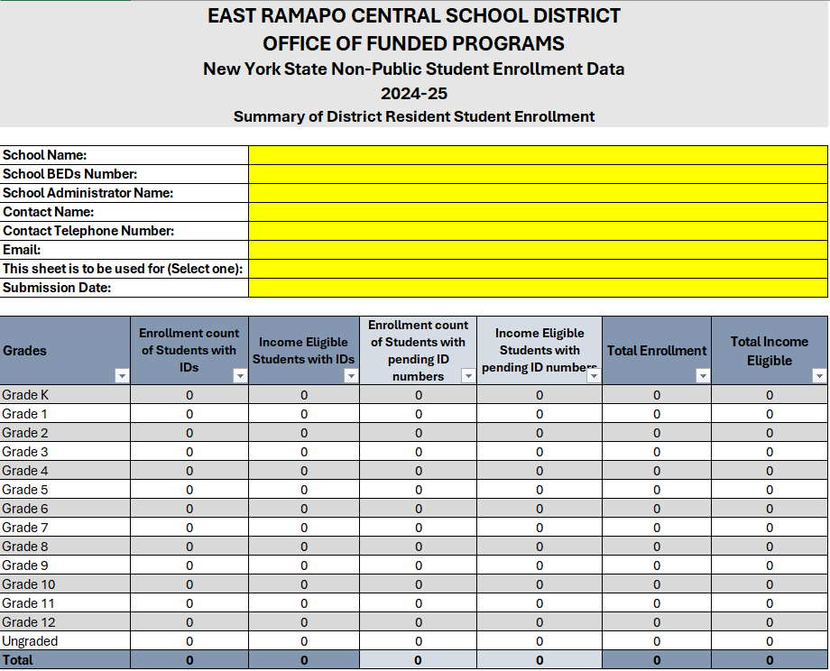
Student Demographic Sheet – Summary tab
New fields for preferred contact name and phone number.
New fields identifying students with pending IDs (all fields in table auto calculate).

Slide 5
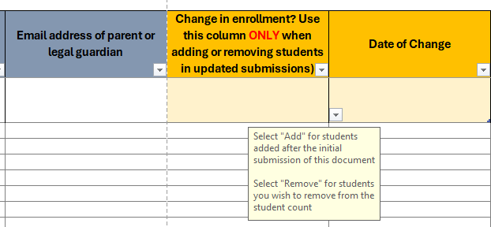
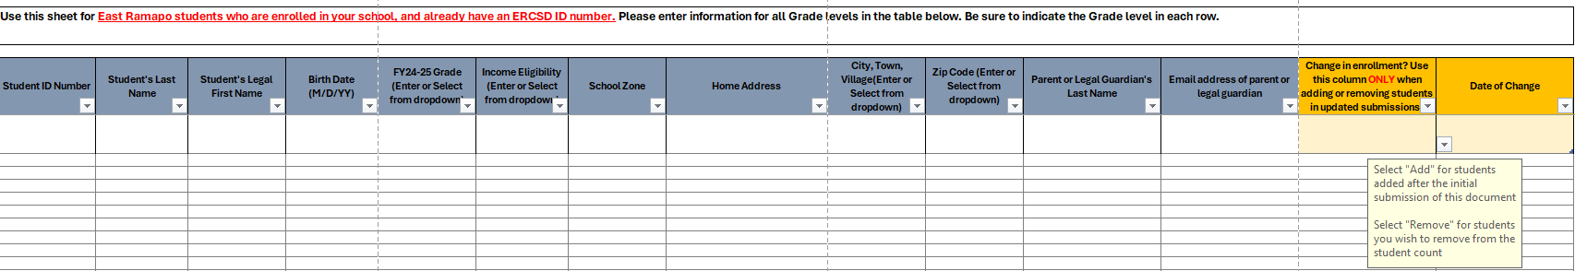
Student Demographic Sheet – Entering students with IDs
Additional fields for students with ID
Benefits:
Accurately and more efficiently process changes in student counts, and allocations

Slide 6
Student Demographic Sheet – Entering students without IDs
Additional tab for students without IDs
Benefits:
Accurately keep track of pending IDs so all parties are aware of the number outstanding IDs.

Slide 7
Student Demographic Sheet – summary of updates
Removed
Added
Current year grade entry field
New fields for preferred contact name and phone number.
Field for parent's email addresses.
Change in enrollment fields for adding or removing students.
Students without IDs tab.

Slide 8

Student Demographic Sheet – resources
Detailed instructions tab in the sheet template
Screen recorded video
Funded Programs staff (equitableservices@ercsd.org)

Slide 9
Book ordering
Orders will be done via an e-Form
Confirmation of submission
All orders require quotes.
All book orders, upon request, will be drop shipped.
Email summary once order is processed
What’s new

Slide 10
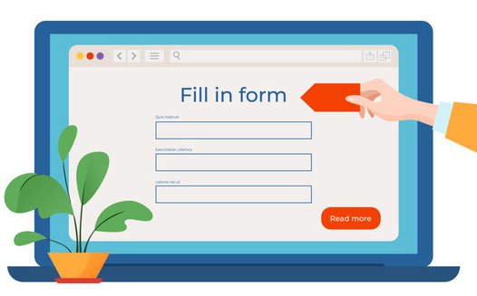
Book Ordering Form
Submit e-Form
Order received by Book Depository
Order processed

Slide 11
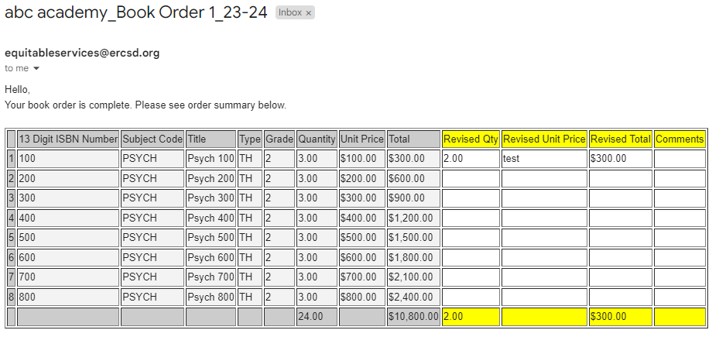
Book Ordering – Order complete email sample
Email summary to confirm the books ordered and any changes/ revisions to the order

Slide 12
Key takeaways
1
Quotes must be attached. Ensure all unit entries match quotes.
2
Ensure BEDs numbers are entered correctly.
3
Indicate accurate summer hours of operation for drop shipping.

Slide 13
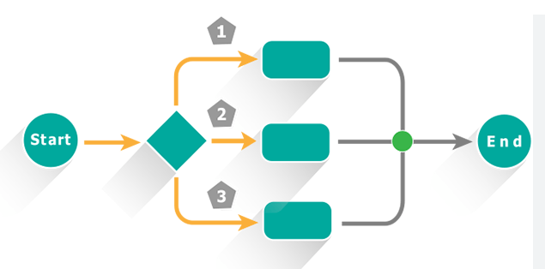
Supplies & Materials, and Hardware & Software order process updates

Slide 14

Objectives
Ordering Process
Quotes
Ordering Forms
Tracking Funds

Slide 15
Supplies & Materials, and Hardware & Software order process updates cont’d
Ordering Process
  Ed Data requisitions - except for Title IV - must be submitted to Sue Fata via email, and must be accompanied by the Title request form, assurance sheet, and justifications form.
  Ed Data requisitions must include a budget code.
  All Title IV orders must be reviewed by CEC prior to submission to OFP. We cannot accept Title IV orders that have not been reviewed by CEC.
  For orders of unique materials, obtain a “sole source” letter from the vendor and include it with your order request.

Slide 16
Supplies & Materials, and Hardware & Software order process updates cont’d
Quotes
  All orders over $1,000 must come with 3 quotes (unless it is Dell).
  All quotes are only good for 30 days unless otherwise specified on quote.
  No tax should be on any quotes as we do not pay tax
  All quotes for books must include ISBN numbers on it; Title-funded books must be shipped to the Book Depository.
  The shipping address must be correct on quotes. The address should not be the school’s address, only the Book Depository or the Warehouse.

Slide 17
Supplies & Materials, and Hardware & Software order process updates cont’d
Ordering forms
  The assurance sheet must be filled out and signed by the Title I Director, the Title III Director, or the School Administrator for Title II and Title IV (or Title III if applicable).
  The justification form must include details. Purpose. People. Place.
  Complete the Title I student numbers section on all Title I orders.

Slide 18
Supplies & Materials, and Hardware & Software order process updates cont’d
Tracking funds
  Schools must create a system for tracking their spending. Use a spreadsheet such as this:
  https://docs.google.com/spreadsheets/d/1MNDHY33mKpK3K3mbDD9IU3UG0Dm3VzpE6JhO0PgtxTc/template/preview

Slide 19

Questions?
Please email us: equitableservices@ercsd.org

