Slide 1
2022 WORKSHOP SERIES for
School Board Candidates
Board Governance Part II – Working Effectively as a Board and as a Board Member
Presented by: Harold M. Freiman
Marin County Office of Education
August 25, 2022

Slide 2


Topics
Working Effectively Together as a Board
The Do’s & Don’ts of Effective Trustees
Board Meeting Procedures

Slide 3
Working Effectively Together as a Board
Notes:
You are one of 5 (or 3 or 7)

Slide 4
Working Together
“Coming together is a beginning; keeping together is progress; working together is success.”
- Henry Ford

Slide 5
Working Together
“But Congress doesn’t have to agree on everything…”
Is that an effective governance model?

Slide 6

Working Together
How do you disagree agreeably?
How do you implement decisions?

Slide 7
Eight Characteristics of Effective
School Boards
Center for Public Education, January 28, 2011
Reviewed research on school board effectiveness since mid-1990’s
Different studies examined districts of various sizes in a variety of communities across the country
Significant conclusion: Board members in high-performing districts have attitudes, knowledge, and approaches that separate them from their counterparts in lower-achieving districts.

Slide 8
The Eight Characteristics
A vision of high expectations for student achievement and quality instruction with clearly-defined goals toward that vision.
Strong shared beliefs about what is possible for students and their ability to learn and of the district’s ability to teach all children at high levels.
Accountability-driven, spending less time on operational issues and more time on policies to improve student achievement.

Slide 9
The Eight Characteristics
Collaborative relationship with staff and community supported by strong communication plan to reach both internal and external stakeholders.
Embrace and use data, even when negative, to monitor and improve programs.
Align and sustain resources, such as professional development, to meet district goals.

Slide 10
The Eight Characteristics
Lead as a united team with the Superintendent, each from their respective roles, with strong collaboration and mutual trust.
Participate in team development and training to build shared knowledge, values, and commitments for their improvement efforts.

Slide 11

How are you doing as a Board?
Watch for mission drift

Slide 12
CSBA Model Bylaw 9005
“The Board expects its members to work with each other and the Superintendent to ensure that a high-quality education is provided to each student. Each individual Board member shall . . . .”

Slide 13
CSBA Model Bylaw 9005
“Keep learning and achievement for all students as the primary focus.”
“Value, support and advocate for public education.”
“Recognize and respect differences of perspective and style on the Board. . . .”

Slide 14
CSBA Model Bylaw 9005
“Act with dignity, and understand the implications of demeanor and behavior.”
“Keep confidential matters confidential.”
“Participate in professional development...”

Slide 15
CSBA Model Bylaw 9005
“Understand the distinctions between Board and staff roles, and refrain from performing management functions that are the responsibility of the Superintendent and staff.”
“Understand that authority rests with the Board as a whole and not with individuals.”

Slide 16
CSBA Model Bylaw 9005
“Board members also shall assume collective responsibility for building unity and creating a positive organizational culture. To operate effectively, the Board shall have a unity of purpose and. . . .”

Slide 17
CSBA Model Bylaw 9005
“Keep the district focused on learning and achievement for all students.”
“Communicate a common vision”
“Operate openly, with trust and integrity”
“Govern in a dignified and professional manner, treating everyone with civility and respect.”

Slide 18
CSBA Model Bylaw 9005
“Govern within Board-adopted policies and procedures.”
“Take collective responsibility for the Board’s performance.”
Evaluate effectiveness
Ensure opportunities for the “diverse range of views”

Slide 19
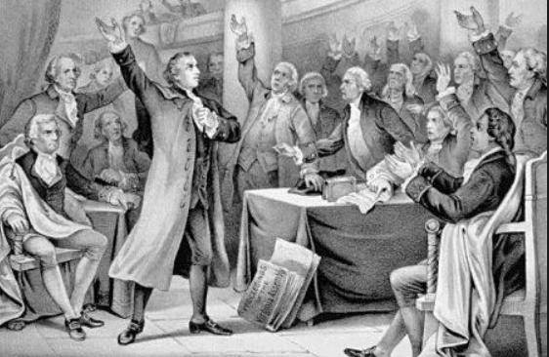
Does that sound like today’s Congress?

Slide 20
The Board Establishes the Vision
The vision:
  Is inspirational
  Includes desired outcomes, benefits, and goals
  Is supported by a strategic plan, with benchmarks to monitor progress

Slide 21

Organizational Structure
Responsibilities of the Board and Superintendent are different, but complementary:
  The Board focuses on Governance concerns
  The Superintendent focuses on Operational concerns

Slide 22

CSBA Model Bylaw 9000
The Board’s role is to “work with the Superintendent to fulfill its major responsibilities.”

Slide 23

A Strong Governance Team Is a Partnership –
Board & Superintendent
Schools operate best when there is a strong partnership between the Board and the Superintendent.
Such a partnership does not develop by chance. It must be carefully cultivated by both the Superintendent and the Board members.

Slide 24

A Strong Governance Team Is a Partnership –
The Board Members
The Board must work together
Again, cultivation is required

Slide 25
A Strong Governance Team Is a Partnership –
The Board Members
“An ongoing part of your job as a board member is to cultivate an atmosphere of mutual respect. This cultivation must be renewed at each board meeting, as reflected in the way you listen and speak.”
--R. Mayer, How Not to Be a Terrible School Board Member

Slide 26
CSBA Model Bylaw 9200
“[A] Board member has no individual authority.”
“[I]ndividual members of the Board shall not exercise any administrative responsibility with respect to the schools or command the services of any school employee.”

Slide 27
Realities of Life as a School Board Member
You have no power and authority as an individual; only the Board collectively can make policies and decisions for the district.
Your role is to “see the big picture” and is not the day-to-day management of the district.

Slide 28
More Realities of Life as a School Board Member
You must represent the needs of ALL students. Your decisions must be made in the interest of the total school system and not for special groups or interest.
You must support the decision of the majority after voicing and voting your different opinion.
Sometimes your decisions may alienate your friends.

Slide 29
More Realities of Life as a School Board Member
Casual comments to community members regarding school district business could be interpreted as the entire Board’s position when it is not.
Effective Board meetings are businesslike, follow established procedures, and require Board members to be prepared.

Slide 30
More Realities of Life as a School Board Member
Privileged and confidential information must remain confidential. If it does not, district operations may be compromised, rights to privacy could be violated, and legal difficulties are probably on the horizon.

Slide 31
More Realities of Life as a School Board Member
After all these years, you discover that you really don’t like surprises!
To be a successful school Board member, you must work as a team – with your fellow Board members and the Superintendent.

Slide 32

Working Together
Back to Congress…
How can we do better?

Slide 33
How do you act after the vote?
How the Board votes and acts after the vote is a litmus test.
When is a unanimous vote important?
How does the minority act following a 3-2 vote?
How does the majority act following a 3-2 vote?

Slide 34
How do You Act After the Vote?
“The time to sound the warning bell is before the vote. All your negative predictions belong before a decision is made. After the final vote, the Board should come together to support what is now the district’s policy. Now is the time for you to turn from negative to positive.”
--R. Mayer, How Not to Be a Terrible School Board Member

Slide 35

And if you don’t row together…

Slide 36
CSBA Model Bylaw 9010
“When speaking to community groups, members of the public, or the media, individual Board members should recognize that their statements may be perceived as reflecting the views and positions of the Board. Board members have a responsibility to identify personal viewpoints as such and not as the viewpoint of the Board.”

Slide 37
“You may be asking yourself, ‘Do I have to watch every word I say?’ The answer is yes when you are standing before the public as a representative of the district.”
--R. Mayer, How Not to Be a Terrible School Board Member

Slide 38
Do’s & Don’ts of Effective Trustees

Slide 39
Do’s & Don’ts
Avoid surprises.
Avoiding surprises means: Board members will contact the Superintendent with information before they hear it from someone else or for the first time at a Board meeting.

Slide 40
Do’s & Don’ts
The Board is the last stop, not the first. “We agree to follow the chain of command and insist that others do so.”
Board members will wear only their Board member “hat” when conducting school district business.
Question: is that “hat” removable?

Slide 41
Do’s & Don’ts
The Board will reserve judgment on all matters until hearing the recommendation of the Superintendent and discussing the matter in a duly authorized meeting.
“Board members will not act as individuals in school district matters; we are a team and have authority only as a team.”

Slide 42
Do’s & Don’ts
The Superintendent will seek Board input on major decisions.
The Board and Superintendent will keep confidential information confidential.

Slide 43
Tips for Handling Concerns/Complaints
Listen, but remember you are hearing only one side of an issue.
Direct the person to staff and follow procedures – honor the process.
Treat everyone fairly and equally
Treat complaints consistently whether against a Board member, Superintendent, or anyone else.

Slide 44
A Word on “Whistle Blowing”
Do:
Take appropriate action – don’t stay silent
Follow the appropriate chain of command/action
About staff: go to Superintendent
About Superintendent: go to Board President
About Board member: go to Board President or Superintendent
About Board President: go to Superintendent or District legal counsel

Slide 45
A Word on “Whistle Blowing”
Don’t:
Jump to conclusions
Violate the Brown Act
Prematurely go to the press
Open the door to District or personal liability

Slide 46
Board Meeting Procedures
Notes:
46

Slide 47

Board Meeting Procedures
“Well-run, efficient meetings model leadership, promote trust and confidence, and provide opportunities to demonstrate wise decisions and planning for the future.”
- Governance Handbook Example

Slide 48
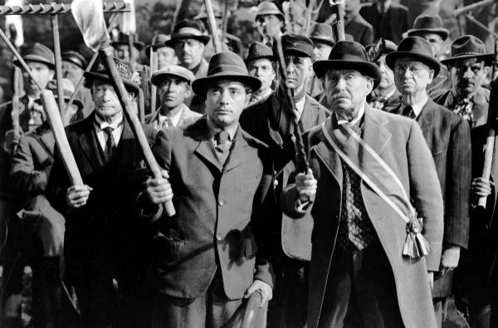
Board Meeting Procedures
What is the purpose of a meeting?
A Board meeting is the Board’s meeting, held in public, not a public meeting attended by the Board.

Slide 49
Board Meeting Procedures
What is the purpose of a meeting?
“Meetings have only two purposes: to inform and to make decisions. Everything else – call it socializing or whatever takes up your meeting time – is not board business.”
- E. Stoesz, Doing Good Even Better

Slide 50

Board Meeting Procedures
What contributes to inefficient meetings?
Lack of protocol
Repetition
Failure of the audience to respect your time
Failure to respect the time of the audience

Slide 51
Board Meeting Procedures
A strategic agenda
“The most common complaint I hear from boards is that they don’t have enough meeting time to cover their agenda. ‘If we only had more time!’ Well, you don’t. And you won’t. Time will always be in short supply. . . . The issue is not so much time, but agenda – how the limited time is used.”
- E. Stoesz, Doing Good Even Better

Slide 52
Board Meeting Procedures
“Stay focused. It is important to stay focused on the agenda in order to effectively and efficiently complete the agenda items. Too often, a board can get off-track if conversations are allowed to begin about personal agenda items or stories. If an item needs additional discussion to continue, tabling it to the next meeting is an option. An effective school board meeting should typically not run past two hours. If it does, there are either too many agenda items and/or discussions that may not be related to true governance. These items should be reviewed for relevance.”
- Kara Coglianese, Illinois Association of School Boards,
10 Do’s for Effective Board Meetings

Slide 53
Board Meeting Procedures
The Board President’s Role
“The Board president shall conduct Board meetings in accordance with Board bylaws and procedures that enable the Board to efficiently consider issues and carry out the will of the majority.”
- CSBA Model Board Bylaw 9323

Slide 54
Board Meeting Procedures
The Board President’s Role
“The Chair is responsible to keep a discussion focused and moving toward a consensus. This goes better when the Chair is not directly involved in making presentations or overtly insistent on getting his/her way. The Chair’s part in conducting meetings is critically important.”
- E. Stoesz, Doing Good Even Better

Slide 55
Board Meeting Procedures
It also comes back to the Board/management roles . . . .
“When this governance/management distinction is understood and practiced, board work is more effective. Meetings are shorter, more productive, and enjoyable. When boards are clear about their role, the rest falls in line.”
- E. Stoesz, Doing Good Even Better

Slide 56
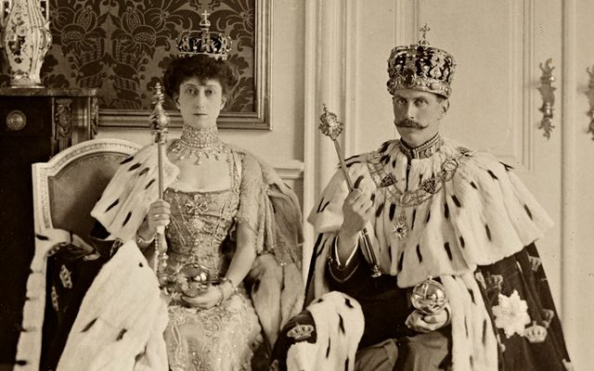
Board Meeting Procedures
Parliamentary Rules

Slide 57


Board Meeting Procedures
There are various options:
Robert’s Rules
Rosenberg’s Rules
District’s own rules

Slide 58
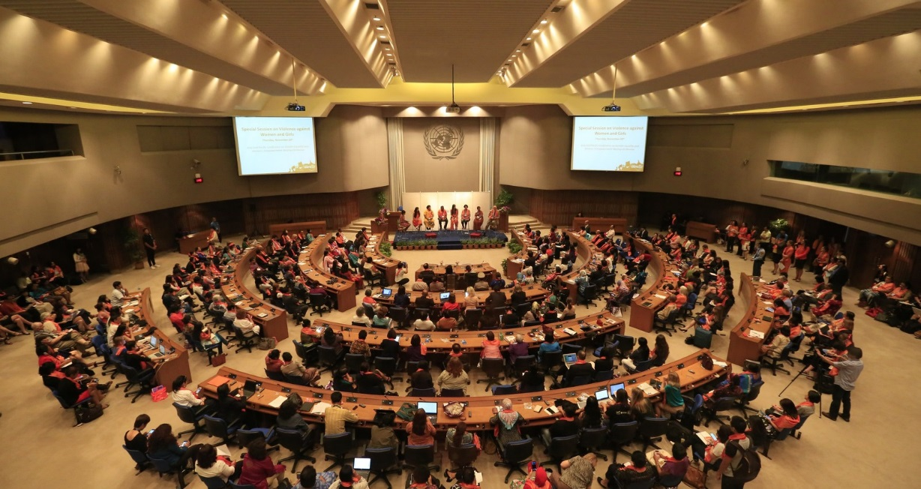
Board Meeting Procedures
Procedural rules are tools to Support An Orderly Meeting…

Slide 59

Board Meeting Procedures
Procedural rules are not to gain advantages or engage in gamesmanship.

Slide 60

Board Meeting Procedures
Don’t get hung up on the rules!

Slide 61
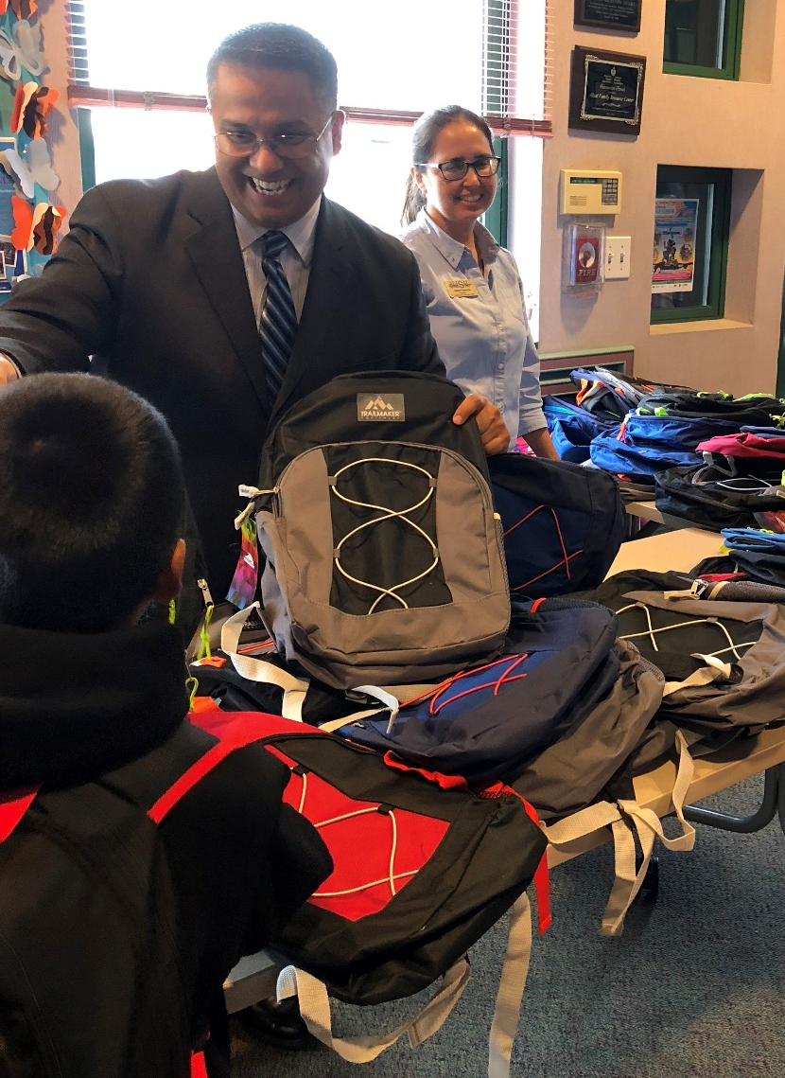
Thank you from Lozano Smith.
Together with you, we’re impacting communities and lives through:
Professional development
Volunteer projects
Sponsorships and award programs
Scholarships
#BlueHatProject
#LozanoSmithFoundation
Notes:
[PICTURE CAN BE SWITCHED OUT WITH OTHER APPROVED BLUE HAT ATTORNEY IMAGES.]

Slide 62
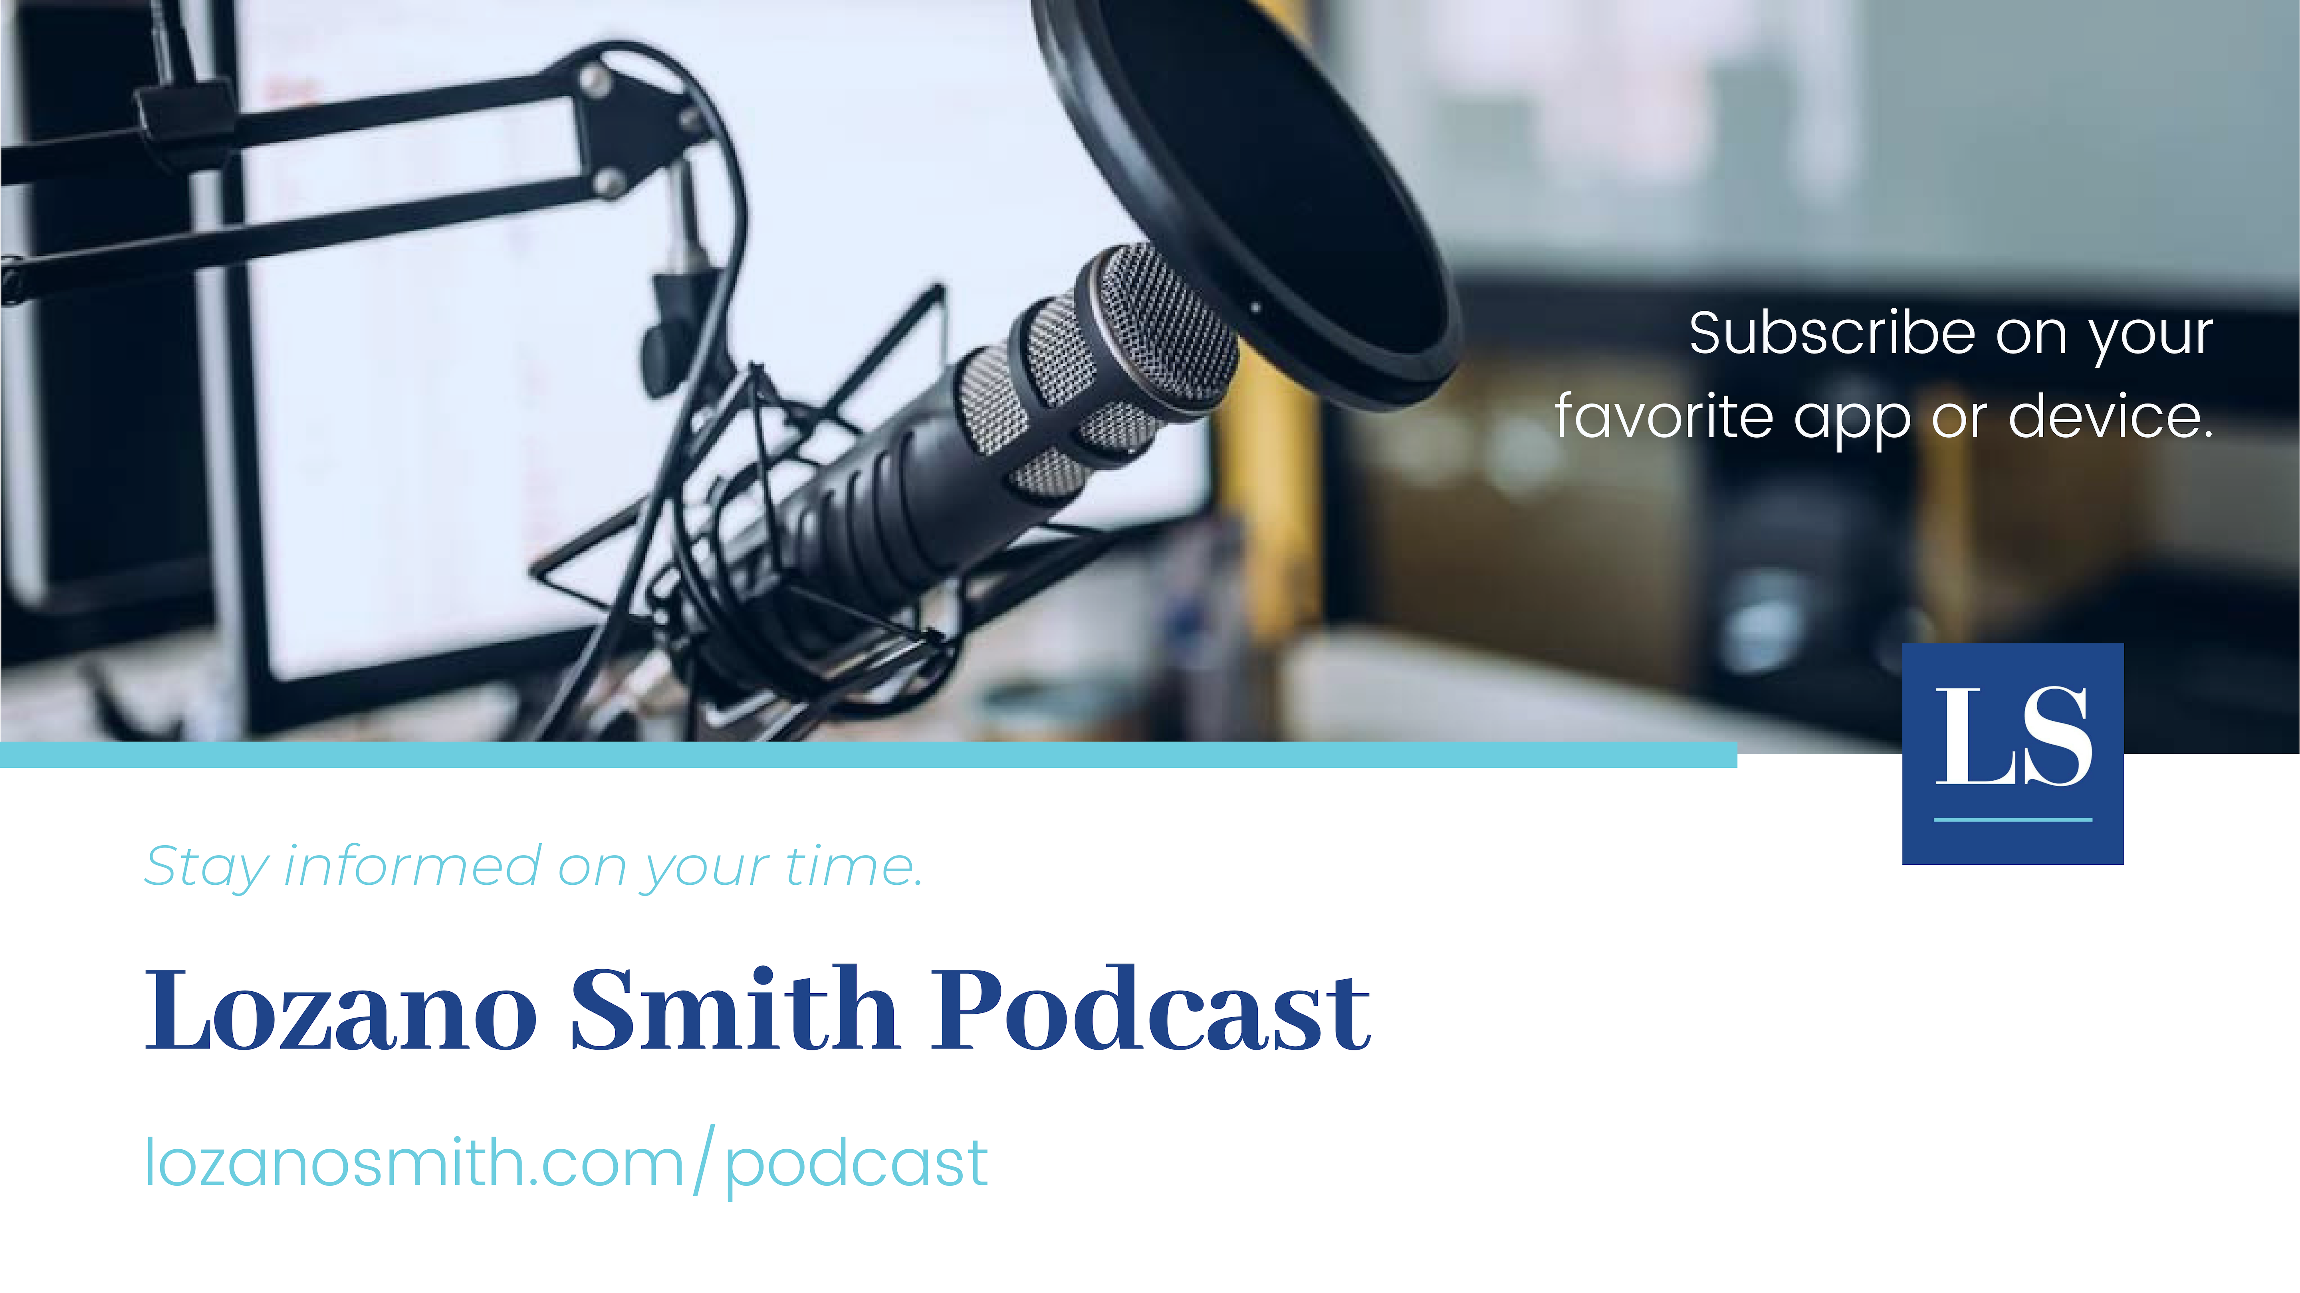

Slide 63

For more information, questions and comments about the presentation, please feel free to contact:
Harold M. Freiman
Partner
Tel: 925-953-1620
hfreiman@lozanosmith.com
Or any of the attorneys in one of our 8 offices.

Slide 64

@LozanoSmith
Disclaimer: These materials and all discussions of these materials are for instructional purposes only and do not constitute legal advice. If you need legal advice, you should contact your local counsel or an attorney at Lozano Smith. If you are interested in having other in-service programs presented, please contact clientservices@lozanosmith.com or call (559) 431-5600.
Copyright © 2022 Lozano Smith
All rights reserved. No portion of this work may be copied, distributed, sold or used for any commercial advantage or private gain, nor any derivative work prepared therefrom, nor shall any sub-license be granted, without the express prior written permission of Lozano Smith through its Managing Partner. The Managing Partner of Lozano Smith hereby grants permission to any client of Lozano Smith to whom Lozano Smith provides a copy to use such copy intact and solely for the internal purposes of such client. By accepting this product, recipient agrees it shall not use the work except consistent with the terms of this limited license.
SR489646.pptx

