Slide 1
2022 WORKSHOP SERIES for
School Board Candidates
Board Governance Part I – Roles and Responsibilities of Board Members
Presented by: Harold M. Freiman
Marin County Office of Education
August 23, 2022

Slide 2
Board Roles & Responsibilities
Notes:
Divider Slide

Slide 3
Roles
“The Governing Board believes that its primary responsibility is to act in the best interests of every student in the district. The Board also has major commitments to parents/guardians, all members of the community, employees, the State of California, laws pertaining to public education, and established policies of the districts. To maximize Board effectiveness and public confidence in district governance, Board members are expected to govern responsibly and hold themselves to the highest standards of ethical conduct.”
- CSBA Model Board Bylaw 9005

Slide 4

The Power of an Individual Board Member
Individual Board members exercise power only when acting as a collective body at lawfully called Board meetings.
Outside of Board meetings, Board members have the same power as ordinary citizens – no more and no less.
But … others perceive Board members as having power.

Slide 5
Roles
Board members generally have been “doers” – volunteers, leaders, activists.
Once elected, Board members leave that role and become “decision makers”.
Limitations on doing, volunteering, ‘getting in the trenches’.

Slide 6
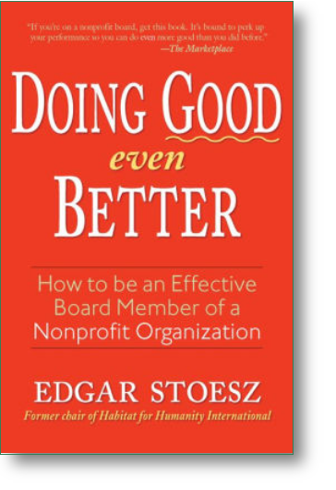
Roles
“Board Work is headwork; hands are optional.”
- E. Stoesz, Doing Good Even Better

Slide 7

Roles
CSBA Model Board Bylaw 9005
“Keep the district focused on learning and achievement for all students.”

Slide 8

Roles
“Whereas the board decides ends (outcomes), management is responsible for the means by which ends are achieved.”
- E. Stoesz, Doing Good Even Better

Slide 9
Roles
“There are important distinctions to be made between the board’s role and that of the superintendent and staff. The role of the School Board is not to run the schools, but to see that the schools are well run.”
- Governance Handbook Example

Slide 10
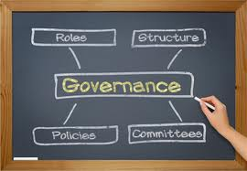
Roles
CSBA Model Board Bylaw 9005
“Understand the distinction between Board and staff roles, and refrain from performing management functions that are the responsibility of the Superintendent and staff.”

Slide 11
Roles
The Board determines policies that define the operations of the district:
  Hiring personnel
  Adopting curriculum
  Establishing budget priorities
  Directing collective bargaining
The Board hires the superintendent to implement its policies

Slide 12
Roles
Stepping out of one’s role and overlapping these responsibilities results in ineffective management.
A lack of understanding regarding the role and function of the board and superintendent results in confusion and misunderstanding among board members, superintendent, staff, and the community.

Slide 13
Roles
“Failure to make this distinction results in over burdening the board, while management is demoralized and uncertain about its role. Boards which are involved in operations at the expense of their governance function are an impediment and perpetually on the verge of exhaustion.”
- E. Stoesz, Doing Good Even Better

Slide 14
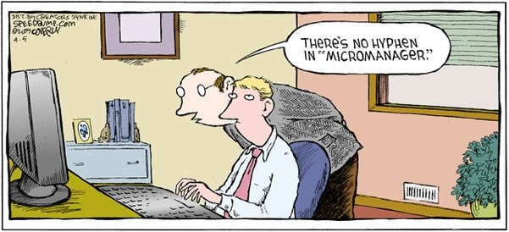
Roles
Your role as a Board member is to “see the big picture” and is not the day-to-day management of the district.

Slide 15
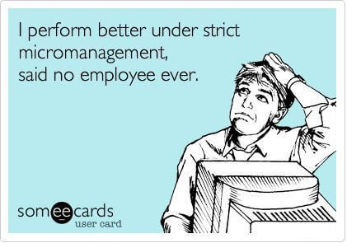
Roles
“When you want to manage an organization by paying extreme attention to small details, you have become a micromanager. In crossing that line into detailed management of the district, you have intruded rather rudely into the school administration’s job and thereby have become a terrible school board member.”
- R. Mayer, How Not to Be a Terrible School Board Member

Slide 16
Roles
“You were not elected to administer the district. You were elected to oversee the administration of the district. By staying on your side of the line between oversight and actual management, you can avoid becoming a terrible school board member.”
- R. Mayer, How Not to Be a Terrible School Board Member

Slide 17
Roles
The Superintendent’s Life
  If a Superintendent receives 2 email inquiries a day from each Board member, that is 10 inquiries a day, 50 inquiries a week, roughly 200 inquiries a month, and roughly 2,400 inquiries a year.
  When is the Superintendent going to do the rest of his/her work?

Slide 18
Board Role in Labor Negotiations
Notes:
18

Slide 19

Why do we negotiate?
The District is required to meet and negotiate with the exclusive representatives of employee bargaining units upon request with regard to matters within the scope of representation (Gov. Code § 3543.3)
Notes:
Space for bulleted text

Slide 20
Direct Dealing
“Direct dealing” between union and District during negotiations is prohibited
Also know as “end run bargaining”
Communication must flow through approved negotiators
Direct dealing can lead to unfair labor practice findings, with sanctions imposed.

Slide 21
What’s Negotiable?

Slide 22
Wages and Benefits
Salary schedule structure
COLA raises
Step increases
Basis for step placement
Extra duty stipends, i.e. yearbook adviser, coaching, committee work, mentoring, etc.
Pay for attendance at training sessions
Medical, dental, vision, and life insurance benefits
Retirement benefits above and beyond STRS
Reimbursement for job-related expenses
Parking fees
Use of personal vehicles for job-related matters
Note: unilaterally increasing wages or the level of benefits is a violation of the duty to bargain even though it benefits the employees.

Slide 23
Hours of Employment
Start and end times of work day
Start and end dates of work year
Number of work days per year
Distribution of workdays in a week
Holidays and vacations
Breaks and duty-free time
Shift schedules
Assignment of special duties
Teacher instructional hours
Extra hours assignments
School calendar as it applies to employee work schedules
Release time
Preparation time

Slide 24
“Other terms and Conditions of Employment”
Matters logically and reasonably related to hours, wages, or an enumerated term and condition of employment
Subjects of such concern to both management and employees that conflict is likely to occur and the mediatory influence of collective negotiations is the appropriate means of resolving the conflict
If obligation to negotiate would not significantly abridge freedom to exercise those managerial prerogatives, including matters of fundamental policy essential to the achievement of the employer’s mission

Slide 25
“Other Terms and Conditions of Employment”
Examples of Other Terms and Conditions of Employment
Impact of adding job duties not listed in job description or wages and hours
Transferring work out of the unit, whether transferred to another unit, private contractor, or management
Bidding procedures for bus routes
Length of class periods
Length of planning periods
Length of lunch period
Non-teaching duties assigned to teachers

Slide 26
Board Member Conduct & Liability
Notes:
26

Slide 27
The Basic Rule
When speaking as a Board member…speak as a Board member.
When speaking as an individual…speak as an individual.

Slide 28
Ask Yourself:
Am I authorized to say this?
Am I creating risk for the District if I say this?
Am I creating personal liability if I say this?

Slide 29
A Word on Social Media:
Who are you talking to?
What role are you in – Board or personal?

Slide 30
Board Member Liability
CSBA Model Board Bylaw 9260: “No Board member shall be liable for harm caused by his/her act or omission when acting within the scope of district responsibilities.”

Slide 31
Board Member Liability
District must generally defend and indemnify if Board member acted within scope of their authority
- Government Code §§ 825, 995.2

Slide 32
What is My Liability?
Statements made by Board members in conjunction with district proceedings are immune from tort liability so long as they are made within the course of official conduct.

Slide 33
What is My Liability?
Once statements are made outside of the Board member’s official capacity, immunity is lost, and the Board member is exposed to personal liability (defamation, etc.).

Slide 34
What is My Liability?
A public entity may “refuse to provide for the defense of a civil action or proceeding” if the public employee or official was not acting “within the scope of his or her employment.” (Gov. Code, § 995.2(a).)

Slide 35
Liability & Confidentiality
Board Members Are Responsible For Maintaining the Confidentiality Of Closed Session Discussions

Slide 36

Board Member Liability
It is a misdemeanor to disclose confidential District information for “pecuniary gain”
- Government Code § 1098

Slide 37
Board Member Liability
Disclosure of confidential information can result in censure of the disclosing Board member, civil action against the Board member for defamation or invasion of privacy, criminal action for willful omission of the performance of a required duty or for disclosure of confidential information for pecuniary gain, or removal from office. Additional remedies include: injunctive relief, discipline of employees, referring Board members to the grand jury. (Gov. Code, § 54963.)

Slide 38
Board Member Liability
In addition to criminal liability, there are many possible negative consequences of revealing information discussed in closed session:
If you discuss instructions given to your labor negotiators, it could impact negotiations and could be considered an indicia of bad faith bargaining.
If you reveal information discussed with your attorney, it could result in a waiver of the attorney-client privilege even as to matters that have not been publicly revealed.
If you reveal information regarding a personnel matter, you could be subject to a lawsuit for damages for invasion of privacy or defamation by the employee.

Slide 39
Board Member Liability
If you reveal any information regarding a student, you may be sued for violation of privacy rights under both federal and state laws and jeopardize federal funding.
If you discuss instructions given to your real property negotiators, it could result in your district having to pay more money for real property or receiving less money for property that the district is selling or leasing.

Slide 40
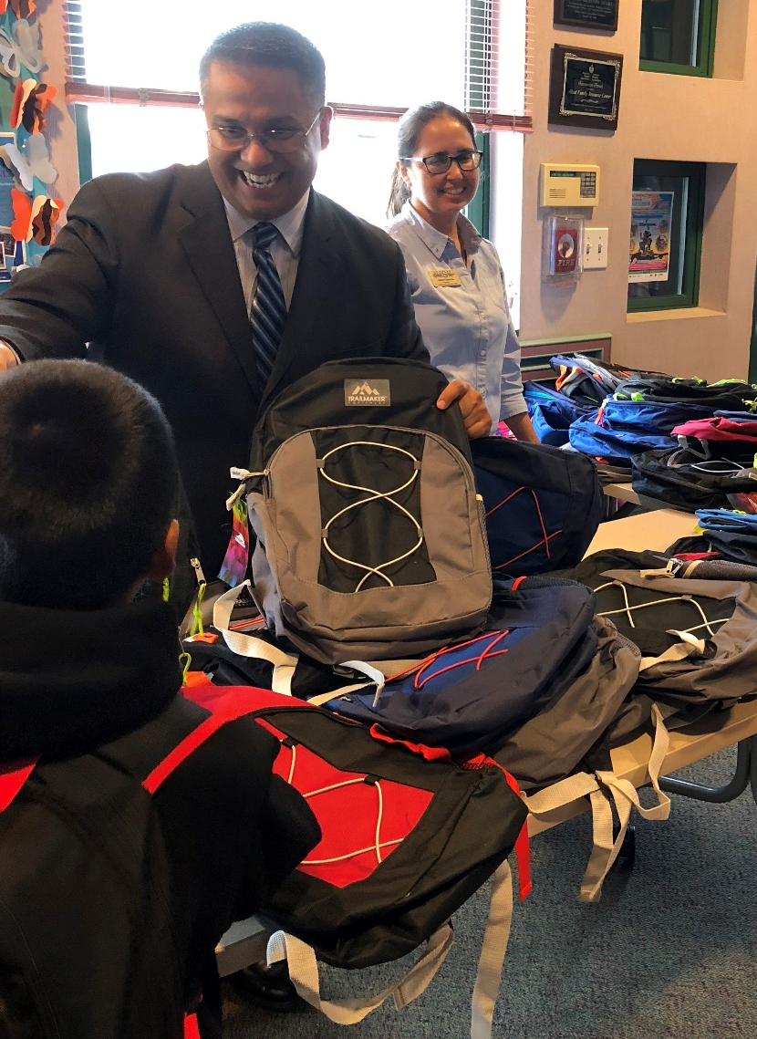
Thank you from Lozano Smith.
Together with you, we’re impacting communities and lives through:
Professional development
Volunteer projects
Sponsorships and award programs
Scholarships
#BlueHatProject
#LozanoSmithFoundation
Notes:
[PICTURE CAN BE SWITCHED OUT WITH OTHER APPROVED BLUE HAT ATTORNEY IMAGES.]

Slide 41
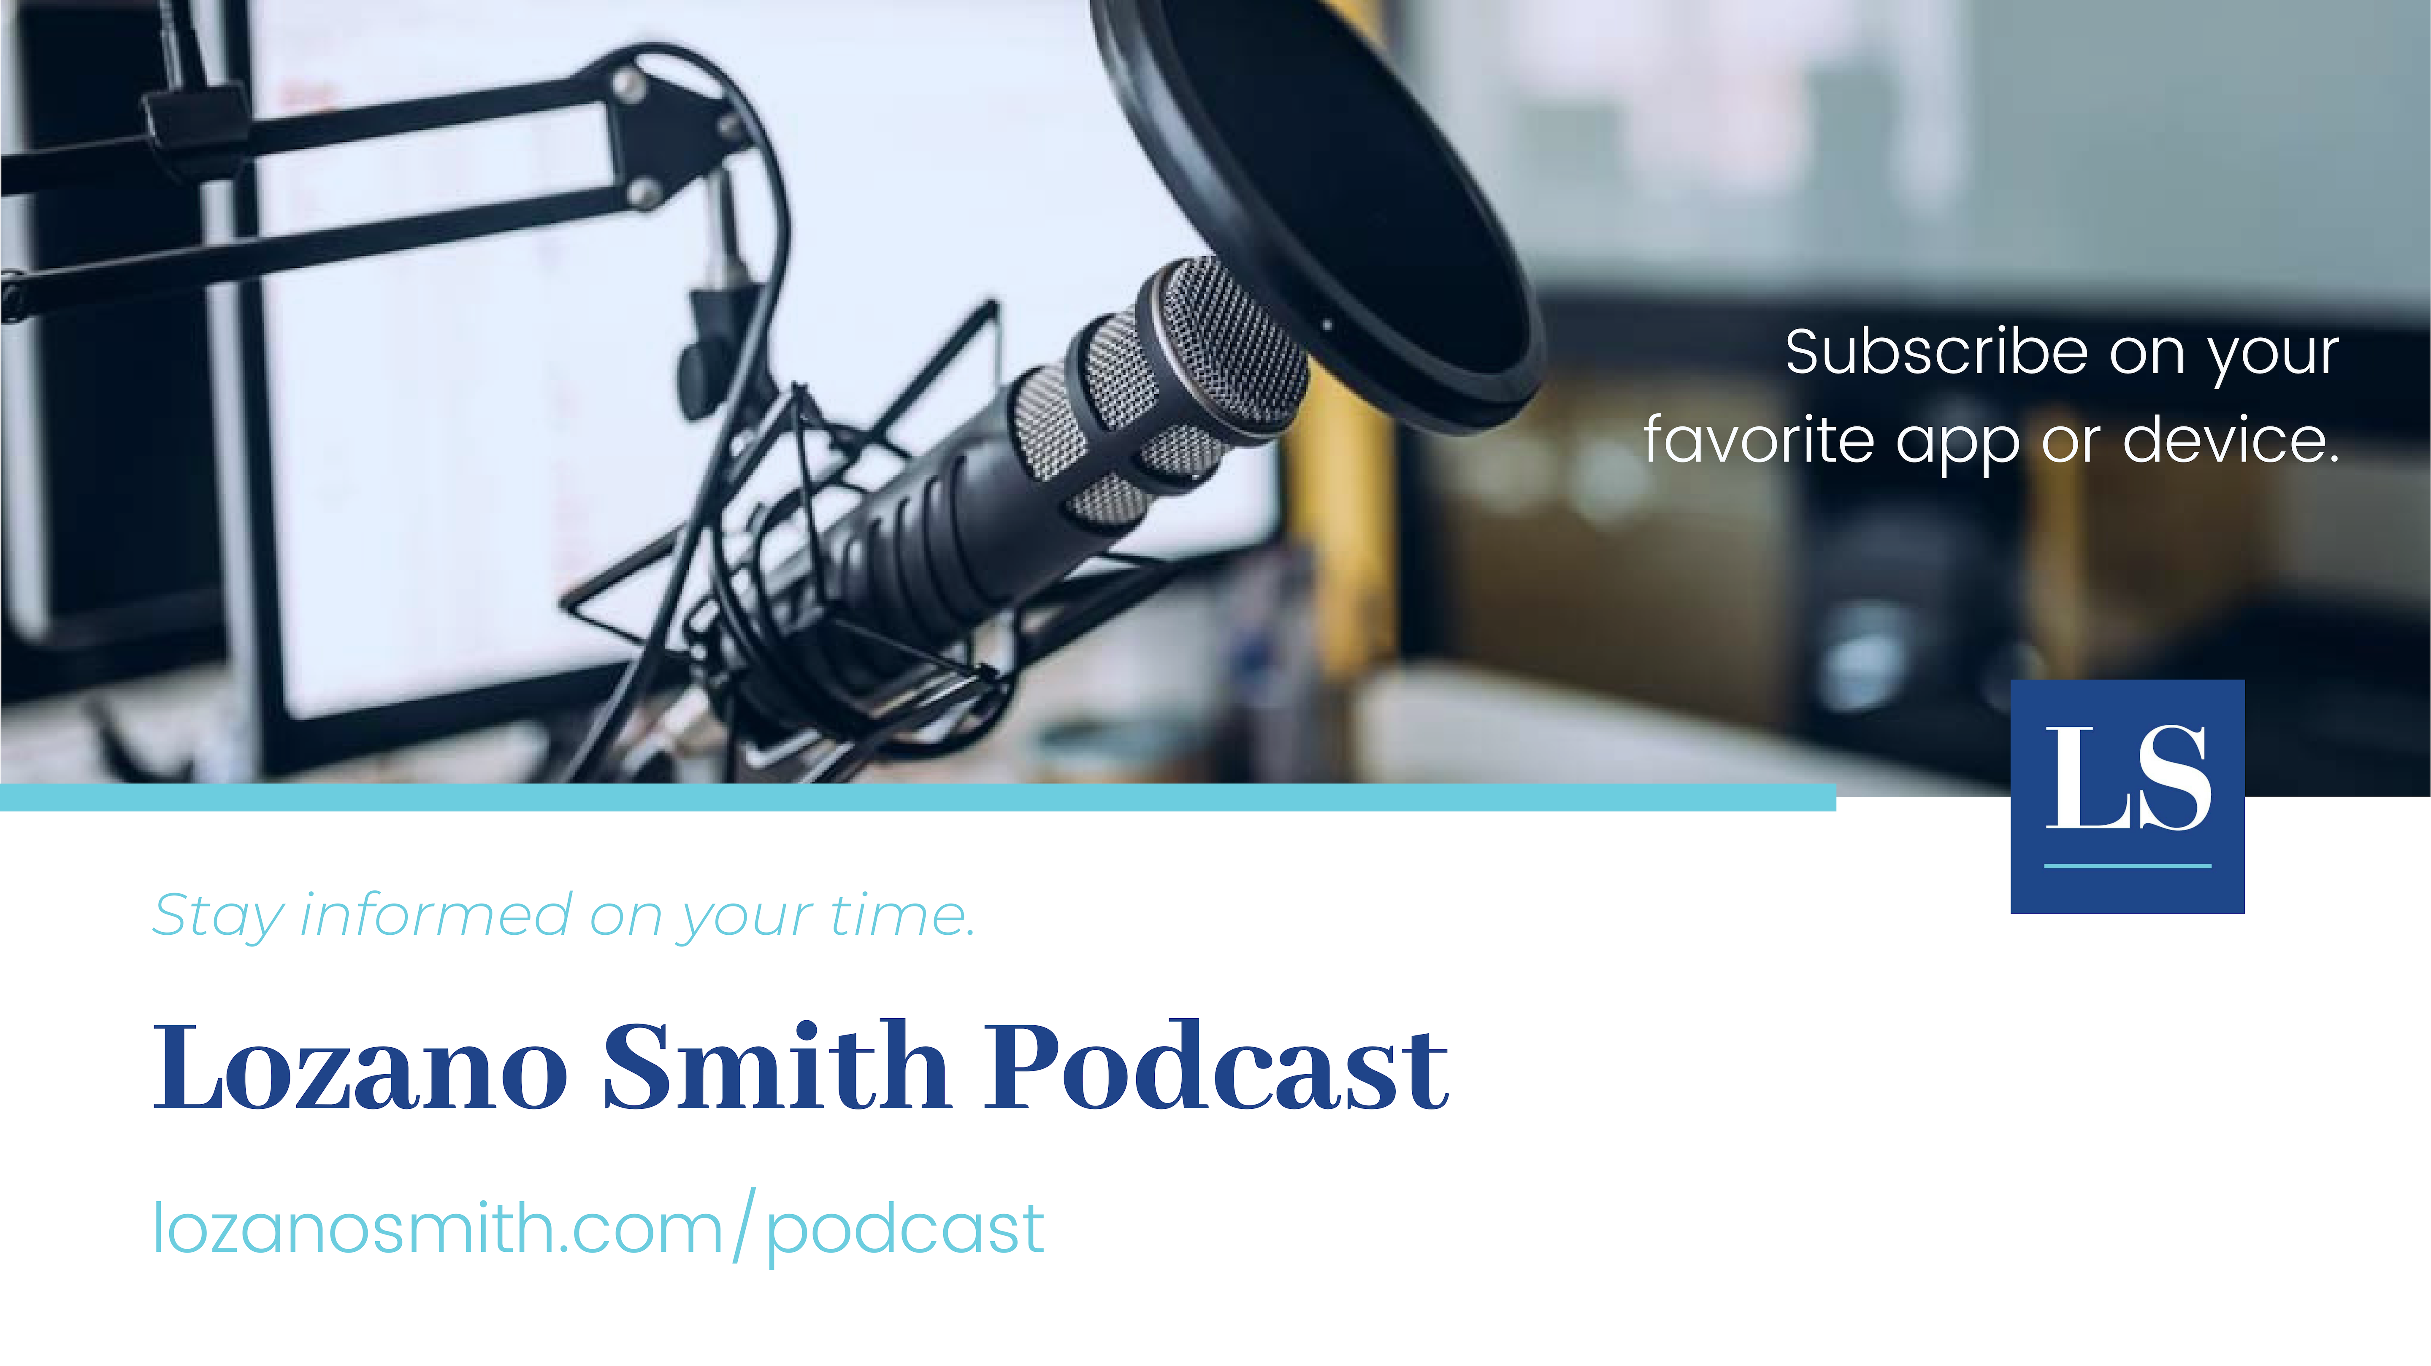

Slide 42

For more information, questions and comments about the presentation, please feel free to contact:
Harold M. Freiman
Partner
Tel: 925-953-1620
hfreiman@lozanosmith.com
Or any of the attorneys in one of our 8 offices.

Slide 43

@LozanoSmith
Disclaimer: These materials and all discussions of these materials are for instructional purposes only and do not constitute legal advice. If you need legal advice, you should contact your local counsel or an attorney at Lozano Smith. If you are interested in having other in-service programs presented, please contact clientservices@lozanosmith.com or call (559) 431-5600.
Copyright © 2022 Lozano Smith
All rights reserved. No portion of this work may be copied, distributed, sold or used for any commercial advantage or private gain, nor any derivative work prepared therefrom, nor shall any sub-license be granted, without the express prior written permission of Lozano Smith through its Managing Partner. The Managing Partner of Lozano Smith hereby grants permission to any client of Lozano Smith to whom Lozano Smith provides a copy to use such copy intact and solely for the internal purposes of such client. By accepting this product, recipient agrees it shall not use the work except consistent with the terms of this limited license.
SR489655.pptx

