Slide 1


Norwalk Public Schools
“FUTURE READY FOR ALL”
FY24-25 BUDGET RECONCILIATION
June 4, 2024

Slide 2

Down Memory Lane….June 2024
Notes:
Promise- Not coordinated……

Slide 3

Budget Development is Collaborative
Superintendent
Cabinet Members
Dept. Heads
School Leaders
Union Leaders
Elected Officials
City Staff
Parents/SGC

Slide 4
Mission
Norwalk Public Schools provides an excellent and equitable education, so ALL students graduate future ready as civically responsible, globally engaged and positive contributors to an ever-changing and diverse world.

Slide 5
Vision
Norwalk Public Schools is building
a more equitable and just world
where each and every Norwalk student is prepared for all aspects of life.

Slide 6
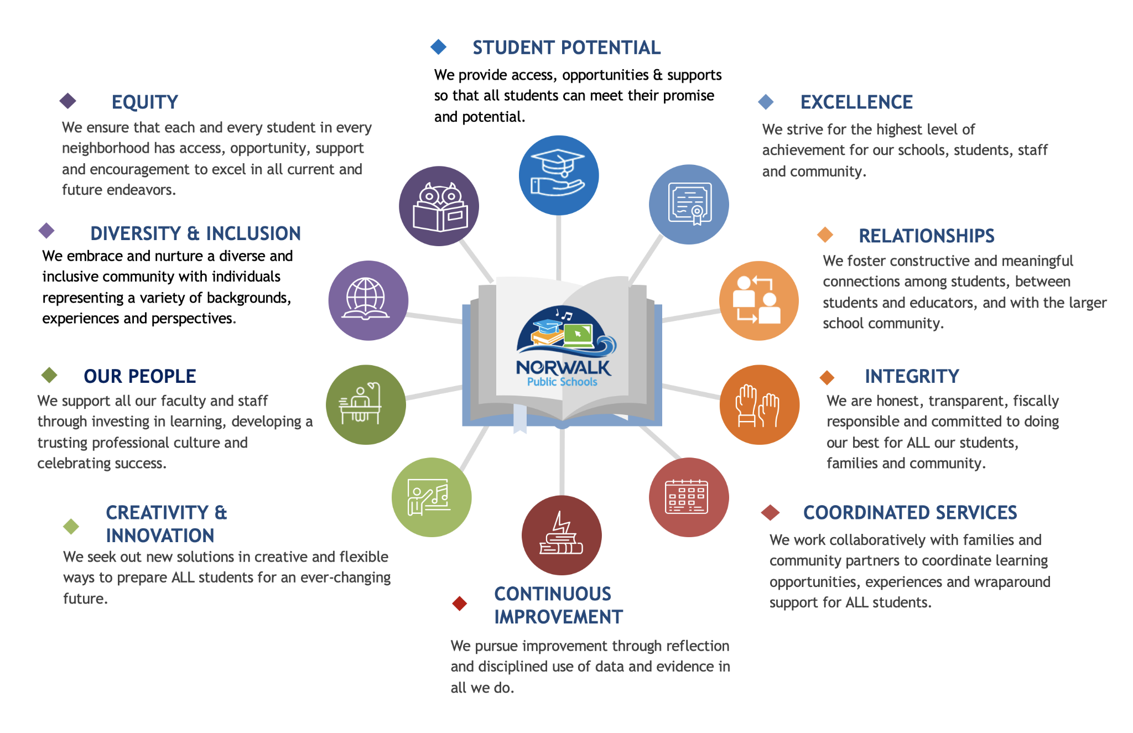
Values

Slide 7
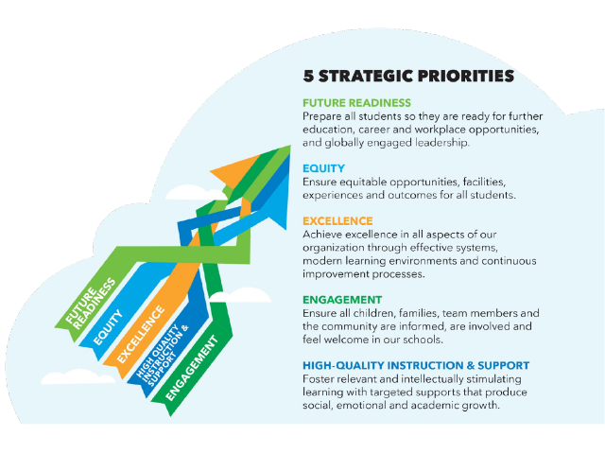

Slide 8
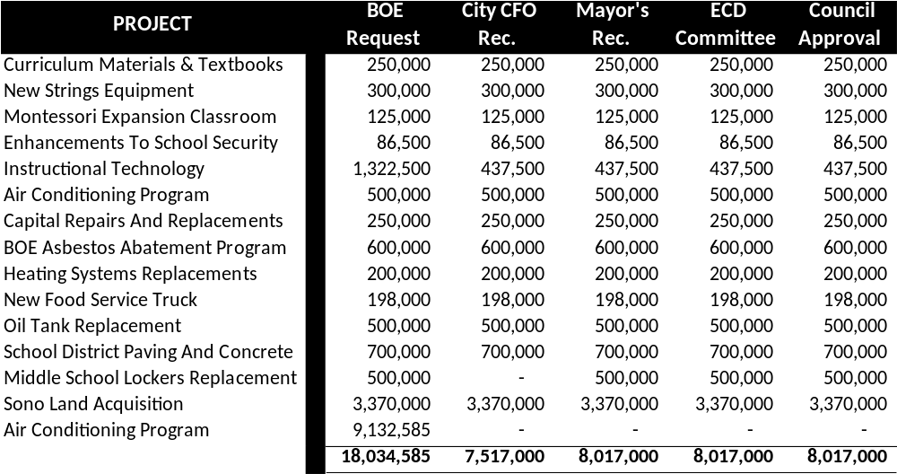
2024-20254 Approved Capital Budget

Slide 9
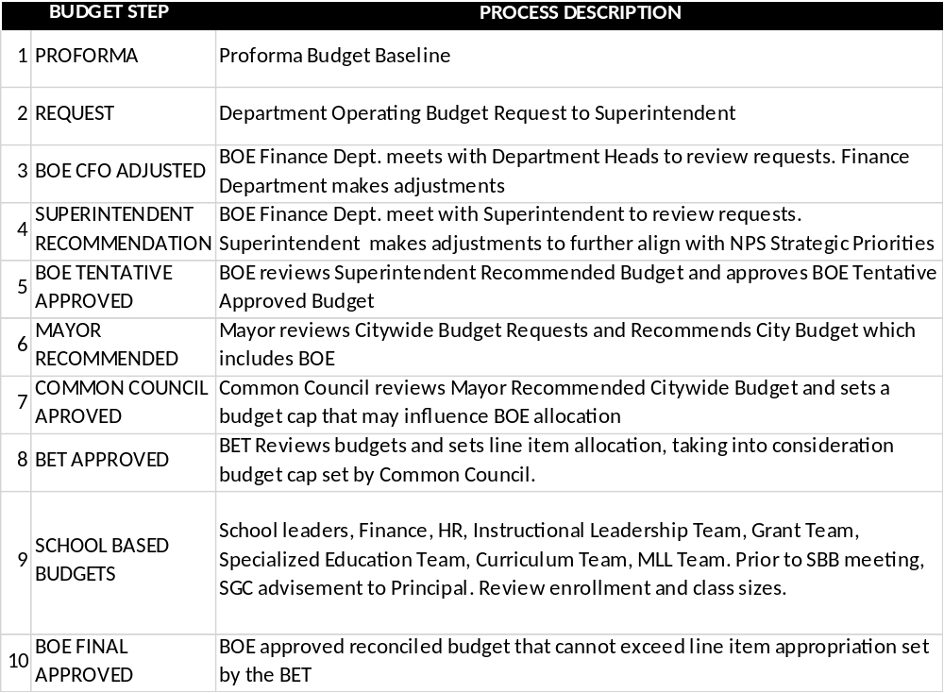
Budget Development Process

Slide 10
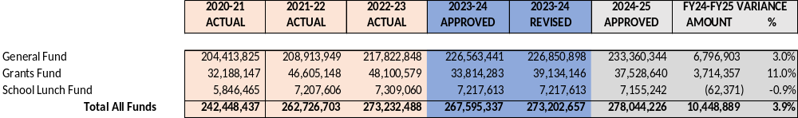
All Funds Summary
Notes:
A Wholistic View
Grants budgets include unexpended fund from prior year

Slide 11
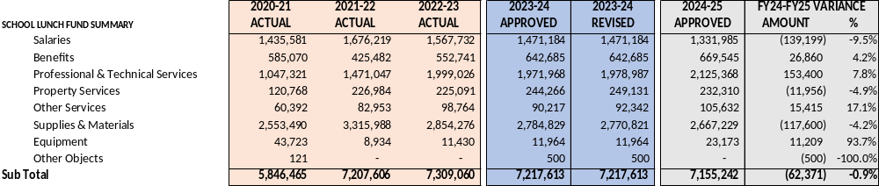
School Lunch Fund
Notes:
School Lunch Fund Represents 3% of the total of financial resources available to fund operating budget. The fund is intended to be self sustaining, however, we will discuss upcoming changes to the program.

Slide 12
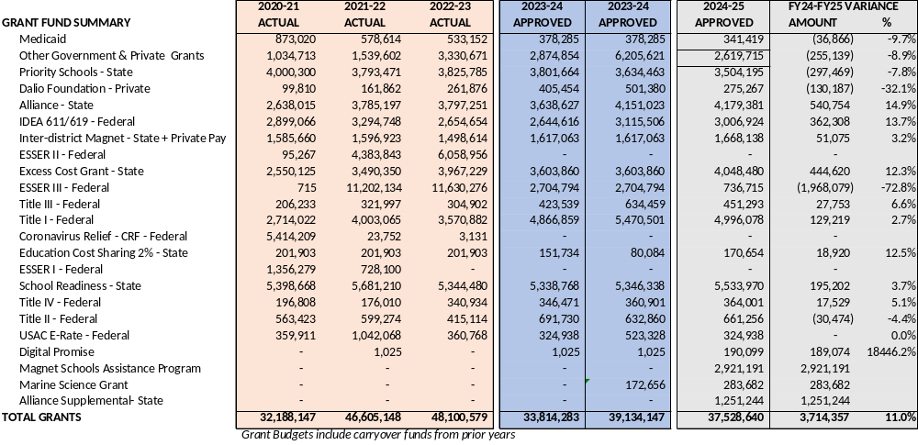
Grant Fund Budget Summary

Slide 13
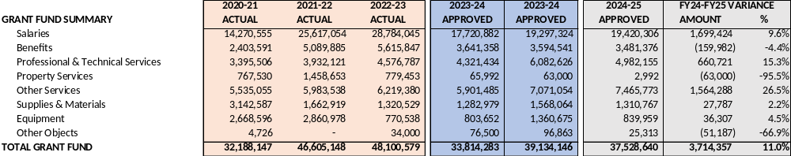
Grant Fund Budget Summary

Slide 14
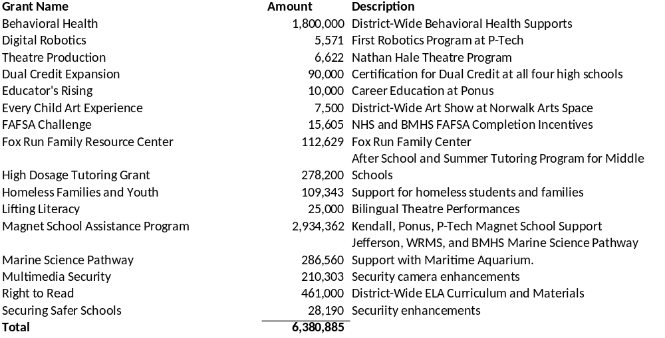
Competitive Grants 2023-24

Slide 15
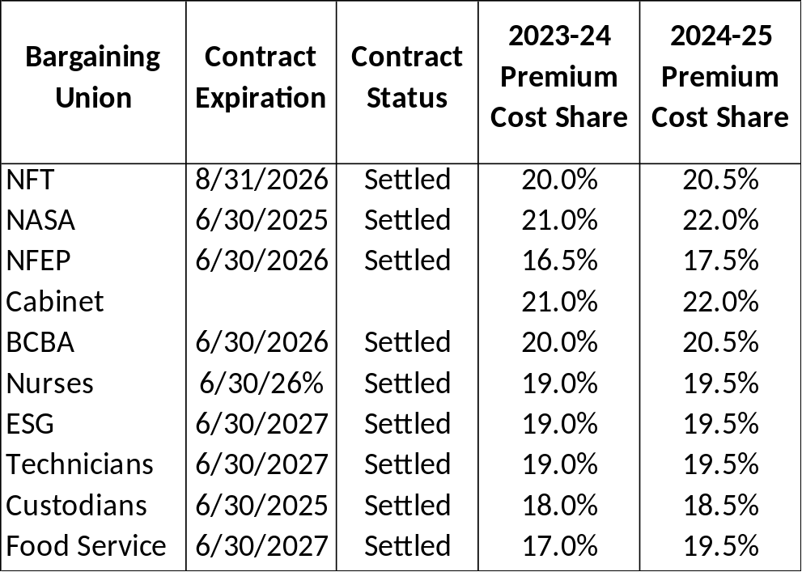
Employee Health Insurance
FY2025 RENEWAL RATES
CIGNA 15%
STATE PLAN 2%

Slide 16
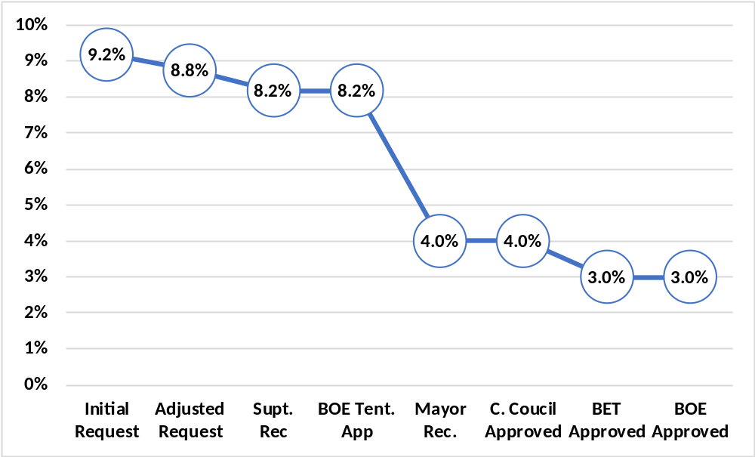
2024-25 Budget Development Process

Slide 17
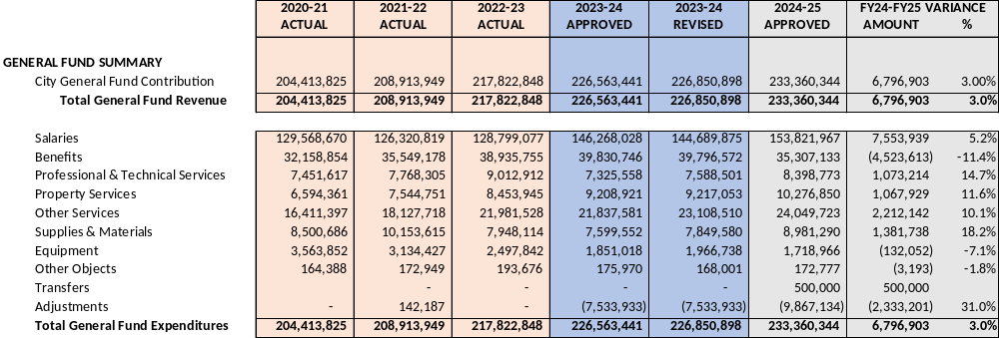
General Fund Budget Summary
Notes:
General Fund Represents 85% (increased from 78% during ESSER)of the total of financial resources available to fund operating budget
Positions funded by ESSER absorbed into local budget
Maintain services, going into FY24 with fewer staff – to be discussed)
Salaries & Benefits are the largest expense items

Slide 18
2024-25 General Fund Budget Summary

Slide 19
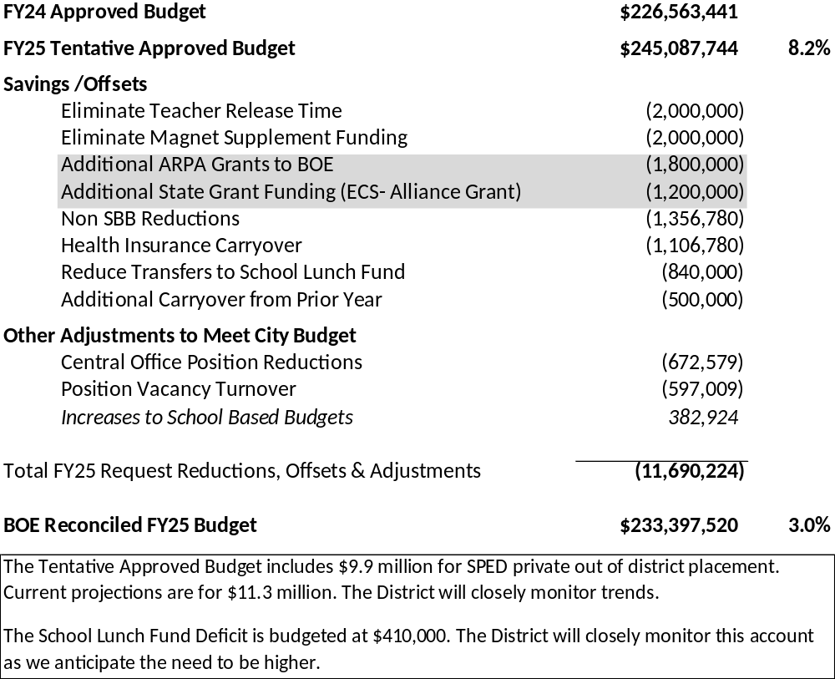
2024-25 Budget Reconciliation

Slide 20
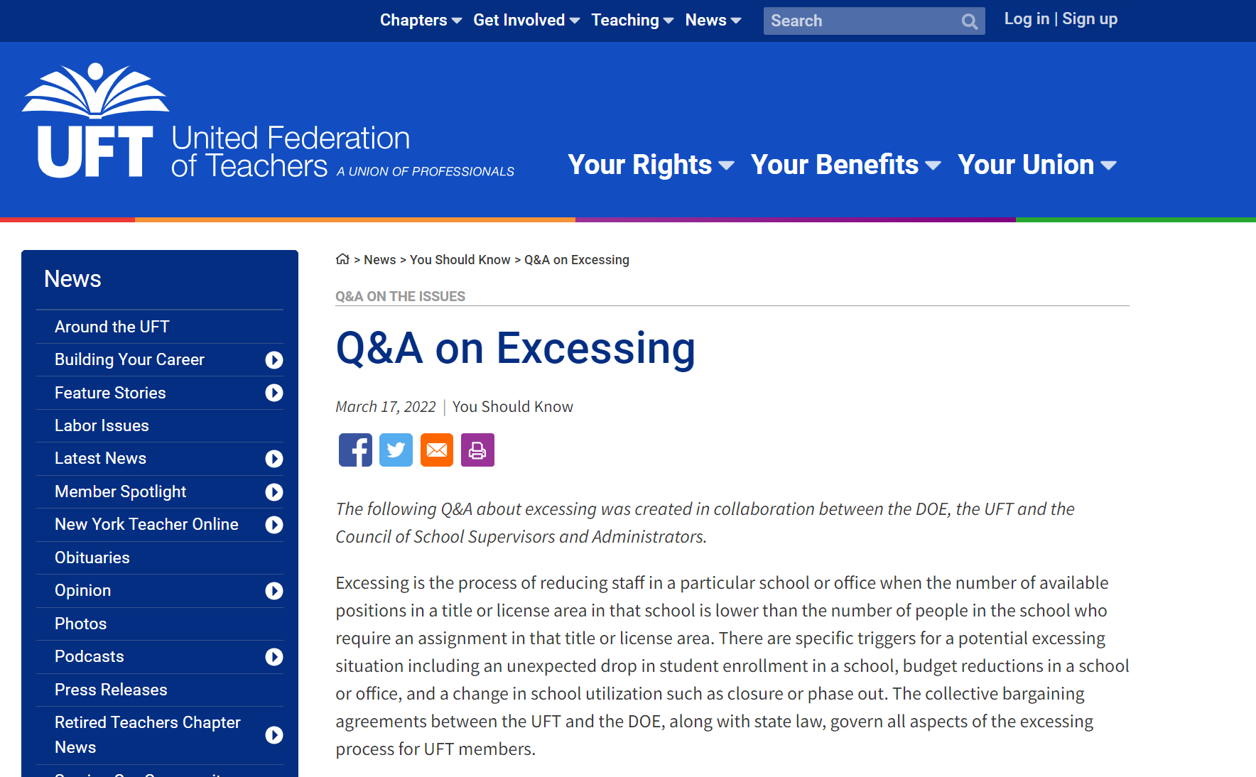

Slide 21
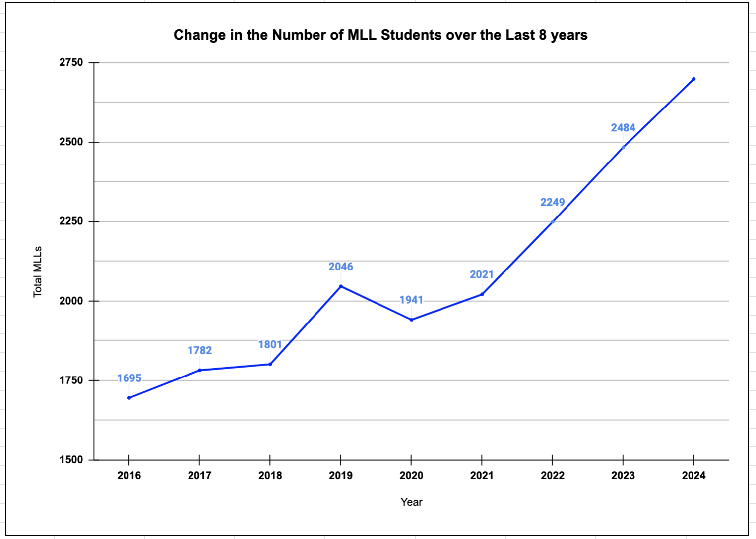
MLL Increase
6/3/24
2699
MLL Increase 2023-2024 School Year
September 1, 2023 | 2,202
June 1, 2024 | 2,699
Total Increase | +497
NPS Population | MLL Scholars | MLL Percent
11955 | 2699 | 23%

Slide 22
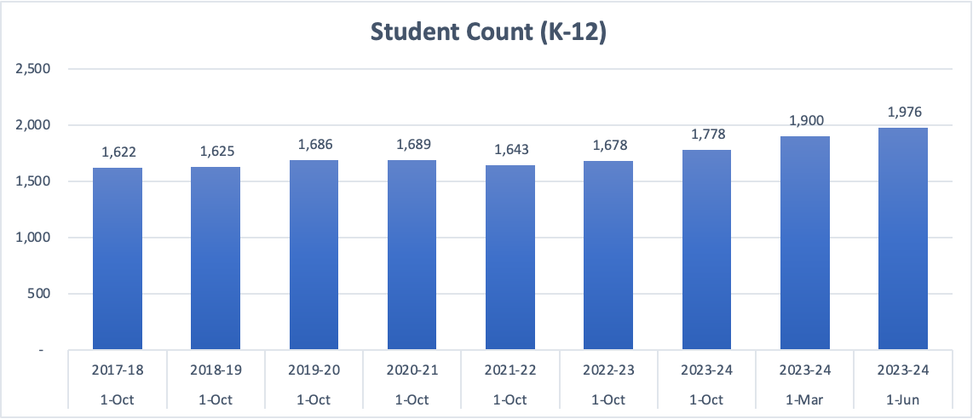
SPED Programs
LEAP Classroom - Kendall College and Career Academy
Teacher
4 RBTs (Registered Behavior Technicians)
6th Grade Specialized Program - Nathan Hale
Teacher

Slide 23
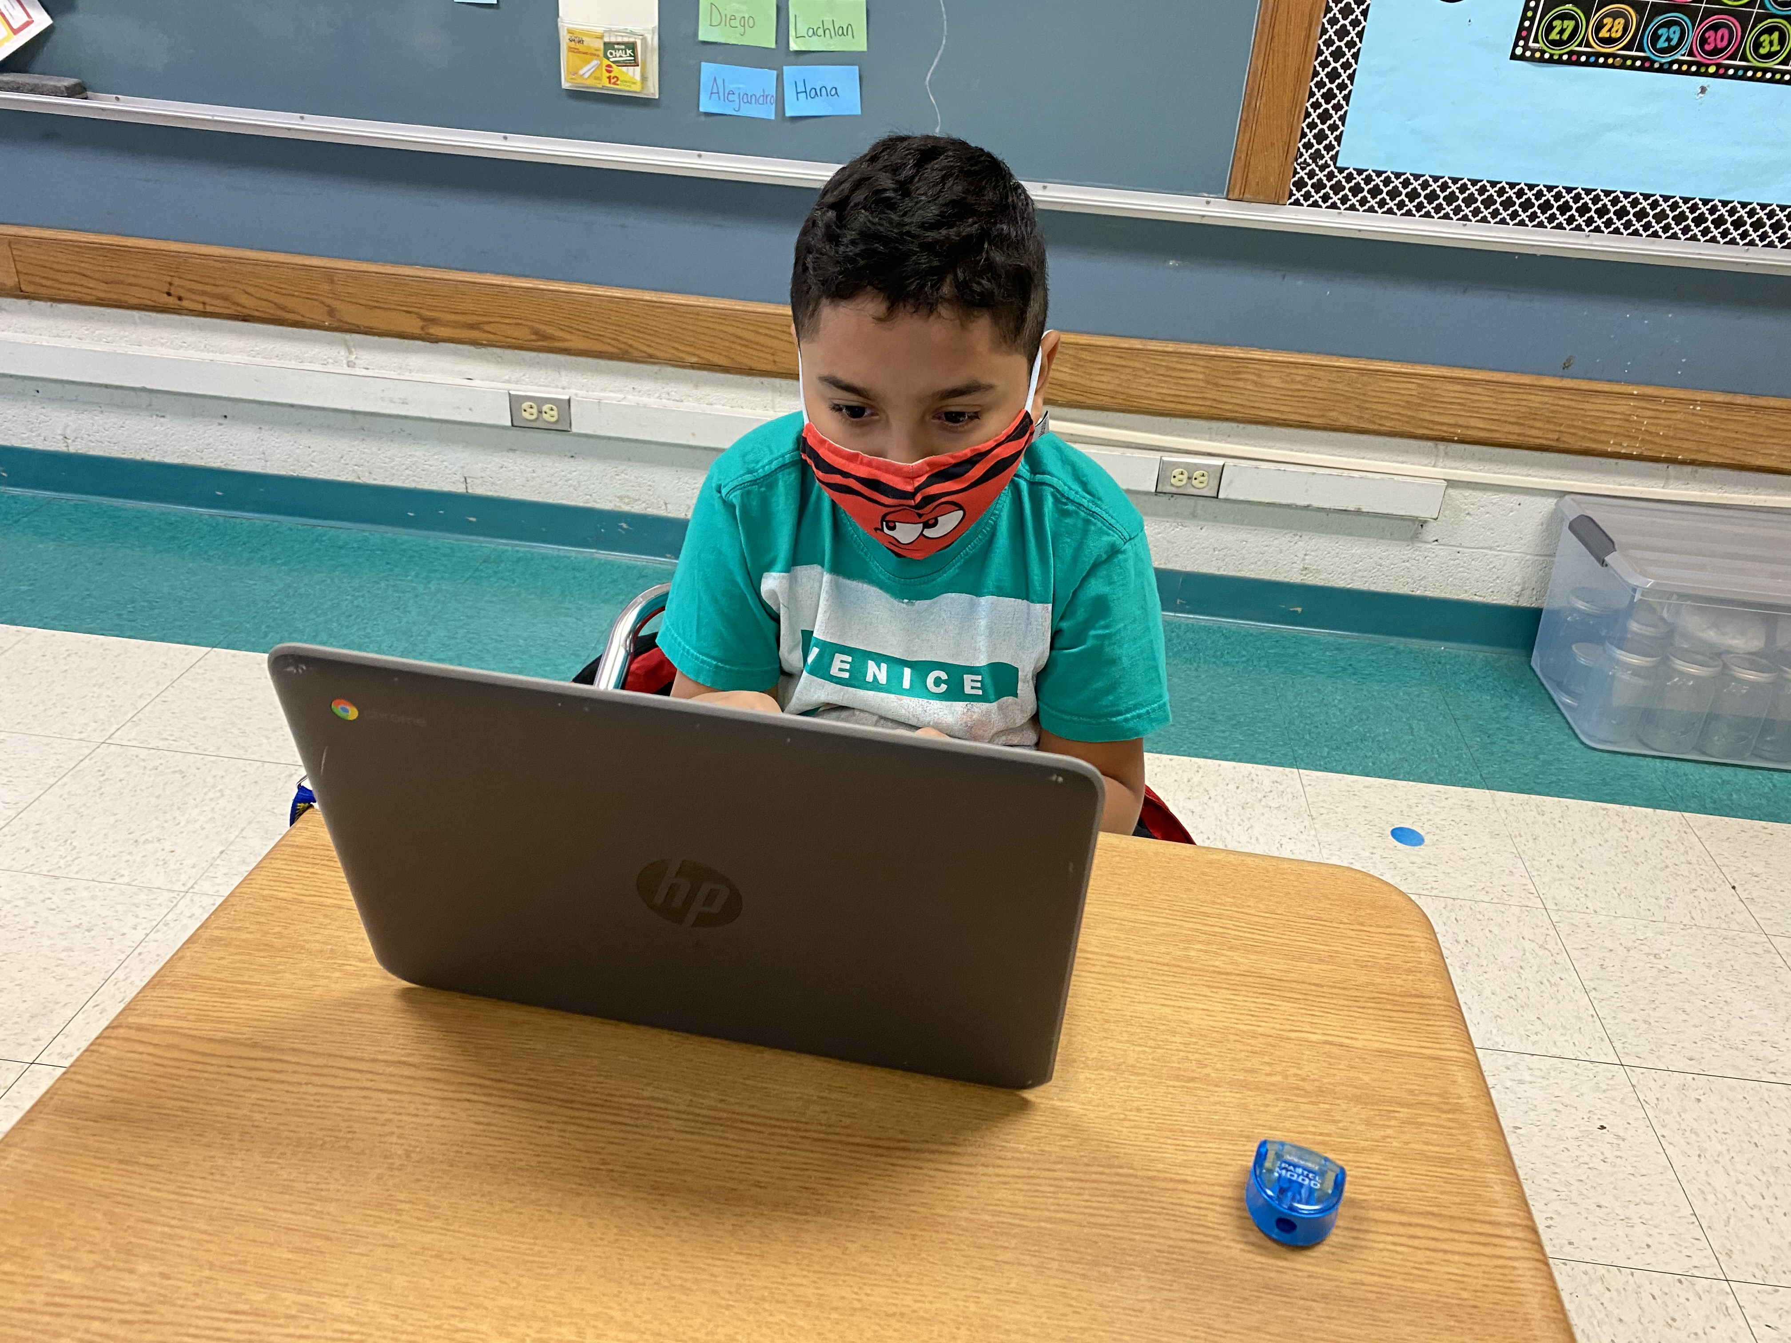
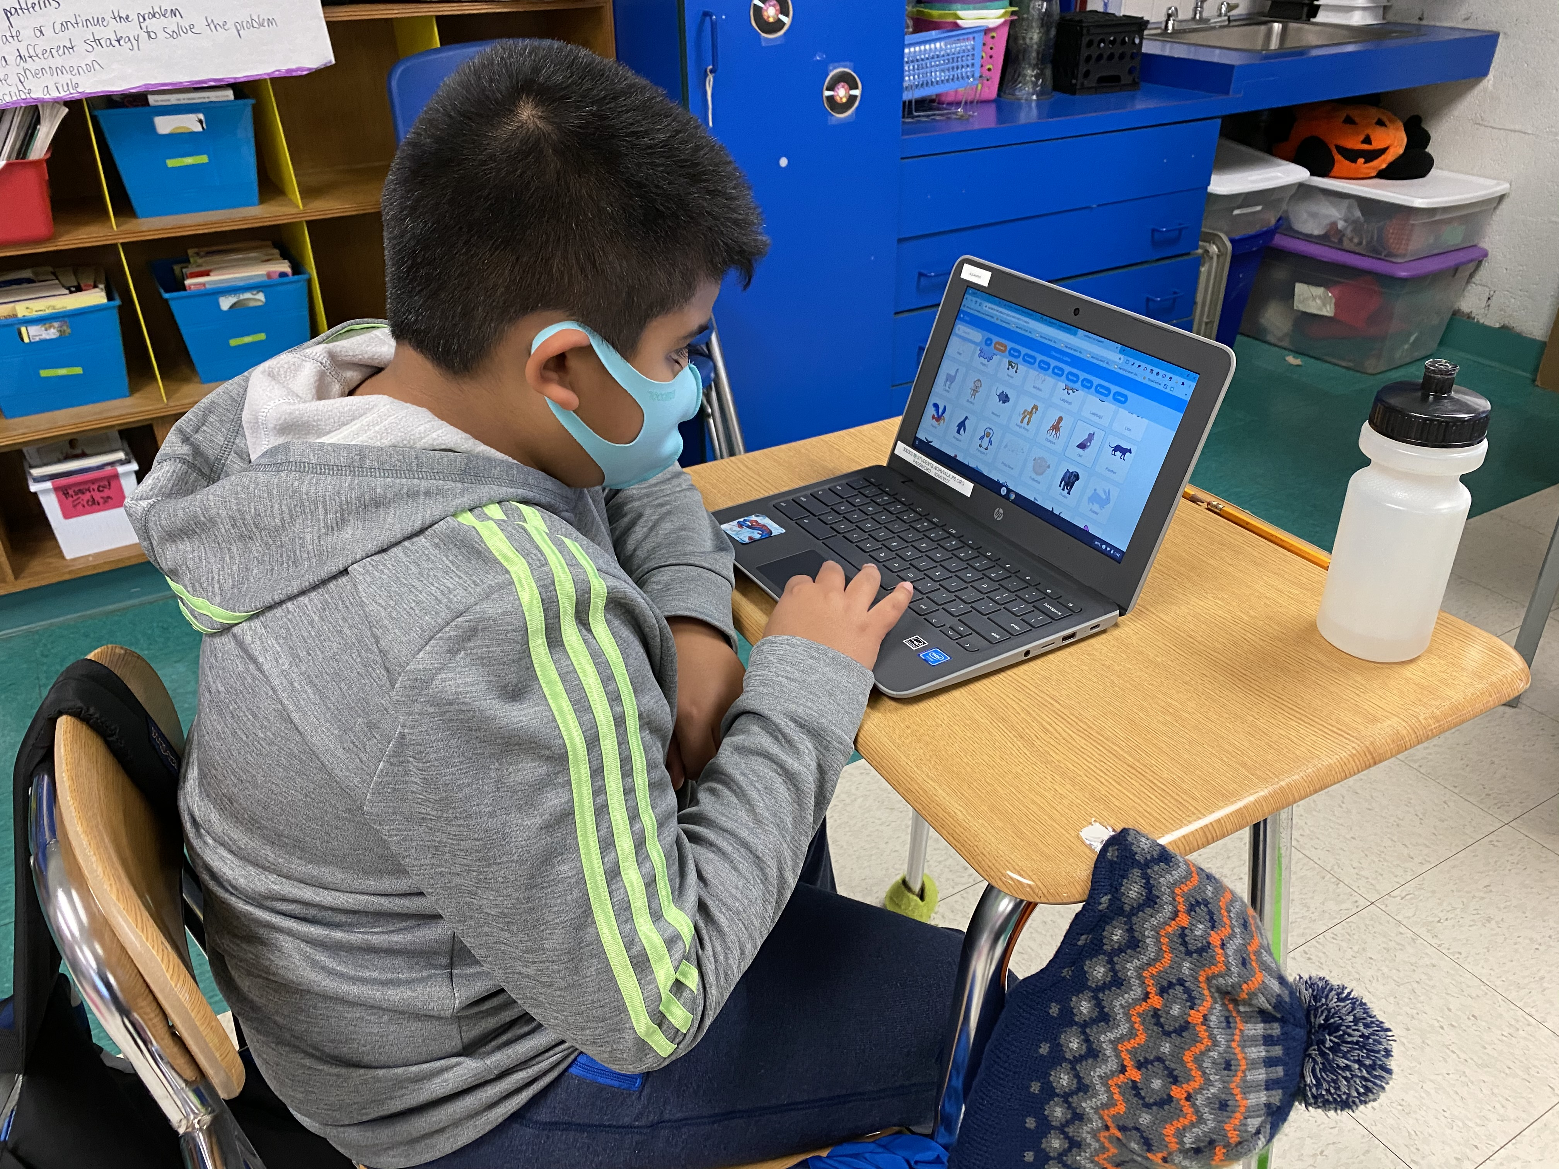
2024-2025 SBB Recap by Level
Elementary School Level:
  All schools have maintained % of the Assistant Principal of Instruction (API) FTE within the local budget with the remainder of the FTE funded in the Alliance grant
  Adhered to # of sections required to stay within class size guidelines per the contract
  All schools have maintained a Math and Reading/Writing Improvement teacher
  All schools have maintained a Math and Literacy Coach
  All schools have maintained a school counselor
  1 LEAP classroom has been added for 2024-25
Middle School Level:
  All schools have maintained a Math and Reading/Writing Improvement teacher
  All schools have maintained a Math and Literacy Coach
  All schools have maintained school counselors and, in the secondary schools the numbers of counselors are accordance with the (ASCA) American School Counselors Association’s ratio of 1 school counselor to a maximum of 250 students
  All schools have maintained a $40k for after school sports and other related after school programming; Concorde has added $20k for after school programming for 6th, 7th and 8th grade students

Slide 24
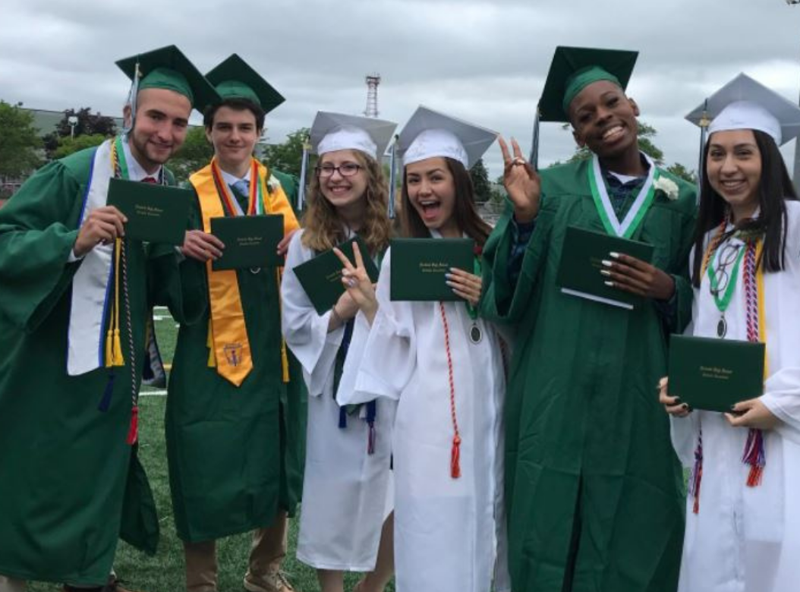
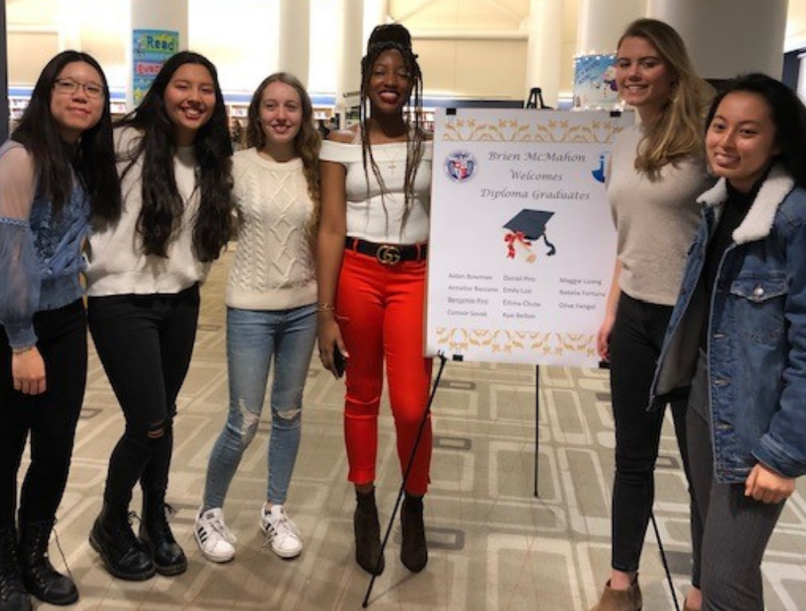
2024-2025 SBB Recap by Level
High School Level:
  Allocation of department select expenditures & staff at PTECH & CGS as well as NHS & PTECH
  Classes aligned with the Program of Study and require a 15-student minimum where appropriate
  All schools have maintained school counselors and, in the secondary schools the numbers of counselors are accordance with the (ASCA) American School Counselors Association’s ratio of 1 school counselor to a maximum of 250 students
All Levels:
  Reserve 0.5% of budget for elementary and middle schools and 1% for high schools (excluding magnet) to address enrollment fluctuations vs. projections
  Benefit allocation aligned with staffing coding in order to present a “true costing”
  Workbook allocations for Math & Science $43 per pupil and ELA $21 per pupil
  Technology supplies elementary $10 per pupil and secondary $15 per pupil
  No internal magnet allocations will be provided during the 2024-25 school year due to budget constraints
  Resource programs utilized at the elementary and middle schools include ICT co-taught classrooms, Success program, LEAP, STARS and the Literacy Academy

Slide 25
SBB Staffing Highlights
2024-25
Multi-Lingual Learner (MLL) teachers and bilingual paraeducators remain within the SBBs
Programmatic special education expenditures only will be shifted from district wide services budget to school-based budgets
All schools have maintained school counselors and, in the secondary schools the numbers of counselors are accordance with the (ASCA) American School Counselors Association’s ratio of 1 school counselor to a maximum of 250 students
Library Media Specialists maintained at elementary level where applicable
At least one Reading/Writing and Math Improvement Teacher at every school
All schools have maintained a Math and Literacy Coach
Added Assistant Principal at SONO ES
Dean of Students role is currently under contractual review within the NASA BU

Slide 26
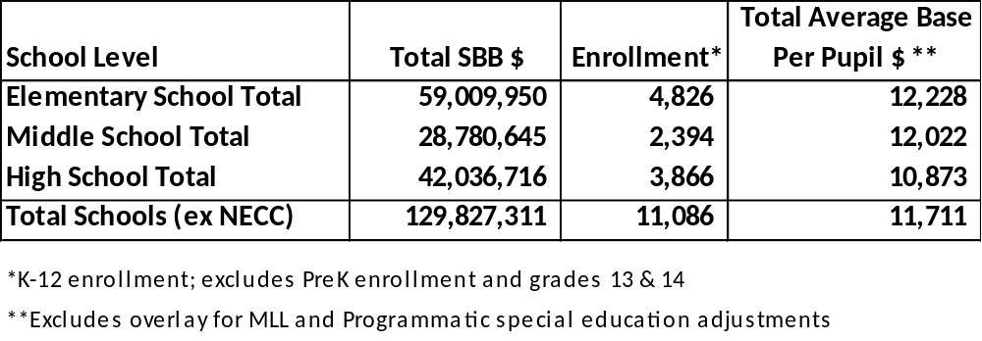
2024-25 Base Average Per Pupil Spending
By Level

