Slide 1
Live Binder Training
Jennifer Henig, San Benito County SELPA Program Specialist

Slide 2

Introduction
What is LiveBinder
Access to LiveBinder
SELPA Local Plan

Slide 3
LiveBinder
LiveBinder is an online handbook that is specific to San Bento County SELPA. It is an integration of state and federal requirements and gives information, policies and procedures on a number of topics including: Additional Adult Assistance, Transportation, ERMHS and Educational Benefit.
It’s valuable for guidance, training and terminology.

Slide 4

Let’s Take a Look

Slide 5
LiveBinder
Access
Casemanagers
Administrators
12345
Adult Assistance
ERMHS
SIRAS
IEP Development
Timelines
eligibility
Discipline
Educational Benefit
Manifest determination
IEE
Records
Low incidence
Can be downloaded
Can be printed

Slide 6
SELPA Local Plan
The SELPA Local Plan is online resource that is specific to the San Bento County SELPA. It is an integration of state and federal requirements and gives information, policies and procedures on several topics including Child Find, Assessments, Least Restrictive Environment and Compliance
It’s valuable for guidance, training and terminology for Districts and parents.

Slide 7

Let’s Take a Look

Slide 8
SELPA Local Plan
Access
Parents
Administrators/
Superintendents
12345
Suspension/expulsion
Private schools
Least Restrictive Environment
CAC
Charter School
Governing council
Annual Budget Plan
Admin Regs
Personnel Qualifications
Can be downloaded
Can be printed

Slide 9
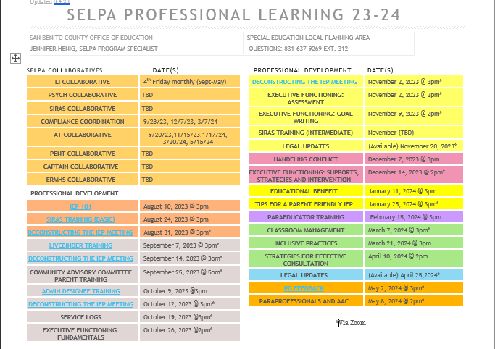

Slide 10

Previous Recorded Trainings

Slide 11
Questions?

Slide 12
Thank you
Mirjam Nilsson​
206-555-0146
mirjam@contoso.com
www.contoso.com

