Slide 1


Community Advisory Committee Guidelines
San Benito County SELPA
San Benito County Special Education Local Plan Area
Chris Lompa, SELPA Director

Slide 2

Agenda
Purpose of the CAC
CAC Membership
Responsibilities of the CAC
Benefits of the CAC
Responsibilities of the SELPA
The SELPA Local Plan for Special Education

Slide 3

Purpose of the CAC

Slide 4
CACs are at the Heart of the
Special Education System in California
California Education Code §56194
Under legislative mandate,
CACs provide the vehicle for active community involvement in:
Input and review of the SELPA Local Plan for Special Education
Parent education
Bringing about positive changes in the educational system at both the local and state levels
The CAC is a vital component of effective
special education programs and services in the SELPA.

Slide 5
Why Do We Have a CAC?
California Education Code §56190
Per the California Education Code, every SELPA is required to establish a Community Advisory Committee.
The IDEA articulates the legislative intent to involve parents of students with disabilities in the planning, development, and implementation of their students’ special education programs.
Assists in advising the SELPA and the Governing Council about the SELPA Local Plan, annual priorities, parent education and other specified special education-related activities.

Slide 6
Legislative Mandate for CACs
California Education Code §56190-56194
The Community Advisory Committee (CAC) is designed in legislative spirit and intent to establish a local forum for active parent involvement. The California Education Code describes the role and responsibilities of the CAC.
Mandated by state and federal laws and regulations that address parent involvement in special education.
Representatives are appointed by and functions in an advisory capacity to the Governing Council.

Slide 7

CAC Membership

Slide 8
CAC Membership Shall be Composed of:
California Education Code §56192-56193
Parents of students with disabilities enrolled in public or private schools
Parents of other students enrolled in school
At least the majority of the CAC shall be composed of parents of students enrolled in schools participating in the SELPA, and at least a majority of such parents shall be parents of students with disabilities

Slide 9
With the Approval of the Governing Council, CAC Membership May Also be Composed of:
California Education Code §56192
Students with disabilities
Adults with disabilities
General education teachers
Special education teachers & other school personnel
Representatives of other public and non-profit agencies
Persons concerned with the needs of individuals with disabilities

Slide 10
CAC Members
Collaborative, Informed, Involved
Designed to be a dynamic collaborative partnership of educators, parents, and community members.
The mandated membership exemplifies the need for informed involvement among those who provide special education programs & services and those who receive special education programs & services
Members should constitute a well-rounded membership that has a sound understanding of special education laws, issues, programs, and services. This understanding serves as the foundation upon which the CAC shares information and advice with the SELPA, as well as with the greater community

Slide 11
CAC Members
Represent the Entire Special Education Community
Members are appointed and approved by their local governing board (California Education Code §56191)
Members must act responsibly to ensure fair representation and a thorough evaluation of the issues and interests handled in the attainment of the goals of the CAC.

Slide 12
Who May Attend a CAC Meeting?
CAC meetings are open meetings;
anyone who is interested may attend the meetings.
CAC meetings provide parents and community members with…
Up-to-date information on issues that impact students with disabilities
The opportunity to communicate with administrators and school staff
The chance to connect with other parents and community members who are interested in quality educational programs and services for students with disabilities

Slide 13
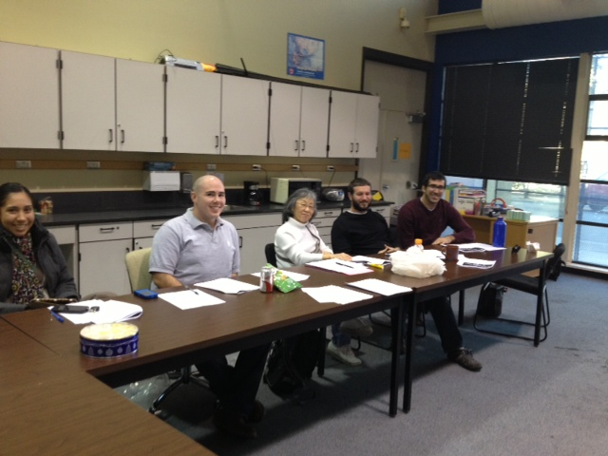
Responsibilities of the CAC

Slide 14
The CAC has Specific & Important Responsibilities
California Education Code §56194
Providing input and review to the SELPA and Governing Council regarding the development, amendment and review of the SELPA Local Plan
Recommending annual priorities to be addressed by the SELPA
Assisting in parent education & recruiting parents & other volunteers who may contribute to the implementation of the Plan
Supporting activities on behalf of individuals with disabilities
Assisting in parent awareness of the importance of regular school attendance

Slide 15
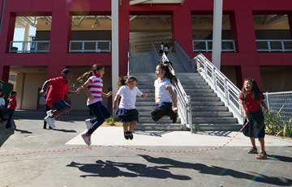
Benefits of the CAC

Slide 16
The CAC Benefits
Parents, Educators & the Community
Serves as a resource for information and ideas related to special education for families and community members.
Provides community support to administrators, the SELPA Governing Council.
Networking promotes parent participation in the special education process and collaboration between the LEAs , parent organizations, and the community agencies.

Slide 17

Responsibilities of the SELPA

Slide 18
Responsibilities of the SELPA
Provide a continuum of program & services availability for all students with disabilities
A resource for professional development
MIS monitoring and compliance support to LEAs
Coordinate regionalized services and program specialist’s activities
Interagency coordination and development of Interagency Agreements
Alternative Dispute Resolution (ADR)
Parent Education and involvement
Community awareness of programs for students with disabilities

Slide 19
San Benito County SELPA
Special Education Directors
Anthony Miranda, Director of Special Ed. Aromas-San Juan Unified School District
2300 San Juan Highway
San Juan Bautista, CA 95023
Email: amiranda@asjusd.k12.ca.us
Paulette Cobb, Special Education Director San Benito High School District
1220 Monterey Street
Hollister, CA 95023
Email: pcobb@sbhsd.k12.ca.us
Gwen Baquiran, Special Education Director
Hollister Elementary School District
2690 Cienega Road
Hollister, CA 95023
Email: gbaquiran@hesd.org
Bill Sachau, Special Education Director San Benito County Office of Education - Regional Special Education Learning Center
1011 Line Street, Suite 12
Hollister, CA 95923
Email: bsachau@sbcoe.org
(Rural Schools, Alternative Education Programs, Infant and Preschool Programs, and Low Incidence)
Kristi Vieyra, Special Education Director
North County Joint Union School District
500 Spring Grove Road
Hollister, CA 95023
Email: kvieyra@ncjusd.k12.ca.us

Slide 20
San Benito County SELPA
San Benito County Special Education Local Plan Area
Chris Lompa, SELPA Director
E-mail: clompa @sbcoe.k12.ca.us
831-637-9269 x 313
Adina Austin, ERMHS Program Coordinator
E-mail:aaustin@sbcoe.k12.ca.us
831-637-9269 x 311
Jennifer Henig, Program Specialist
E-mail:jhenig@sbcoe.k12.ca.us
831-637-9269 x 312

