Slide 1

Succeeding and Achieving, Developing Unique Personal, Sustainable Learning Strategies with Christ as a model of patience, strength, and service

Slide 2
ACCOMMODATIONS PLAN
Proofing and Approving
Read through the accommodations plan
Sign the release and return plan and release
QUESTIONS?
Request a phone meeting to discuss the plan if you have questions.
Notes:
Student Support

Slide 3


Welcome to
Foundations
Feathering the nest is best to start the year off comfortably, calmly, and with encouraged competence.
To complete orientation you will want to...
Strong Faith, Spirit Guided, High Expectations, Renewed Hope

Slide 4
Attend the Foundations new student orientation and view the slides.
Review the your student’s accommodations plan and approve it by signing the release and returning the accommodations plan. (This allows teachers and professionals to provide access to accommodations and to share information to assist your student.You will receive the finalized copy through your student.)
Taking Achieving Mastery? Sign the equipment release agreement for your student’s on loan headset set. (The headset is required for all students taking the Achieving Mastery class.)
Understand Parental Particulars - Knowledge and tips to support your Cardinal.

Slide 5
Agenda
Program Functioning
Supporting your new Cardinal
Building habits for success:
Strategies and Accommodations
- Communicating concerns
Questions

Slide 6
FOUNDATIONS at Bishop John J. Snyder High School provides skills that encourage....
Top Researched Skills Needed for College Survival
Through knowledge of “who they are” and “how they learn”, learning difficulties included !
Strong decision making skills; knowing and accessing resources
Strong self –advocates
Strong social communication skills
Strong organizational skills
Strong study skills
NOTE: The drop - out rate is much higher for students without these skills.

Slide 7

What does being part of FOUNDATIONS mean?
A time to……
Organize and commit with the Trinity by our side
Learn one’s “Unique Learning Style”
Capitalize on neuroscience and understanding
of how the brain learns- “What fires wires”
Make changes and gains- new strategies and skills
Transference- strategies and skills across the
curriculum independence and determination

Slide 8
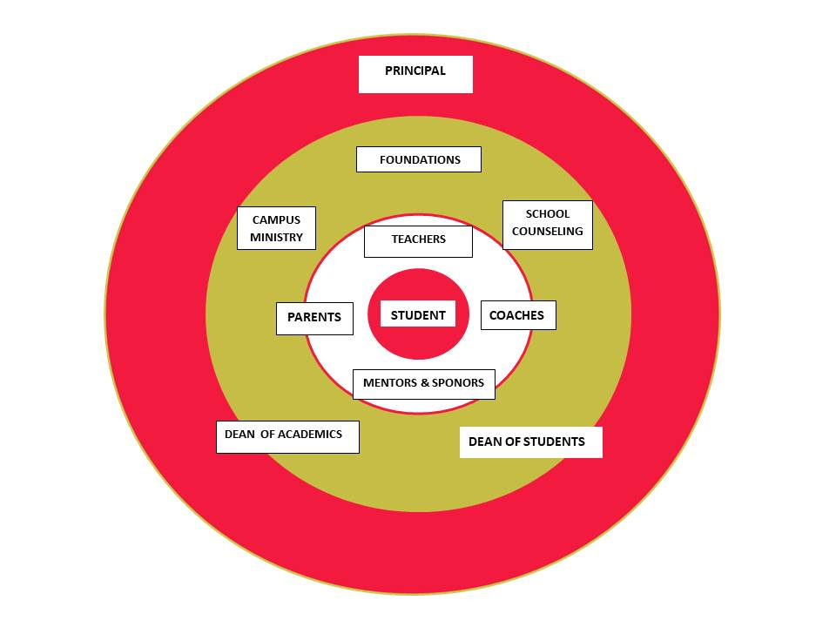
Support
Notes:
Functioning

Slide 9
A Plan for Success
How we begin…
Metacognition = Reflective Learning
Critical Thinking
+ Brain Based Activities - Building a set
of strategies & tools The Portfolio Notebook
+ Technology Helps
+ Accommodations

Slide 10


Slide 11
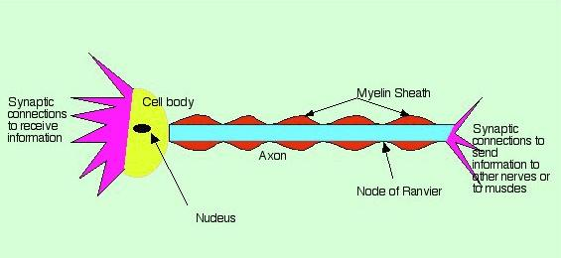
Changing the Brain: What Fires Wires
Breaking old patterns, developing new
This pattern is a cellular insulation that wraps neural circuits and grow in response to signals sent
Notes:
Strategies

Slide 12

ABT
Notes:
Strategies + Support
-15 min. 2x daily - 5 days a week = 10 times
- In class 4 times a week and at home
- can do while doing other homework, Game? Or activity? - make up 4 on the weekend!
- Homework - Class only HW Plus print grades

Slide 13
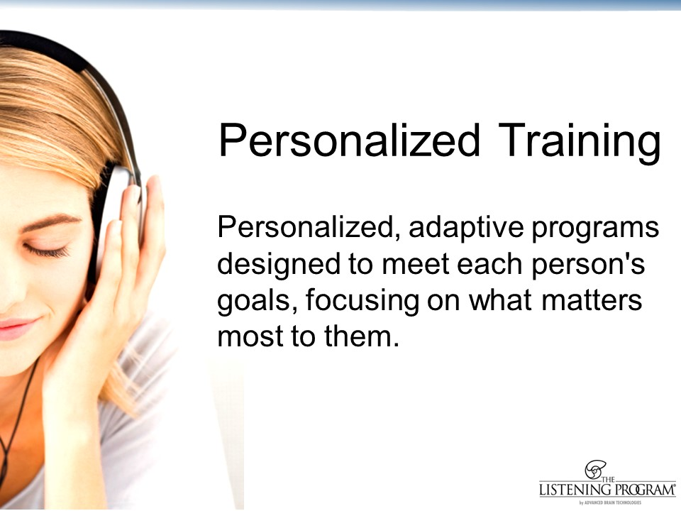

Slide 14
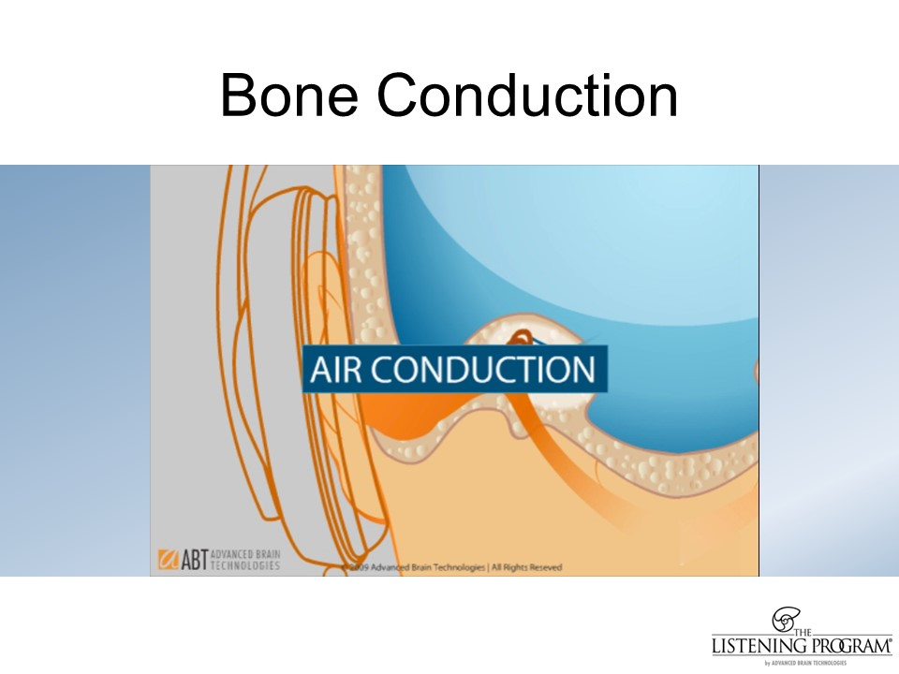

Slide 15
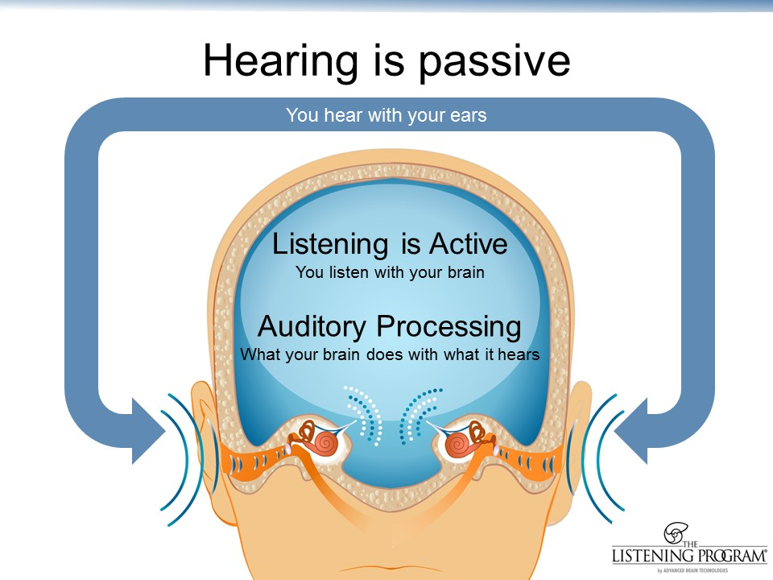

Slide 16
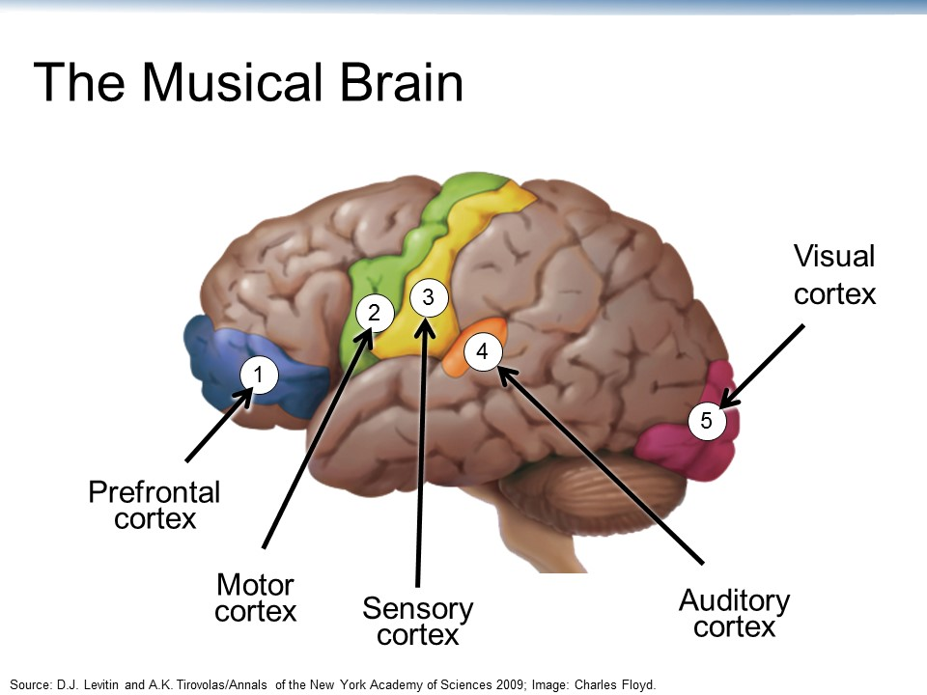

Slide 17
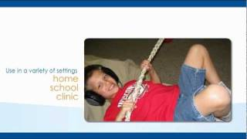
Individually Targeted
+ Areas of strength and difficulty
Executive Functioning
Stress Response
Motor Skills
Social & Emotional
Auditory Processing
Creativity
Communication

Slide 18


Building the
Portfolio NoteBook and
the 7 pocket folder

Slide 19
How does a student change the brain to become more efficient?
SIM Strategy model works along with Meta-cognition speed, growth, leading to independent to deep practice.
Explanation Commitment
Guided Practice Independent Practice
Habit (Covert – Change)
Independent practice results a covert is the result of efficient and effective neural firing
Notes:
-Strategies

Slide 20



Strategic Progression
Organization
Metacognition Road
Writing Process
Time Management
PIRATES
GPS
Goal Setting
SHARE
LAPS
Step-up for Writing
FINALS
1
3
5
7
Priority
2
4
6
Communication
Direction
Dissection
Step-up for Reading
SQ4r

Slide 21


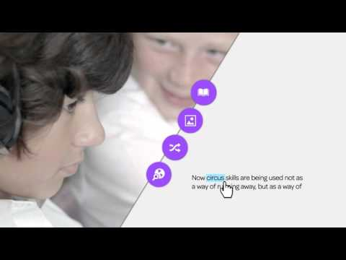
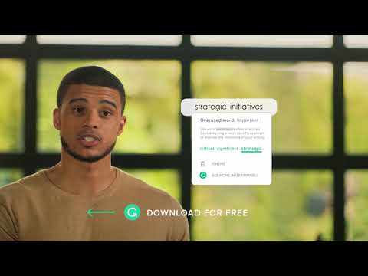

Technology Helps
Google Calendar and online agenda apps
Google Texthelp
Grammarly
Equatio

Slide 22
Accommodations at BJS
Based upon documented need
Are NECESSARY for a student to receive, retain, or process academic or social information
May change based upon a student’s performance
Must be used by the student in order to remain an accommodation
Access = Shared Support Student and Teacher
Notes:
‹#›
Explain necessary- Diagnosis
Explain used and how used is tracked and how accommodations may change -retention for college
SHARED support -Student responsibility
Encourage student to take accommodations -
IMPORTANT!!! - HOW - REQUEST at least 24 hours in advance, best when the test is announced!
AFTER school - Tests are usually announced a week to 3 or 4 days prior to a test. Students are taught to know when a test will occur.
They have 48 hours to take their accommodations.
Students can call home if they forget

Slide 23




Expectations
Accommodations v.s. Modifications
(YES) (NO)
Changes to content
Changes in requirements
Changes towards credits
Impact Forever
Requirements & content remain the same
Tools or format may change (Instruction, Assessment)
Eventually faded
Regular Diploma
Impact Forever

Slide 24
Accommodations
Part of the Plan
Classroom and testing accommodations (extended time percentages)
+ Requested 24 hours in advance, accessed Independently
Class is not interrupted - MUST complete same day, after school. Students can call home from the front office at lunch. If more than 1 test, arrangements are made for follow up days.
Extenuating circumstances (Doctor appointments, games or meets)

Slide 25
Accommodated Testing
After School/ Before School
Before Sports/Clubs/Art
Accommodations are available: 7:00 -7:50 m and From 2:50 - 3:30 except when staff to stays until 4 or 4:30 to accommodate those students with 100% extended time. Wednesday, from 2:-3:30 if staff is available for same day testing.
Students understand that they are asked to complete their extended time, the SAME day as the assessment.
Students taking extended time only, report back to their teacher at the end of the day.
Difficulties with scheduling: Dr. appointments, athletic events, and more than one test on the same day with extended time, need to be scheduled at the earliest opportunity.
Transportation is to be provided by the parent

Slide 26
Highlighting Parent Support
Support your New Cardinal!
Routines
Reinforcement
Morning Routine
Activity Routine - sports,
the arts, clubs, service
Homework and Study Routine (ABT and STRATS)
Tutoring on and off Campus
Transportation for Accommodations
Rest, Reflection, Relaxation
Encouraging
Expecting
Praying
Celebrating
Notes:
Get to school in plenty of time (locker, ask questions, ready to learn), (2) Activities are great, but taking on too much at first can be difficult. Managing time is key. (3) Students always have at least 1.5 to 2 hours of study time a night. This includes homework and STUDYING - looking over notes - Make ABT a habit and a priority. It pays big dividends! (4) Getting rest is important, reflecting on the day in prayer and getting in relaxation away from a screen can help with restorative sleep for mental and physical needs. ENCOURAGE and EXPECT listening at home, consistent homework time and study time, and yes on weekends too! Strategies to be implemented, accommodations requested and accessed.

Slide 27
QUESTIONS ???
Notes:
Don't forget to get together the anxiety students! For handouts- 2 groups?

Slide 28
Access: The Foundations
Information and Resource Page
For Announcements and Resources
Go to the Bishop John Snyder’s webpage
Click the the link
Watch for information and announcements
Email questions to Mrs. Moser or Mrs. TIchy

Slide 29
Sign and return The Foundations release with the Accommodations Plan. This allows teachers and professionals to provide access to accommodations and to share information to assist your student.
Sign the equipment release agreement for your student’s on loan headset set. The headset is required for all students taking the Achieving Mastery class to complete Advanced Brain work.
3. Questions?
lisamoser@bishopsnyder.org
andriatichy@bishopsnyder.org

Slide 30
Welcome
Class of 2026 to the beginning of a great year !

Slide 31
Success lies in the nest here at BJS!
Don’t Forget!
Questions?
Release
Acc. Plan
Headset
Anxiety Protocol
Plan
Prayer
Participate
Practice
Competence
Conscience
Compassion

