Slide 1
Welcome –
FORM I-9 Training
Human Resources
Notes:
Welcome to the Form I-9 Training
Introduce myself & others from HR who are present
Thank them for taking the time to attend

Slide 2
Form I-9 Training
Objective ~
Clarify the requirements and process to verify the Form I-9 for new employees
The Basics –
  Why
  What
  When
  Who
  How
Notes:
Today will be an overview of the Form I-9 and the need to comply with Federal law in completion of the Form and verifying the documents to meet the legal requirements.
Cover the basics & provide resources for detailed information
Why the departments/ sites/ schools versus HR?
With Taleo and electronic hiring process we will gain more efficiency and less paper. The I-9 process is part of the Onboarding process.
Allows the new hires to complete this process at their site versus time away to attend session with HR.
If the scheduled session was at a time they couldn’t attend, very difficult for them to reschedule – delayed paperwork would delay their access – benefits enrollment – paycheck.
Allows the District to meet the requirements of I-9 Timeframe – within 3 days of starting date.
We have had to return I-9 for corrections which you are probably thinking we are so PICKY – but we need these documents to be accurate to meet the Federal Law requirements.
Our objective is to provide you the information to assist you in completing the I-9’s quickly and accurately.

Slide 3
Purpose of Form I-9
3
In compliance with the Immigration Reform and Control Act of 1986, all U.S. employers must verify the identity and employment eligibility of all new employees (both citizen and noncitizen) hired after November 6, 1986.
This requirement is satisfied by having the new employees complete Form I-9.
Form I-9 also is used to re-verify work authorization information for rehires and employees who renew their work authorization documentation.
Notes:
Failure to comply with this Federal Law could result in considerable fines, civil penalties and may be prosecuted criminally
For all Employees – not volunteers or others who are not paid, interns

Slide 4
Introduction to Form I-9
Form I-9 consists of three sections:
- Section 1 – Employee Information and Verification
    Must be completed by the new employee on the date the employee begins employment and can also be completed prior to the beginning of employment, after an employment offer has been made to the individual.
- Section 2 – Employer Review and Verification
    Must be completed by the company’s representative before or within three business days of beginning employment.
- Section 3 – Updating and re-verification
  This section is used only to update or re-verify Form I-9.
4
Notes:
For the purposes of this training – we will mainly focus on Section 2 –Employer Review and Verification.

Slide 5
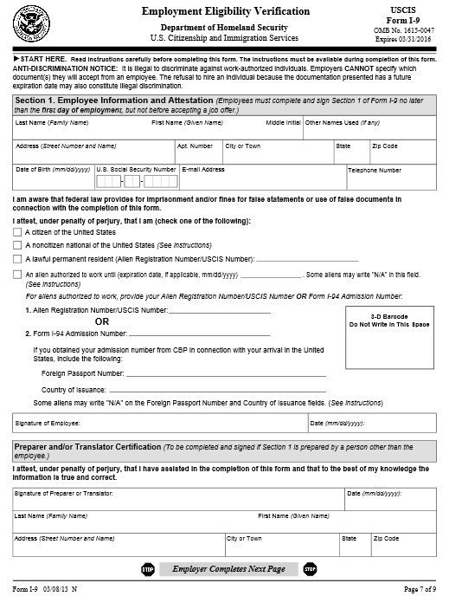
Section 1 -Completed by new employee

Slide 6
Section 1
Employee Information and Verification Section
Section 1 of the form must be completed and signed by the new employee on the date employment begins (or prior to that date) .
A translator or preparer may be used by the employee to complete Section 1 of the form. However, the form must be signed by the employee, and the translator or preparer must complete the last portion of Section 1.
Social Security numbers are not required from new employees (unless E-verify is used by the employer).
When an employee enters an employment authorization expiration date in Section 1, the employer is required to re-verify employment authorization for the employee in Section 3 on or before the expiration date provided by the employee.
Notes:
Section 1 is completed by the new employee - this is done in Taleo On-Boarding tasks
When that has been completed and validated by HR, you will receive a message that you have a task to complete.

Slide 7
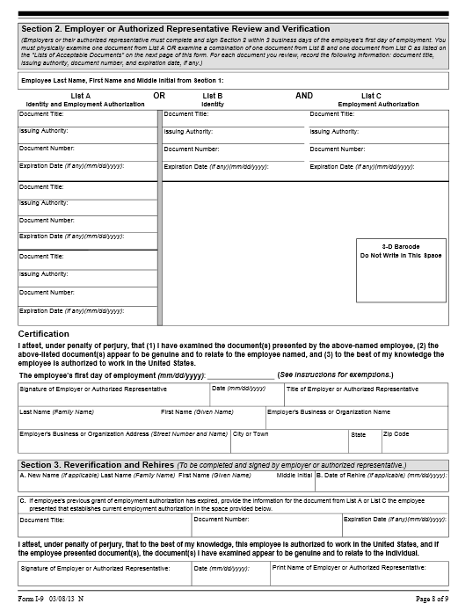
Section 2 – completed by employer
Section 3 – Reverification
Notes:
This is Section 2 which is where the employer’s designee – you – will review and validate the documents presented by the new employee.

Slide 8
Section 2 Employer Review and Verification
The new employee must present original and unexpired document(s) that prove his or her identity and employment authorization. Certified copies of birth certificates are acceptable.
  Documents from List A show both identity and employment authorization.
  Documents from List B show identity only (employers participating in E-verify can only accept List B documents with a photograph).
  Documents from List C show employment authorization only.
You must accept any document(s) from the Lists of Acceptable Documents presented by the new employee that reasonably appear on their face to be genuine and relate to the person. You cannot specify which document(s) an employee should present.
Examine the documents presented and fully complete Section 2 by recording the title, issuing authority, number and expiration date (if any) of the document(s).
Notes:
You are not expected to be a document expert but must accept documents that reasonably appear to be genuine and to relate to the person presenting them. However, if your new employee provides a document that does not reasonably appear to be genuine and relate to them, you must reject that document and ask for other documents that satisfy the requirements of the I-9. the key is “reasonableness” You may ask the employee for the reason in differences if there is a slight difference say in the name or spelling of a name. If they are able to provide a reason for the difference and the document appears to be genuine you can accept the document.
If you are unsure – please feel free to contact HR.

Slide 9
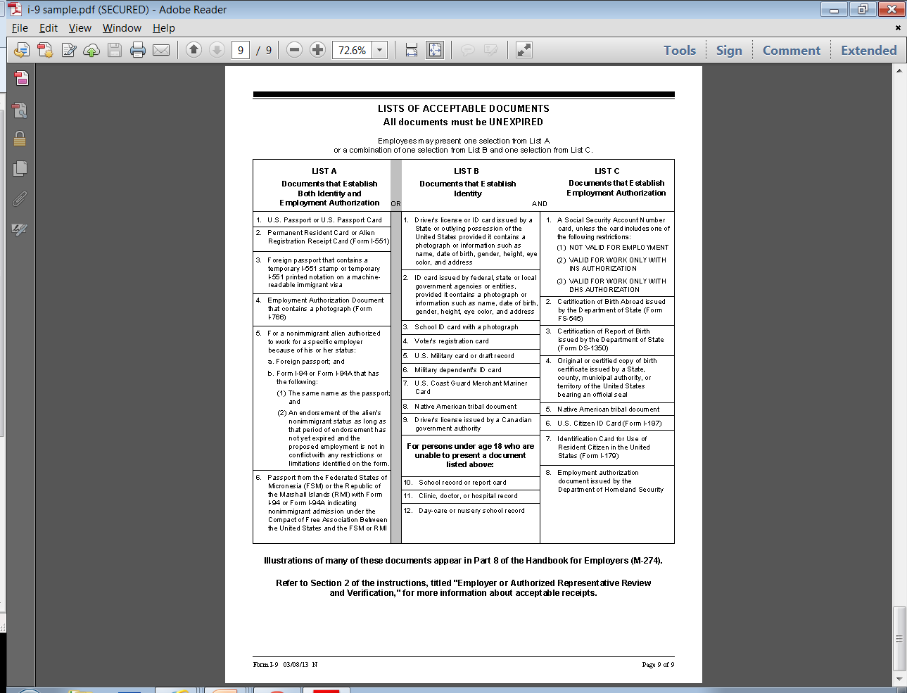

Slide 10
Acceptable Documents: List A
List A consists of documents that establish both identity and employment eligibility
For persons over the age of 18:
U.S. Passport or U.S. Passport Card
Permanent Resident Card or Alien Registration Receipt Card (Form I-551)
Foreign passport that contains a temporary I-551 stamp or temporary I-551 printed notation on a machine readable immigrant visa
Employment Authorization Document that contains a photograph (Form I-766)
For a nonimmigrant alien authorized to work for a specific employer because of his or her status:
    Foreign passport; and
    Form I-94 or Form I-94A that has the following:
    (1)The same name as the passport; and
    (2) AN endorsement of the alien’s nonimmigrant status as long as that period of endorsement has not yet expired and the proposed employment is not in conflict with any restrictions or limitations identified on the form.
6. Passport from the Federated Stats of Micronesia (FSM) or the Republic of the Marshall Islands (RMI) with Form I-94 or Form I-94A indicating nonimmigrant admission under the Compact of Free Association Between the United States and the FSM or RMI
Notes:
If the employee presents a document from List A – that is all they need to provide us. The items from List A establishes both identity and employment eligibility. The most common document provided from this list is the USA Passport. Again, you can not tell them what documents to provide…..
Provide accurate information when verifying any and all documents:
The Passport Issuing Authority is United States Department of State.

Slide 11
Acceptable Documents: List A (cont.)
For persons under age 18 who are unable to present a document listed above:
7. U.S. Coast Guard Merchant Mariner Card.
8. ID card issued by federal, state or local government agencies or entities, provided it contains a photograph or information such as name, date of birth, gender, height, eye color and address.
9. Native American tribal document.
10. School record or report card.
11. Clinic, doctor, or hospital record.
12. Daycare or nursery school record.
If a person under age 18 cannot provide a List B document, their parent or legal guardian can complete section 1 for them, and enter “Under age 18” in the signature block. Parent also completes the Preparer/Translator block.

Slide 12
Notes:
Go through the sections to complete if they are using List A document
Document title - issuing authority - document number - expiration date
DATE the employee’s first day of work.
Including employee who is verifying documents --their name, title, signature, date they viewed the document and completed the form. etc. at the bottom of the form.
Employer name, address and phone number will be auto populated by Taleo.

Slide 13
Acceptable Documents: List B
List B consists of documents that establish identity.
For persons over the age of 18:
1. Driver’s license or ID card issued by a state or outlying possession
of the United States, provided it contains a photograph or information such as name, date of birth, gender, height, eye color and address.
2. School ID card with a photograph.
3. Voter’s registration card.
4. U.S. military card or draft record.
5. Military dependent’s ID card.
6. Driver’s license issued by a Canadian government authority.
Notes:
List B – identity but not employment eligibility – they will also need a document from List C to validate employment eligibility.

Slide 14
Notes:
Go through the sections to complete if they are using List B document – what is the document titie – issuing authority - document number - expiration date…
DATE the employee’s first day of work.
Including employee who is verifying documents --their name, title, signature, date they viewed the document and completed the form. etc. at the bottom of the form.
Employer name, address and phone number will be auto populated by Taleo.

Slide 15
Acceptable Documents: List C
List C consists of documents that establish employment authorization.
1. U.S. Social Security account number card other than one that specifies on the face that the issuance of the card does not authorize employment in the United States.
NOTE: A copy (such as a metal or plastic reproduction) is not acceptable.
Certification of Birth Abroad issued by the U.S. Department of State (Form FS-545).
Certification of Report of Birth issued by the U.S. Department of State (Form DS-1350).
Identification Card for Use of Resident Citizen in the United States (Form I-179).
Original or certified copy of a birth certificate issued by a state, county, municipal authority or outlying possession of the United States bearing an official seal.
Native American tribal document.
U.S. Citizen Identification Card (Form I-197).
8. Employment authorization document issued by DHS.
Notes:
List C employment authorization but not identity
If they provide a Social Security Card – look at the actual card for the issuing authority. Typically the red ink around the seal provide this information –
Social Security Administration or may be Department of Health and Human Services. Use whichever the particular card lists

Slide 16
Notes:
Go through the sections to complete if they are using List C document
Document title – issuing authority - document number - expiration date if any .
DATE the employee’s first day of work.
Including employee who is verifying documents --their name, title, signature, date they viewed the document and completed the form. etc. at the bottom of the form.
Employer name, address and phone number will be auto populated by Taleo.

Slide 17
Notes:
This represents what needs to be completed for documents from list B & List C - both are required as B = identity and C = employment authorization.

Slide 18
Section 3 - Re-verification/Rehire
Re-verification:
U.S. citizens and noncitizen nationals never need re-verification.
Do not re-verify an Alien Registration Receipt Card/Permanent Resident Card (Form I-551) or a List B document that has expired.
Employees cannot work beyond the date their employment authorization expires without re-verifying their authorization to work in the U.S.
Rehire:
If the employee is rehired within three (3) years of the date the Form I-9 was originally completed, you have a choice of re-verifying the rehire with the use of Section 3 or by completing a new Form I-9 for the rehire. (Employer should choose the method and be consistent)
Update or complete a new Form I-9 on the date re-employment begins.
You must complete a new Form I-9 if the original Form I-9 has been replaced by a newer version.
Notes:
Section 3 –
Please do not complete any information in this section - Only used for those whose employment authorization has expired or rehires if the organization chooses to use that process.
We have rehires complete a new I-9 which is acceptable as long as that is consistently done for all rehires. With Taleo – that is our process.

Slide 19
Colorado Affirmation Form
Colorado State Employment Verification
In Addition to the Federal Form I-9 form
Affirm four requirements:
  Examined legal work status
  Retained file copies of the documents required
  Not altered or falsified employees identification documents
  Not knowing hired an unauthorized alien.
Notes:
The State of Colorado has an additional requirement that supplements the Federal Form I-9. You will see this as the final step in the I-9 process of the OnBoarding tasks.– Affirmation of Legal Work Status. Be sure to complete the form with your signature and title.

Slide 20
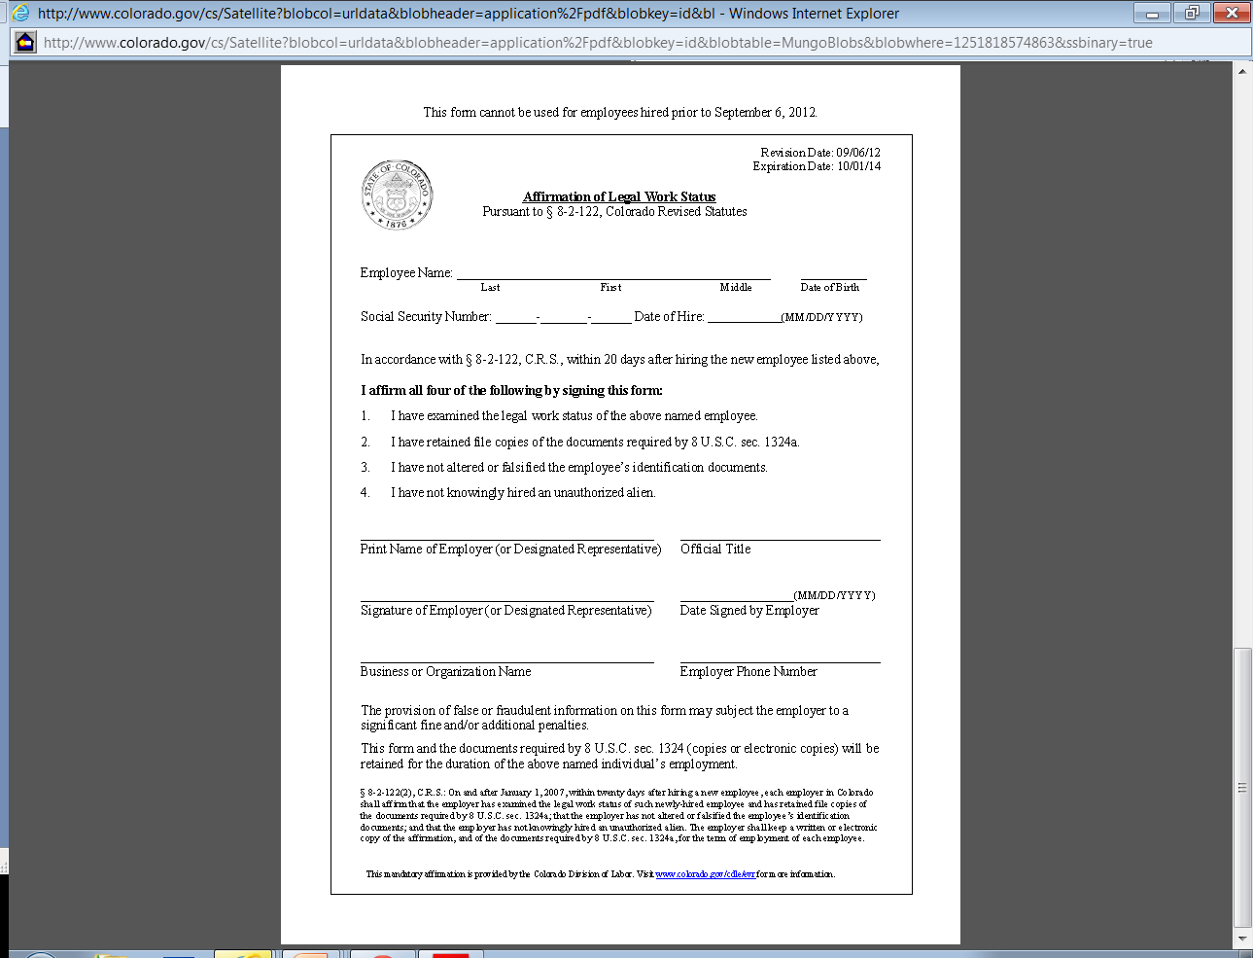

Slide 21
The Test ☺
Must I complete an I-9 form for interns and unpaid employees?
May I accept a photocopy of a document presented by a new hire?
Can I accept an expired document (passport, driver's license, etc.) to establish a new hire's identity for I-9 purposes?
Can I refuse to hire a person who shows an employment authorization card that will expire in three months?
May I terminate an employee who fails to produce the required documents within three business days of his or her start date?
Do I need to complete a new Form I-9 when one of my employees transfers to another school or a different location?
The name on the document my employee presented to me is spelled slightly differently than the name she entered in Section 1 of Form I-9. Can I accept this document?

Slide 22
Resources
22
Form I-9 Employers’ Handbook
  http://www.uscis.gov/USCIS/Verification/E-Verify/E-Verify_Native_Documents/E-Verify%20Manuals%20and%20Guides/M-274-Handbook-for-Employers.pdf
  Form I-9
http://www.uscis.gov/files/form/i-9.pdf
Human Resources – Customer Cares number
720 433-0140
Notes:
Additional resources if you want to review the details of the requirements or have additional questions.
Show the M-274 Handbook
Of course, you can always contact HR

Slide 23

Questions? Comments?
23

Slide 24

THANKS
HR Customer Cares Number:
720 433-0140

Slide 25
Back up slides

Slide 26
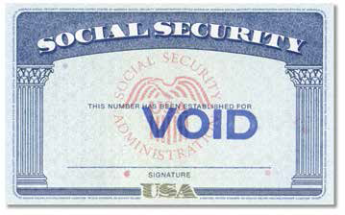

Slide 27
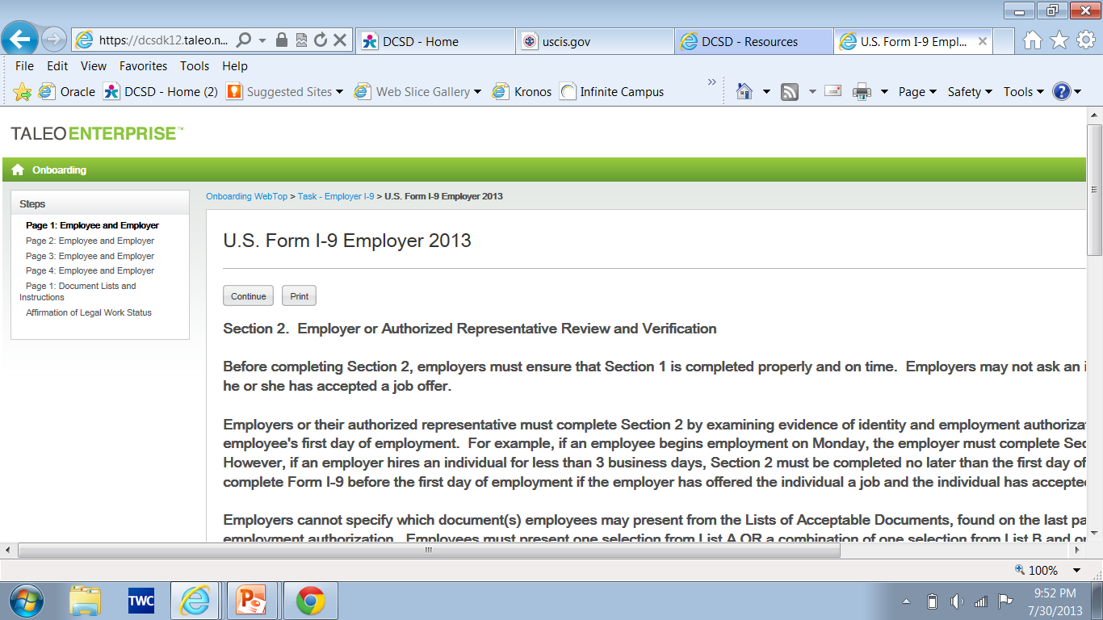

Slide 28
Can I refuse to hire a person who shows an employment authorization card that will expire in three months?
No. You cannot refuse to hire persons solely because their employment authorization is temporary. The existence of a future expiration date does not preclude continuous employment authorization for an employee and does not mean that subsequent employment authorization will not be granted. In addition, consideration of a future employment authorization expiration date in determining whether an individual is qualified for a particular job may be an unfair immigration-related employment practice in violation of the anti-discrimination provision of the Immigration and Nationality Act.

